Slide 1
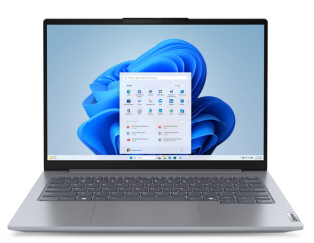
MY DIGITAL SKILS PORTFOLIO
Student Name: Anna Serbista 2537805
Course: Business Skills level 4
Module: Digital Skills
Tutor Name: Zahida Khan
Bullet point
This portfolio shows my work from Week 2,3,5,6 and 9.
I chose these examples because they show my progress during the module
They demonstrate the digital skills I have learned and improved
I will explain what I learned and how these skills will help me in the future

Slide 2
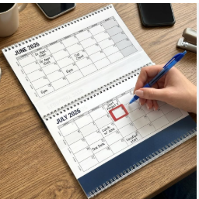
Week 2
Planning Assessments and LinkedIn
Bullet points
I learned how to organise my assessments and deadlines
I created a study plan to manage my time
I also learned how to create and improve my LinkedIn profile
I also learned how to create and improve my LinkedIn profile
This helped me become more organised and prepared for university
What I learned
Time management
Organisations skills
Using LinkedIn professionally

Slide 3
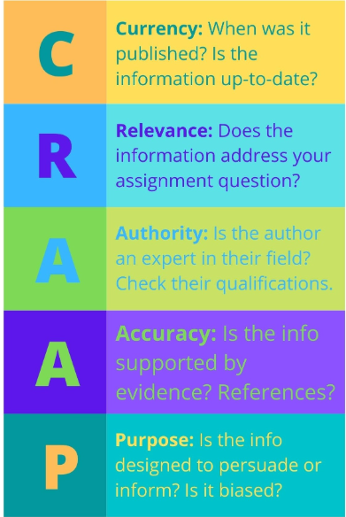
Week 3
Finding Business Information
Bullet points
I learned how to find reliable business information
I used search engines and library resources
I learned how to check information using the CRAAP method
I organised my sources into folders
What I learned
Research skills
Evaluating information
Organising digital skills
This was difficult at first because:
I don’t know how to decide f information was trustworthy
Now I can
Find reliable information by myself

Slide 4

Week 5
Referencing and Academic Integrity
Bullet point
I learned how to safe and organise references correctly
I understand why AI is not a source of information
I learned about copyright and how to use online content fairy
I become more confident with academic work
What I learned
Referencing
Copyright rules
Academic honestly

Slide 5
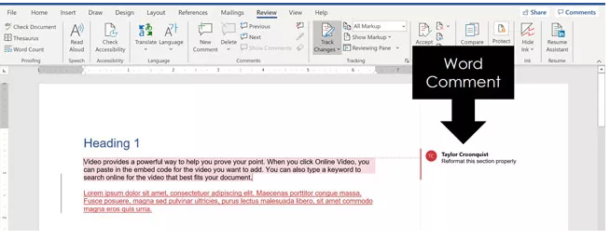
Week 6
Editing Documents
Bullet points
I used Microsoft Word tools to improve my working
I learned how to use Track Changes and Comments
I practiced paraphrasing instead of copying text
I improved the clarity of my work
This is something I improved
At first o found editing difficult
Now I can edit my work independently
Skills
Microsoft Word
Editing
Paraphrasing

Slide 6
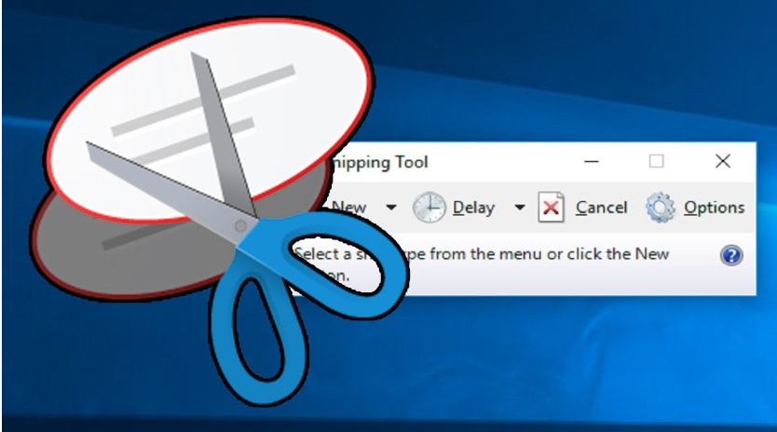
Week 9
Business Report
Bullet points
I learned how to create clear business reports
I used headings and structure to make reports easier to read
I learned how to use feedback to improve my work
I become more confident writing professional documents
Now I can do confidently
Write and improve a business report using feedback
Skills
Report writing
Formatting
Using feedback

Slide 7

My Progress
At the beginning I found research and referencing difficult
I was not confident using Microsoft Word tools
During the module I practised these skills every week
Now I feel much more confident working independently

Slide 8
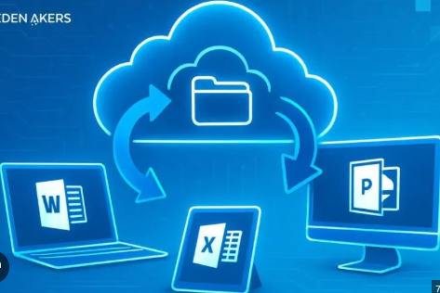
Reflection
What I learned
Bullet points
I improved my digital skills
I learned how to organise my work better
I can find reliable information
I know how to reference sources correctly
I can edit documents and use feedback
These skills will help me in my future studies and at work

Slide 9

Conclusion
Bullet points
This module helped me become more confident using digital tools
I developed useful academic and professional skills
I can now complete many tasks independently
I will continue using these skills in university work and everyday life

Slide 10

Thank you for listening

