Slide 1
Unilever: Opening a production facility in Bulgaria
Presentation by Georgi Stoykov
Student ID:2124048

Slide 2

About Unilever
Founded in 1929
Global company in more than 190 countries
Their famous brands are: Dove, Rexona, Omo and others and their products are used by more than 3.4 billion people every day
Unilever has 148 000 employees
53% of their plastic package is reusable according to their sustainability report (Unilever, 2023)

Slide 3
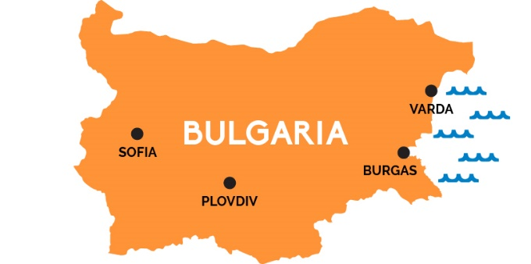
Introduction to Bulgaria
A country in Southeastern Europe. The country has a strategic location and is well connected by sea, air and land
Member of the EU, NATO & WTO
Corporate income tax is only 10%
Cost of electricity for industrial users is lower than the other European countries
62.2 % of the population is in a working age (appr. 4.6 million)
60 000 people graduate from universities every year (Bulgarian Embassy in USA, 2023)

Slide 4
PESTEL Analysis of Bulgaria(1)
Political factors:
  Part of the EU, NATO & World Trade Organisation, which makes it easy for an international company to operate in
  Bulgaria does not have a stable government situation at the moment, which could impact new investments.
  The country does not have an elected government now.
Economic factors
  Low taxes (10% flat tax) which is very low for Europe
  Bulgaria has a stable currency tied to the euro. Stable economic environment.
  Rising inflation worldwide
  Lower salaries and cheaper labour compared to the rest of EU.

Slide 5
PESTEL Analysis of Bulgaria(2)
Social factors
  People in Bulgaria are shifting towards more sustainable products
  More than 60% of the population is in working age
  High unemployment rate for Europe
Technological factors
  Bulgaria has one of the fastest internet connections in Europe
  Bulgaria is up to date with the most recent manufacturing technology
Environmental factors
  A lot of investments are currently being done in Bulgaria when it comes to recycling factories

Slide 6
PESTEL Analysis of Bulgaria(3)
Environmental factors
  A lot of investments are currently being done in Bulgaria when it comes to recycling factories
Legal factors
  Bulgaria is complying to the EU corruption laws, but it is one of the most corrupt countries in Europe
  Bulgaria complies with EU laws which would make opening a production facility easier

Slide 7
SWOT Analysis: Strengths & Weaknesses
Strengths | Weaknesses
Recognised brand in Bulgaria which makes them an attractive employer | Unilever does not have a production facility in Bulgaria which would require a high investment.
The company also operates on a global scale
Mass product production which makes it cheaper
Technological advantage

Slide 8
SWOT Analysis: Opportunities & Threats
Opportunities | Threats
Lower costs compared to the UK, which would lead to savings | The Economic crisis
Low taxes which would lead to savings | Rising Interest rates
Improving brand image by creating new facilities in developing country | Competitors of similar industries
High unemployment rate in Bulgaria, so easy to find new employees

Slide 9
Porter’s Five Forces Framework Industry Analysis
Threat of entry: The segment they operate in is easy to enter. But hard to have entrant of such scale
Threat of substitutes: Very high as their products are easy to substitute.
Power of buyers: The buyers of Unilever are retailers. Those buyers are ultimate customers (Whittington, Regner, Angwin, Johnson, & Scholes, 2020, p. 70) and they have more negotiating power than end customers.

Slide 10
Porter’s Five Forces Framework Industry Analysis
Power of suppliers: Unilever has a lot of suppliers around the world with a total number of 54,000 suppliers. (Uniliever, 2023) The company has a strong bargaining power and diversification of products.
Competitive rivalry: Main competitors of Unilever are Procter and Gamble, Johnson & Johnson and others. They produce similar products, but Unilever has a strong brand and is a famous name which makes it stand out in front of it’s competitors.

Slide 11

Why should Unilever move their production facilities to Bulgaria?
Save costs
Significant lower salary than the UK and taxes
Big investment, but a lot of government incentives
Stable currency in Bulgaria
Location and good transportation
Opportunities for creating new jobs
Positive impact on local economy which would result in positive brand image for the company.

Slide 12
References
BTA. (2022). BTA. Retrieved from BTA Web Site: https://www.bta.bg/en/news/economy/310965-average-salary-in-bulgaria-reaches-bgn-1-730-in-q2
Bulgarian Embassy in USA. (2023). Why Invest In Bulgaria? Retrieved from Bulgarian Embassy in USA Web site: http://www.bulgaria-embassy.org/en/why-invest-in-bulgaria/
Bulgarian Ministry of Tourism. (2022). About Bulgaria. Retrieved from Bulgaria Travel: https://bulgariatravel.org/about-bulgaria/geographic-location/
Statista. (2023). Statista full rime annual salary in the UK. Retrieved from Statista: https://www.statista.com/statistics/416139/full-time-annual-salary-in-the-uk-by-region/
Unilever. (2023). Unilever. Retrieved from Unilever Company Website: https://www.unilever.com/
Uniliever. (2023). Suppliers. Retrieved from Uniliever Website: Suppliers: https://www.unilever.com/suppliers/
Whittington, R., Regner, P., Angwin, D., Johnson, G., & Scholes, K. (2020). Exploring Strategy 12th edition. Harlow: Pearson.

