Slide 1

Digital Skills Portfolio
(Weeks 2-7)
Marian Miker
Student ID: 2536116
Module: LCLM4002

Slide 2
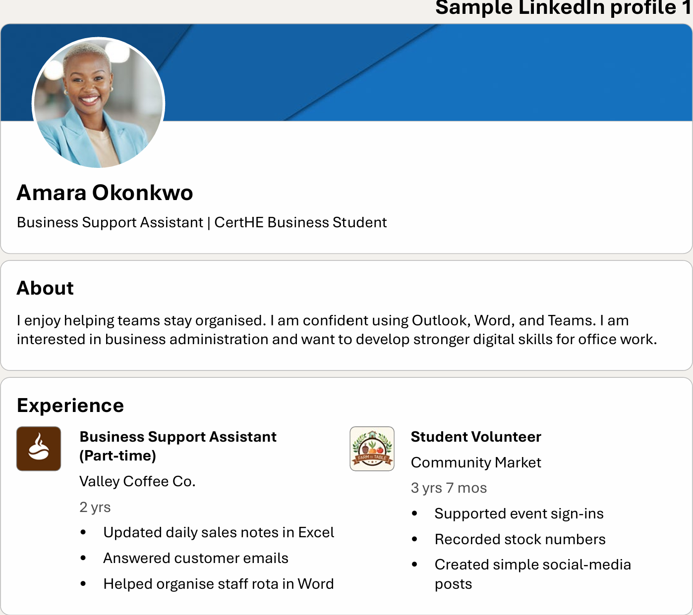
Week 2 – Assessment Planning and Digital Organisation
What I Learned:
Learned about module assessment and submission deadlines.
Used digital calendar to organise important dates.
Explored LinkedIn through Moodle and learned why it is important for professional networking.
Learned how planning and organisation help manage university work.
Reflection:
This week helped me to improve my organisation skills.
I now used digital calendar to keep track of deadlines and understand the importance of LinkedIn for future career opportunities.
Notes:
2

Slide 3
Week 4 - Formatting, Editing and Accessibility in Microsoft Word
What I learned:
Formatted documents using Microsoft Word.
Used editing tools to improve clarity and readability.
Applied basic accessibility improvement using AI while using my own judgment.
Complete track changes practice task and corrected messy document
Reflection:
This week improved my confidence using Microsoft Word. I can now format documents, improve readability and make them more accessible.

Slide 4
Week 5- Managing Digital Sources and Using AI Responsibly
Reflection:
I now understand how to manage sources correctly and use AI responsibly while checking information with reliable academic sources.
What I learned:
Recorded and managed sources using digital tools.
Learned why AI is not an academic source of information.
Understood why human judgement is important when using AI.
Learned how to use online content ethically and safely.

Slide 5
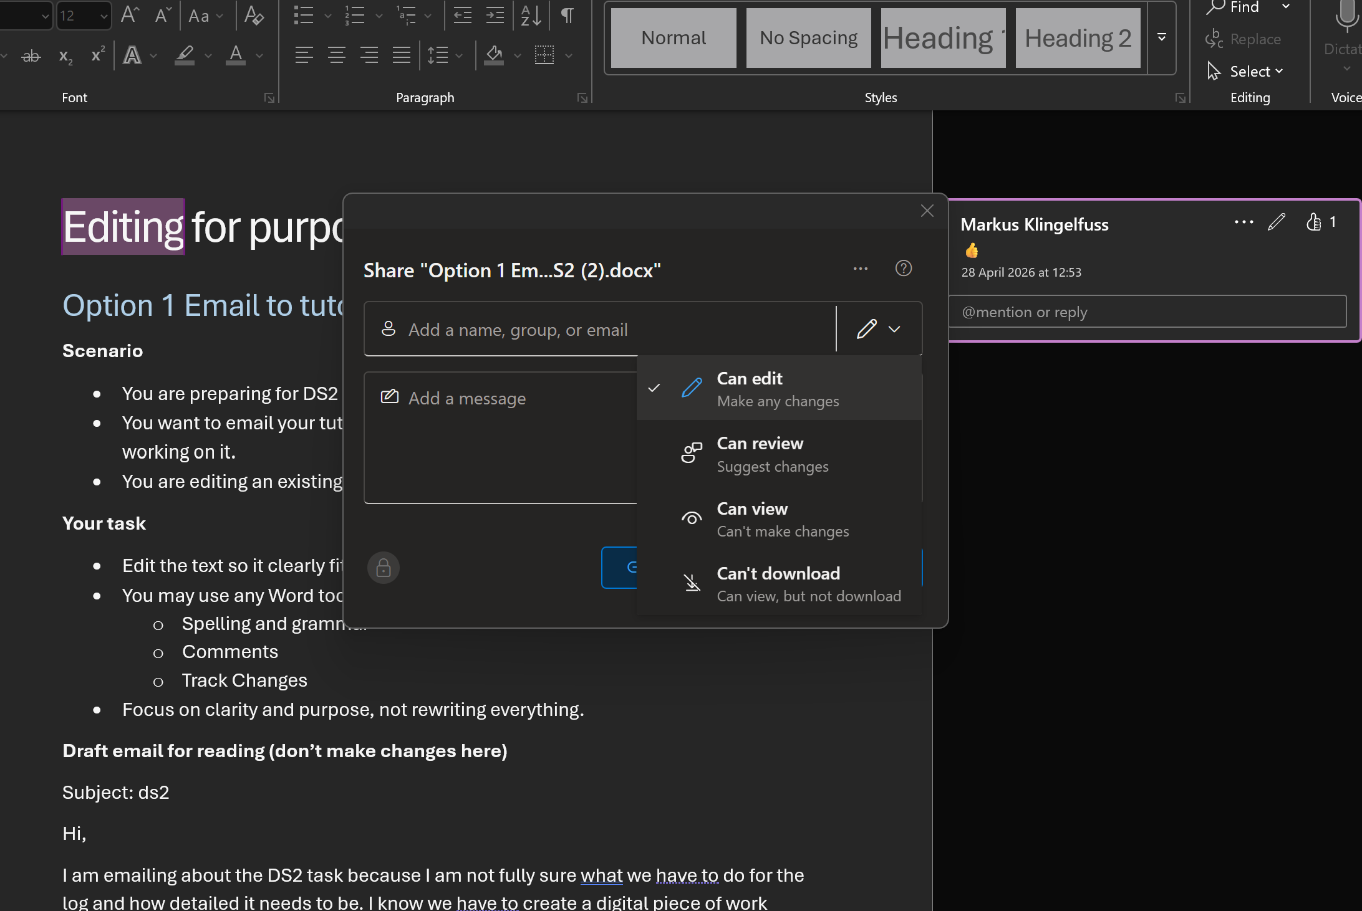
Week 6 – Digital Editing and Track Changes
What I learned:
Learned the difference between editing and rewriting.
Used Microsoft Word Editor to improve spelling, and grammar and readability.
Shared documents and managed permission.
Used comments and Track Changes for collaboration.
Reflection:
At first, I found Track Changes difficult, but after practicing I became more confident using editing and collaboration tools.

Slide 6

Week 7- Professional Communication and Business Emails
Reflection:
I am now more confident writing professional emails, using the correct tone and presenting documents clearly.
What I Learned:
Wrote clear and polite business emails.
Adjusted tone for managers, colleagues and customers.
Recognised professional language in emails and LinkedIn examples.
Improved layout and readability using editing and formatting

Slide 7

Overall Reflection
My learning journey:
Most Difficult skill
Using Track Changes because I was unsure how to review and manage edits.
Skills I improved
Formatting and editing documents in Microsoft Word.
Skills I can now do confidently
Writing professional emails, organizing my work and using Word editing tools.
Conclusion
Throughout this module I developed a range of digital skills that will help me complete university assignment more effectively, I improved my organization, document formatting, source management, professional communication and collaboration skills, and I feel more confident using these tools in both my studies and future employment.

Slide 8
Thank You

