Slide 1

Key study skills in education
By Shannon-Amelia
https://uowtsd.sharepoint.com/teams/DysguynyrOesDdigidolLearningintheDigitalEraECGE4005PC_GRP-ShannonMeacham-Broadbent/Shared%20Documents/Recordings/New%20channel%20meeting-20221107_234744-Meeting%20Recording.mp4?web=1

Slide 2
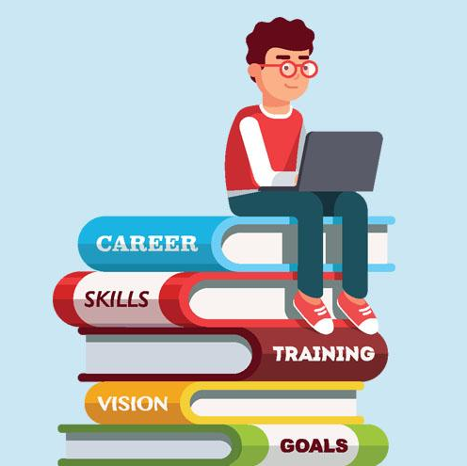
Study skills for university
Two study skills that can be considered the be the most effective to advance learning in higher education are digital literacy and reflection.
I have chosen to speak about these skills because of how they have helped me in past education settings and how I hope to use them during my degree at university.

Slide 3
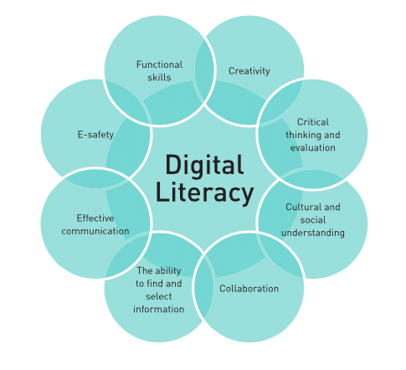
Digital literacy
I believe that digital literacy is key in regards to the education environment due to the many advantages that it holds. In my experience, digital literacy has helped me to expand my knowledge on different topics because of the access to a variety of different research platforms to choose from. It has also helped me to advance my assignments and projects, giving them more of a professional and aesthetic tone.
According to Adobe (2020), digital literacy has been prominent when improving career prospects and student engagement. Furthermore, it goes without saying how digital literacy has become a huge part of academic life within the COVID-19 era, due to most lessons/lectures being online, giving both students and lecturers the need to produce engaging and enhanced online documents.

Slide 4

Reflection
Judging from past experiences ranging from secondary school to college, refection can be a huge factor when it comes to improving studies, and also rewarding yourself when a piece of work is of good standard. An individual may reflect on their work or performance in order to become more aware of their achievements, or in some circumstances, to be able to develop a deeper understanding of where their weak points are within a topic, and in turn work to improve them. Libby Cross (2018) states that "The process of reflection occurs in many aspects of our lives; whether it’s personal or professional, the events of the weekend or, a recent problem we encountered and how we might have handled the situation differently." This can help us develop critical thinking skills which can be used to evaluate work produced and how it can be altered for the better.

Slide 5
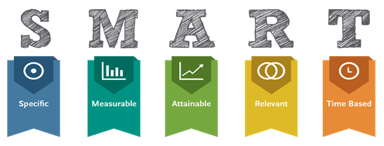
summary
To end my presentation and to summarise overall, I believe that both study skills, digital literacy and reflection, are major components when it comes to learning. I believe they can not only benefit you during times of study, but also contribute further when it comes to employment and the outside world. In an article published by the BBC, Alex Christain (2022) states that digital literacy in non-negotiable, and it an absolute need when it comes to the work place. The article explains how working with computers can make more produced more efficient and more adaptable.
Similarly, The Open University (n.d.) documents that reflection "helps you to develop your skills and review their effectiveness" in the workplace. If you are not aware of where you are going wrong, there is little chance of you being able to correct yourself and develop a higher quality of work.
To conclude, the smart targets which I have placed on the left hand side are something to be considered when producing an academic piece of work.

Slide 6
Action plan
During my studies, I plan on using both reflection and digital literacy skills, along with others, in order to demonstrate my academic skills to their best ability.

Slide 7
Reference list
Adobe (2020). Digital Literacy In Higher Education: Now More than Ever. [online] https://www.adobe.com/content/dam/cc/uk/education/higher-education/Digital-Literacy-in-Higher-Edu_More_Now_than_Ever.pdf. Available at: https://www.adobe.com/content/dam/cc/uk/education/higher-education/Digital-Literacy-in-Higher-Edu_More_Now_than_Ever.pdf [Accessed 7 Nov. 2022].
Webb, L. (2018). Why ‘Reflection’ Encourages a Better Learning Experience. [online] Learning Pool. Available at: https://learningpool.com/why-reflection-encourages-a-better-learning-experience/ [Accessed 7 Nov. 2022].
Christian, A. (2022). Why ‘digital literacy’ is now a workplace non-negotiable. BBC. [online] 26 Sep. Available at: https://www.bbc.com/worklife/article/20220923-why-digital-literacy-is-now-a-workplace-non-negotiable [Accessed 7 Nov. 2022].
The Open University (2019). Self Reflection | The Open University & Unison in Partnership. [online] Open.ac.uk. Available at: https://www.open.ac.uk/choose/unison/develop/my-skills/self-reflection [Accessed 7 Nov. 2022].
www.structural-learning.com. (n.d.). Developing Students’ Digital Literacy Skills. [online] Available at: https://www.structural-learning.com/post/developing-students-digital-literacy.
Moryani, P. (n.d.). Learn the S.M.A.R.T way of studying – YourDOST Blog. [online] Available at: https://yourdost.com/blog/2016/08/studying-tips.html [Accessed 7 Nov. 2022].
woc.aises.org. (n.d.). Top Five Study Skills of ‘A’ Students | Winds of Change. [online] Available at: https://woc.aises.org/content/top-five-study-skills-a-students.

