Slide 1

Healthy Eating: Evidence-Based Insights
Understanding global dietary patterns and their affect on health

Slide 2

Objectives
The relationship between diet, lifestyle, and health.
Dietary patterns, obesity trends, and challenges in modern diets.
The role of excess alcohol, salt, sugar, and processed foods in modern health issues.
Growing consumption of fizzy drinks and their impact on health.
Failure to meet dietary guidelines
Lessons from the blue zones

Slide 3
Historical Dietary Shifts
Shift from traditional to modern diets over the past 50 years.
Rise of low-fat, high-carbohydrate diets in the 1980s.
Increased consumption of processed and convenience foods.
Concurrent rise in alcohol consumption contributing to empty calorie intake.
Significant increase in fizzy drink consumption, leading to higher sugar intake.
Snacking - An early study conducted by Gore et. al (2003) suggested that the growing rise in obesity was due to snacking whilst watching television.

Slide 4

The modern diet
The current diet is marked by high consumption of ready-made foods, processed meats, refined grains, unhealthy fats and high sugar beverages.
These foods have been linked to detrimental health outcomes such as metabolic dysfunction, inflammation, diabetes cardiovascular diseases, cancer. They also have an affect on the gut micro biota which have been shown to be essential for over all health and well being (Clemente-Suarez et al , 2023)

Slide 5

Impact of the modern Diet
The transition away from traditional diets has been linked to numerous negative health outcomes and evolving dietary patterns across various regions across the world.
The modern diet high in salt, fat and salt coupled with limited physical activity has resulted in significant increases in non-communicable diseases (NCD). Therefore, increasing the burden of disease (Cerf, 2021).

Slide 6
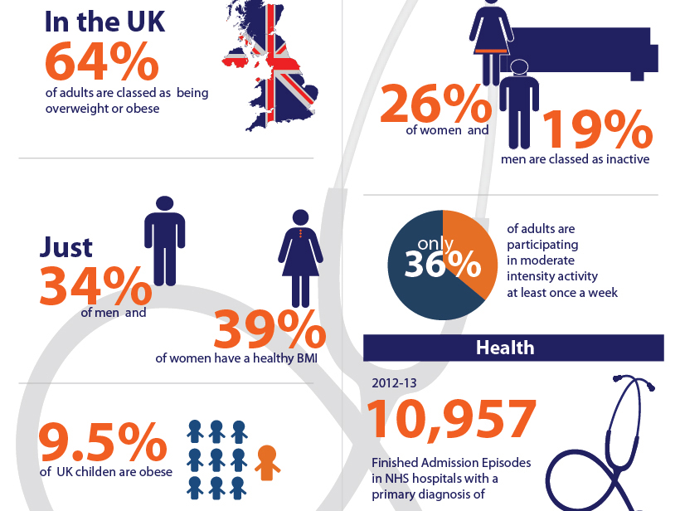

Slide 7

The Blue Zones
Regions with the highest longevity (e.g., Okinawa, Sardinia, Nicoya).
Common dietary features: plant-based, whole foods, moderate caloric intake.
Lifestyle factors: physical activity, social connections, purpose.

Slide 8
Lessons from the blue zones
The regions known as Blue Zones are recognized for their inhabitants' exceptional longevity and health. These areas offer valuable insights into practices that promote well-being and life extension.
Research highlights shared lifestyle features among these populations, including natural physical activity integrated into daily life rather than formal exercise, dietary patterns emphasizing plant-based meals, moderate caloric consumption, and the use of whole, minimally processed ingredients.

Slide 9
The Mediterranean Diet
Dominguez, Bella & Veronese (2021)
High consumption of fruits, vegetables, nuts, seeds, whole grains, and olive oil.
Moderate intake of fish, dairy, and wine; low intake of red meat and processed foods.
Proven benefits: reduced risk of cardiovascular disease, diabetes, and certain cancers.
Wine as a cultural, not excessive, component in moderation.

Slide 10
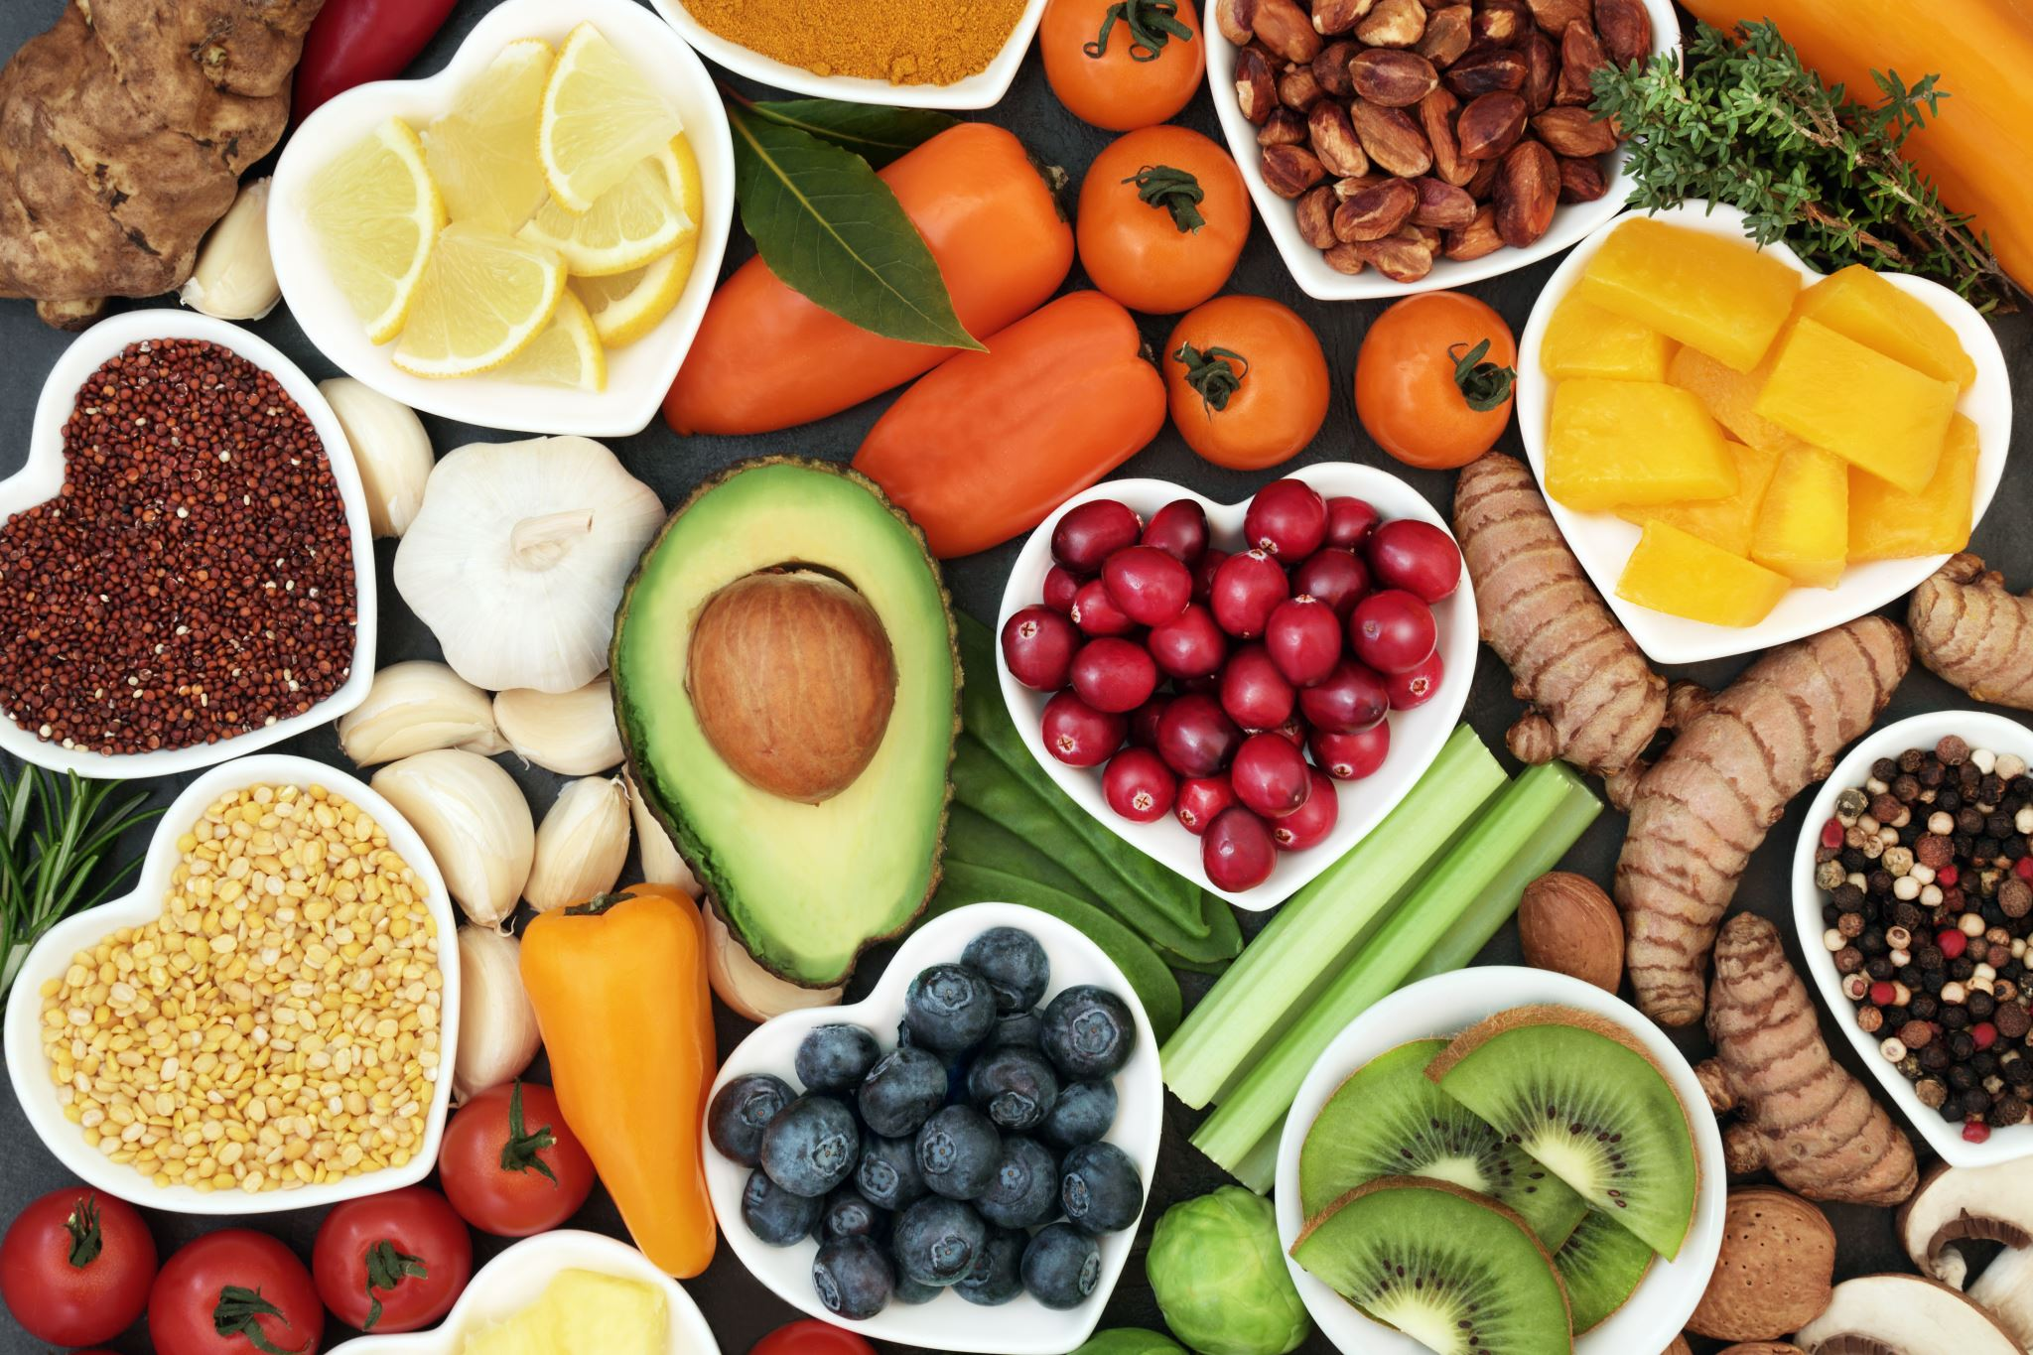
Comparing diets
The comparison of modern and traditional diets highlights significant differences in their impact on health and dietary habits. Diets, such as the Mediterranean or DASH diet, are associated with reduced risks of mortality and chronic diseases, including cardiovascular disease, even in populations not traditionally following these patterns. The Mediterranean diet with it’s high intact of health fats especially olive oil has been show to help prevent heart disease (Delgado-Lista et.al, 2016)
Findings from the Moli-Sani Study demonstrate that adherence to these diets correlates with lower all-cause and cardiovascular mortality. This suggests that traditional dietary practices may provide health benefits that are not consistently achieved with modern diets (Iacoviello, & Bonaccio ,2020).

Slide 11

Blue zones social networks
Social networks are also pivotal in Blue Zones, where strong family bonds, robust community support, and meaningful friendships create a sense of belonging and purpose. This sense of purpose, often called "ikigai" or similar concepts, is linked to better health outcomes and longer lifespans.

Slide 12
Blue zones and stress
Stress management is another hallmark of these regions. Residents commonly practice mindfulness, take naps, or participate in spiritual activities, all of which contribute to reduced stress and enhanced mental health.
Additionally, community-driven initiatives, such as the Blue Zones Project, illustrate how environmental and policy interventions can encourage healthier choices.

Slide 13
Key Highlights
The lessons of the Blue Zones highlight the importance of lifestyle habits, social connections, and enabling environments in fostering longer, healthier lives.
These findings can guide public health efforts to improve well-being on a broader scale.

Slide 14

The Problem with Processed Foods
High in added sugars, unhealthy fats, and preservatives.
Low in nutrients
Impact on metabolic health: obesity, type 2 diabetes, cardiovascular disease.
Heavily marketed and conveniently packaged, leading to overconsumption.

Slide 15
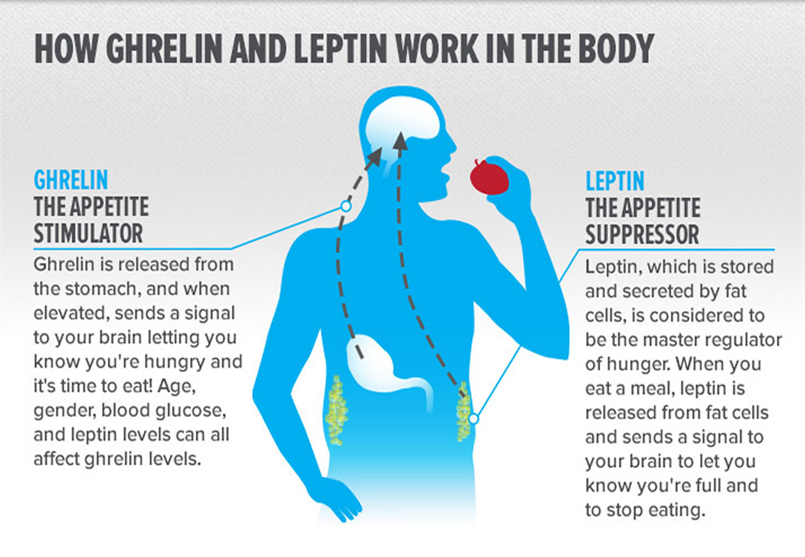
Processed food and the affects on hormones
Leptin is a hormone that signals satiety, while ghrelin is known as the hunger hormone, stimulating appetite.
The relationship between leptin, ghrelin, and processed foods is complex and may result in overeating as the body is lacking in nutrients and fibre which signal satiety.

Slide 16
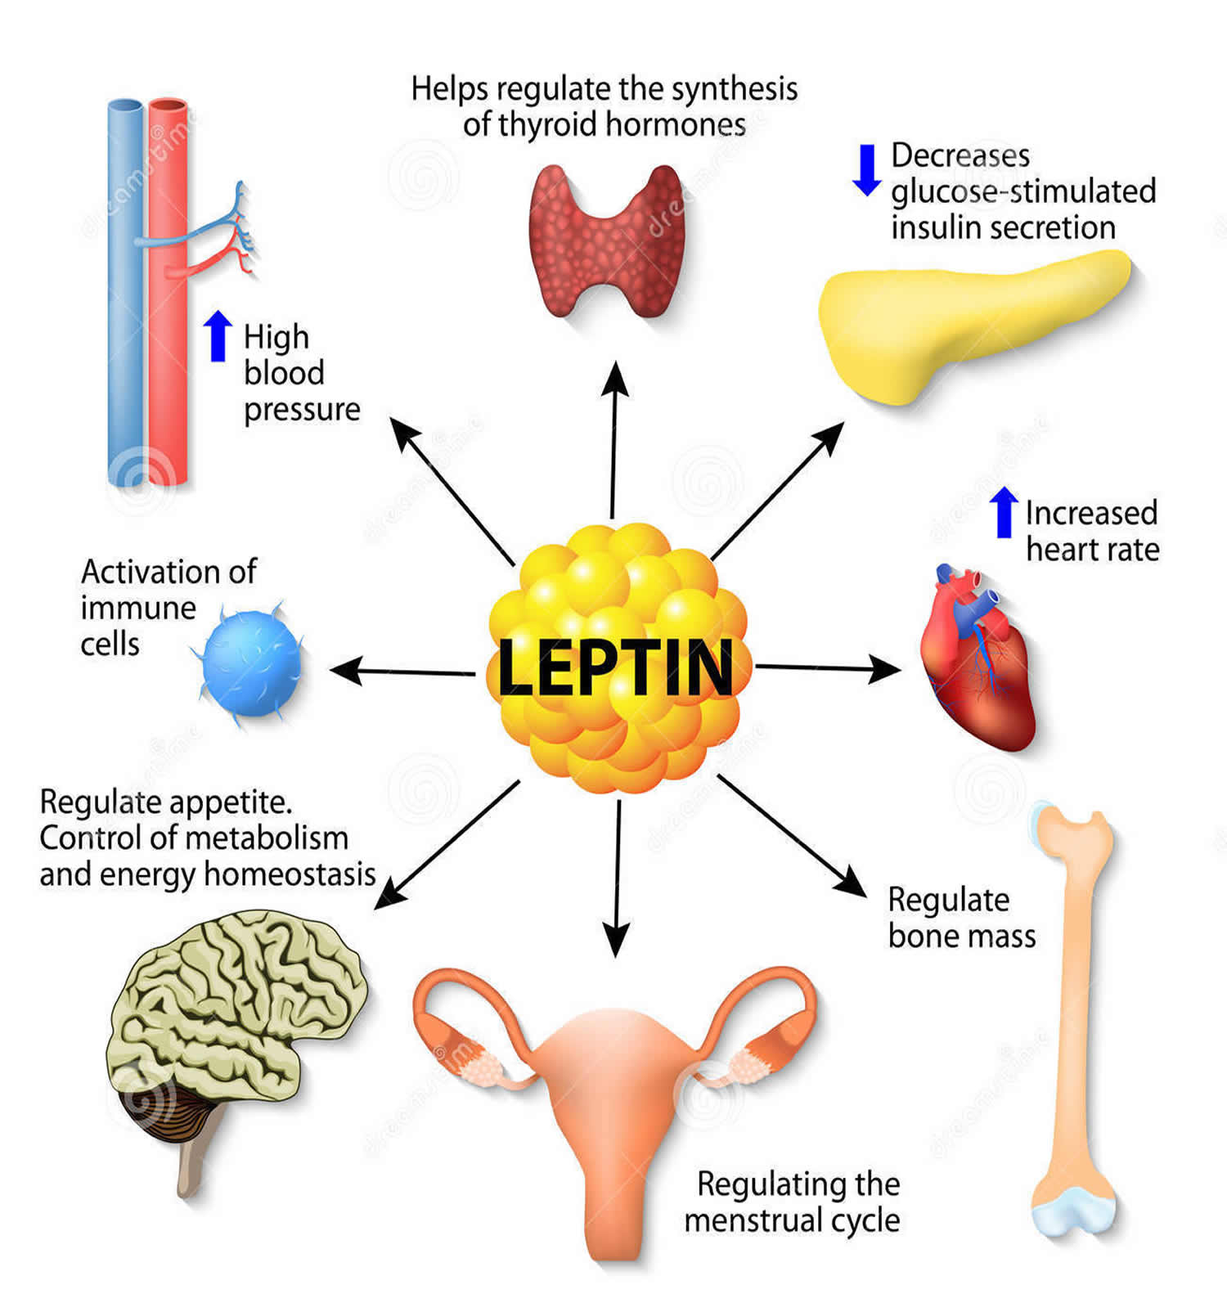
Other factors leading to hormone imbalance
Research suggests that chronic stress,lack of sleep can disrupt these hormones which may foster unhealthy eating habits and can lead to obesity (Piątkowska-Chmiel, et. al 2023).

Slide 17

Diabetes
As of January 2025, the prevalence of type 2 diabetes in the United Kingdom has been increasing. According to Diabetes UK, more than 5.6 million people are living with diabetes, with approximately 90% of these cases being type 2 diabetes Diabetes UK
This indicates that over 5 million individuals in the UK have type 2 diabetes.

Slide 18
Diabetes
In addition to those diagnosed, an estimated 1.2 million people are living with undiagnosed type 2 diabetes, and over 3.2 million people are at increased risk of developing the condition based on elevated blood sugar levels. Diabetes UK
The prevalence of type 2 diabetes is notably higher among certain ethnic groups; individuals of Asian, Black African, or African Caribbean descent are two to four times more likely to develop the condition compared to those of White ethnicity

Slide 19
Diabetes
The increasing prevalence of type 2 diabetes is closely linked to rising rates of obesity and sedentary lifestyles. Research indicates that living with obesity is the single greatest risk factor, accounting for 80-85% of an individual's risk of developing type 2 diabetes. Diabetes UK
Social determinants such as income, education, housing, and access to healthy food also significantly influence the risk of developing the condition

Slide 20
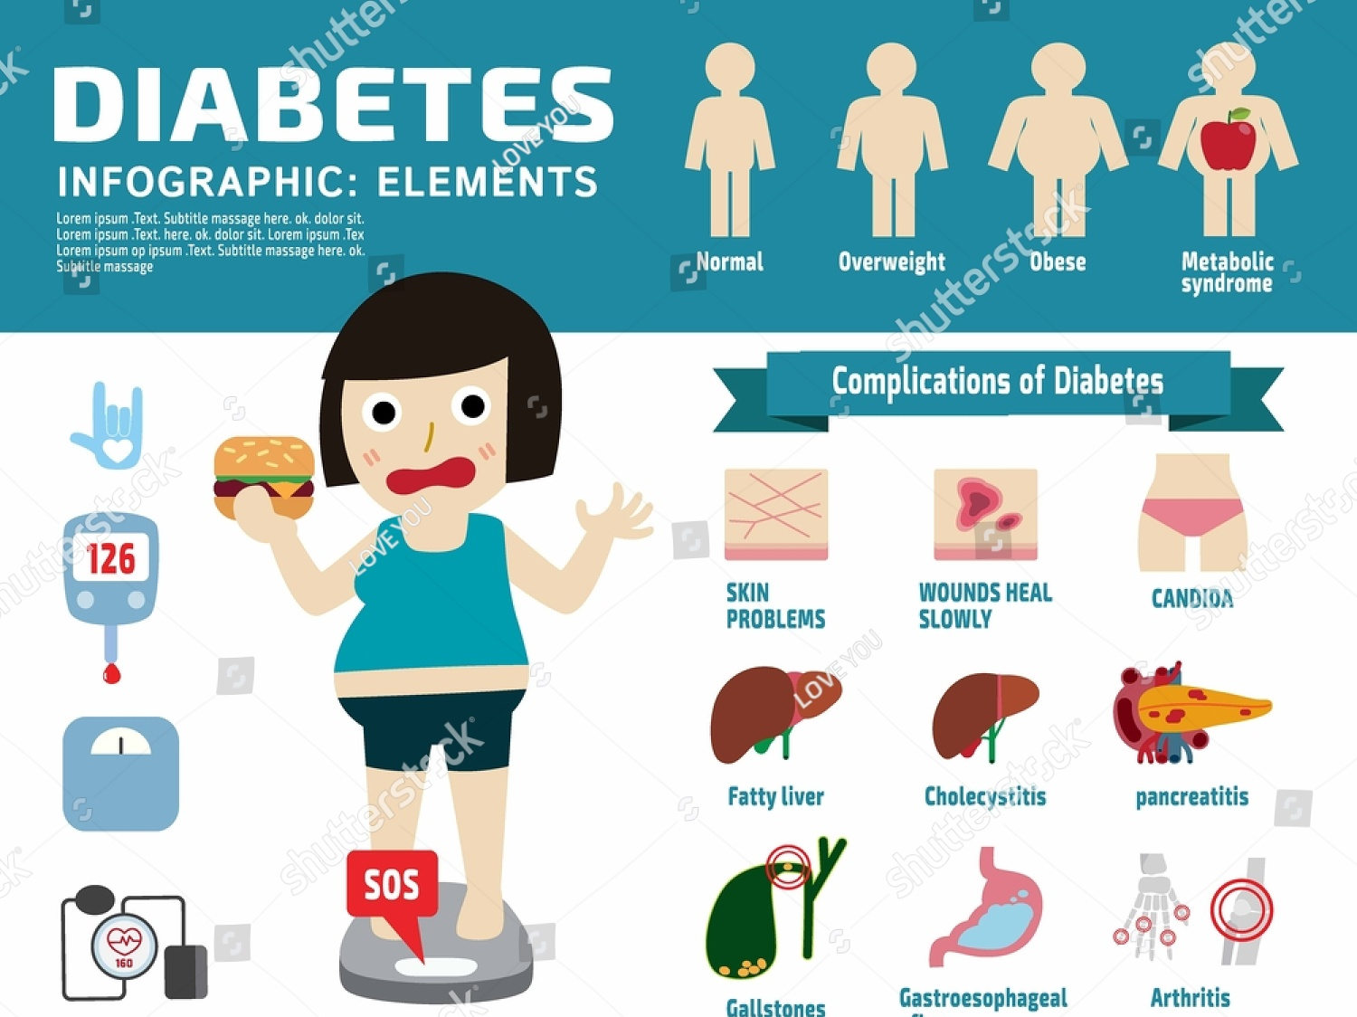

Slide 21
What is the problem with sugar?
Excess sugar contributes to obesity, type 2 diabetes, and tooth decay.
High salt intake linked to hypertension and cardiovascular disease.
Hidden sugars and salts in processed and convenience foods exacerbate health risks.
Recommended daily limits: no more than 6g of salt and 30g of free sugars for adults.
Fizzy drinks often exceed the daily recommended sugar intake in a single serving

Slide 22
The Health Risks of Added Sugars
Chronic Diseases:High sugar intake is linked to obesity, heart disease, diabetes, and non-alcoholic fatty liver disease (NAFLD).
These conditions often arise from metabolic dysfunction.
Metabolic Impact: Added sugars can trigger processes like fat production in the liver (de novo lipogenesis).
Excess sugar also raises insulin levels (hyperinsulinemia), worsening metabolic issues.

Slide 23
Incremental Growth in Diabetes
Diabetes prevalence has steadily increased alongside poor dietary habits.
Direct link between sugar-sweetened beverages, including fizzy drinks, and type 2 diabetes.
Rising healthcare costs for managing diabetes: significant burden on the NHS.
NHS cost: Over £10 billion annually spent on diabetes care.
Alcohol’s role in disrupting glucose regulation, particularly with binge consumption.

Slide 24
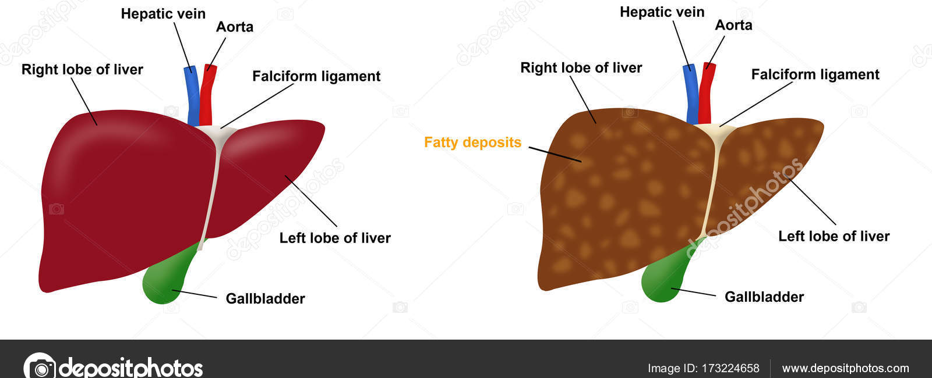
Sugar and Liver Health
NAFLD Connection
Sugar consumption is strongly tied to the rise in obesity and fatty liver disease.
Diet plays a crucial role in maintaining liver health and metabolic balance.

Slide 25
Sugar’s Role in Inflammation
Systemic Effects:
High sugar intake contributes to inflammation throughout the body.
This can harm oral health, leading to gum inflammation and imbalance in the mouth and gut microbiota.
Chronic inflammation from sugar may worsen other health conditions.

Slide 26
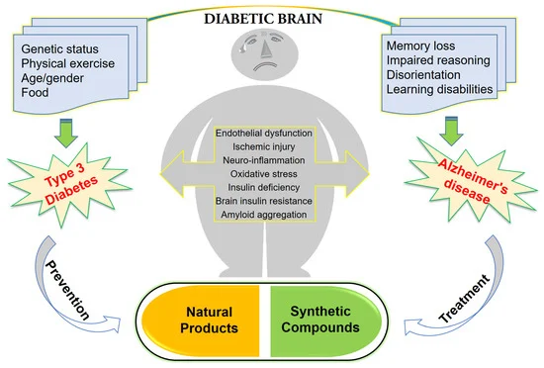

Slide 27

The Role of Convenience Foods
Highly processed, calorie-dense, and nutrient-poor.
Often high in sugar, salt, unhealthy fats, and calories from alcohol.
Linked to increased risk of obesity, diabetes, and heart disease.
Fizzy drinks and convenience snacks are often consumed together, compounding health risks.
Addictive?

Slide 28

The role of good gut bacteria

Slide 29
Gut microbiota & health
The gut microbiome influences immunity, metabolism, and the gut–brain axis through microbial metabolites (e.g., short-chain fatty acids), bile acids, tryptophan pathways, gut barrier integrity, and neuro-immune/vagal signalling (Al Bander et al., 2026).

Slide 30
Mental Health
The gut microbiome influences immunity, metabolism, and the gut–brain axis through microbial metabolites (e.g., short-chain fatty acids), bile acids, tryptophan pathways, gut barrier integrity, and neuro-immune/vagal signalling (Al Bander et al., 2026).

Slide 31
Burden of disease
The impact of obesity on the UK is extensive, affecting both health and economic factors. Studies show that obesity and overweight cost the NHS approximately £3.2 billion annually. Earlier estimates varied, ranging from £480 million in 1998 to £1.1 billion in 2004.
It is estimated that in 2023 the UK will see an increase of approximately 11 million more adults leading to 5.7-7.3 million cases of heart disease and stroke.

Slide 32
Dementia/Alzheimer’s
Meta-analytic and review evidence shows microbiome differences in Alzheimer’s disease and proposes mechanisms involving inflammation, permeability, and microbial metabolites; intervention evidence is emerging but not yet definitive (Zhang et al., 2024; Li et al., 2024; Kelly et al., 2026).

Slide 33

Traffic Light System
The UK Traffic Light food labelling system is a front-of-pack colour-coded nutritional guide.
It was designed to help consumers quickly assess levels of fat, saturated fat, sugars and energy in packaged foods.

Slide 34
Limitations
Diet Coke is NOT healthy! That green light is misleading. Learn how ar... | TikTok

Slide 35
What it means
Green: Indicates low content of the nutrient, making it a healthier choice.
Amber: Signals a moderate amount of the nutrient, which can be consumed in moderation.
Red: Denotes high in saturated fats, sugars and salt eat sparingly

Slide 36
Weight Gain and Obesity
Meta-analytic and review evidence shows microbiome differences in Alzheimer’s disease and proposes mechanisms involving inflammation, permeability, and microbial metabolites; intervention evidence is emerging but not yet definitive (Zhang et al., 2024; Li et al., 2024; Kelly et al., 2026).

Slide 37
Fermented foods (what they are)
Fermented foods are produced via controlled microbial growth that converts food components (often sugars) into acids/alcohols, changing taste, texture, and digestibility (Tamang et al., 2023). Not all fermented foods are “probiotic” (some are pasteurised), and “probiotic” implies defined strains at effective doses with demonstrated benefit (Dimidi et al., 2025). Evidence suggests fermented foods may support gut ecology via live microbes and fermentation metabolites, though effects vary by food and outcome (Nath et al., 2025).

Slide 38
Burden of disease
6-8.5 million cases of diabetes, and 492,000-669,000 additional cancer cases.
The combined medical coats associate with these preventable disease are expected to rise to £1.9- 2 billion annually.
This underscores the urgent need for effective public health initiatives to mitigate the increasing prevalence of obesity and its associated health risks

Slide 39

Why We Turn to Convenience Foods
Busy lifestyles: lack of time to cook fresh meals.
  Marketing and availability: convenience foods are heavily promoted and widely accessible.
  Cost-effectiveness: perceived affordability of processed foods compared to fresh options.
  Emotional eating: stress and fatigue drive consumption of comfort foods.
  Alcohol as a social and stress-relief mechanism tied to convenience consumption.

Slide 40
What does the best evidence converge on as a healthy diet?
Healthy dietary patterns consistently emphasise vegetables, fruit, legumes, nuts, whole grains, and unsaturated oils, with lower intakes of free sugars, salt, saturated/trans fats (WHO, 2026).
• Systematic review evidence for lower all-cause mortality is strongest for patterns high in veg/fruit/legumes/nuts/whole grains, plus fish and unsaturated fats, and lower in red/processed meat and refined carbs/sweets (Dietary Guidelines Advisory Committee, 2020).
• Umbrella evidence links higher nuts/whole grains/fruit/veg/fish to lower mortality, and higher red/processed meat and sugar-sweetened beverages to higher mortality (Onni et al., 2025).

Slide 41
Do “best diets” differ? Pattern beats macro-ratio
Evidence syntheses suggest named patterns (e.g., Mediterranean/DASH/plant-forward) are more reliably linked to health outcomes than macro percentage targets alone (Dietary Guidelines Advisory Committee, 2020).
Weight management reviews generally find several dietary approaches can work; long-term success is driven by adherence, food quality, and sustained energy deficit rather than one macro split (NICE, 2025).

Slide 42
How the food industry shapes “what’s normal to eat”
Ultra-processed foods are engineered for convenience and palatability, and rising UPF dominance is linked to poorer diet quality; policy proposals target marketing, availability, affordability, and corporate practices (Scrinis et al., 2025; Baker et al., 2025).

Slide 43
Food industry continued
Ultra-processed foods are engineered for convenience and palatability, and rising UPF dominance is linked to poorer diet quality; policy proposals target marketing, availability, affordability, and corporate practices (Scrinis et al., 2025; Baker et al., 2025).

Slide 44

Food industry continued
Reviews of partnerships with commercial actors raise concerns about effectiveness and conflicts of interest (Blanchard et al., 2025).
Sponsorship and conflicts of interest can bias nutrition evidence and messaging (López-Moreno et al., 2025

Slide 45
What we recommend (evidence-aligned)
Base meals on vegetables, fruit, legumes, whole grains, nuts/seeds; use unsaturated oils; include fish and/or other minimally processed proteins as appropriate (WHO, 2026; Dietary Guidelines Advisory Committee, 2020; Onni et al., 2025).

Slide 46

The evidence
Limit free sugars, salt, industrial trans fats, and keep saturated fat lower by swapping toward unsaturated fats (WHO, 2026).
Reduce ultra-processed foods; cook more from basic ingredients; support food-environment policies (front-of-pack labelling, marketing limits, procurement standards) (Scrinis et al., 2025; Baker et al., 2025).

Slide 47
Benefits of Whole Foods
Nutrient-dense and rich in vitamins, minerals, and antioxidants.
Supports gut health and reduces inflammation.
Encourages a balanced calorie intake.
Reduces dependency on processed and salt and sugar laden products.

Slide 48

The Importance of Fibre
Essential for digestive health and reducing the risk of bowel cancer.
Recent increase in bowel cancer among younger populations linked to low fibre intake.
Slows gastric emptying, which helps regulate blood sugar levels and prevents glucose spikes. Naturally increases GLP1
Whole foods like fruits, vegetables, nuts, seeds, whole grains, and legumes are rich in fibre, vitamins, and minerals
(Vale, Almeida, Azevedo, & Padrão, 2024).

Slide 49
The Evidence for "10 a Day"
New research suggests 10 servings of fruits and vegetables per day provide optimal health benefits.
Associated with reduced risk of heart disease, stroke, and certain cancers.
Rich in essential nutrients, fiber, and antioxidants.
Practical tips for achieving 10 a day: include fruits and vegetables in every meal and snack.
A study shows 60%-87% of adults fail to meet even 5 servings per day, raising concerns about health implications (Palmer, 2014).
WHO highlights links between lifestyle diseases and insufficient intake of fruits and vegetables, suggesting that even 5 a day might be insufficient for optimal health (Living Media India, 2010).
Doubling fruit and vegetable intake could lead to further reduction in chronic disease risk (Mazzoni et al., 2023).

Slide 50
The Role of Exercise
Combats the effects of poor diet and sedentary lifestyle.
Enhances metabolic health, builds muscle, and reduces stress.
Recommendations: at least 150 minutes of moderate exercise weekly.

Slide 51
Challenges in the UK
Access to healthy food: food deserts and economic disparities.
Education: lack of knowledge about nutrition and cooking skills.
Policy: need for public health interventions to address obesity.
Alcohol consumption trends and its contribution to health disparities.

Slide 52
Moving Forward
Embrace principles of traditional diets like Mediterranean and Blue Zones.
Reduce processed food consumption and prioritize whole foods.
Promote public awareness and policy changes to combat obesity.
Address excessive alcohol consumption as part of a holistic health strategy.

Slide 53
Conclusion
  Healthy eating is rooted in evidence-based dietary patterns.
  Combining diet with exercise and lifestyle changes is essential.
  Global lessons can help address the obesity crisis in the UK.
  Reduce the burden of disease.

Slide 54
References
Aliberti, S.M., Donato, A., Funk, R.H.W., and Capunzo, M., 2024. A narrative review exploring the similarities between Cilento and the already defined “Blue Zones” in terms of environment, nutrition, and lifestyle: Can Cilento be considered an undefined “Blue Zone”? Nutrients.
Anyanwu, O.A., Naumova, E.N., Chomitz, V.R., Zhang, F.-F., Chui, K., Kartasurya, M.I., and Folta, S.C., 2022. The socio-ecological context of the nutrition transition in Indonesia: A qualitative investigation of perspectives from multi-disciplinary stakeholders. Nutrients, 15(1), p.25.
Buettner, D., 2021. Micro nudges: A systems approach to health. American Journal of Health Promotion, 35(4), pp.593–596.
Cao, Y.Y., et al., 2025. Gut microbiota variations in depression and anxiety: a systematic review. BMC Psychiatry, 25, Article 6871. https://doi.org/10.1186/s12888-025-06871-8
Cerf, M.E., 2021. Healthy lifestyles and noncommunicable diseases: Nutrition, the life-course, and health promotion. Lifestyle Medicine (Hoboken, N.J.).
Clemente-Suárez, V.J., et al., 2023. Global impacts of Western diet and its effects on metabolism and health: A narrative review. Nutrients, 15(12), p.2749.
Delgado-Lista, J., Perez-Martinez, P., Garcia-Rios, A., Alcala-Diaz, J., Perez-Caballero, A., Gomez-Delgado, F., Fuentes, F., Quintana-Navarro, G., Lopez-Segura, F., Ortiz-Morales, A., Delgado-Casado, N., Yubero-Serrano, E., Camargo, A., Marin, C., Rodriguez-Cantalejo, F., Gomez-Luna, P., Ordovas, J.M., Lopez-Miranda, J., and Perez-Jimenez, F., 2016. CORonary Diet Intervention with Olive oil and cardiovascular PREVention study (the CORDIOPREV study): Rationale, methods, and baseline characteristics: A clinical trial comparing the efficacy of a Mediterranean diet rich in olive oil versus a low-fat diet on cardiovascular disease in coronary patients. The American Heart Journal, 177, pp.42–50.
Dimidi, E., Cox, S.R., Rossi, M., and Whelan, K., 2019. Fermented foods: definitions and characteristics, impact on the gut microbiota and effects on gastrointestinal health and disease. Nutrients, 11(8), Article 1806. https://doi.org/10.3390/nu11081806
Dominguez, L.J., Bella, G.D., and Veronese, N., 2021. Impact of Mediterranean diet on chronic non-communicable diseases and longevity. Nutrients, 13(6), p.2028.
Gore, S.A., Foster, J.A., DiLillo, V.G., Kirk, K., and Smith West, D., 2003. Television viewing and snacking. Eating Behaviors: An International Journal, 4(4), pp.399–405.
Iacoviello, L., and Bonaccio, M., 2020. Health benefits of Mediterranean and non-Mediterranean dietary patterns in different cultural contexts. European Journal of Public Health, 30(Supplement_5).
Jimenez-García, A.M., Villarino, M., and Arias, N., 2024. A systematic review and meta-analysis of basal microbiota and cognitive function in Alzheimer’s disease: A potential target for treatment or a contributor to disease progression? Alzheimer’s & Dementia: Diagnosis, Assessment & Disease Monitoring, 16(4), e70057. https://doi.org/10.1002/dad2.70057
Kreouzi, M., Theodorakis, N., and Constantinou, C., 2024. Lessons learned from Blue Zones, lifestyle medicine pillars, and beyond: An update on the contributions of behavior and genetics to wellbeing and longevity. American Journal of Lifestyle Medicine, 18(6), pp.750–76.
Masi, D., Watanabe, M., and Clément, K., 2026. Gut microbiome and obesity care: Bridging dietary, surgical, and pharmacological interventions. Cell Reports Medicine, 7(2), 102573. https://doi.org/10.1016/j.xcrm.2025.102573
Park, I., and Mannaa, M., 2025. Fermented Foods as Functional Systems: Microbial Communities and Metabolites Influencing Gut Health and Systemic Outcomes. Foods, 14(13), 2292. https://doi.org/10.3390/foods14132292
Piątkowska-Chmiel, I., Krawiec, P., Ziętara, K.J., Pawłowski, P., Samardakiewicz, M., Pac-Kożuchowska, E., and Herbet, M., 2023. The impact of chronic stress related to COVID-19 on eating behaviors and the risk of obesity in children and adolescents. Nutrients, 16(1), p.54.
Roca, C., 2016. The dying of the blue zones. Maclean’s (Toronto), 129(48–49), p.30.
Shaikh, R.G., et al., 2025. Understanding the Impact of the Gut Microbiome on Mental Health: A Systematic Review. Cureus, 17(1), e78100. https://doi.org/10.7759/cureus.78100
Vale, C., Almeida, C., Azevedo, J., and Padrão, P., 2024. Nutrient profile of packaged foods according to the degree of processing. International Journal of Food Sciences and Nutrition, 75(2), pp.148–158.
Vinderola, G., et al., 2023. Fermented foods: a perspective on their role in delivering biotics. Frontiers in Microbiology, 14, 1196239. https://doi.org/10.3389/fmicb.2023.1196239
Warren, A., et al., 2026. The microbiota-gut-brain axis in mild cognitive impairment and Alzheimer’s disease: a scoping review of human studies. Alzheimer’s & Dementia, 22(1), e71023. https://doi.org/10.1002/alz.71023

