Slide 1




ECAY5004: Work, Poverty and Welfare in the Modern World.
Theme One:
Module Overview, First Tutorial and Key Concepts.
CCharlene Sadd and Andrea Burson

Slide 2
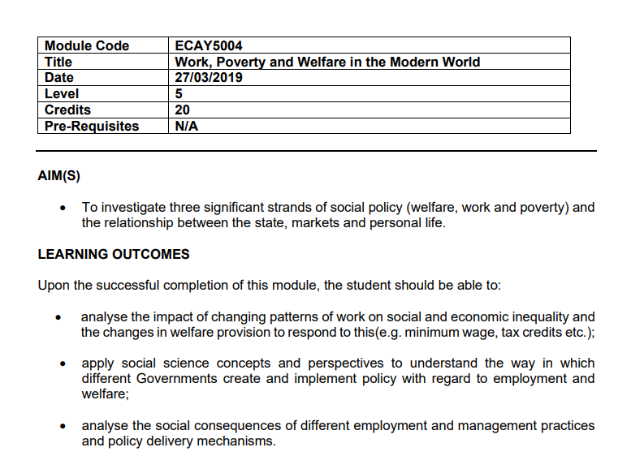
Module Overview
Please find the module Overview on Moodle

Slide 3
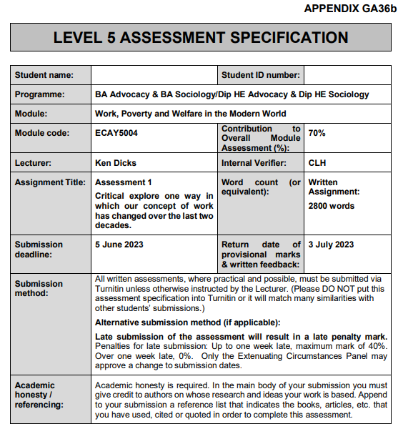
Assessment one

Slide 4
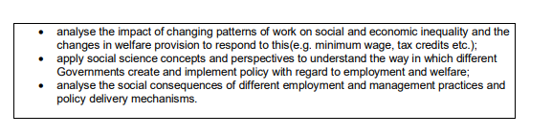
Module Learning Outcomes

Slide 5
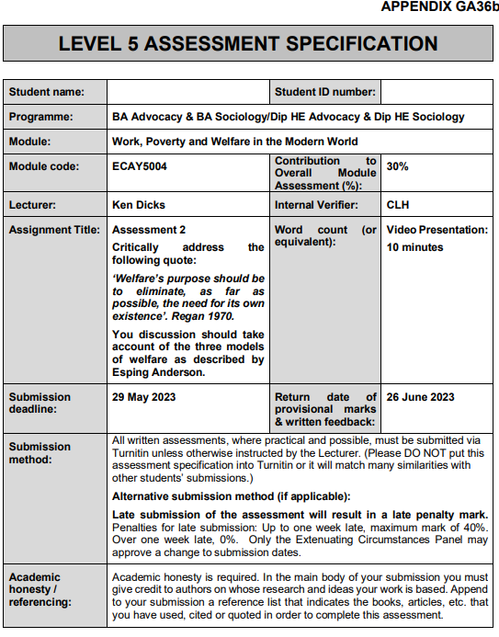
Assessment
Two

Slide 6
Any Questions?
Monday’s Tutorials will be Assignment Workshops if necessary.
You can you use the Module Forum on Moodle for any questions.

Slide 7
Key Concepts
There are three key concepts to this module.
These are Work, Poverty and Welfare.
These concepts are often taken for granted.
Therefore, it is important to focus on the definitions in relation to our field of study.

Slide 8
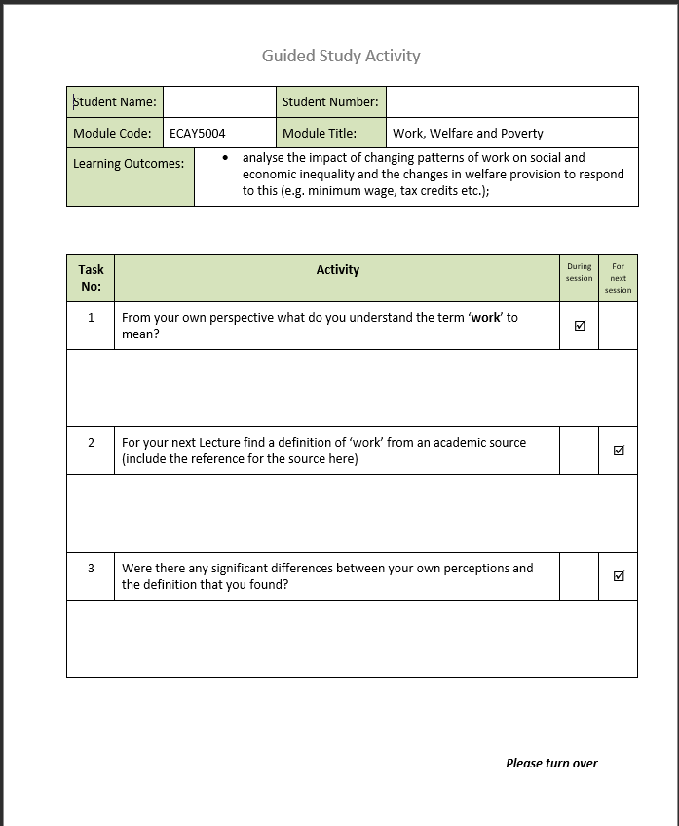
Guided Study

Slide 9
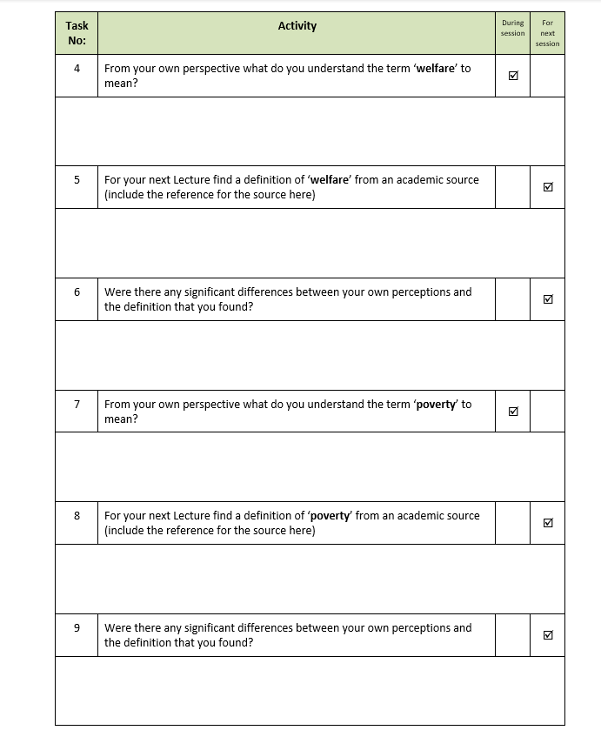
Guided Study

Slide 10

Discussion and Feedback

