Slide 1

Critical Thinking
Week 5

Slide 2

This week
Toulmin’s Model
Research methods

Slide 3
The ‘Theorists’
1.John Adair | 8.Frederick Herzberg
2.Charles Handy | 9.Rensis Likert
3.Henry Mintzberg | 10.Edward de Bono
4.Douglas McGregor | 11.Stephen Covey
5.Daniel Goleman | 12.W. Edwards Deming
6.Elton Mayo | 13.Reginald Revans
7.Henri Fayol | 14.Max Weber
Notes:
Tutor to use whatever method they prefer to conduct a ‘draw’ where each student will have ‘2’ theorists to prepare a report on – approx. 500 words – ready for a group discussion and review at the next session. Make a note of ‘who’ has ‘which theorist. Several students can have the same theorist – it only adds to the debate, and it is critical thinking we are interested in….not necessarily the individual theories.

Slide 4
Theorists – Collate the following…
Name of theorist
Brief background
Most famous theory
Other views, critiques etc
How useful in the workplace
Give a practical example of how its been applied (positive or negative)
Your opinion
Referencing

Slide 5
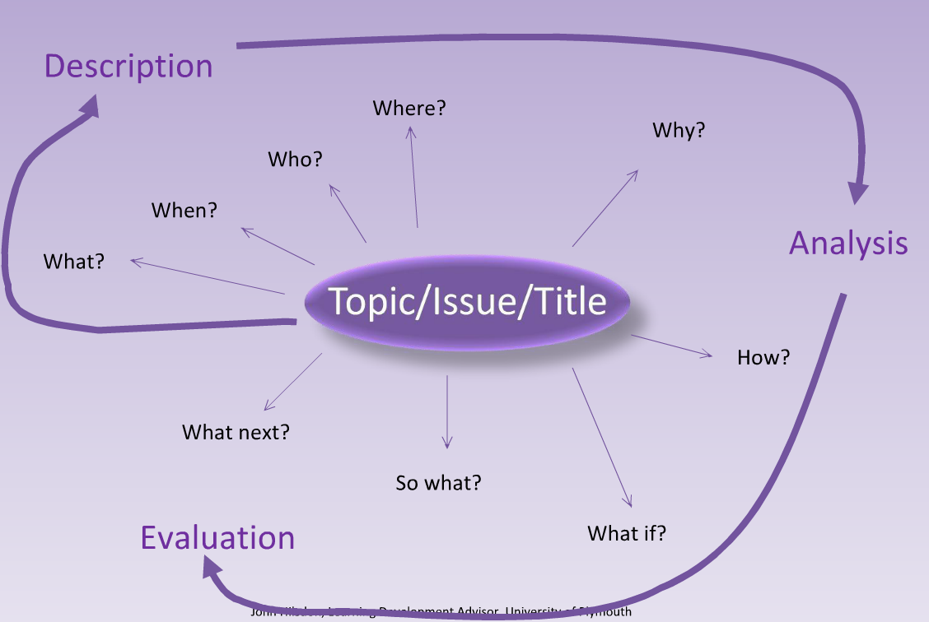
Critical Thinking Model

Slide 6
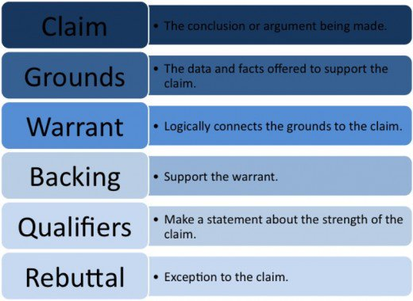
Toulmin’s Model
Notes:
Stephen Edelston Toulmin was a British philosopher, author, and educator focussing his work on analysing moral reasoning. He developed arguments to be used in evaluating the ethics behind moral issues. The Toulmin model of argumentation, a diagram containing six interrelated components used for analysing arguments, and published in his 1958 book The Uses of Argument.

Slide 7
Toulmin’s Model
Claim
A claim is a statement that you are asking the other person to accept.
Grounds
The grounds (or data) is the basis of real persuasion and is made up of data and hard facts, plus the reasoning behind the claim.
Warrant
A warrant links data and other grounds to a claim, legitimizing the claim by showing the grounds to be relevant.
Backing
The backing (or support) for an argument gives additional support to the warrant by answering different questions.
Qualifier
The qualifier (or modal qualifier) indicates the strength of the leap from the data to the warrant and may limit how universally the claim applies.
Rebuttal
Despite the careful construction of the argument, there may still be counter-arguments that can be used. These may be rebutted either through a continued dialogue, or by pre-empting the counter-argument by giving the rebuttal during the initial presentation of the argument.
Notes:
The Claim: The first component of the Toulmin model is the claim—the conclusion that we are seeking to establish over the course of the argument. A claim is a statement that requires support. By itself the statement carries little argumentative force. It is missing evidence on which to ground it so the audience can start to accept it.
The Grounds: for an argument represent the facts, data, statistics, or any other type of evidence. The grounds are the second component of the model.
The Warrant: According to Dr. Toulmin, the connection between the evidence and the claim is not automatic. In most arguments, people make strong claims and have some data, but they invest relatively little time in connecting them. The connection is the warrant—the third component of the model. Its key to focus your attention on the warrant – because it is the connection between the grounds and the claim is often the most vulnerable part of an argument.

Slide 8
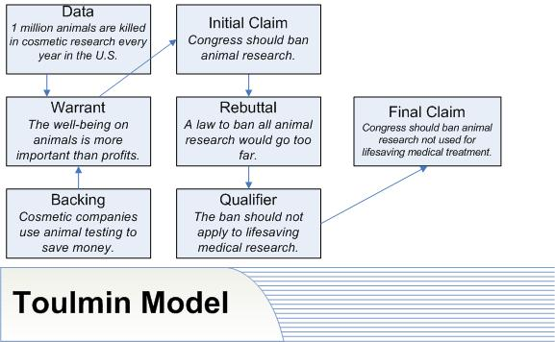

Slide 9

Research mehtods
Notes:
What are the different research methods and why is it important when considering critical thinking

Slide 10

Primary v Secondary Data
Primary
Pros
  Answers specific questions/issues
  Tailor made
  Confidential - gives competitive edge
Cons
  Expensive
  Time consuming
Notes:
There are two types of data i.e. the primary and the secondary sources of data. These are briefly stated below as a brief introduction of the two types:
Primary Data: Data collected by investigator for his own purpose, for the first-time, from beginning to end, are called primary data. These are collected from the source of origin. In other words data originally collected in the process of investigation are known as primary data. Primary data are original. The concerned investigator is the first person who collects this information. The primary data is thus first hand information.
Secondary Data:Secondary data is the information which is already inexistence, and which has been collected, for some other purpose than the answering of the question at hand. In other words data collected by other persons is called secondary data. There data are, therefore, called second hand data. These are available in published or unpublished forms

Slide 11

Primary v Secondary Data
Secondary
Not collected by you, but collected by a third party
Pros
  Covers broad areas
  Relatively inexpensive
  Good starting point
  Can prevent re-inventing the wheel
  Usually available immediately
Cons
  Not specific
  Not confidential
  Out of date

Slide 12
Primary and Secondary Data
Secondary data can also be your historical research reports
It is good practice to re-visit old research to glean new insights

Slide 13
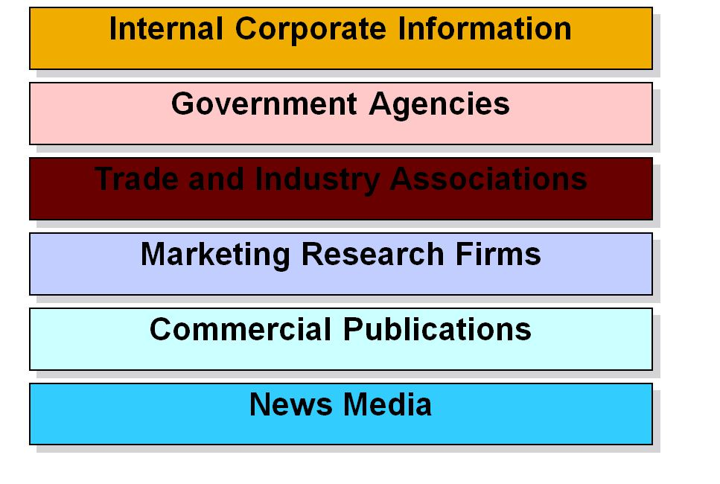
Sources of Secondary Data

Slide 14
Quantitative/Qualitative Data
Quantitative Data
Numerical data – an amount (quantity).
E.g number of students who study psychology.
Qualitative Data
Descriptive data – opinions, preferences, beliefs.
E.g interviewing students to find out why they chose to study psychology.

Slide 15
Qualitative v Quantitative
Qualitative | Quantitative
“all research has a qualitative grounding” – Donald Campbell | “There is no such thing as qualitative data. Everything is either 1 or 0” – Fred Kerlinger
The aim is a complete detailed description | The aim is to classify features, count them, and construct statistical models in an attempt to explain what is observed
Recommended during early stages of research project | Recommended during latter phases of research project
Quotes from Miles & Huberman (1994, p. 40) Qualitative Date Analysis

Slide 16
Qualitative v Quantitative
Qualitative | Quantitative
The design emerges as the study unfolds | All aspects of the study are carefully designed before data is collected
Researcher is the data gathering instrument | The researcher uses tools, such as questionnaires or equipment to collect numerical data
Data is in the form of words, pictures or objects | Data is in the form of numbers or statistics

Slide 17
Qualitative v Quantitative
Qualitative | Quantitative
Subjective; individuals interpretation of events is important (participant observation, in-depth interviews, etc) | Objective; seeks precise measurements & analysis of target concepts (uses surveys, questionnaires, etc)
Data is more ‘rich’, time consuming and less able to be generalised | Data is more efficient, able to test hypothesis but may miss conceptual detail
Researcher tends to be subjectively immersed in the subject matter | Researcher tends to remain objectively separated from the subject matter

Slide 18
Collate information on following topics and highlight data used from primary or secondary sources
Bullying at schools create a detrimental effects on children
Anorexia can be commonly found among girls due to their obsessive behaviour toward getting thin
The relationship between age of individuals and their social media usage patterns
Does household income have an impact on the number of students that drop out of school

Slide 19
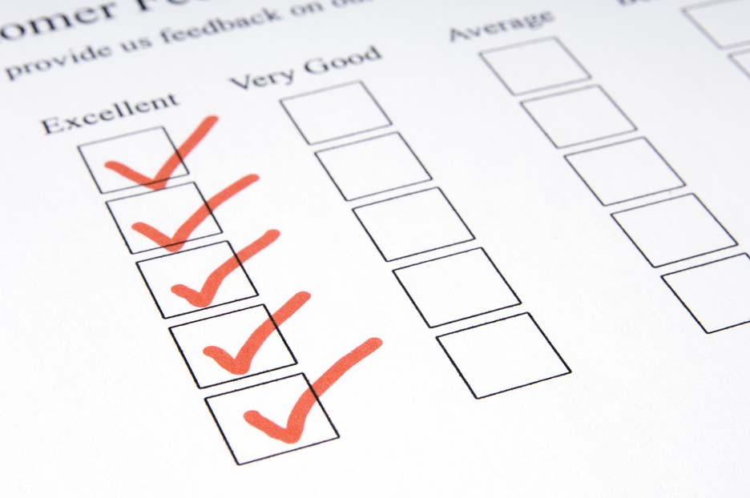
Qualitative v Quantitative
Exercise:
What are the advantages, challenges and purposes of:
  Questionnaires, surveys & checklists
  Interviews
  Observation
  Focus groups
  Case studies

Slide 20
Overview of Research Methods
Method | Overall Purpose | Advantages | Challenges
When you need to quickly and/or easily get lots of information from people in a non threatening way
Can complete anonymously
Inexpensive to administer
Easy to compare and analyse
Administer to many people
Can get lots of data
Many sample questionnaires already exist
Might not get careful feedback
Wording can bias client's responses
Are impersonal
In surveys, may need sampling expert
Doesn't get full story
Questionnaires
Surveys
Checklists

Slide 21
Overview of Research Methods
Method | Overall Purpose | Advantages | Challenges
When you want to fully understand someone's impressions or experiences, or learn more about their answers to questionnaires
Get full range and depth of information
Develops relationship with client
Can be flexible with client
Can take much time
Can be hard to analyse and compare
Can be costly
Interviewer can bias client's responses
Interviews

Slide 22
Overview of Research Methods
Method | Overall Purpose | Advantages | Challenges
To gather accurate information about how a programme actually operates, particularly about processes
View operations of a programme as they are actually occurring
Can adapt to events as they occur
Can be difficult to interpret seen behaviours
Can be complex to categorise observations
Can influence behaviours of programme participants
Can be expensive
Observation

Slide 23
Overview of Research Methods
Method | Overall Purpose | Advantages | Challenges
Explore a topic in depth through group discussion, e.g., about reactions to an experience or
suggestion, understanding common
complaints, etc.; useful in evaluation and marketing
Quickly and reliably get common impressions
Can be efficient way to get much range and depth of information in short time
Can convey key information about programs
Can be hard to analyse responses
Need good facilitator for safety and closure
Difficult to schedule 6-8 people together
Focus groups

Slide 24
Overview of Research Methods
Method | Overall Purpose | Advantages | Challenges
Case studies
To fully understand or depict client's experiences in
a programme, and conduct comprehensive
examination through cross comparison of cases
Fully depicts client's experience in programme input, process and results
Powerful means to portray program to outsiders
Usually quite time consuming to collect, organise and describe
Represents depth of information, rather than breadth

Slide 25
Ethics & Morals
Rules or standards governing the conduct of the research and researcher
Moral code – what is ‘right’ and what is ‘wrong’?
Highly subjective nature
Tension between different stakeholders

Slide 26
Kahoot Quiz
Critical Writing
Research Methods
Go to Kahoot.it

