Slide 1
Notice: Assignment Extension?
Check: CM-CVC Assignment 1 extension from Friday 6th March to Tuesday 10th March?
Double check with you before I change it on Moodle & email everyone.
Just in case you have another assessment on that day, that I’m not aware of.

Slide 2
Notice: CM-CVC next week (reading week)
Assignment 1 support session
No new taught content
Q&A session
Usual day and time
Optional attendance.

Slide 3

Changemakers: Creativity & Value Creation.
Assign. 1: Task 3.
Development Method & Design options
This Photo by Unknown author is licensed under CC BY-SA-NC.

Slide 4
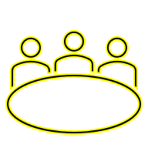

Log-in to MS-Teams
Tutor show:
  Ask Questions
  Receive feedback
  Collaborate with others
  Share resources.

Slide 5

Open Word document / OneNote Notebook
Open your module document.
To save activity answers to go towards completing the assignment questions and tasks.

Slide 6
This week’s focus & Activity:
Assign. 1 Task 3: Project Development method & Design work
Your answers to the questions below should refer to a Computing project/research area of your choice. The task answer should be approx. 6-700 words with supporting citations.
Q.1: Describe a suitable Development method that will help you plan and complete your project.
Q.2: Document and describe some project ‘Design work’. 2 pieces required, e.g. depending on the nature of your project example design work could include: a requirements specification, sketches/drawings, storyboard, wireframes, flow chart/UML diagram, ERD data structure, network structure diagram, network security architecture/diagram.
Q.3: Use several screenshots with brief description to document some initial practical implementation work for your project.

Slide 7

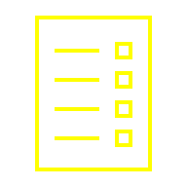
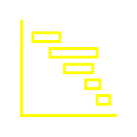
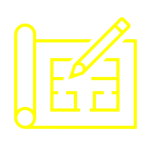
Introduction & Overview
    Lecture & Tutorial 1:
    Project Development Methods
    Activity: Project Development Method
    Lecture & Tutorial 2:
    Project Design methods
    Activity: Project Design work
    Activity: Practical work (start)

Slide 8
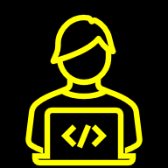
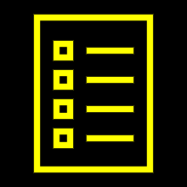
Project Development Methods

Slide 9
Activity: Development Method selection
There are many Development methods to choose from.
As we go through the following slides, make some notes.
And consider which one you would like to use for your project.
You will need to choose / combine / create one to answer Task 3 of Assignment 1.

Slide 10
Development Methods/Methodologies
Example Development methods:
  Waterfall Methodology
  The Software Development Lifecycle (SDLC)
  The Prototyping Process (PP)
  Design Thinking Process (DTP)
  Rapid Application Development (RAD)
  Agile Methods: FDD, Scrum, Kanban etc…
  You will need to choose one or combine/create one, and describe how it will help you to plan and complete your project for Task 3.
  They all the have very similar stages. Looks look at them.

Slide 11
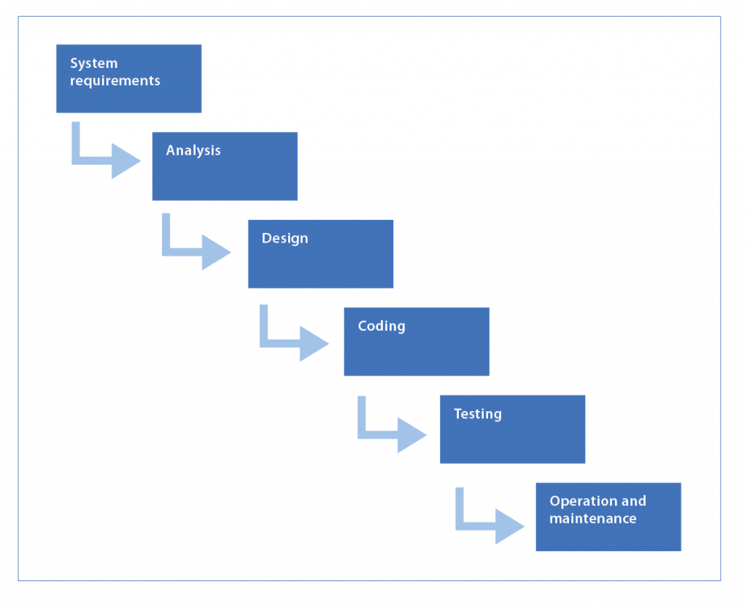
The Waterfall Methodology
The Waterfall model / method / methodology is a sequential project development process.
The Waterfall model is named as such because each stage of the model flows into the next.
Flowing down like a waterfall through all phases of a project, that include:
Analysis, Design, Development, Testing & Deployment.
Requirements are gathered at the start, and the following project stages achieve those requirements.
For more information on the Waterfall Model please click here & here.
This Photo by Unknown Author is licensed under CC BY

Slide 12
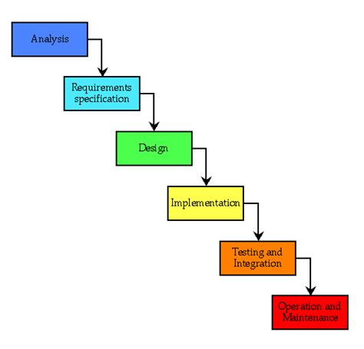
The Waterfall Model
The waterfall model followed phases in sequential order:
  Analysis: specify requirements in a document;
  Design: network structure, design diagrams (flow chart/UML), character/wireframe sketches, data schemas (project dependant);
  Implementation: practical development work;
  Testing: testing and debugging;
  Operations & maintenance: the installation, support, maintenance and updates of the practical implementation.
The original waterfall model states we should move to a phase only when its preceding phase is complete.
Various modified waterfall models include variations on this.
These variations include returning to the previous cycle after flaws were found downstream e.g. returning to the design phase if downstream phases were deemed insufficient.
The Waterfall Model can be used iteratively like modern agile methods.
Note (r)

Slide 13
Bg. The Waterfall Model
The Waterfall model was originally perceived as sequential, not iterative so that when the exhaustive requirements were agreed they would not change, at least until the entire project was complete, post deployment.
It included ‘extensive documentation’ throughout all phases.
Popular in the 70s & 80s until the 90s when RAD & prototyping emerged.
Still used where emphasis is required on strict planning control and documentation.
Modern variations of the model allow greater flexibility.

Slide 14
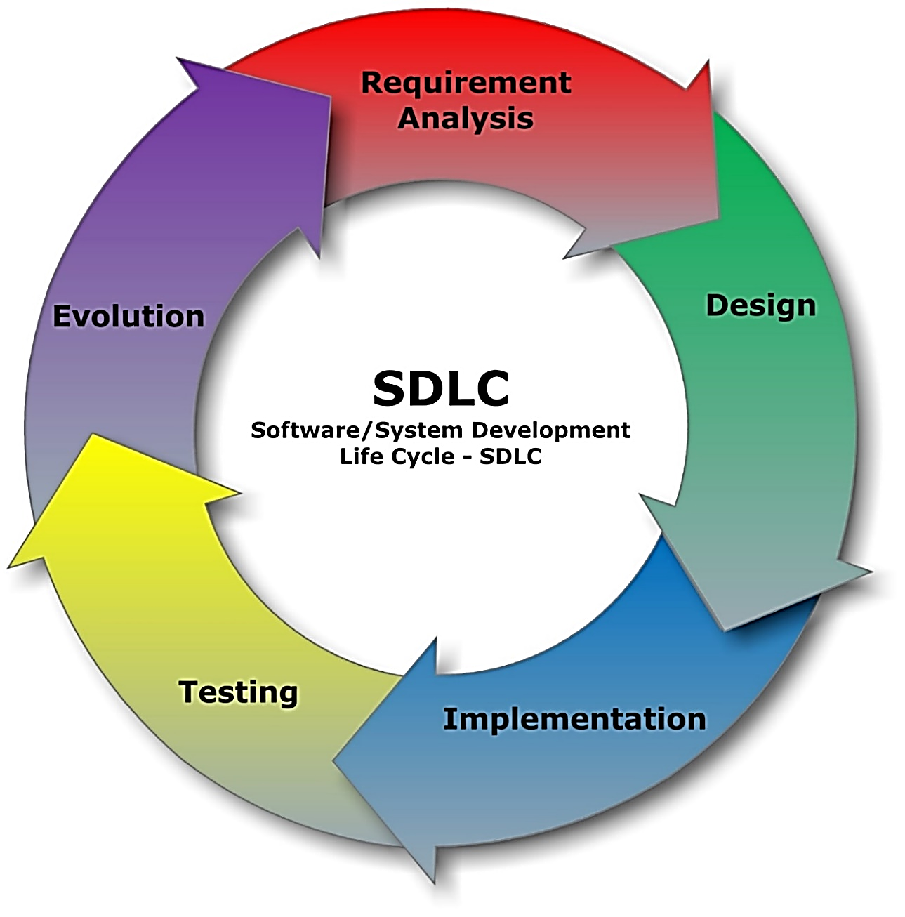
The Development Life Cycle
The more modern Systems Development Life Cycle (SDLC) is also used to describe key stages in a project process.
These stages include: Project
Analysis, Design, Implementation, Testing, evaluation & evolution.
Traditionally used for Computer System/software development, it can be applied to all projects, and variations are used in many different industries.
It is sequential but also flexible and iterative.
Ref: (i1)
Notes:
For more information please click here: https://stackify.com/what-is-sdlc/
(i1) https://tinyurl.com/y2plpy56

Slide 15
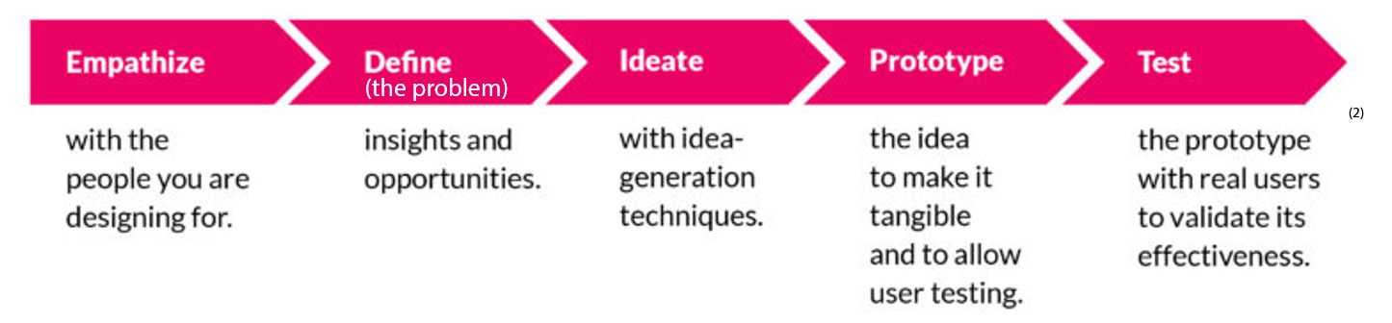
Design Thinking Process
Similar to the SDLC Model, is the Design Thinking Process Model
Design Thinking is all about finding a problem worth solving.
It is a systematic process to solving problems based on empathetic observation of people.
Design Thinking is popular in many industries including Design & IT/Computing sectors as a method of problem-solving and innovation.
Similar to other project process models, it also generally includes 5 key stages.
The Design Thinking process is also flexible, iterative and loops back around.
Ideas to solve the problem
  For more information about Design Thinking, it’s history and origin please click here.
Notes:
(1) Based on Design Thinking for Start-ups by Nitin Sethi.
(2) When to apply Lean Startup and/or Design Thinking by Lucas Tamboryn
“Design thinking has been central to user-centered design and human-centered design—the dominant methods of designing human-computer interfaces—for over 40 years.(3) Design thinking is also central to recent conceptions of software development in general.(4)” Ref[1]
(3) Norman, Donald A. (1986). User Centered System Design. Taylor & Francis.
(4) Ralph, Paul (2015). "The Sensemaking-Coevolution-Implementation Theory of software design". Science of Computer Programming. 101: 21–41.
[1] https://tinyurl.com/y4ml6um.

Slide 16
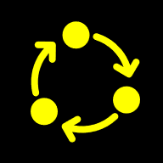

Prototyping
Prototyping is the activity of creating incomplete prototypes and improved iterative versions.
Prototypes allow users to test and evaluate early on in the project.
Early feedback at the Analysis & Design stage of the project improves the prototype, final implementation and user experience.
Prototyping is another development method you could use for your project. It has 3 key stages.. Next slide >>>
This Photo by Unknown Author is licensed under CC BY
Notes:
- removed:.
EIGP Archive: Team Roles: You can use whichever method suits your team e.g.
Evolutionary Parallel Prototyping: Work on and develop all layers simultaneously by assigning them to different roles within the team. Or
Evolutionary Extreme Prototyping: work on and develop the UI then Server/Client logic then Db.
Db design include E-R (Entity Relationship) Modelling: https://www.astera.com/type/blog/all-you-need-to-know-about-database-design/#:~:text=%20How%20to%20Design%20Database%3A%20Steps%20of%20Designing,that%20every%20data%20item%20becomes%20a...%20More%20

Slide 17

The Traditional Prototyping process
The prototyping process involves the following steps:
1. Identify requirements: Determine basic requirements including the most important elements. The ‘details’ can be left for later consideration and iterative refinement.
2. Implement practical work early and develop an initial prototype.
  Bg. There are different prototyping methods such as: Incremental, Throwaway, Xtreme or Evolutionary prototyping or just jump in and get building. For more information please click-here.
3. Test & Review: With relevant stakeholders (e.g. end-users), test & acquire feedback on potential changes many times throughout the project. Your L5 project, only 1/2 times.
4. Revise and enhance the prototype: Using feedback, enhance the requirements and prototype.
5. Repeat.
  Note: This is a traditional ‘Software prototyping / prototyping’ process that is used in many different industry sectors.

Slide 18
Prototyping
The Rapid Prototyping Process includes a simple but effective ‘3-step process’, repeated as many times as needed:
  Prototype: Create a visual mock-up of your solution.
  Review: Share the prototype with users and evaluate to see if it meets their needs and expectations.
  Refine: Improve & refine it based on user feedback.
  Bg. For more information, see e-Handout: A Beginner's Guide to Prototyping.
Notes:
(1)

Slide 19

Contemporary Tech Development methods
Contemporary Development & IT Management methods value:
Flexibility Change & Innovation
Continuous improvement
User / Customer focused and involvement
  People over Processes.
Open holistic collaboration with all stakeholders (e.g. Business owner / client, users, Development and operations team)
Empowerment: Bottom-up employee involvement
Business & IT collaboration
Small milestones
Practical testing over planning and documentation
Sustainable balanced working.

Slide 20

The following slides will focus on modern Agile Development methods.

Slide 21
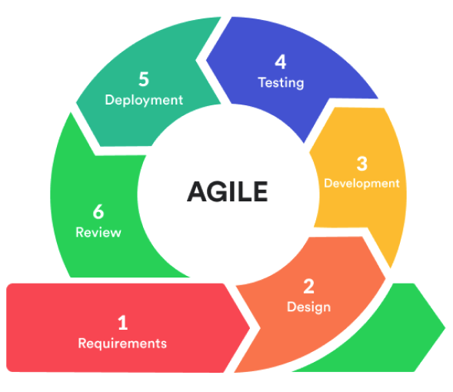
Agile Development Methods
Modern development methods focus more on people,
On collaboration with all,
Embracing change and flexibility, rather than on strict planning methods and tools.
Agile dev methods reflect the new values of focusing on people and embracing change.

Slide 22
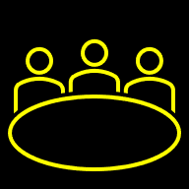
Agile Development
Agile development methods include requirements gathering and prototype development & feature improvement with cross-functional teams and collaboration with users/client/customers.
Key aspects of agile include:
  Early implementation,
  Frequent meetings,
  Flexible/adaptive planning,
  Evolutionary development & continual improvement and
  Flexible changes in requirements, prototypes & implementation, deployment & maintenance updates.
Agile methods focus on iterative quick start prototype development, frequent user feedback and iterative (cyclical) feature/prototype improvement.
The principles of Agile can be used by individuals on individual projects as well as in teams.
Typically, Agile development methods are commonly used by Software Development Teams to build software collaboratively.

Slide 23
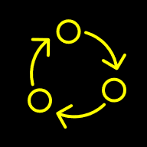
Rapid Application Development (RAD)
The Waterfall method had it’s roots in conventional engineering.
Which involved very carefully planning and absolute sequential stages that had to be progressed through in a linear fashion and did not have the flexibility of returning to and updating earlier stages.
To address this, in the early 1990s, the early creators of RAD saw that software engineering were different in that software wasn’t a fixed structure such as a bridge or building. Software was soft not hard, it was malleable/flexible and could be changed/updated to suit the needs of the user.
And that Software/App./Game development was not limited to traditional methods of engineering.
Less emphasis could be put on initial and absolute planning, and that software engineering is more of an adaptive evolving process that could be iterative.
Rapid Application Development or RAD focuses less on rigid plans and more on fast, iterative cycles of prototyping and relies on user feedback throughout.

Slide 24
Rapid Application Development
The initial phases of RAD included:
1: Requirements planning
2: User design
3: Rapid construction and
4. Cutover/Deployment
The updated RAD model includes these 4 key steps:
  Requirements definition
  Initial Prototype
  Iterative Development (with user feedback)
  Deployment

Slide 25
RAD: Rapid Application Development
RAD is user-focused, iterative and emphasis practical prototype over process.
However documentation was typically still extensive at the design phase e.g. Vast array of UML diagrams for design / systems analysis.
Popular today for creating managing and maintaining large complex systems.
Modified versions of RAD with less focus on documentation such as prototyping, are popular today for creating smaller scale software projects.

Slide 26
Agile methods: FDD, Kanban and SCRUM
Some other example Agile development methods include FDD, Kanban, SCRUM.
Feature-driven development (FDD) is an agile software development framework, that focuses on identifying required ‘features’, assigning features to personnel/teams/people and building software, feature by feature.
  Bg. For an overview of the FDD framework please click here.
Kanban (developed by Japanese company Toyota) is a project scheduling & development method that uses a visual ‘Kanban board’ that moves identified required product features known as a ‘backlog list’ through typical project stages to production/deployment.
  Bg. For a Kanban overview and example tools, please click the preceding links.
SCRUM is a team-orientated feature focused agile development method for organising managing and developing software using Sprints. A sprint is a short, time-boxed period when a scrum team (or individual) works to complete a feature.
  Bg. For an overview of the SCRUM framework please click-here, and for a Video of SCRUM click here.

Slide 27
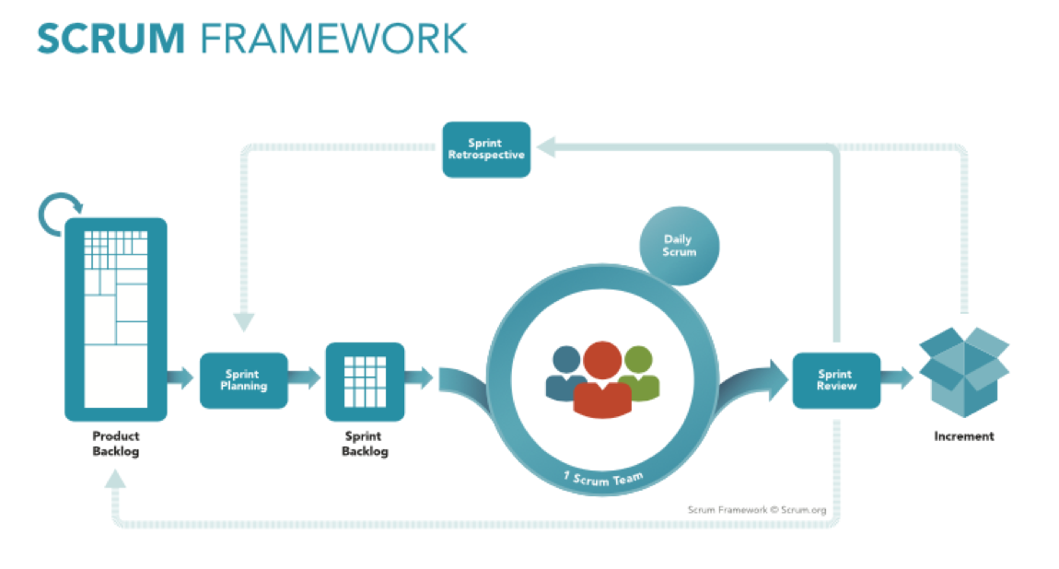
The Scrum method includes a Backlog of features to be developed.
A Scrum meeting is typically a 15-minute meeting at the start of the day for the Development Team/person to synchronize activities and create a plan for the next 24 hours.
A Scrum Sprint is an agreed time-period to complete a feature/requirement.
Ref: https://www.scrum.org/resources/what-is-scrum
Further information: https://www.scrum.org/resources/what-is-scrum
Notes:
Ref: https://www.scrum.org/resources/what-is-scrum

Slide 28
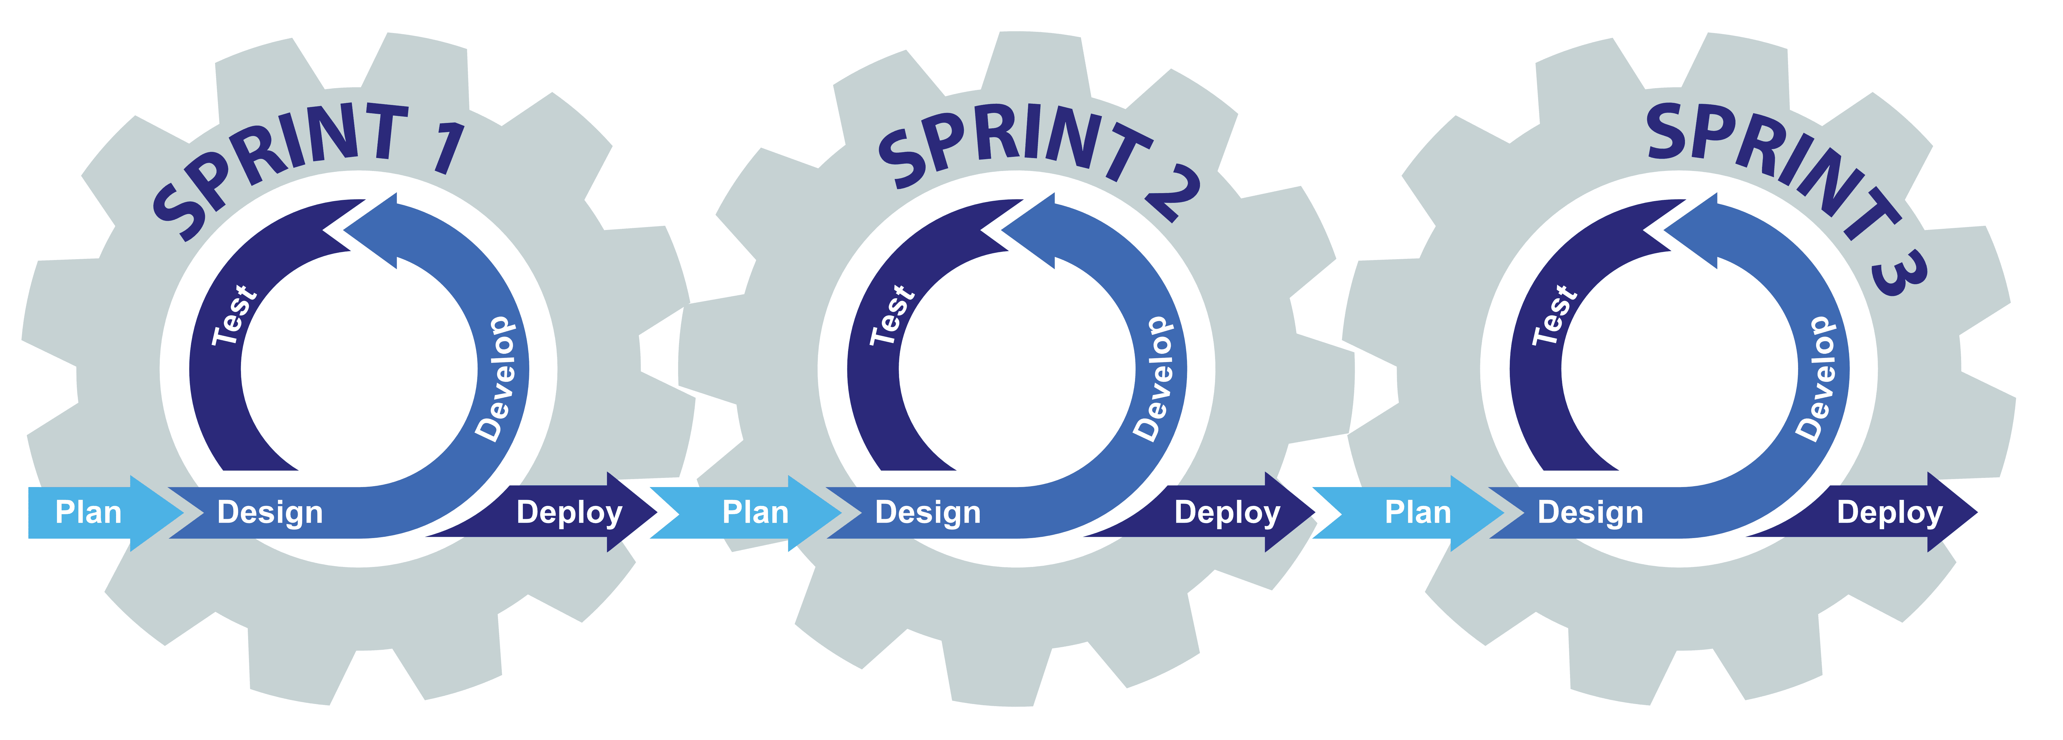
Scrum: 1 feature can take several sprints
Depending on user feedback, one feature may take several sprints/iterations to get right. Until the end-user/s is happy with the application feature.

Slide 29
Scrum-Lite
Scrum-Lite is a simplified version of the Scrum framework, used for individual projects or small teams.
It streamlines the standard Scrum practices, focusing on core elements only.
It’s more accessible for those new to Scrum or for smaller projects where a full-fledged Scrum implementation isn't necessary.
Reduced ceremonies: Scrum-Lite typically omits some of the more formal Scrum events.
Focuses on core elements of Scrum: such as backlog features and realistic balanced time-boxed sprints (1 to several days or a week) per feature.
Emphasis on Visual transparency: Like standard Scrum, it promotes transparency through the use of a visual board to track progress such as a Kanban-style board and Gantt chart.
Flexibility: Scrum-Lite allows for customization and adaptation to suit individual or small team project needs, making it easier to use.
Example: One example involves using a Kanban board to track tasks, breaking them down into manageable chunks, and moving them through stages like "To Do," "In Progress," and "Done".
Bg. Video overview: Simplified Scrum Project Management in ASANA 🚀 | Asana Tutorial
Notes:
“* For the development period of the project I will use a lightweight iterative agile approach which is more tailored to being a solo developer such as a "Scrum-Lite" approach which still utilises development sprints to ensure that there is not too much time spent on certain features. * This approach will establish relatively strict time-keeping. As each task will be assigned brief sprint to maintain workflow. Each sprint will have enough time to both implement, test and debug the respective feature.
* I will also keep a backlog of each task to help keep log of what has been completed and what is next to achieve this will be done with the help of a tool like an online Trello board.”

Slide 30
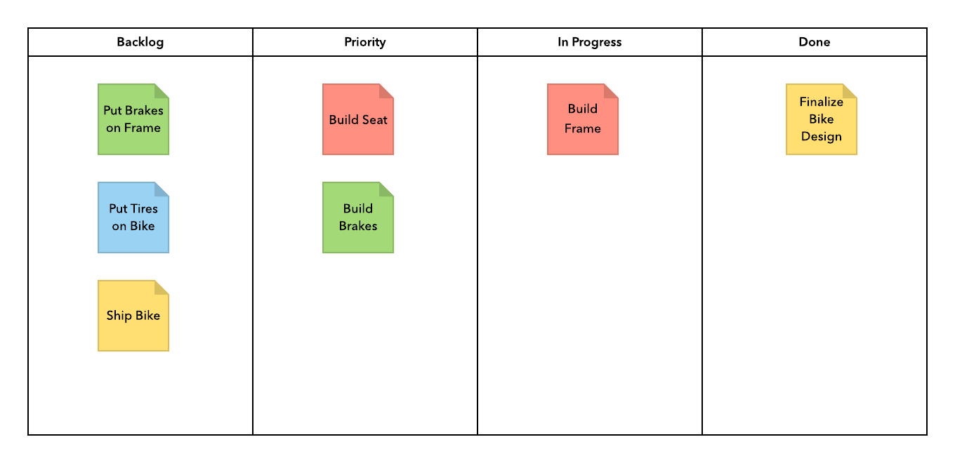
Example: Kanban board
Notes:
Ref: https://lucidchart.zendesk.com/hc/en-us/articles/360001139203-Gantt-Chart-Template-Kanban-board

Slide 31
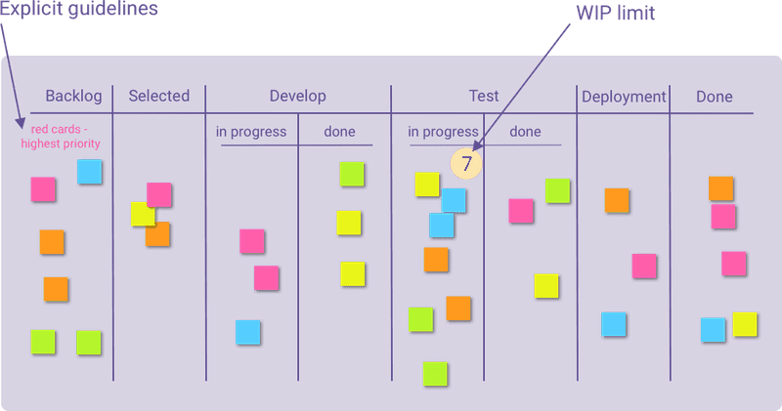
Bg.
Kanban board

Slide 32
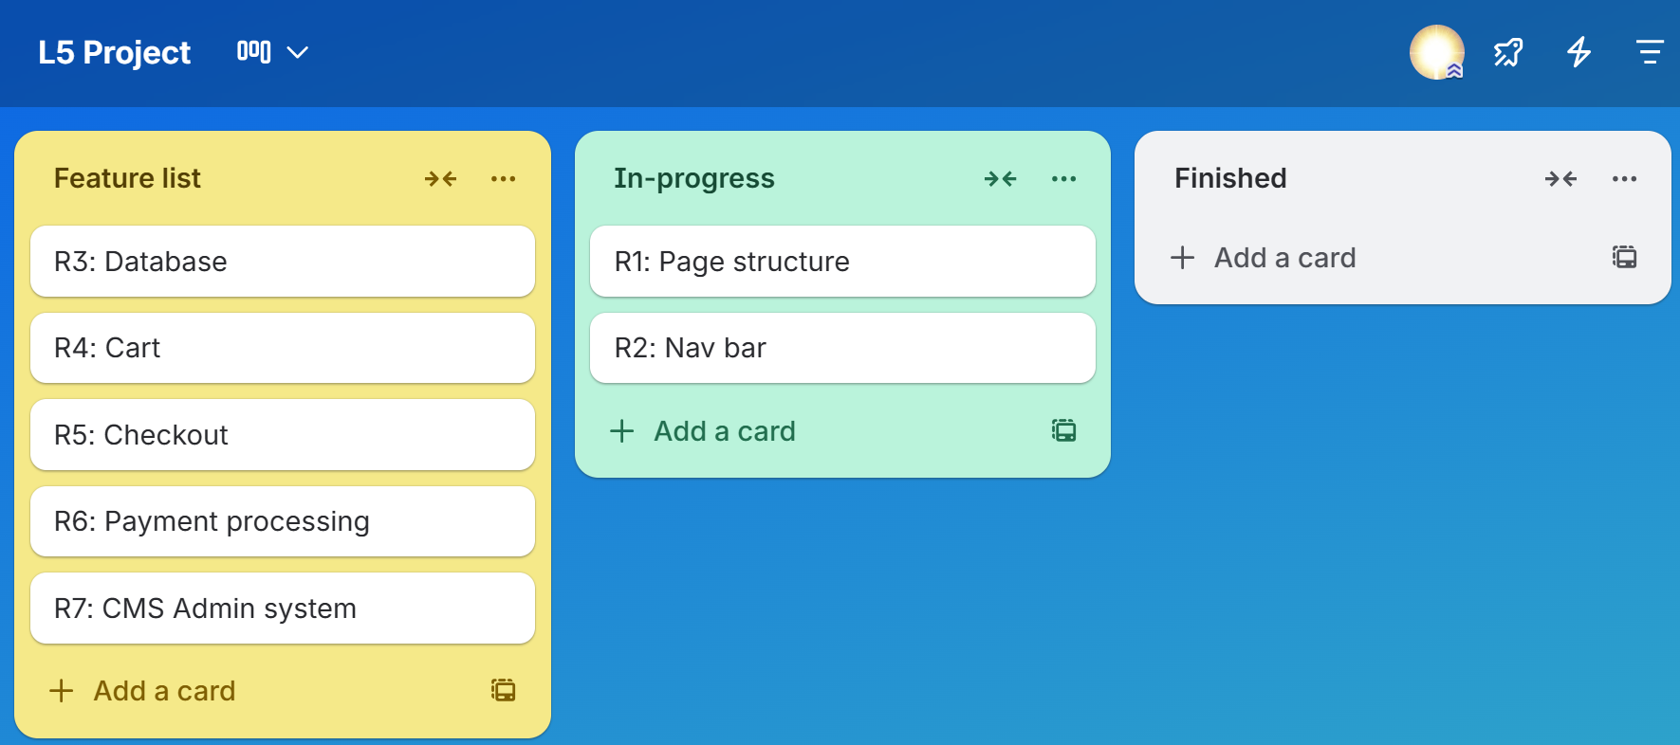
Example: A Simpe ‘Kanban board’ in Trello

Slide 33
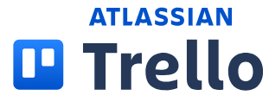
Bg. Trello by Atlassian
Trello is a web-based project management tool. It’s an online app that allows us to organize our project ideas, tasks and to-dos.
The Trello board feature is like a Kanban board with organised lists of sticky notes, with each note as a to-do / doing / done task for you and your team.
Trello helps individuals and teams organise work, capture to-dos from anywhere (email, texts, & dms from multiple apps) , and use features such as Inbox, Boards, and Planner(calendar) to stay organized.
Url: https://trello.com
Trello provides a free plan and 3 paid options: Standard, Premium, and Enterprise.
  Bg. Video: How To Use Trello For Project Management 2025 (Step-by-step)
  The video shows how to use Trello for task/project management in it’s default set-up which is a kanban board.

Slide 34
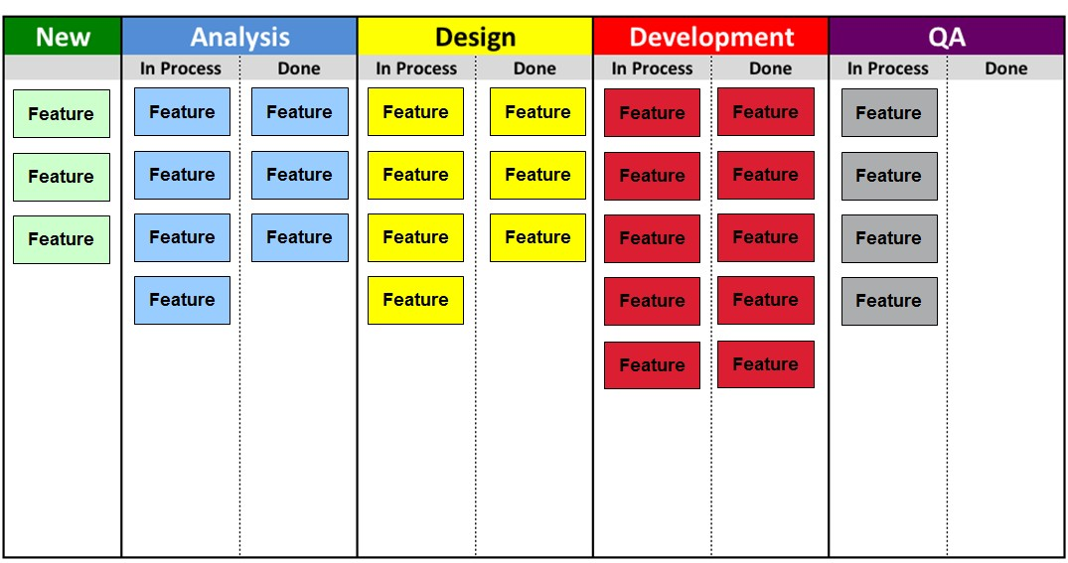
Combination example: SDLC FDD & Kanban
Overview: SDL Stages, Feature-driven (FDD) Kanban type board.
Some features are at the Analysis/planning stage.
Some features are being designed.
Some features are in development.
Others are in the Testing/QA stage.
You could create a similar type board to manage the implementation of your project.

Slide 35
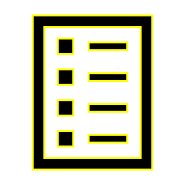
Mixed methods: A Hybrid approach
A Mixed methods approach could be used aka a Hybrid approach.
For example,‘Waterfall + Agile: initially set the framework according to the waterfall method, and then make flexible adjustments according to the agile method in the later stages.
This approach balances stability and flexibility, suitable for projects that require both compliance and innovation.
Flexibility: Reduces the need to stubbornly adhere to one method, and allows the manager/team-leader and team to switch flexibly according to needs of the project.

Slide 36
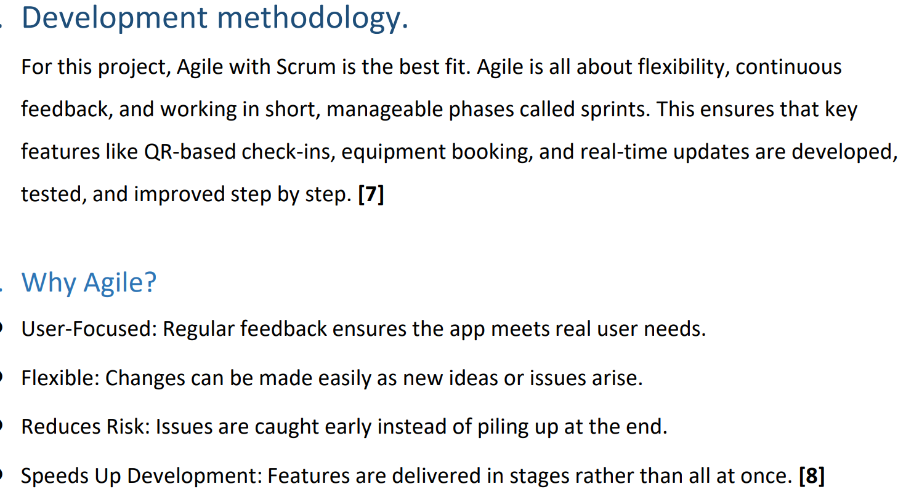
Student example: App. development

Slide 37
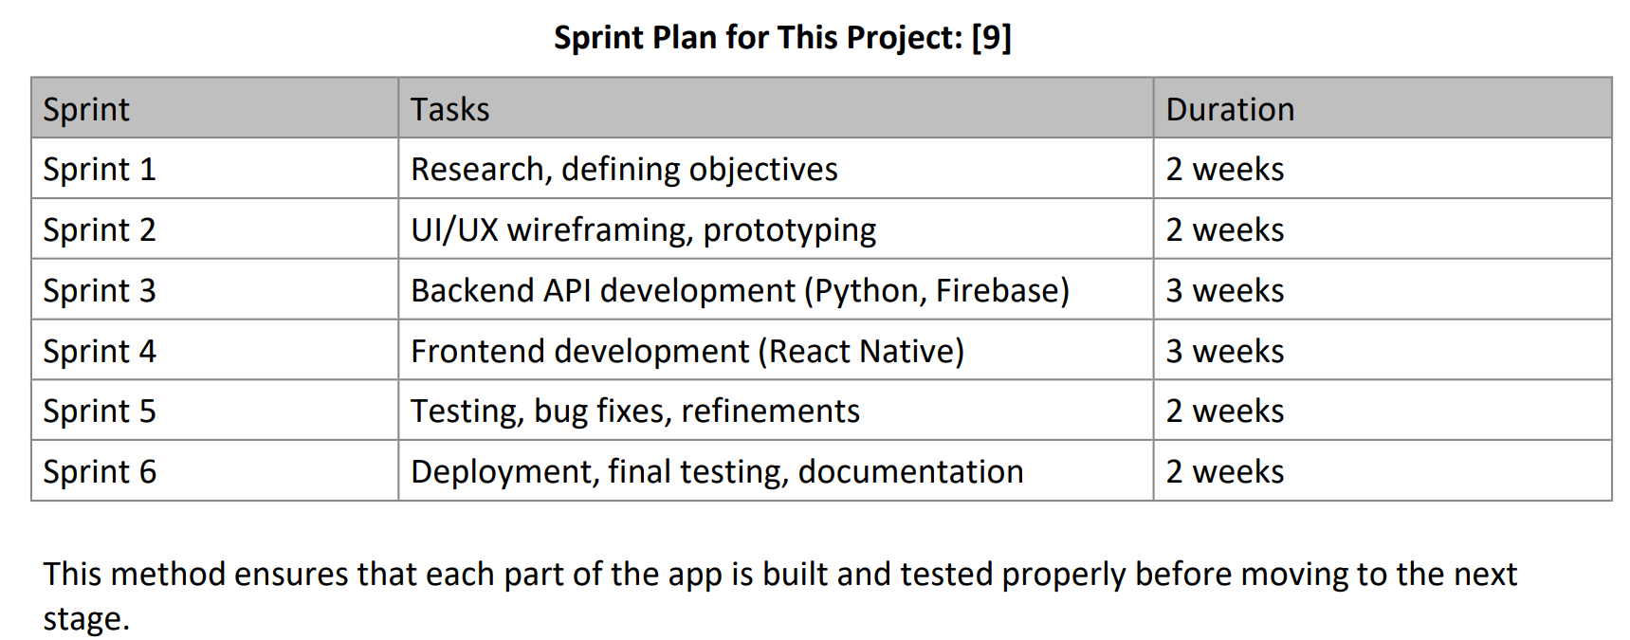
Cont… example: App. Development using SCRUM

Slide 38
Bg. Student example: Game development
Development method selected: Scrum
I'll use Agile for my game project.
It's like building in small chunks, making it easier to adjust as I go.
I'll split the project into short periods called sprints, lasting 2 weeks each.
In each sprint, I'll focus on adding new features or fixing things.
At the end of each sprint, I'll check what I've done and review what went well and what could be better.
This way, I can keep improving the game step by step, working closely with users, and staying on track with what I want to achieve.
I will have regular meeting with potential users and keep everything open, open mind, open conversations and continual evolutinary development.

Slide 39
Bg. Student example: Software Development
Mixed Methods approach: Personal Kanban & SDLC
A Kanban development methodology, known as personal Kanban for solo development, will be used during this project.
Kanban is an Agile approach for managing software development projects. To apply it I will:
  Maintain a simple Kanban Board with columns: To Do, In Progress and Done. This will provide an easy-to-follow progress planning and check.
  Set ‘Work in Progress (WIP)’ limits: by setting an upper limit of WIP jobs, I can keep my workload under control and not try to take on too much at a given time.
  Regular Monitoring: by routinely consulting the Kanban board, I will always be aware of what stage of the project I am currently at and know if the project is progressing in a timely manner. If the project is behind schedule, I will be able to identify bottlenecks and make changes to improve my efficiency.
While Kanban is a very useful Agile tool, I will also endeavour to integrate the 6 SDLC stages (Requirements, Design, Development, Testing, Deployment & Review) to create a more rounded and useful Agile methodology, with Kanban helping me become and stay organised and the 6 Agile stages ensuring I cover all phases.

Slide 40
Bg. Student example: Network project
Mixed methods approach: Kanban & Scrum
For this project, a mixture of multiple agile development methods would be beneficial.
A mixture of Scrum and Kanban would be used for this project, the benefits are listed below.
The use of the Scrum methodology is well-suited to projects with ever changing requirements and where frequent feedback is provided. The project will get split into smaller tasks that can be developed and demonstrated, before acquiring feedback and moving on.
For this project, the parts that get split into tasks could be the vulnerability assessment, security measures implementation, and documentation. Meetings will be held frequently with the client to ensure the project remains on track and any feedback can be addressed quickly.
The Kanban methodology will be used to create a visualisation of the workflow to be completed, using a board to track tasks from the backlog to completion.
As the project progresses, different tasks can be prioritised to ensure the most important project parts are completed first; this pairs well with the Scrum method as feedback gained can be used to prioritise on the Kanban boards.
Kanban can also provide flexibility when managing unexpected changes in the project structure, which would be common in a project dealing with network vulnerabilities, as more or less vulnerabilities may be detected than expected, resulting in a change of workflow.

Slide 41
Project Methods & the Assignment
You can choose any Development method (e.g. SDLC, Prototyping, RAD, FDD) you feel is appropriate for your project.
You can select a Development method and modify it to suit your project. Or select and combine aspects of 2 or more methods such as SDLC & Kanban. This is common practice in industry.
Whether you select 1 as it is, customise 1 or select 2 and combine/modify them. Just include a little description to justify your selection/customisation. That’s ok.
Bg. Agile development methods are covered in more detail on some programmes e.g. on the Software engineering programme, there is a module where students are grouped into teams to build software using an agile process.

Slide 42
Activity: Project Development method
Q.1: Describe a suitable Development method that will help you plan and complete your project.
The task answer should be approx. 200 words with supporting citations.
You can use AI & Search tools to discover information, and references to help you answer the question.
Any Qs during the activity please let me know.

Slide 43
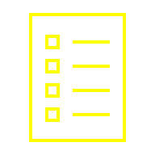
Session 2: Requirements Analysis

Slide 44

Requirement Specifications & Prioritisation
We will consider two types of Requirements Specifications:
Requirements / Feature specifications: Are suitable for the creation of new Computing prototypes.
Product specifications: Are suitable for the creation of new hardware products e.g. a component list.

Slide 45
Requirement Specifications & Prioritisation
Requirement specifications can be used for hardware or software prototypes and should be prioritised. This will help you to focus on what is most important.
When prioritising your requirements, consider the most important features of your project implementation aka MVP Minimum Viable Product.
Many methods can be used to prioritise your list e.g. By number (1, 2, 3, etc..), High, Med. or Low, or the MoSCoW* method.
  * M for Must haves, S for Should haves, C for Could haves and W for Won’t haves.

Slide 46
Requirement Specification template
A Requirements specification is a description of the features for a proposed project/prototype to be developed/implemented.
It outlines the SCOPE of the prototype.
A Requirement often starts with a unique Number, a Name/Title, followed by a priority status and brief description that outlines the purpose of the requirement.
A Requirements specification outlines Functional (Fr) and Non-functional requirements (NFr).
Unique number | Requirement Name/Title
Priority status P:1 | Requirement brief description.

Slide 47
Functional & Non-functional requirements
You can have a combined or separate requirement list for Functional and Non-functional requirements.
A functional requirement outlines something the system should do/perform.
Non-functional requirements outline all other non-functional aesthetic-design/network/security activities that are required by the system.
You may have different types of Non-functional requirements, and they can be grouped together or partitioned into e.g. Design requirements, Performance req., Security req. etc…
For a small project you can have 1 simple list, that lists all the req./features.
1 | Requirement Title
P:1 | Requirement brief description.

Slide 48
A Simple Requirement list (Keep it Simple)
1 | Requirement Name
P:1 | Requirement brief description.
2 | Requirement Name
P:1 | Requirement brief description.
3 | Requirement Name
P:1 | Requirement brief description.
4 | Requirement Name
P:2 | Requirement brief description.
5 | Requirement Name
P:3 | Requirement brief description.
6 | Requirement Name
P:3 | Requirement brief description.

Slide 49
Student example for a small project
Requirement ID | Requirement Statement | Must/Want | Comments
FR001 | The website will have a homepage which greets new users and introduces them to the different features the website offers. | Must
FR002 | The website will have a sign-up and log in function to allow users access to unique pages separate from visitors. | Must
FR003 | Profile page will be added for users who have logged in. | Must
FR004 | Exercise page that lays out a routine for users to follow. | Must | This can be found here - https://www.reddit.com/r/bodyweightfitness/wiki/kb/recommended_routine
FR005 | Help page will be available for users to find answers to questions that are likely to be asked. | Must | These will be found from the reddit page that the exercises are sourced from.
FR006 | A list of alternative exercises that will help users explore different types of fitness hobbies. | Must | These can include running, hiking, yoga and swimming.
FR007 | Food page that informs users on both weight loss and bulking. | Must | Clearly include a disclaimer to state that the advice is not from a medical authority.
FR008 | Dynamic features for each element testing a range of screen sizes to make sure the content is appropriate for mobile, laptop and desktop users. | Must
FR009 | Gamification feature rewarding users for progression. | Must
FR010 | Easier routines for users who want to do less exercise. | Want
FR011 | Calendar for users to schedule workouts | Want
FR012 | Notification feature to remind users to workout or to take a rest depending on time and day. | Want
Q. What is missing here?, what would benefit this specification?
Notes:
A Clear simple Title for each requirement.
With permission: Ref.: Kai Harley Strand Regan

Slide 50
Student example for a small project
Note: This example would benefit from including a ‘Title’ with each requirement.
Requirement ID | Requirement Statement | Must/Want | Comments
FR001 | The website will have a homepage which greets new users and introduces them to the different features the website offers. | Must
FR002 | The website will have a sign-up and log in function to allow users access to unique pages separate from visitors. | Must
FR003 | Profile page will be added for users who have logged in. | Must
FR004 | Exercise page that lays out a routine for users to follow. | Must | This can be found here - https://www.reddit.com/r/bodyweightfitness/wiki/kb/recommended_routine
FR005 | Help page will be available for users to find answers to questions that are likely to be asked. | Must | These will be found from the reddit page that the exercises are sourced from.
FR006 | A list of alternative exercises that will help users explore different types of fitness hobbies. | Must | These can include running, hiking, yoga and swimming.
FR007 | Food page that informs users on both weight loss and bulking. | Must | Clearly include a disclaimer to state that the advice is not from a medical authority.
FR008 | Dynamic features for each element testing a range of screen sizes to make sure the content is appropriate for mobile, laptop and desktop users. | Must
FR009 | Gamification feature rewarding users for progression. | Must
FR010 | Easier routines for users who want to do less exercise. | Want
FR011 | Calendar for users to schedule workouts | Want
FR012 | Notification feature to remind users to workout or to take a rest depending on time and day. | Want
.
Notes:
With permission: Ref.: Kai Harley Strand Regan

Slide 51
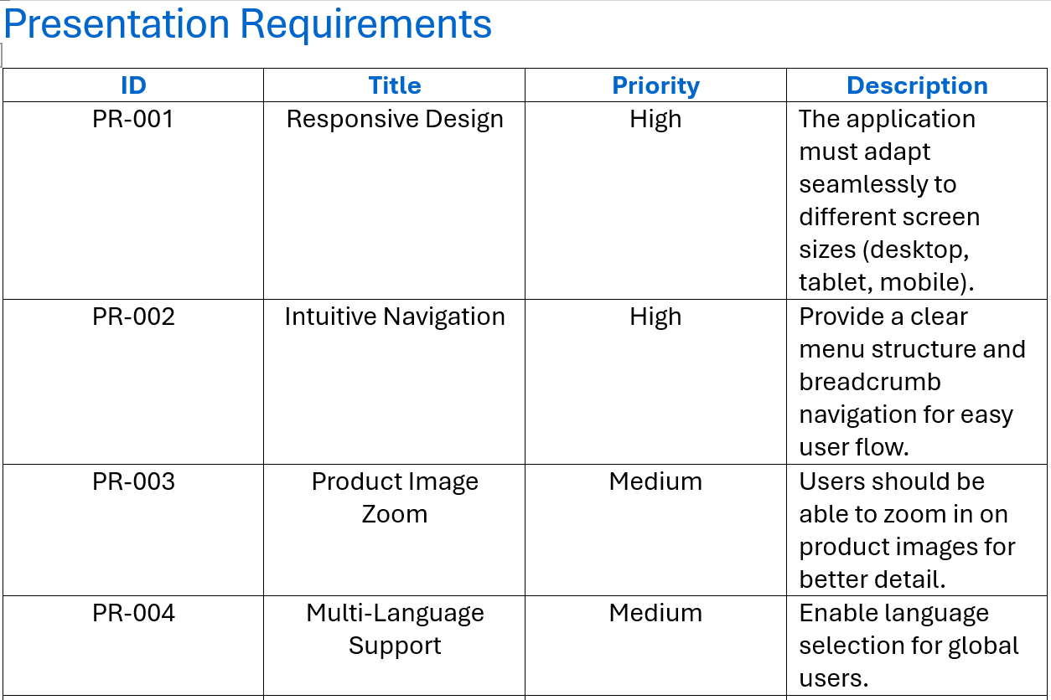
Sample from handout: n-tier Requirement Spec

Slide 52
Bg. 3/n-tier Requirement specification
A Requirements specification can also be partitioned into 3 or multiple sections (which could relate to the 3-tier model: Presentation, Logic and Data tiers).
  Presentation/Design: The presentation section would include the typical non-functional presentation aesthetic-design requirements/features.
  Logic: The logic section would include the typical functional requirements/features, that generally need to be coded.
  Data: The data section typically includes the database design. But can include other data (storage, analysis, modelling, cleaning, visualisation/output) related considerations.
N-tier: The requirement specification can be further partitioned into additional sections appropriate for the project such as network and security requirements, or any other requirements/features that are required for the practical aspect of the project.
For an example n-tier requirement specification, please click-here.

Slide 53
Sample from handout: n-tier Requirement Spec.
Template:
1 | Requirement Title
P:1 | Requirement brief description.
Example:
PR-001 | Responsive Design
P:1 | The application must adapt seamlessly to different screen sizes (desktop, tablet, mobile).
PR-002 | Navigation Menu
P:1 | Provide a clear menu structure and breadcrumb navigation for easy user flow.
PR-003 | Product Image Zoom
P:2 | Users should be able to zoom in on product images for better detail.

Slide 54
Bg. Requirement Spec. considerations:
Network project
Example network considerations to create a Network project requirement specification:
Functional Requirements: What the network must do (e.g., support 200 users, provide secure remote access).
Design Considerations: Proposed topology, hardware/software choices.
Non-Functional Requirements: Network performance, reliability, security considerations.
Constraints: hardware & software availability, compliance standards.
Testing & Validation: How you will verify the network meets the requirements.
For more information see example requirements specification handouts on Moodle.

Slide 55
Bg. Requirement Spec. considerations:
Cybersecurity project
Example CyberSec. considerations for a project requirement specification:
Functional Requirements: e.g., Firewall Deployment, MFA, Endpoint Protection
Non-Functional Requirements: e.g. Performance, Reliability, Compliance
Security Requirements: e.g. Encryption, RBAC, Incident Response
Testing & Validation: e.g. Penetration Testing, Vulnerability Scanning, Compliance Audit
Deliverables: e.g. Architecture Diagram, Config Files, Test Reports, Assignment report.
For more information see example requirements specification handouts on Moodle.

Slide 56
Bg. Requirement Spec. considerations:
Game development project
Some example Game dev. considerations for a project requirement specification:
Functional Requirements: e.g. Game engine, platform support, core mechanics, single or multiplayer
Non-Functional Requirements: e.g. Performance, graphics quality, usability, scalability
Design: Story, Environment, Characters, assets, effects, music, inventory
Security Requirements: Data protection, secure authentication for multiplayer
Testing & Validation Requirements: Unit tests, performance tests, multiplayer stability
Deliverables: Prototype, source code, asset pack, testing reports, final assignment report.
For more information see example requirements specification handouts on Moodle.

Slide 57

Activity: Requirements Specification start
Reflect, consider and list the requirements for your project.
Decide on the layout for each requirement.
Consider if you need/want multiple requirement sections or if you want to create 1 simple list. See example in Moodle Handout folder.
Make a list of requirements using your preferred template/layout.
  Use the format of: a unique number, title, priority status and brief description for each.

Slide 58
Activity: Requirement Specification (G-AI)
Generate(AI) a Requirements Specification for your project.
Update: Use the generated version for ideas to enhance the specification you started in the previous activity.

Slide 59

Break time

Slide 60
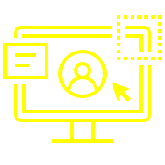
Session 3: Project Design

Slide 61
Project Design
The following slides introduce some key terms, concepts and tools commonly used in the ‘Design stage’ of Computing projects.
Relates to Assign.1, Task 3: Q2.

Slide 62
Design stage: Overview
The upcoming slides, listed below, contain Design options that may be useful for the Design section of your assignment and project. You will be doing some of these in other modules. A brief overview is provided here.
You do not need to include all of the following, due to the different various types of projects, different design methods are covered for consideration, 2/3 methods may be suitable and can be used for your assignment/project.
Aim to include2 (3 if needed) types of design work. The following slides will cover:
3-Tier Design considerations. | Interface & prototype design tools.
Requirements Specification. | UI Design, Wireframes & Mock-ups.
Full Stack Design Model | Network Mapping tools.
Minimum Viable Product (MVP). | Product design specifications.
Prototyping on Paper (PoP). | Design work.

Slide 63
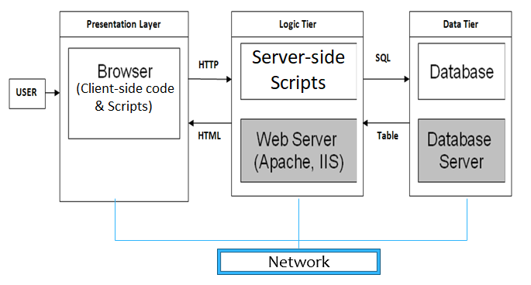
Tips: Multi-tier / Full Stack Design Overview
The table below lists some traditional design methods that you could use.
Presentation tier | Logic/Server/Dev. tier | Data tier
Wireframe designs Storyboard diagram Colour & font scheme UI Mockups Branding (Logos etc) | Pseudo code Flow chart UML diagrams Identify needed Server-side/dev tools | Database Schema (Normalisation & E-R Entity Relationship Models. Identify needed Db Software.
Hardware specification. * Network Structure diagram/Map. Server / Network / Security requirements. * Network Security architecture/diagram.
* Mock-ups are a proposed model or structure, for experimental design purposes.

Slide 64
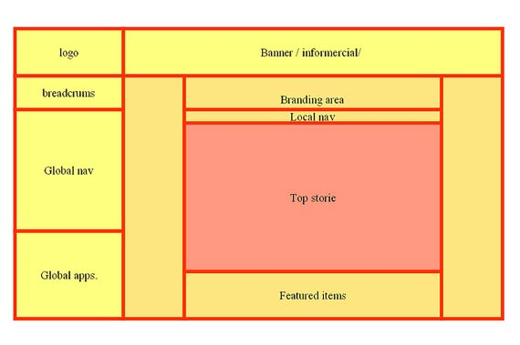
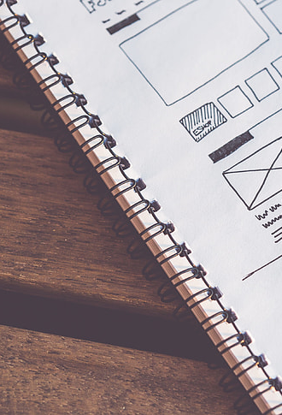
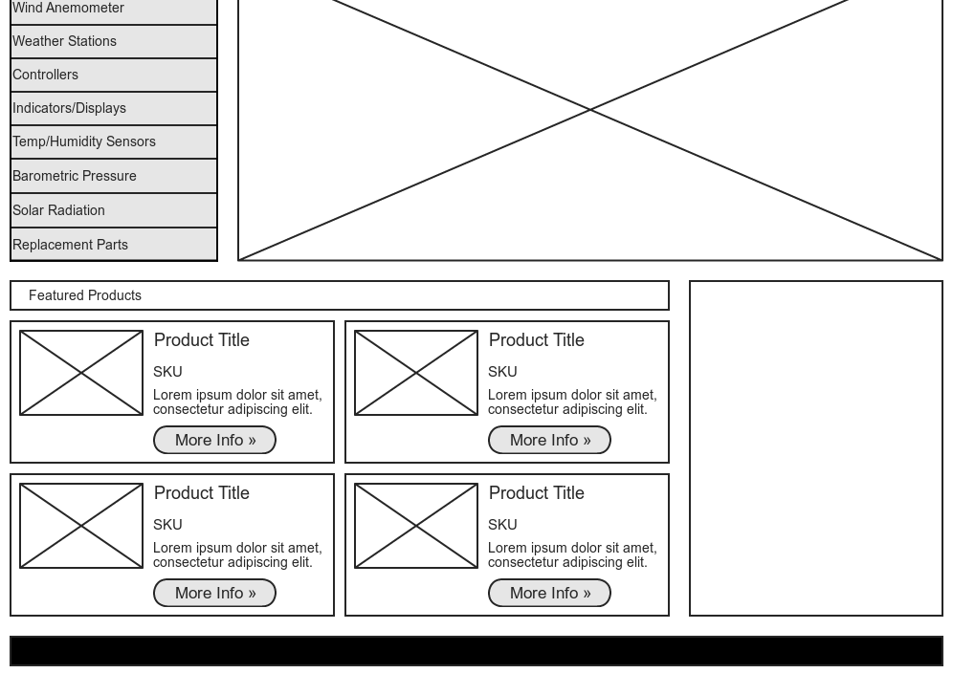
Sketch it, use Word, Paint, a Graphics package or UI Wireframe design tool.
Example tools next…
Wireframe designs
This Photo by Unknown Author is licensed under CC BY-SA-NC
This Photo by Unknown Author is licensed under CC BY-SA

Slide 65
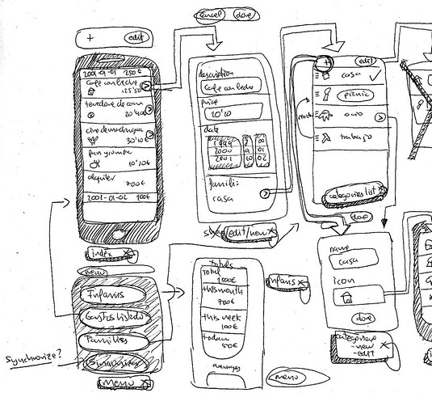
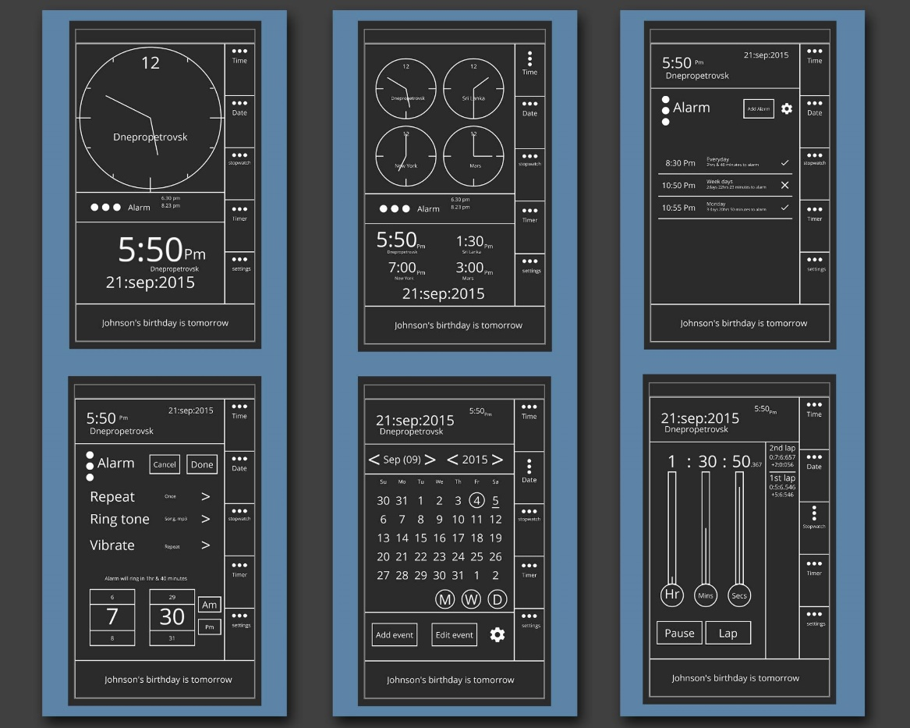
Bg. Mobile App. Wireframe designs
Sketch it, pen & paper, use Word, Paint, a Graphics package or UI Wireframe design tool.
This Photo by Unknown Author is licensed under CC BY-NC
This Photo by Unknown Author is licensed under CC BY

Slide 66

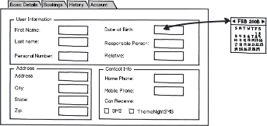
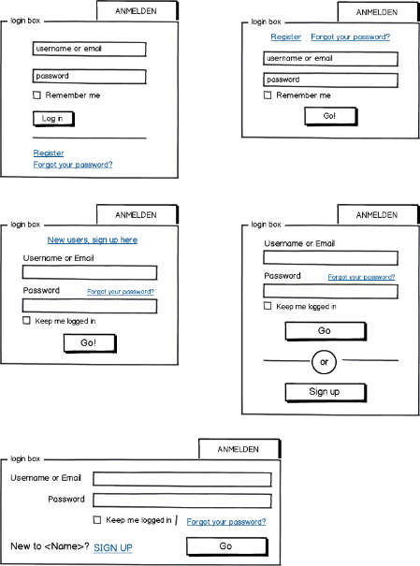
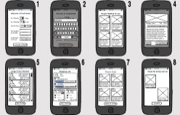
Example Design tool: Balsamiq Wireframes
Balsamiq Cloud: User Interface (UI) Design Wireframe tool.
If you are building an App. you may find Balsamiq useful at the Design stage.
Play: 1min overview: click-here.
+ You can put it on fish and chips ;-)
Bg. For further information:
  Website: balsamiq.com.
This Photo by Unknown Author is licensed under CC BY-SA
This Photo by Unknown Author is licensed under CC BY-SA
This Photo by Unknown Author is licensed under CC BY-SA-NC
This Photo by Unknown Author is licensed under CC BY-SA-NC

Slide 67
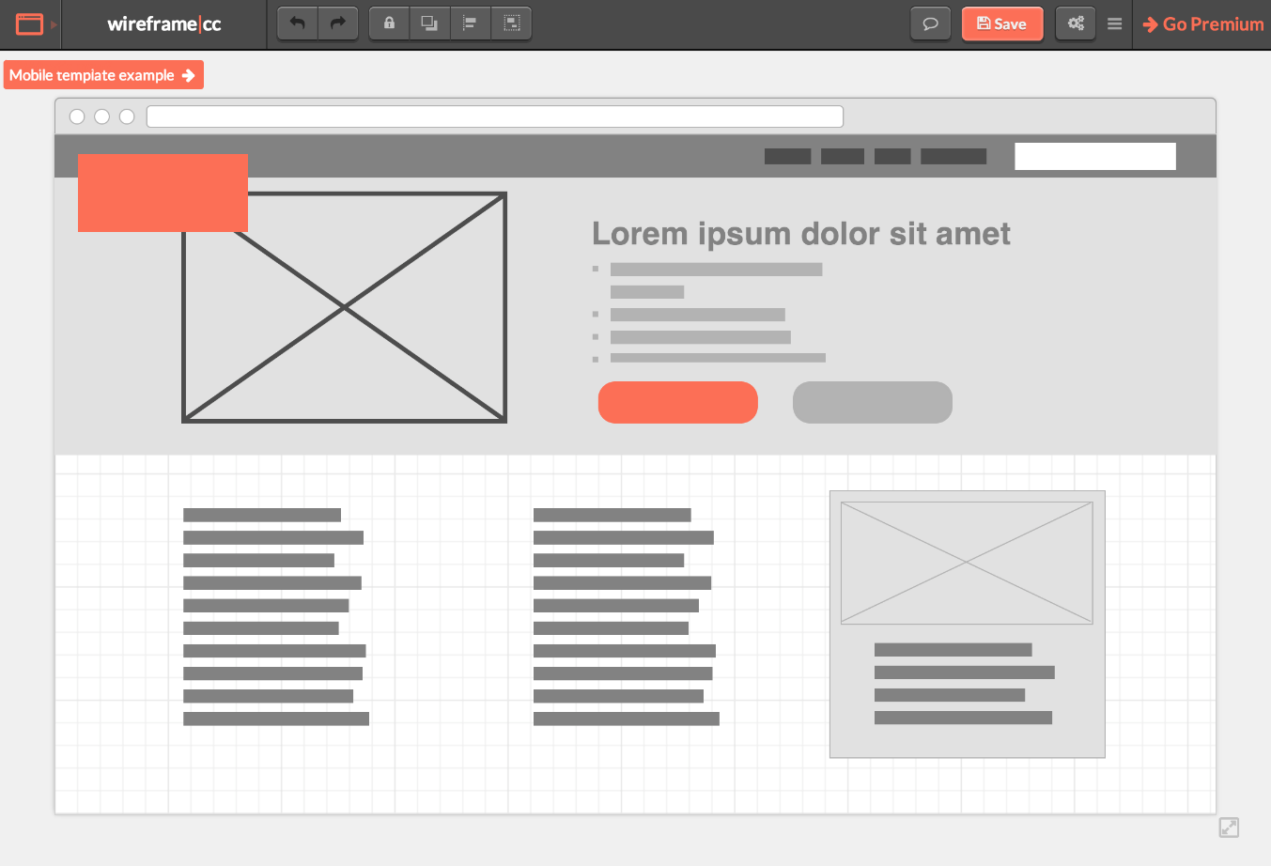
Example tool: Wireframe.cc
Wireframe.cc is a simple Online Wireframing Tool.
Designed for quick easy use.
Ideal for sketching a web, tablet or mobile layout.
Suitable for simple, clean wireframes without advanced prototyping complexity.
Free basic version available, exporting requires a paid plan.
URL: https://wireframe.cc/

Slide 68
Bg. Other Balsamiq alternatives:
Balsamiq no longer has a free level ☹ it is available as a 30 day trial.
However, there are some free alternatives ☺ such as:
  https://wireframe.cc/
  PenPot.app
  Framer.com
  Pencil Project
  UIzard.io
  Moqups - Online Mockup, Wireframe & UI Prototyping Tool
  Lucidchart - Intelligent Diagramming
Notes:
Bg. Note: Not free but a good commercial Design tool for Web/Mobile Apps:
Mockplus - Design, Prototype & Collaborate better and faster.

Slide 69
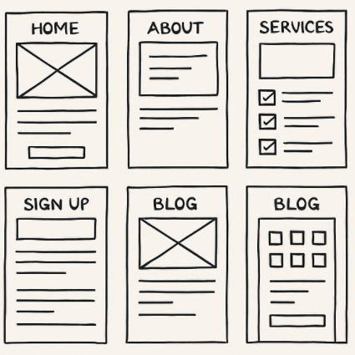
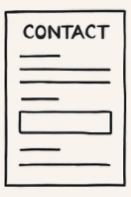
Storyboarding
A Storyboard is a visual plan showing how the pages of a
website/application will look. It uses simple sketches or
boxes to outline what will appear on each page and how
users will move between pages.
A storyboard is a blueprint that shows:
  The main pages of the site,
  What content goes where & Active buttons
It’s a method to clearly outline the layout and purpose of each page before any coding or detailed design begins. It’s similar to a film storyboard but for web design, it’s a sequence of panels that outline:
  Page structure, Navigation, Key content areas, User interactions, Layout ideas
It helps to organise the site logically before designing or building anything.
The storyboard can be updated based on feedback from students or the team.
A storyboard can be created on paper, using Office365 tools such as tables in word, of using specific online digital tools such as (free): Miro, Canva, Figma, Google Drawings

Slide 70
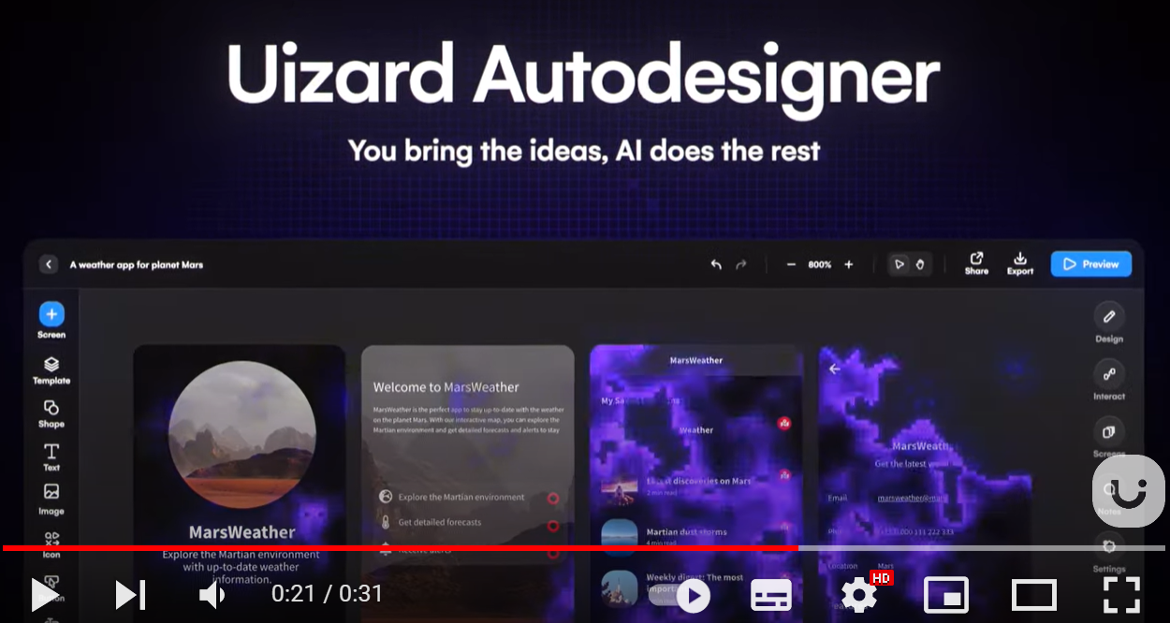

Prototype Design: Uizard.io
Uizard | App, Web, & UI Design Made Easy | Powered By AI
Uizard is a UI design tool for creating wireframes, mockups, and Web & Mobile App prototypes.
Uizard also allow you to convert hand-drawn sketches into wireframes. And Transforms wireframes into prototypes.
Uizard has many pre-made design templates you can modify.
Uizard allows online Team collaboration.
And has AI features e.g. draw or screenshot a design you like and it will create a customizable version for you to edit.
Uizard can also create a customizable prototype from a Generative AI text, a feature called Autodesigner.
With Autodesigner, simply type text & it will create a prototype design for you.
Uizard has a free, Pro and business pricing structure: www.Uizard.io

Slide 71

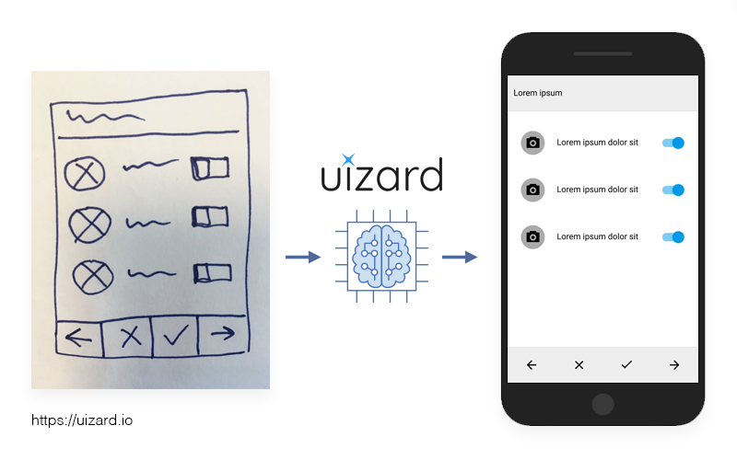
Demo: Uizard
Uizard (https://uizard.io) is a great tool for creating wireframes, mockups & prototypes.
It has a free level for students.
Play: Uizard Wireframe example (Mobile App)
  Bg. Web App example.
Play: Design an App Using a Screenshot
Bg. Pro level: Uizard AI Autodesigner: Generate an App Design from Text
  Bg. Uizard AI Autodesigner 1.5: App Design from a Text Prompt + Updates
  Bg. You can publish a working prototype with Uizard, meaning you can create an interactive mockup that simulates how a website or app would function, including clickable elements and transitions, but you cannot directly publish a fully functional website or app that can be deployed live on a server as Uizard does not generate code for full functionality; you would need to implement the design into a live application based on your Uizard prototype.
This Photo by Unknown Author is licensed under CC BY-SA-NC
This Photo by Unknown Author is licensed under CC BY-SA-NC

Slide 72
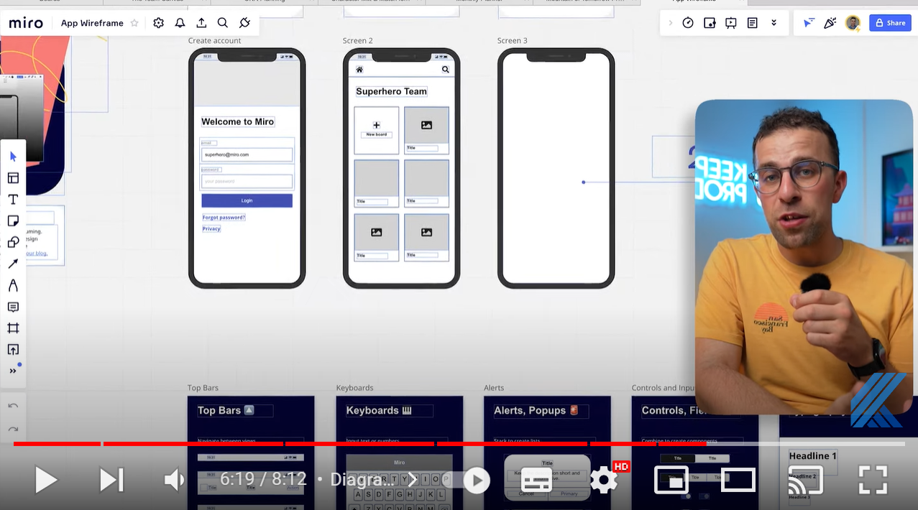

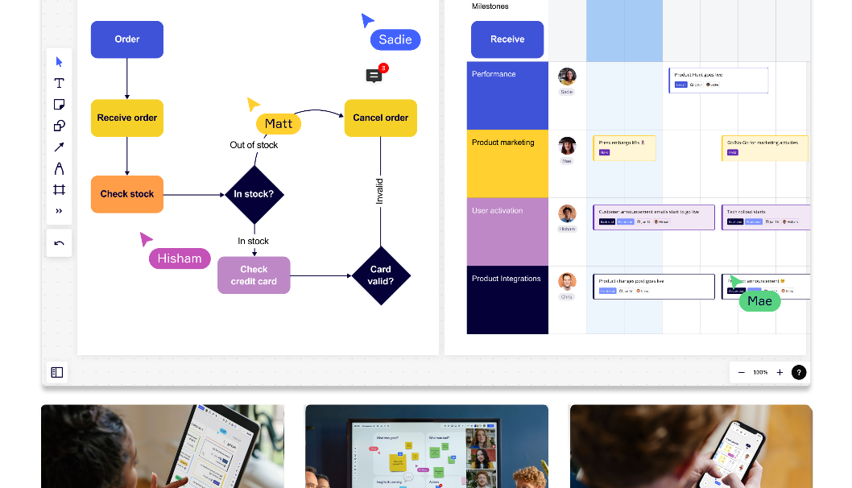
Demo: Miro.com
Play
Miro is an online individual / collaborative platform that allows you to create flowcharts, Gantt charts and wire-frame diagrams.
Play: Video Overview: Up to 6:21mins

Slide 73
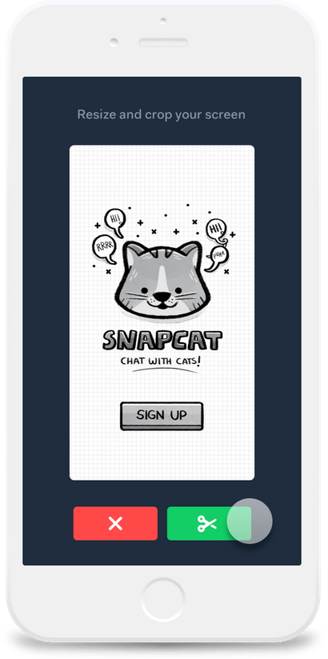
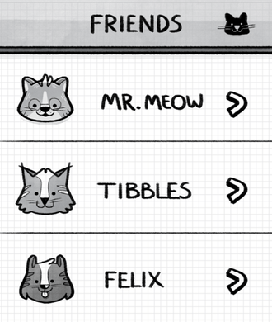
Bg. Prototype Design: POP App
For initial Mobile App. Prototype design, you could use the POP ‘Prototyping on Paper’ App.
POP allows you to turn any drawing/sketch or image into an interactive prototype.
Key links:
  POP App: for ‘Prototyping on Paper’.
    Bg. 15sec Video Overview.

Slide 74
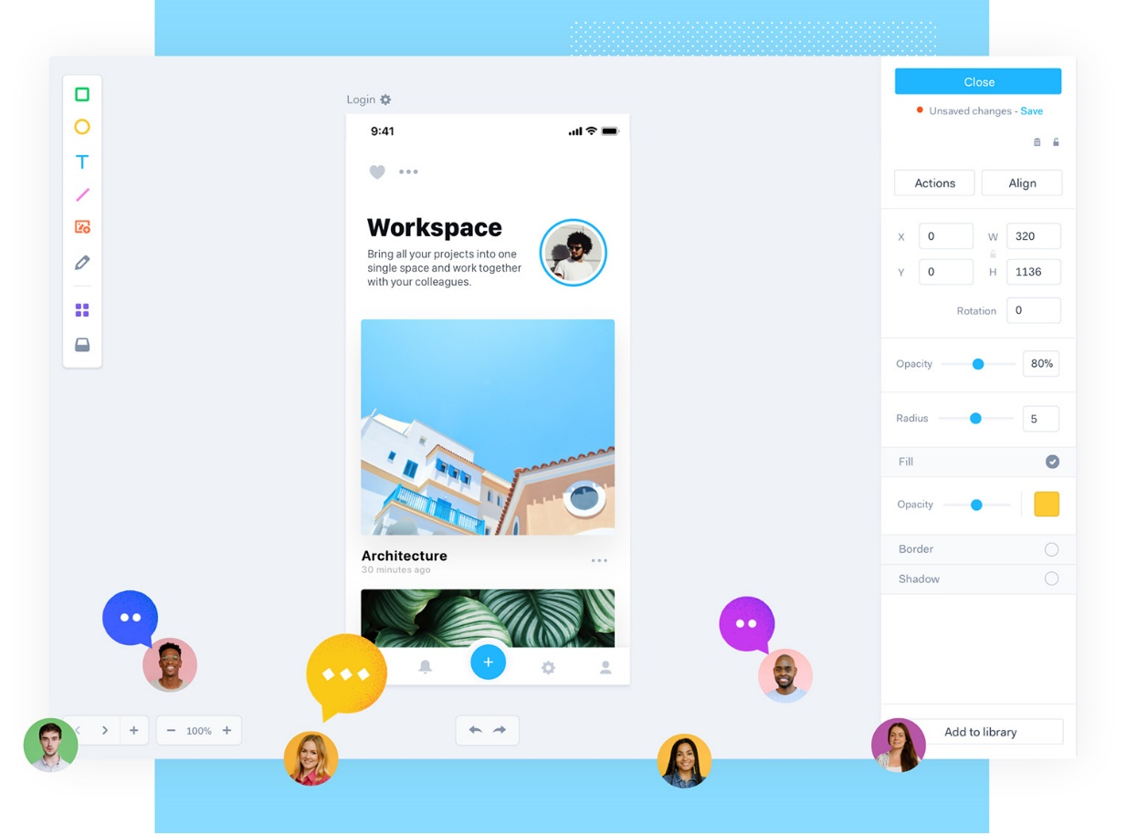
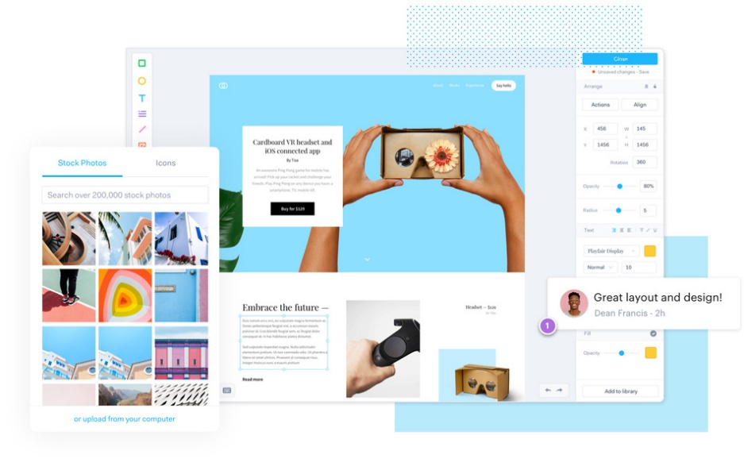
Bg. Prototype Design: Marvel App
For initial Rapid App. Prototyping design, you could try the Marvel App., to create Web & Mobile App prototypes.
It allows you to individually or collaboratively create interactive prototype Mockups.
https://marvelapp.com/
  Bg. 6min Video Overview: click here.

Slide 75
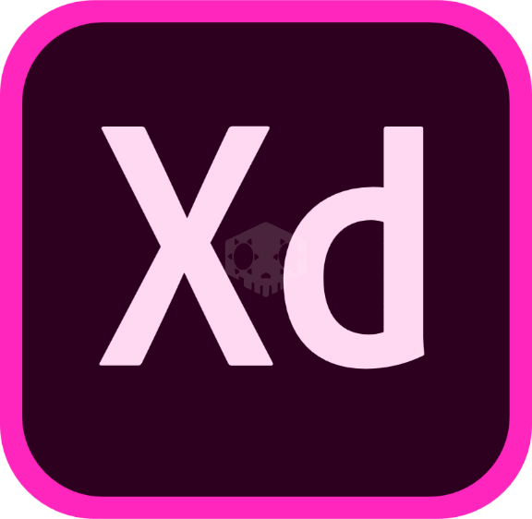
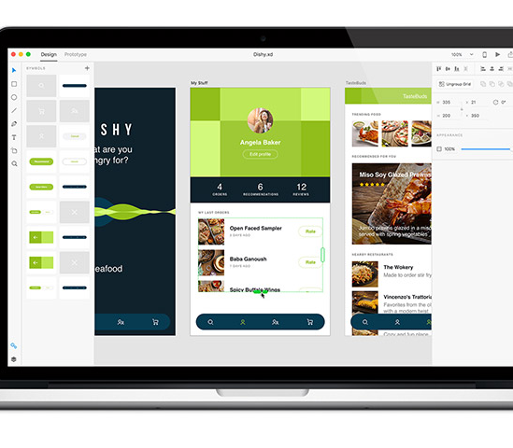
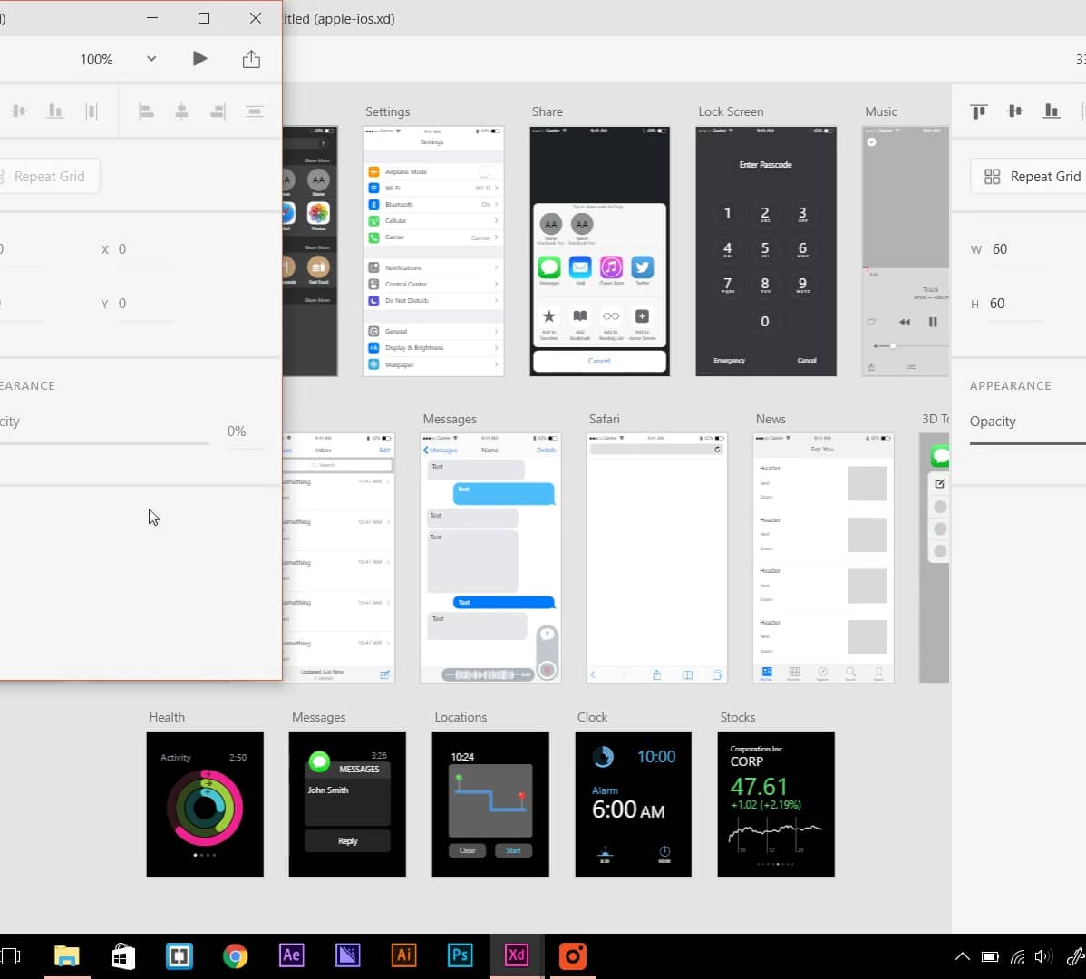
Adobe Xd
Adobe XD (Adobe eXperience Design) is a vector-based UX User eXperience design tool for Web and Mobile apps.
Adobe XD allows you to create wireframes and click-through prototypes / mock-ups.
As a UWTSD Computing student, you are able to use the Adobe Creative Cloud suite including Adobe XD for free (Click here)
  Bg. For more information click below for the:
  Adobe XD Homepage & Overview.
  Adobe XD features.
  And here for Video overview and tutorials.
This Photo by Unknown Author is licensed under CC BY-NC-ND
This Photo by Unknown Author is licensed under CC BY-SA-NC
This Photo by Unknown Author is licensed under CC BY-NC-ND

Slide 76

Demo:
To build a Prototype or initial fully functioning App, using words & AI instead of code, you could try vibe coding with https://base44.com/
Base44.com is an ‘AI‑powered no‑code app builder’ that lets anyone create fully functional web or mobile apps by describing what they want in natural language.
Base44 automatically generates the UI, backend, database, authentication, hosting, and integrations.
Free-tier available. Include basic visual editing. Code editing only available in paid plan. Web App creation is free but Mobile App requires subscription.
Bg. Wix acquired Base44, an AI-powered ‘vibe coding’ startup, in June 2025 for $80 million. Vibe coding is an AI-driven software development approach where developers use natural language prompts to guide LLMs (like GPT) to generate, refine, and debug code, often without writing it line-by-line. Coined by Andrej Karpathy in early 2025, it prioritizes rapid iteration, prototyping, and high-level, creative flow over manual, detailed coding.

Slide 77
Activity: Vibe Coding with Base44.com
Goto https://base44.com/
Clearly write down and refine what exactly you want it to build.
Note: Free-tier = 5 free AI prompts/credits pd & 25 pm.
Register and log-into build a fully functioning prototype/app using natural language.
Publish as a ‘Web App’ for free
Note: Not suitable for the L5 project as you are not able to edit the code. But if relevant for your project, suitable for initial prototype design/idea test and initial experimentation (pre-implementation).

Slide 78


Flow charts
A flowchart is a diagram that shows the intended/existing sequence of functions of a program.
Example tools for creating Flowchart & UML diagrams:
  Lucidchart - Online flowchart maker
  Others:
  Diagrams.net (previously Draw.io)
  Smartdraw Flowchart Maker (Free)
  ClickCharts Flowchart Software
  Drawing tools in Office Apps. such as Word can also be used.
    Bg. For further information:
    What is a Flowchart | Lucidchart. What is a Flowchart and its Types?
This Photo by Unknown Author is licensed under CC BY
This Photo by Unknown Author is licensed under CC BY-SA

Slide 79


Tool: Lucidchart
Lucidchart is an online diagramming tool that enables individuals and teams to create and share diagrams in real time.
Types of Diagrams we can create include:
  Flowcharts: for illustrating functions of a program.
  Wireframes: simple UI mockups and layout concepts.
  Network Diagrams: mapping IT infrastructure and systems.
  UML & Software Diagrams: including sequence, class, and activity diagrams.
  ER Diagrams: for database design.
  Agile Templates: Kanban & Scrum boards
URL: https://www.lucidchart.com/ - https://lucid.app/
Video tutorials: Getting Started in Lucidchart in Under 5 Minutes
Bg.
Process Maps: for illustrating workflows and business processes.
Organisation Charts: visualizing team structures.
Mind Maps: brainstorming and idea organization.
Venn Diagrams & Charts for comparisons or simple data visuals.

Slide 80

Bg. Lucidchart: Kanban board
Lucidchart offers a wide range of templates to use including templates for Agile projects including Kanban and Scrum boards. Although I prefer using Trello and find it much easier to use.

Slide 81

UML diagrams
UML or Unified Modeling Language are diagrams used in object-oriented software design to outline and represent the objects/features, structure and behaviour of an Application.
The next slide shows an example for an Order processing system.
This Photo by Unknown Author is licensed under CC BY-SA

Slide 82
Bg. Example
UML Class diagram
Shows the Class/objects of a system. Each Class has a:
* Name
* Attributes/variables and
* Methods/functions.
For a Clear and comprehensive UML tutorial: UML Tutorial – Javatpoint.

Slide 83

Bg. Example
UML Use Case diagram
Shows the interaction between the Actors/Users and the system.
For other examples please click here.

Slide 84
Bg. UML tool: UMLet & support sources
UMLet - Free Open Source UML Tool for fast UML diagrams.
UMLet is a free, open-source UML tool with a simple user interface: draw UML diagrams fast, create sequence and activity diagrams from plain text.
Video overview: Tutorial for Open-Source Tool UMLet: Basic Use
  Bg. Other tools and information on UML diagrams:
    Overview: What is a UML Diagram?
    Tool: Smartdraw.com: UML Diagrams
    Tool: Miro - What are UML diagrams and how to use them
    Video: UML 10min Tutorial.
    Tool & tutorial: LucidChart.com UML Class Diagram Tutorial.
    UML Diagram types, click here: UML Diagram Types Guide.
      UML Diagram Types and learn about UML Diagram Types with examples here.

Slide 85

Data Model / Database structure e.g. Entity Relationship (ER) Diagram
This Photo by Unknown Author is licensed under CC BY-SA

Slide 86


Network & CyberSec. Mapping Monitoring & Analysis
You can create network maps, charts or diagrams during the design phase (+ during the implementation and testing phases too).
Or Cyber Security graphs/charts and maps using network and security mapping and monitoring software.
See following Bg. slides for example tools such as WireShark, Nmap, ZAP and W3af.
This Photo by Unknown Author is licensed under CC BY-SA

Slide 87
Network & CyberSecurity Mapping, Monitoring & Analysis tools
Many tools are available to help you design a solution, such as Network Topology creators, Network Performance Monitors, Pen/Penetration Testing tools, Network & Server Security tools.
For Network Topology & Mapping software:
  Top Network Mapping Tools.
  Best Network Mapping & Topology Software (2022)
  Visual Paradigm Online - Network Diagram software.
For Network Security & Analysis software:
  Network Security Analysis & Monitoring Software.
  14 Best Network Security Tools For Safer Environments.
  13 Best Network Security Auditing Tools.
This Photo by Unknown Author is licensed under CC BY-SA

Slide 88


Bg. Example tool:
Wireshark is a free open-source network packet analysis tool.
It allows users to capture, examine, and analyze network traffic by viewing the detailed content of individual packets, making it a valuable tool for network troubleshooting, security analysis, and protocol development.
Wireshark gives a detailed view of what data is being sent and received on a network, which is useful for troubleshooting network issues, analyzing network protocols, and identifying potential security threats.
Wireshark · Go Deep

Slide 89

Bg. Example tool: NMAP
Nmap, which stands for ‘Network Mapper’, is a widely used, open-source tool that functions as a network vulnerability scanner.
Mainly used to discover devices on a network, Nmap scans networks by sending packets to different ports on devices and analyzing the responses to determine if ports are open, closed, or filtered, allowing users to identify potential vulnerabilities based on open ports and running services.
It is considered a valuable tool for both security professionals and penetration testers.
Nmap: the Network Mapper - Free Security Scanner

Slide 90
Bg. Example: Application Security Testing tools
Many tools can be used for application security testing, including scanners, static code analyzers, and software composition analysis tools, such as:
Zed Attack Proxy (ZAP): Free, open-source scanner with anti-CSRF tokens
Bg. Anti-CSRF tokens, also known as XSRF tokens, are unique codes that prevent unauthorized access to websites and web applications. The server generates the token and includes it in forms or requests. When a request is made, the server verifies the token to prevent unauthorized actions.
W3af: is an open-source web application security scanner.
Bg. Addresses OWASP's Top 10 vulnerabilities. OWASP, or the Open Web Application Security Project, is a non-profit organization that aims to improve software security. OWASP provides tools, guidelines, and methodologies to help organizations develop secure applications.
Netsparker: An open-source security testing tool that supports Windows.
OpenVAS: An open-source security testing tool that supports Windows, Linux, and MacOS
Nessus: An open-source security testing tool, also supports Windows, Linux, and MacOS

Slide 91

Product Design Specs (PDS)
Product design specifications
are suitable for hardware / electronic prototypes, and usually include a diagram/image that documents the prototype’s proposed characteristics, component list and dimensions.

Slide 92


Example: Product Design & Specification
Illustration:
Specification:
Notes:
Ref: http://multigate.homestead.com/Product-Specifications.html

Slide 93



Hardware Prototype design
For initial Hardware Prototype design, you could use CAD (E.G. AutoCAD by Autodesk, SmartDraw or other free alternative), Adobe Illustrator or Photoshop.
For electronics you could use ‘Proteus Design Suite’ to create automate and test electronic circuit board schematics.
This Photo by Unknown Author is licensed under CC BY-SA
This Photo by Unknown Author is licensed under CC BY-SA-NC
This Photo by Unknown Author is licensed under CC BY-SA-NC

Slide 94







Games Des. Dev. &/or Animation
This Photo by Unknown Author is licensed under CC BY
If your project is Game or Animation based, you can include initial design work such as character design, sketches, illustrations, models, storyboards.
This Photo by Unknown Author is licensed under CC BY-SA-NC
This Photo by Unknown Author is licensed under CC BY-NC-ND
This Photo by Unknown Author is licensed under CC BY-SA
This Photo by Unknown Author is licensed under CC BY-SA-NC
This Photo by Unknown Author is licensed under CC BY

Slide 95

Keep it Simple: Design & System Modelling
Keep the Design docs simple.
For this module you do not need to go into detail with your Design planning & documentation.
Keep it Clean & Simple.
The Design documents produced by different students will vary significantly and depend on your project area. You will all have different design documentation. And that’s ok.
Notes:
Complicated charts and diagrams are not required but can be created and included if you feel it necessary.

Slide 96
Activity: Project Design
Document:
Reflect consider and document/describe the project ‘Design work’ you will do for your project. For example:
  Depending on the nature of your project, example design work could include:
    Diagrams/sketches/drawings, storyboard, wireframes, flow chart/UML diagram, ERD data structure, network structure diagram, network security architecture/diagram.
Start to use a design tool/method of your choice to start creating some design work for your project. You could use an AI tool to help you get started.
* Any Qs during the activity please let me know.
Notes:
The task answer should be approx. 4/500 words with 1/2 supporting citations.

Slide 97
Home Activity: Initial Practical work
To answer Q.3 of Task 3:
Start some initial practical work for your project
Use several screenshots with brief description to document some practical implementation work for your project.

Slide 98


Any Questions
Any Qs?
Thumbs up if ok👍
Register reminder

Slide 99

The End.

Slide 100
Archive slide.

Slide 101


Notice: Use ‘Desktop OneNote’ to Export for Turnitin
The Desktop version of OneNote allows you to export a notebook as a pdf for submission to Turnitin.
The online version only allows you to 'share’ or export 1 page at a time. > Use the Desktop version.
Desktop OneNote is available to download for free.
See Assignment 1 for further instructions.
This Photo by Unknown Author is licensed under CC BY-SA-NC

Slide 102
Bg. Software prototyping
Software prototyping is the activity of creating software prototypes i.e. incomplete versions of the software program being developed.
Prototyping has several benefits:
  The software designer and implementer can get valuable feedback from the users early in the project.
  The purpose of a prototype is to allow users of the software to evaluate the product by actually trying it out, rather than having to interpret and evaluate the design based on descriptions.

Slide 103
Bg. Definition: Rapid Application Development
RAD is an agile adaptive software development model, that is based on prototyping and quick feedback with less emphasis on planning. With rapid application development, developers can change the design, add functionality, and keep reiterating without having to start from scratch each time. (r)
Rapid Application Development is an agile framework focused primarily on rapid prototyping of a software product, frequently iterating based on feedback, and continuously releasing updated versions of the software product to the market. (r)

Slide 104
Computing Innovation Project:
Design work
Example Design work: Requirements specification, MVP (Minimum viable product), Sketches/drawings/illustrations, storyboards, UI, wireframe diagrams, colour scheme, flow chart, data structures, network maps, circuit diagrams etc..
The main focus of the project is ‘innovation’ and on allowing you to develop your skills using new technologies through practical implementation. Time to progress onto the Design and Practical stages of the project.
The Design documents produced by different students will vary significantly and depend on your project area. You will all have different design documentation. And that’s ok.

Slide 105
Bg. MVP - Minimum Viable Product
MVP Minimum Viable Product is a prototype/product with just enough features to satisfy early customers, and to provide feedback for future/iterative development.
What is your MVP? i.e. the most important features for your project implementation.
Consider your MVP to help you identify your top-level/high priority requirements.
MVP is a Lean Start-Up method. Termed by early Tech Entrepreneurs based in Silicon Valley California and adopted by the most successful Tech companies such as Google e.g. Gmail launch and all other Google Apps.
It is now used by Tech Start-Ups across the world.

Slide 106
Bg. Further reading: Requirement Specifications
For further information and examples, please click below:
What is a Functional Requirement in Software Engineering? Specification, Types, Examples (guru99.com)
Functional Requirements (Functional Requirement Specifications, Functional Specs, FRS, FS) (ofnisystems.com)
A Guide to Functional Requirements (with Examples) (nuclino.com)

Slide 107
NIST CF for managing Cybersecurity projects
NIST (National Institute of Standards and Technology) CSF Cybersecurity Framework.
The NIST Cybersecurity Framework (CSF) acts as a structured guide for organizations to identify critical assets, implement protective measures, monitor for potential cyber threats, plan responses to incidents, and recover from cyberattacks by outlining five key functions: "Identify," "Protect," "Detect," "Respond," and "Recover," each with specific categories and subcategories to address different aspects of cybersecurity across the entire lifecycle of a potential threat.
Breakdown of the functions:
Identify: This initial step involves creating an inventory of critical assets, understanding the organization's cybersecurity risks, and developing a cybersecurity policy to address them.
Protect: Focuses on implementing safeguards to mitigate identified risks, such as access controls, data encryption, vulnerability management, and employee security awareness training.
Detect: Defines procedures to continuously monitor systems and networks for potential cyber threats, anomalies, and suspicious activities to enable timely detection of incidents.
Respond: Outlines actions to be taken when a cyber incident is detected, including containment, eradication, and recovery strategies to minimize damage.
Recover: Addresses restoring normal operations after a cyber incident, including data restoration, system recovery, and business continuity plans.
Key points about NIST CSF:
Flexibility: The framework is adaptable to different organizations based on their size, industry, and risk profile.
Risk-based approach: It prioritizes cybersecurity efforts based on the potential impact of identified risks.
Voluntary framework: Organizations can choose to adopt the CSF and tailor it to their specific needs.

