Slide 1
Accompanied Patrol Phase
Professional Development Unit
Chief Inspector Lysha Thompson

Slide 2
Aims & Objectives
Aim: This session is for you to gain an awareness of the APP
Learning Outcomes:
Describe the next phase of the PEQF Student Officer journey namely The Accompanied Patrol Phase
Describe the Role of a Professional Development Officer
Describe the Role of the Assessment Team and PDU Sgt.
Recognise the mandatory criteria for the APP phase.
Recognise the PDU estate and staff
Recognise the importance of this phase in line with the Unsatisfactory Performance Procedures for Students Officers
Notes:
We will revisit these at the end of the session

Slide 3
Acronyms
PDU | Professional Development Unit
PDO | Professional Development Officer
OCP | Occupational Competency Portfolio
SLA | Service Level Agreement
SOP | Standard Operating Procedure
LPA | Local Policing Area
SMT | Senior Management Team
ILP | Initial Learning Phase
PCDA | Police Constable Degree Apprenticeship
DHEP | Degree Holder Entry Programme
CoP | College of Policing
WBL | Work Based Learning
PLT | Protected Learning Time
Notes:
Give out the Handouts with acronyms for reference

Slide 4
What do we know already?
Flip Chart 1
Write one thing you know about you the APP in the PDU
Flip Chart 2
Write one thing that you would like to know about the APP and the PDU
Flip Chart 3
Write one thing that concerns you about the APP and the PDU
We will visit these throughout the session
Notes:
Have 3 flip Charts already on the wall and individual post it notes on the student chairs – they will need to use their own pens
BE COVID AWARE.

Slide 5
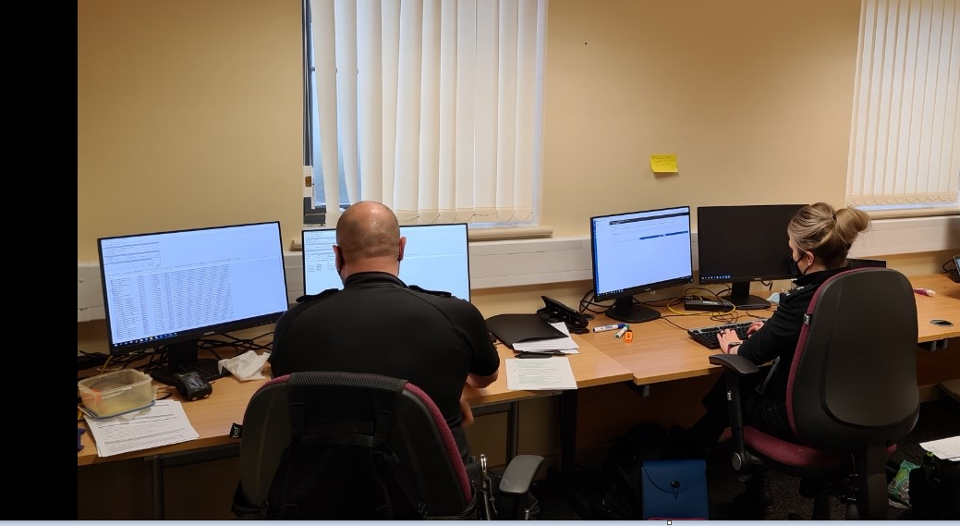
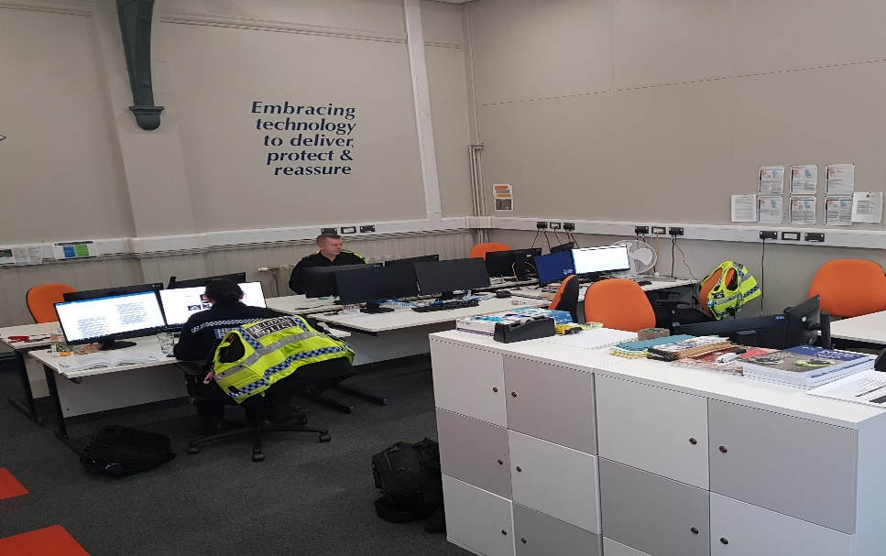
What’s Next?
Leave your ILP at Vantage Point
Period of Annual Leave
PDU 28th December 20
East Postings Maindee PDU
West Postings Ystrad PDU
12 weeks
1:2
Assessment Criteria
Notes:
East – Newport and Monmouthshire
West – Caerphilly, BG and Torfaen.
Explain current changes to the PDU Model due to Gold Instruction no more than 3 in a car..

Slide 6
APP Criteria
10 Areas to achieve during the APP
Operating in accordance with the law, authorised professional practice and The Code of ethics
Following appropriate processes for the management of information and intelligence
Providing an initial response to police incidents
Managing conflict in a professional policing context
Providing support to vulnerable people, victims and witnesses
Using Police powers to deal with suspects
Conducting police searches
Conducting police searches of individuals
Conducting priority and volume investigations
Interviewing victims, witnesses and suspects
Notes:
Refer to the assessment document, explain each one has criteria for it
Record one incident where you have achieved the standard of a report sheet…. This is the incident where the PDO deems you as competent to be signed off in this area.

Slide 7
The Patrol Log
5 - Providing support to vulnerable people, victims and witnesses | 6 - Using police powers to deal with suspects | 7 - Conducting police searches | 8 - Conducting police searches of individuals | 9 - Conducting priority and volume investigations | 10 - Interviewing victims, witnesses and suspects | Assessor Comments | Learner Reflection | Development Plan
Notes:
Each student has an allocated Patrol Log which is stored in the PDU U Drive – your PDO has access to it.
You will complete this Patrol Log together.
Your PDO will evidence where you have gained competency in this area and tick it off when you have reached the required standard.
You need to achieve a competent level in these areas ONCE during your 12 weeks APP to be signed off in that area.
Both you and your PDO need to provide a reflective account on the incident – quite in depth will require some thinking.
Read an example from a completed Patrol Log.

Slide 8
Assessment
Criteria
Work Book One
Work Based Learning Days (WBL)
Week 5 and Week 10 Review
Week 12 Sign Off
Notes:
10 areas of assessment to be completed.
PCDA – Two workbooks to complete during Year One
DHEP – One workbook to complete during Year One.
5 Work Based Learning Days during your 12 weeks in the PDU. You will not come to the PDU for these. This is your protected time to work through your workbooks or any other consolidated learning.

Slide 9
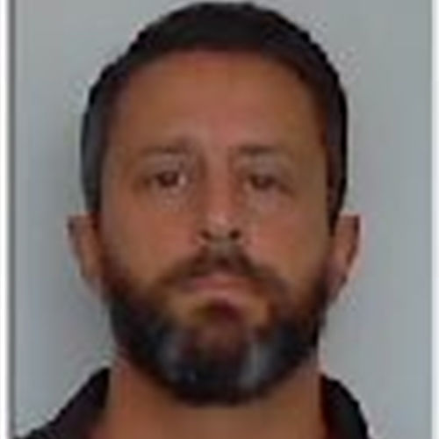
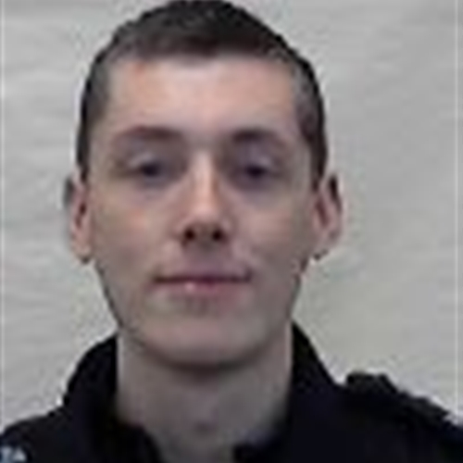
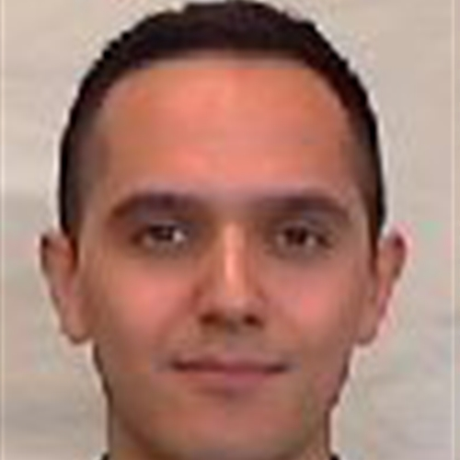
Who’s who?
Inspector Nic Mancino
PS 400 Jamie Jones PS 1618 Dan Palmer
Notes:
Inspector Nic Mancino – oversees both PDU
Jamie – West PDU
Dan – East PDU as of 13th December.

Slide 10

What do we know?
What do I Know ?
What do I want to Know ?
What Concerns me?
Notes:
Revisit the Flip Charts and take them off one by one as covered
2 teams of 7…
Knowledge check – call out the questions first one to raise the hand – score as in a game of tennis…

Slide 11
Aims & Objectives
Aim: This session is for you to gain an awareness of the APP
Learning Outcomes:
Describe the next phase of the PEQF Student Officer journey namely The Accompanied Patrol Phase
Describe the Role of a Professional Development Officer
Describe the Role of the Assessment Team and PDU Sgt.
Recognise the mandatory criteria for the APP phase.
Recognise the PDU estate and staff
Recognise the importance of this phase in line with the Unsatisfactory Performance Procedures for Students Officers
Notes:
Run through Objectives and refer back to Quiz / Group discussions to show

Slide 12

Any Questions?
Notes:
Any questions from the group..

