Slide 1

University Of Wales
Trinity Saint David
MSc Property and Facilities Management
Building Services & Energy Performance
Lecturer: Alun Watkins Created By: Allyn Pritchard
Submission Deadline: 31st May 2022 Student No.: 1101011

Slide 2
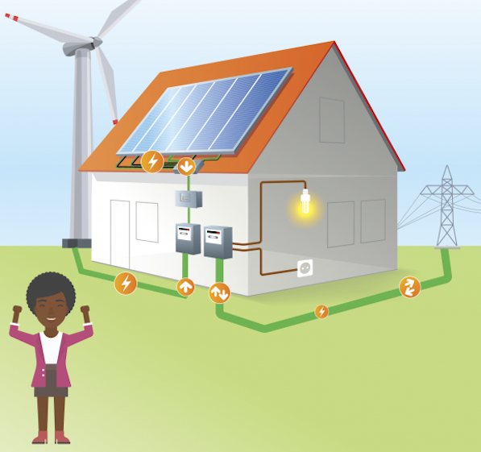
Presentation Aim
To look at my chosen case study which will be ateb groups head office, Meyler House in Haverfordwest.
Understand the buildings' current function post covid.
Look at available asset management data.
Look at what building performance evaluation techniques will be applicable.
Define a retrofit plan to prepare building for ‘net zero’ carbon emissions.
Figure 1

Slide 3
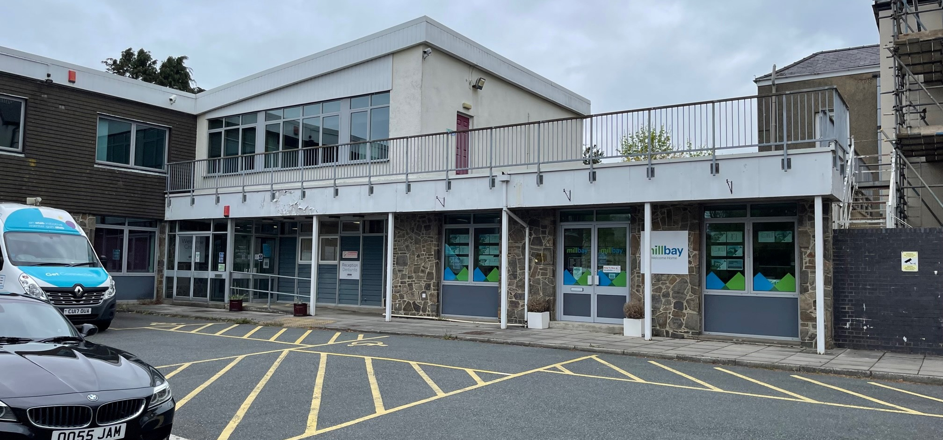
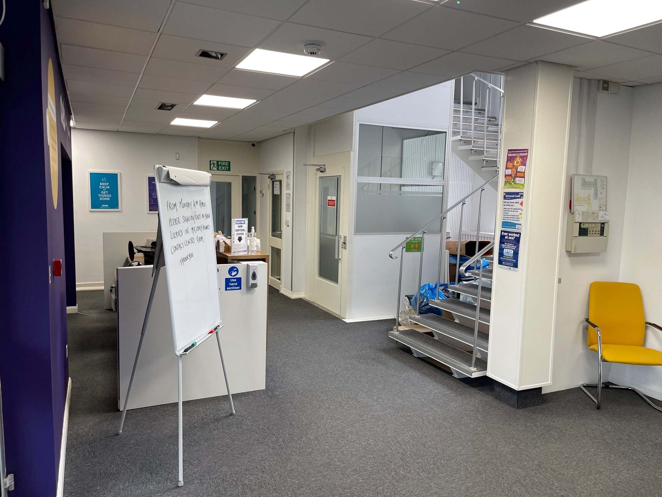
ateb Group, Meyler House, Haverfordwest
Registered social landlord.
Owns and manages over 3,100 properties throughout West Wales.
The office is a commercial premises in the heart of Haverfordwest.
Office currently operating a hot desk setup with staff booking a desk as needed.
The organization utilizes the asset management software ‘Lifespan’ for all asset data.
Figure 2
Figure 3

Slide 4
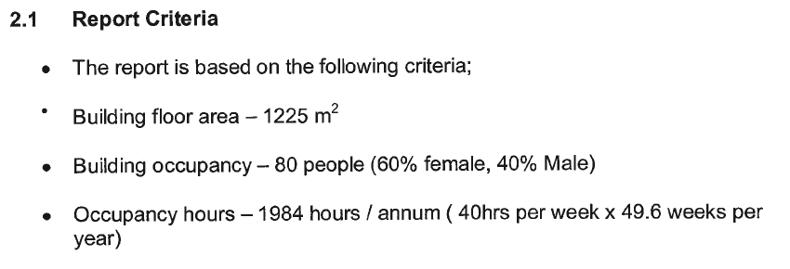
ateb Group, Meyler House, Haverfordwest
How Big is Meyler House ?
Occupancy ?
How Long is it Used ?
(Ateb Water & Energy Audit. 2007)

Slide 5
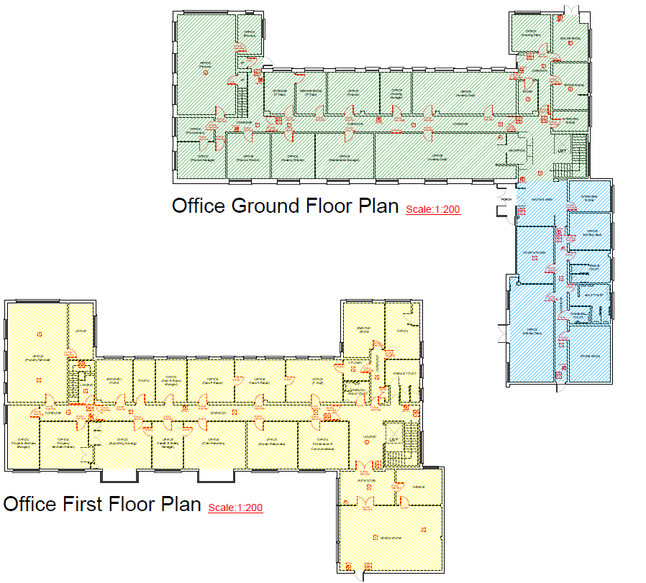
Building Components
Three Phase Electrical Supply – 3 phase Hager distribution board.
Commercial Gas Supply/Meter – 2 X Hamworthy NGR 320 Boilers.
Fiberglass roof
External Fabric is traditional render (painted).
External Doors are Aluminum, and all windows are double glazing.
(ateb Fire Plan to Meyler House.2006)

Slide 6
What is Net Zero
Climate Change Act 2008, Amended 2019 (2050 Target Amendment)
            (legislation.gov.uk, 2019)
Ban on combustion engine cars by 2030
            (UK Government , 2020)
WHQS 2023 – Energy Storage and Generation
(The Welsh Housing Quality Standard 2023 Draft for consultation)
WHQS 2032 – Renewable heating systems only after 2026 (Ban on new build properties having gas boiler)
(The Welsh Housing Quality Standard 2023 Draft for consultation)
Institute of Engineering BS7671 Amendment 2 (2022) (introduction of the term ‘Prosumer’)
(The Institute of Engineering & Technology, 2022)

Slide 7
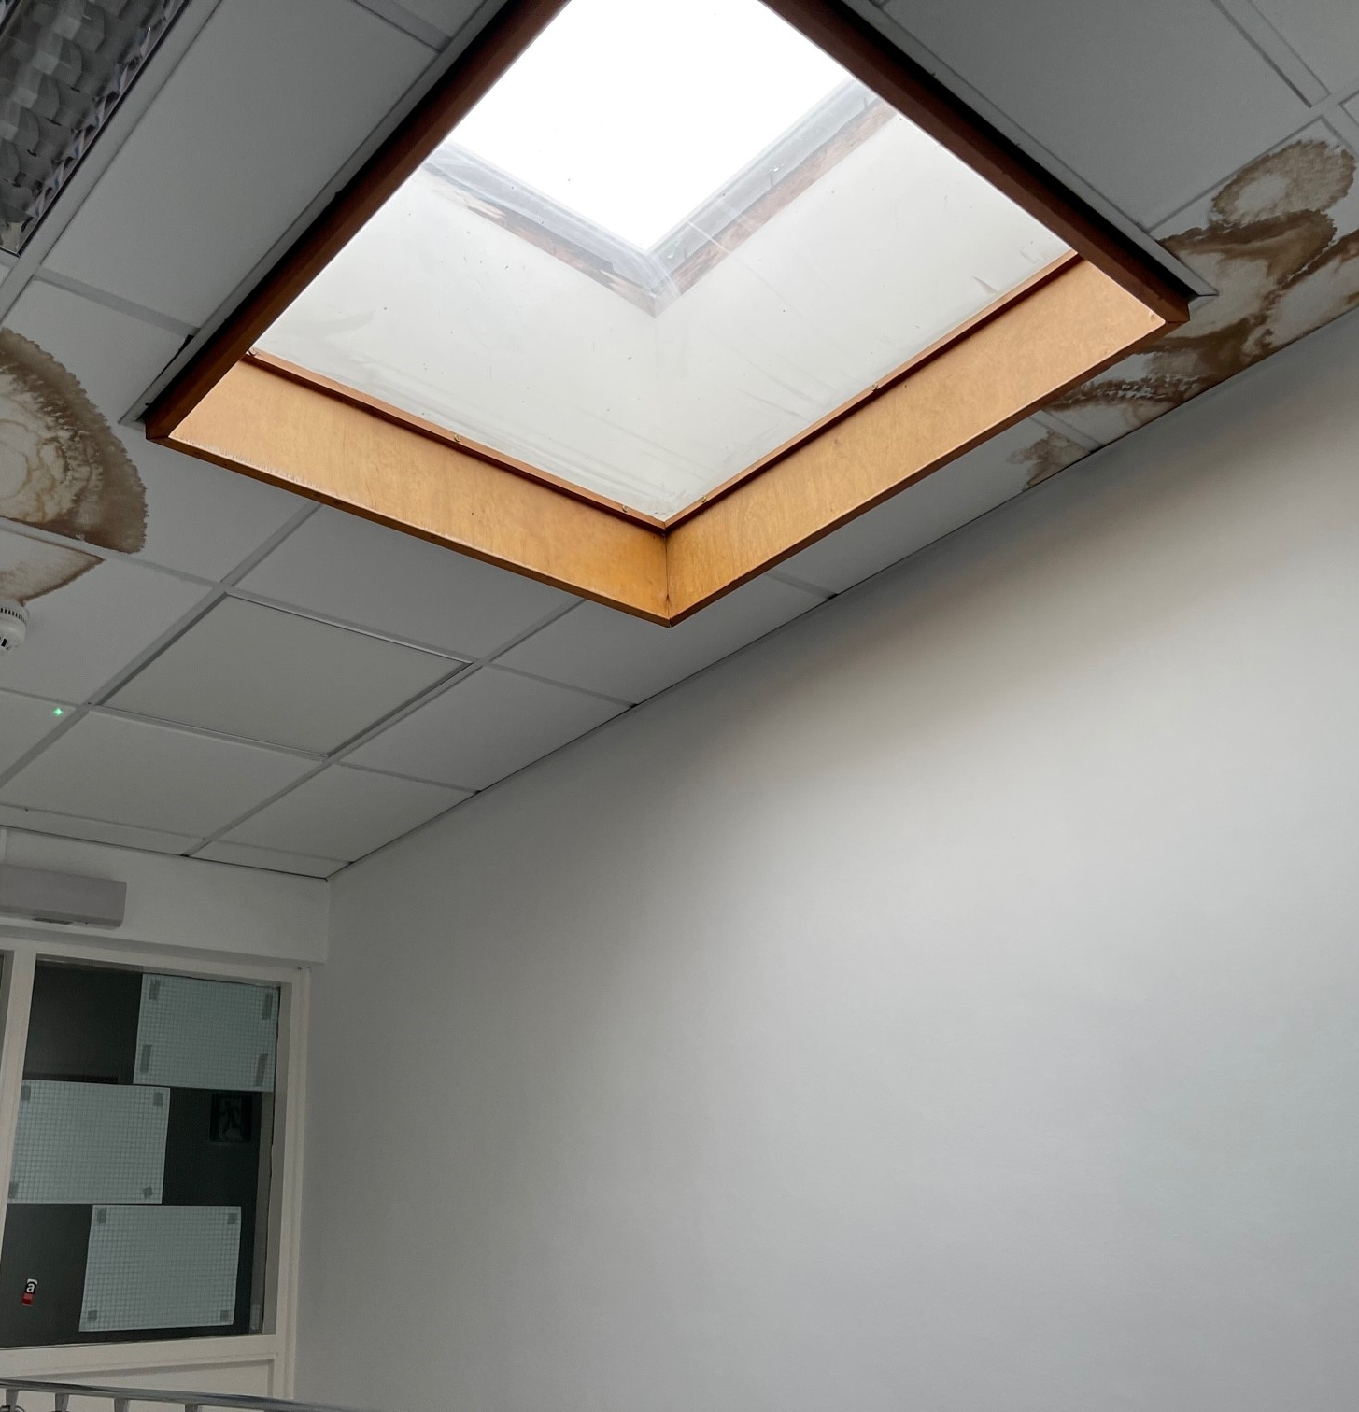
Approach
Look at Mechanical and Electrical components of the building based on data held in Asset Management System Lifespan
Undertake site visits to idenify fabric, roofing and envelope options for retrofit pathway
Base decisions on data available and model available data and potential solutions in RDSAP within Lifespan
Use Core and Detailed ‘Building Performance Evaluation’ techniques to help idenify methods of understanding building performance
Figure 4

Slide 8
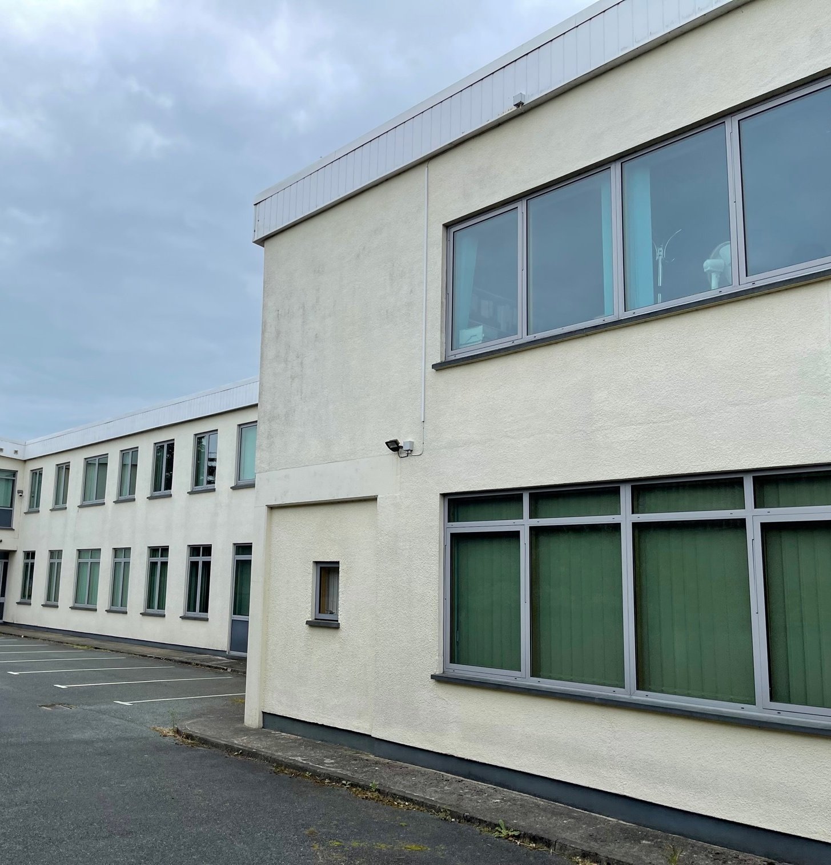
Current Available Data
Figure 5
Gas, Electrical & Water regarding going back to 2002, (readings do not include the period in which the UK was in lockdown)
Current Gas, Electric & Water Bills (Total Energies, EDF, Welsh Water)
Energy & Water Audit (Dated 2007)
Fire Plan, 2D Birdseye view of the office layout (as shown in slide 4)
Asset Data from our inhouse system “Lifespan”, on all components within the building, (Boilers, Electrical, Fire Alarm, Roof, External Fabric, Windows, Asbestos, etc)

Slide 9
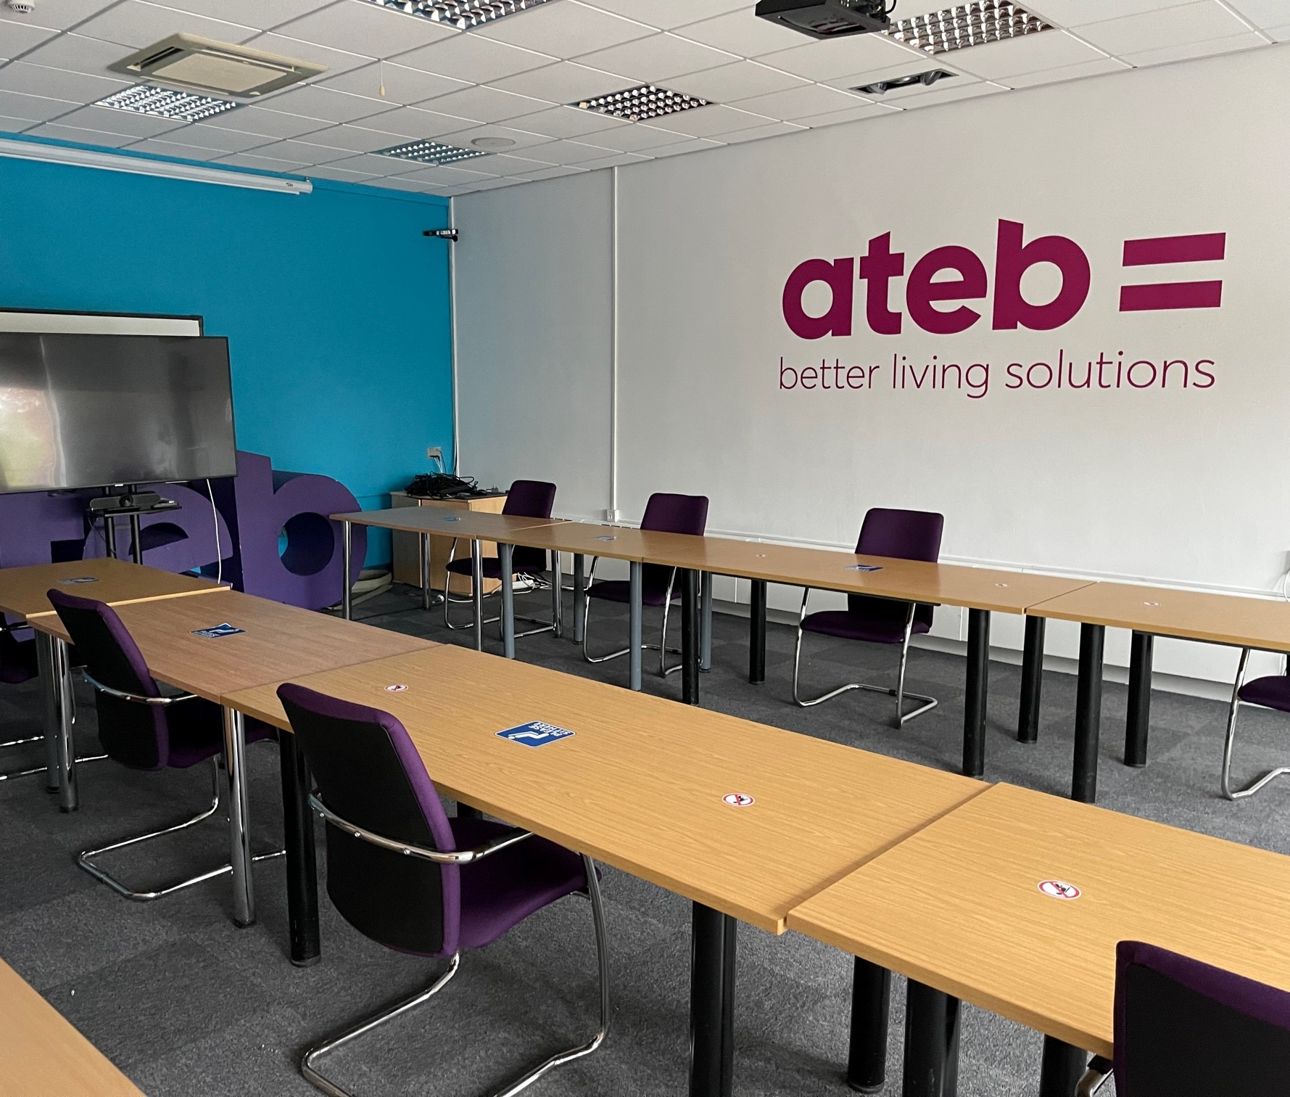
Core Building Performance Evaluation Techniques (BPE)
Figure 6
Site Visits and Inspections
  Understand how the building is new being used in a post covid world compared to pre covid
  How things work - heating, hot water, ventilation, lighting, and controls
  Condition of key building components
  General impressions on daylight and views
  Signs of mould or condensation?

Slide 10
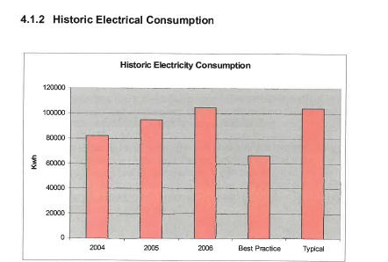
Core Building Performance Evaluation Techniques (BPE)
Energy Use and Audit
  Analysis of annual energy consumption
  Look at pre and post covid data
  How the building is being utilised currently against energy used
  Look at Patterns (Weekday/Weekend/Summer/Winter, etc.)
  Look for comparable trends with other core BPE techniques
(Ateb Water & Energy Audit. 2006)

Slide 11
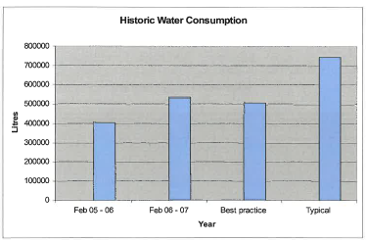
Core Building Performance Evaluation Techniques (BPE)
Water use Audit –
  Analysis of annual water consumption data
  Look at pre and post covid data
  Idenify where and what part of the building is utilising the most water and for what function
  Look at Patterns (Weekday/Weekend/Summer/Winter, etc.)
  Look for comparable trends with other core BPE techniques
(Ateb Water & Energy Audit. 2006)

Slide 12
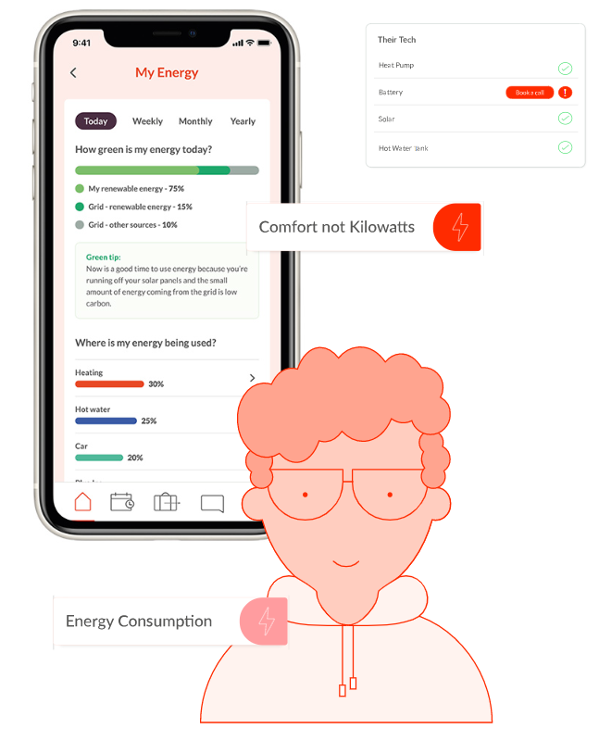
Detailed Building Performance Evaluation Techniques (BPE)
Energy Monitoring and Analysis–
What is it?
  Installation of smart and sub metering, clearly idenify energy usage. Smart Meters become the Norm – currently 26.4m have been installed
    (Department for Business, Energy & Industrial Strategy, 2021)
  Energy usage broken down to key components, i.e., space heating, water heating, unregulated loads, etc
  Will provide granular data of how energy is being used with the building
  Can be linked with intelligent energy units i.e., ORP – Serio Bee Unit (The Mill, Cardiff)
  (https://www.seroprojects.com/our-projects/the-mill/)
Figure 7

Slide 13
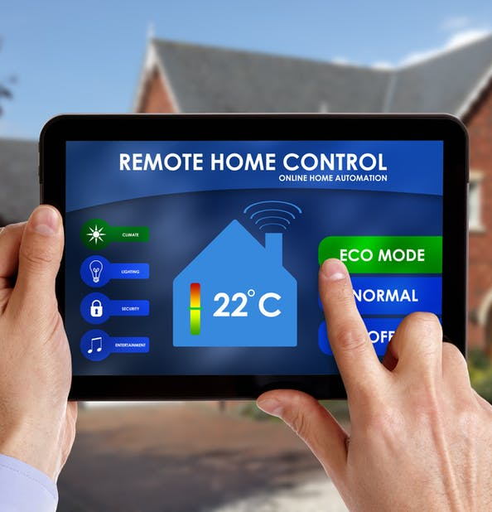
Detailed Building Performance Evaluation Techniques (BPE)
Figure 8
Energy Monitoring and Analysis–
why would it benefit the retrofit plan?
  This will idenify habits of usage, which can be mapped can planned for
  Will help idenify fabric issues with data from core BPE techniques (site visits)
  Will help idenify components and systems that are ineffective and a poor use of energy.
  Will generate large amounts of data which can inform retrofit planning
  Can be linked with other types of monitoring, i.e. humidity, CO & temperature

Slide 14
Long Term Plans
Figure 2
Follow retrofit pathway option set out by Welsh Government under the recently announced WHQS 2023 draft and PAS 2038.
Set out a clear pathway to Net Zero and set clear milestones. Using PAS 2038, SAP
By undertaking pathway approach cost can be spread over a longer period
Procurement of works can be undertaken in stages to make pathway more affordable, which will allow for a measured approach to achieving net zero.
If the data changes, we can change the pathway
Figure 3

Slide 15
Conclusion
(Office of Energy Efficiency & Renewable Energy)
Use Energy, Water and Asset Management data to understand how the building is functioning
Look at pre and post covid data and understand how the building will be used going forward
Use 3 core BPE Techniques to understand how energy is used
Use energy monitoring detailed BPE Technique to map out the full retro plan using key building data.
Follow the pathway approach which will help stagger costs
Use targeted procurement which follows the pathway
Figure 1

Slide 16
References
legislation.gov.uk, 2019. legislation.gov.uk. [Online]
Available at: https://www.legislation.gov.uk/ukdsi/2019/9780111187654
[Accessed 21 May 2022].
The Institute of Engineering & Technology, 2020. BS7671:2020 Requirements for Electrical Installation IET Wiring Regulations 18th Edition. London: British Standards Institution.
UK Government , 2020. gov.uk. [Online]
Available at: https://www.gov.uk/government/news/government-takes-historic-step-towards-net-zero-with-end-of-sale-of-new-petrol-and-diesel-cars-by-2030
[Accessed 28 November 2022].
Sero , 2020. Sero Projects. [Online]
Available at: https://www.seroprojects.com/our-projects/the-mill/
[Accessed 28 November 2022].
Department for Business, Energy & Industrial Strategy, 2021. Smart Meter Statistics in Great Britain: Quarterly Report to end September 2021, London : Department for Business, Energy & Industrial Strategy.
Building Performance Evaluation Guide. 2021 Susie Diamond, Inkling & Julie Godefroy Sustainability, for the Good Homes Alliance Version 1.1 February 2012
ateb Energy & Water Audit 2006
Fire Plan to Meyler House
Property Summary Report Meyler House

Slide 17
List of Figures
Figure 1
Office of Energy Efficiency & Renewable Energy [Online]
Available at: https://www.energy.gov/eere/office-energy-efficiency-renewable-energy
[Accessed 19 May 2022].
Figure 2,3,4,5,6
Photos of Meyler House – ateb HQ
Meyler House, St Thomas Green, Haverfordwest SA61 1QP
Figure 7
Sero life [Online]
Available at: https://sero.life/
[Accessed 19 May 2022].
Figure 8
How Smart Homes Work[Online]
Available at: (https://home.howstuffworks.com/smart-home.htm)
[Accessed 19 May 2022].

Slide 18
Thank you very much.

