Slide 1

PETER NGUTY ACHA
2018019
BMHP4003
LECTURER REBECCA KAVANAGH
This Photo by Unknown author is licensed under CC BY-SA-NC.

Slide 2


THE TASK
WHY IS PSYCHOLOGY IMPORTANT WHEN WORKING AS A DOMICILIARY CARER WORKING WITH ADULTS.
This Photo by Unknown author is licensed under CC BY-SA.

Slide 3

Before I proceed I would like to see the meaning of the two key words here.
(Psychology and Domiciliary carer)
As maintained by S, Mcleod (2019) Psychology is the study of the mind and behavior. according to American psychological Association.
A domiciliary carer is a paid care professional who visits people in their own homes, helping them to continue living on their own.
This Photo by Unknown author is licensed under CC BY-SA-NC.

Slide 4

In my presentation I am going to use the Erik Erikson theory and Albert Bandura Behaviour theory to best explain why psychology is important when working as domiciliary carer working with older people because both theories are very important in this domain of care.
According to Albert Bandura (1997) behaviour is learn from the environment through the process of observational learning. Applying this theory as a domiciliary carer working with older people it would enable me to learn good ideas and practices from others and even from the service users .
Psychology will help me for counselling
It appreciates the way how we can understand the behavior of the service user.
It informs the relationship of behavior and its influence of the well-being of the service user.

Slide 5
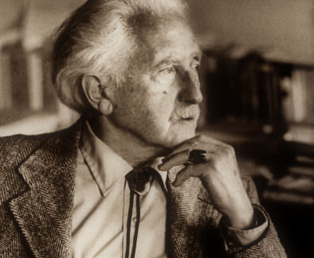
(A) Why is psychology important when working as a domiciliary carer working with older adults?
According to Erikson theory of psychosocial development there are eight stages in life, but I will be talking only about the eight stage because as a domiciliary care worker working with older people, I will be working with people at this stage
As maintained by Erikson (1950, p268) ego integrity is acceptance of one's one and only life cycle as something that had to be.
This Photo by Unknown author is licensed under CC BY-SA-NC.

Slide 6
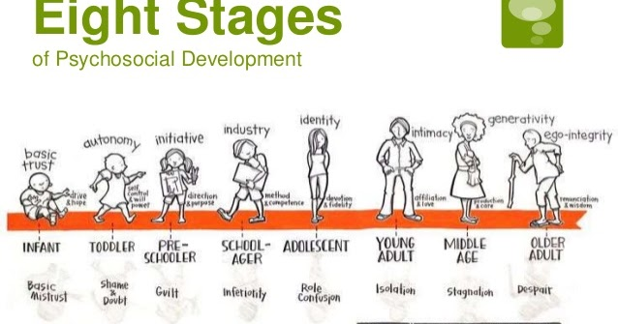
(B) Why is psychology important to work as a domiciliary carer working with older people
As a domiciliary carer working with older people psychology is important because with the knowledge of psychology, I will be able to know the different stages of life and how to relate with the service users correctly
This Photo by Unknown author is licensed under CC BY-NC-ND.

Slide 7

Why psychology is important when working as a domiciliary health care working with adults
According to the World Health Organisation, health is ‘a state of complete physical, mental and social well-being and not merely the absence of disease or infirmity. (Wyatt et al, 2017). Due to this definition, it becomes inevitable that psychology has a big role in health and social care. This definition highlights the importance of emotional well-being, which is why psychological perspectives are important in Health and Social Care. Examples of how psychology fits into health and social care including helping people cope with their situations lor helping people sort out solutions to deal with anger issues or relationship problems or things they cannot change.
This Photo by Unknown author is licensed under CC BY-NC.

Slide 8
REFERENCE LIST
McLeod, S. A. (2019). What is psychology? Retrieved from https://www.simplypsychology.org/whatispsychology.html
McLeod, S. A. (2018, May 03). Erik erikson's stages of psychosocial development. Simply Psychology. www.simplypsychology.org/Erik-Erikson.html
Bandura, A. (1977). Social learning theory. Englewood Cliffs, NJ: Prentice Hall.
Page 123. CACHE Technical Level 3 Extended Diploma in Health and Social Care (2017). Linda Wyatt, Pete Wedlake, Maria Ferreiro Peteiro, Elizabeth Rasheed. Hodder Education- London.
Counselling psychology is a specialty within professional psychology that maintains a focus on facilitating personal and interpersonal functioning across the life span

