Slide 1
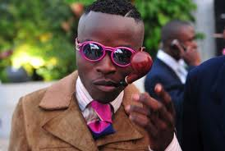
Biographies, Intimacies and Memories
The Construction of the Self

Slide 2
Key Themes
Ways of thinking about ‘the self’ and personhood
The construction of the self and a biography through objects
  Distributed personhood
Objects, emotion and memory
  Start to think about affect and the agency of objects
Relatedness between people through objects and between people and objects

Slide 3
Concepts of ‘The Self’ (see Morris 1994)
The biological human being
  we recognise ourselves and others as discrete and separate biological beings
Psychological aspects of the self:
  the notion of a conscious personality and a sense of personal identity
Social aspects of the self:
  the way in which selfhood and self identity is constituted through social relations;
  Social selfhood can have more expanded meaning to the biological self
    things, animals and abstract concepts (corporations) can be socially recognised as persons.
    Human beings can also be treated as non-persons (women, children, slaves)

Slide 4
Implications
Personhood is something that is acquired and not innate
  To what extent is the concept of the ‘individual’ universal?
  How are personhood and self-identity constituted through the consumption of things?
  Should this be judged positively or negatively in relation to the effects of consumer society?

Slide 5
The ‘Postmodern’ Self
we have now entered a ‘postmodern’ phase of social life
  where the social world no longer has an clearly defined centre, and neither do we
  the self becomes composed of fragmented, multiple and possibly conflicting identities and subject positions with no fixed centre or essence.
  We are just a bundle of conflicting experiences and social roles with no centre of gravity that holds it all together.

Slide 6
What is Consumption?
‘the incorporation of the consumed item into the personal and social identity of the consumer...the appropriation of objects as part of one’s personalia’(Gell 1986: 112)
“consumption as a general phenomenon really has nothing to do with the destruction of goods and wealth, but with their reincorporation into the social system...even quite ephemeral items, such as the comestibles served at a feast, live on in the form of social relations they produce’ (Gell 1986: 112)

Slide 7
Gell: Consumption and Self-Definition
Conspicuous consumption amongst Sri Lankan fishermen
Use their excess earnings to purchase television sets and to build garages
Gell argues that this is not just about status seeking or middle class aspiration, nor does it point to an irrationality
‘’the fisherman is totalizing his biography, his labour, his social milieu, in the form of an object’ (Gell 1986: 114)
Symbolic value and meaning of commodities shift

Slide 8
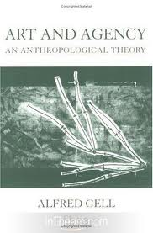
Distributed Personhood
A person can be distributed through the objects with which they are associated
They become present, and their fame circulates, through the object
The person resides in the objects
Challenges subject-object distinctions
  Both can cause action

Slide 9
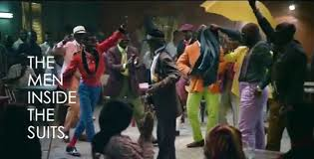
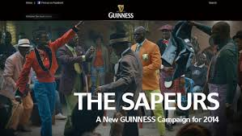
http://www.youtube.com/watch?v=CScqFDtelrQ

Slide 10
Clothing in the Congo (Friedman 1994)
‘Clothing is definitive in the practice of social differentiation’ (Friedman 1994: 170).
Historically signified in the pre-colonial era by Congolese aristocracy who made great efforts to dress elegantly according to the dress codes of the time.
With colonialization by the French and Belgians, Congolese nobles gained access to a wider variety of elegant materials (such as silk) and western clothing.

Slide 11
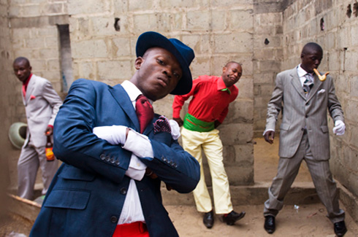
Despite colonization leading to the collapse of the prior political system
Makindangolo (life force) is still acquired through participation in the group, and is also expressed in terms of one’s proximity to the elders of the group.
The flow of life force from the top was expressed through a system of patronage,
  goods channelled down through the ranks in the form of bridewealth

Slide 12
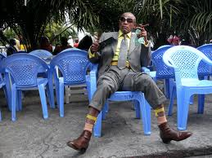
With colonialism, Congolese concepts of makindangolo shifted and became mapped onto new colonial hierarchies
  expressed in terms of the hierarchical relations between Paris and Brazzaville
Modes of dress - via the consumption of French designer labels - comes to be treated as ‘the ultimate means of self-definition’
Facilitated via the diffusion of images Parisienne/European lifestyles amongst the populace.

Slide 13
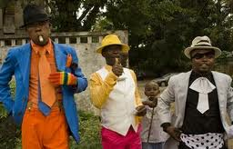
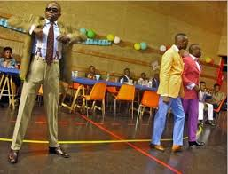
Brazzaville youth clubs sought to replicate the style and fashion of Paris,
  leading to the emergence of a youth subculture known as the existos (whose style, but not philosophy, was based on Parisian existentialists).
Clubs would have their own tailors, and compete with other clubs.
By the late 1960s, these youth clubs had largely disappeared, to be replaced with La Sape (from se saper, meaning to dress elegantly),
  or La Societie des Ambianceurs et Peronnes Elegantes

Slide 14
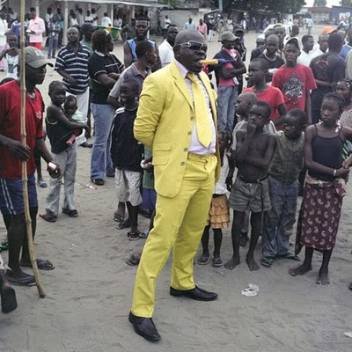
Members of La Sape - sapeurs - are often unemployed and unmarried youths who ultimately seek to participate in the consumption of haute couture and attain the position of a grand or elder in La Sape.
This is done by building a reputation within a ranked hierarchy of sapeurs as a stylish person in urban nightspots.

Slide 15
Thus La Sape mirrors previous cultural forms in acting as:
‘a ritual program for the transformation of ordinary unranked youth into great men. It begins and ends in Bacongo [a quarter in the city of Brazzaville], with a ‘liminal’ phase in Paris. It consists in the continual build up of a wardrobe and ritual display at organized parties and dance bars. In Brazzaville one can begin to accumulate lower ranked clothing...copies and ordinary ready-to-wear. The move to Paris...is the beginning of the real transformation of the ordinary sapeur into a person of higher status’ (Friedman 1994: 178).

Slide 16
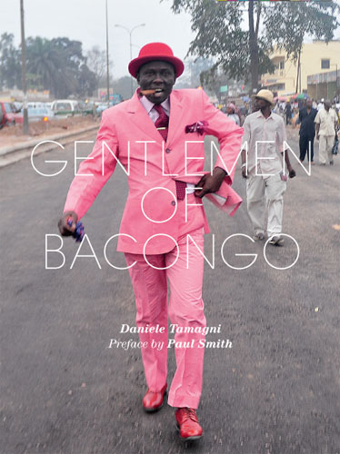
Time spent in Paris is used to gather a wardrobe of haute couture clothing
Problematically delineates the acquisition of personhood via moving from a ‘natural’ state to an ‘encultured’ one
This progression occurs in relation to the acquisition of a hierarchy of clothing:
  Tailor made in Brazzaville using local cloth
  Tailor made in Barzzaville using imported cloth
  Ready-to-wear imported clothing
  Copies of haute couture
  French and Italian haute couture
Particular labels are also ranked according to a pre-defined hierarchy

Slide 17
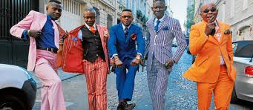
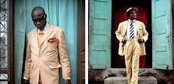
The Real Thing
‘Elegance is not, then, merely about looking elegant, about appearing in clothes that look like haute couture. It is about wearing the real thing and in this sense of being the real thing’ (Friedman 1994: 179).
Friedman also notes that another aspect of the process of becoming a sapeur is the use of skin-lightening cosmetics.

Slide 18
The process comes to an end with the eventual return of the sapeur to Brazzaville via a ritual gala where an ‘official panegyrist introduces the star or hero, carefully listing his qualities and the entire gamut of his ensemble, clothing, shoes and makeup’ (Friedman 1994: 179-180).
Akin to old lineage / chief role
Friedman argues that clothing is more than just an expression of the self in Brazzaville, but is constituent of the self and of makindangolo as life force
  in the literal sense of ‘clothes maketh the man’.
He returns to the debate regarding the alienating quality of commodities - for members of La Sape, commodities are extensions of oneself rather than being independent of the user

Slide 19
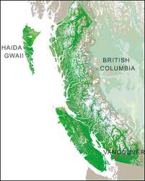
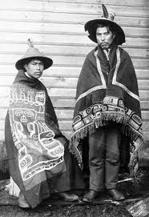
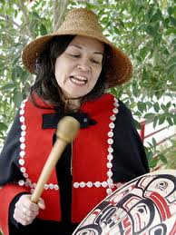
Krmpotich (2010)
Repatriation of Haida Ancestral Remains

Slide 20
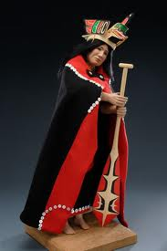
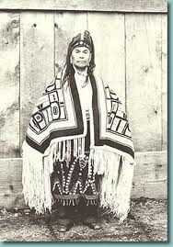
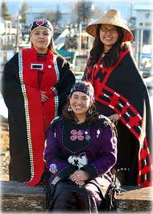
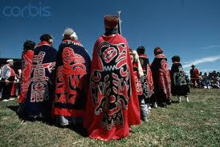
Haida Objects

Slide 21
Key Arguments
Challenges the notion that repatriation is motivated by political agendas of self-determination and sovereignty
First and foremost, repatriation is motivated by kinship
And living Haidas fulfilling their obligations to deceased relatives
Moral action – the relation between self and others
Embodied engagement with objects facilitates this process

Slide 22
Draws our attention to how objects are emotionally charged
Absence endangers the well-being of the ancestors
  Spirits can’t settle far from home
Reburied with tangible and intangible property to demonstrate affection
  Belonging
  Continuity between the deceased and the living
  Reintergration into family and community
  Extending respect
Construct a collective memory which shapes how they identify themselves and their relatedness to others
Creates a shared experience across the generations

Slide 23
Haida Kinship
Relations between family members continue after death
  Presence is felt
  Provide guidance, are blamed for minor incidents
Reincarnation
While there is change and rupture, place, objects, and the continuation of reincarnation and lineages, provides continuity

Slide 24
Repatriation and Reburial Reconnects
Reconnects people as kin
Enables living Haidas to fulfil their familial obligations
Create new objects to mark, honour and bury their ancestors
And coming into contact with the objects of their ancestors
Create shared experiences and shared spaces
Being kin as their ancestors were

Slide 25
For tomorrow
Objects and memory
Think of an object that provokes a memory
What is it about that object that does so?
  Taste
  Sound
  Smell
  Feel
  Narrative
  It’s place and people

