Slide 1
ARTS IN ACTION
2019

Slide 2
What is Arts in Action?
Funded through the UWTSD Widening Access and Community Engagement Committee and the South West Wales Reaching Wider Partnership (SWWRWP), Arts in Action projects show children, their parents and their teachers the many different career paths in art and design.
We hope that the projects will give encouragement to future generations of artists and designers to emerge from our villages, towns and cities.

Slide 3
UWTSD students/ graduates working with schools to develop and deliver curriculum linked classroom based projects
“During my long career in teaching I have been involved in numerous projects. Undoubtedly this was the best regarding planning, delivery, development of pupils' knowledge and skills related to the subject matter, development of life skills and pupil engagement and enjoyment! Teacher, St Joseph’s Cathedral School

Slide 4
BENEFITS FOR STUDENTS
Develop workshop activities compatible to your practice and interests
Working in collaboration with external client
Apply your specialist skills and creative outlook to the workplace
Fully supported to prepare and deliver workshop activities in a professional framework
Classroom experience if applying for a PGCE
Paid

Slide 5
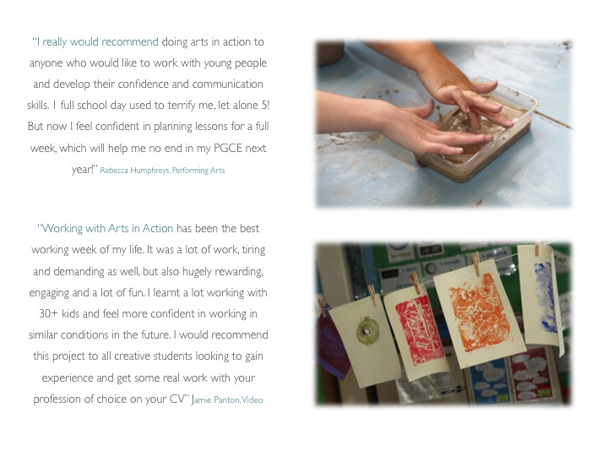

Slide 6
WHAT WILL IT INVOLVE?
Each school has been allocated a student/artist for 7 full days.
One day is for a planning meeting at the school and to develop and write up a scheme of work and lesson plans supported by an Arts In Action educational mentor.
The last session will be a celebration event at the school which the student/artist design, set up and run.
There is budget to contribute to transport costs
Material costs will be covered, with £550 allocated per school
There is a budget for 1x coach per school for offsite activities

Slide 7
APPLICATION PROCESS
1) Interested parties attend a group meeting or individual meeting to have an overview of the Arts in Action scheme and register for the mailing list if interested in applying.
2) Project briefs from participating schools will be circulated via the mailing list. Please apply to an individual school project. Applications to more than one school project are welcome. An application form* must be completed for each school applied to.
3) Selected applicants will attend an interview* with the Art After Dark representatives.
4) The application forms from candidates successful at interview will be submitted to the schools who will select the practitioner they would like to work with.

Slide 8
5) The selected practitioner will visit the school with The AIA mentor, meet the teaching team, discuss and adapt the project plan and set dates for the project activities
6) The student will write up a scheme of work and lesson plans using the template provided* This will need to be approved by the AIA mentor (and University mentor if applicable) before the workshops can start.
7) The student will deliver the workshops. They will feedback to their AIA mentor after each session and collect and submit completed baseline and completion feedback documents*

Slide 9
Sea View Community Primary School
Townhill Primary School
Terrace Road Primary School
Bishopgore School
Cefn Hengoed School (TBC)

