Slide 1
LCBB6002
International Financial Management
Week 6
Lecture 6.1 – The Management of Working Capital

Slide 2
Session Objectives
To explain what working capital is
To explain how to calculate working capital
To discuss working capital policies

Slide 3

Discussion- Watch the video clip on this slide and explain what working capital is (10 Minutes)

Slide 4
Working Capital Management
Working capital is concerned with short-term
resources and short-term funding
Net working capital = Current Assets less Current Liabilities
(inventory plus receivables less trade payables)
The need for liquidity must be balanced
against the need for profitability
Denzil Watson and Antony Head, Corporate Finance: Principles and Practice, 5th Edition, © Pearson Education Limited

Slide 5
Working Capital Policies
Policies cover level of investment in working capital and its components, and financing of working capital.
Policies should take account of nature of business, credit policy, seasonal factors and manufacturing period
(South-Western/Thomson Learning 2003)

Slide 6
Level of Investment
Aggressive policy on level of working capital will have lower levels of investment than a conservative policy.
Aggressive policy will have higher risk and higher profitability.
Conservative policy will have lower risk and lower profitability

Slide 7
Short-term Finance
Overdraft
Short-term loan
Trade credit
Short-term finance is cheaper than long-term finance (yield curve)
Short-term finance is riskier than long-term
finance. (from the perspective of a borrower)

Slide 8
Cash Conversion Cycle
Inventory conversion period plus receivables
conversion period less payables deferral
period.
Cash conversion cycle is the average time
between paying for inputs and receiving
cash from sales.
Length of cash conversion cycle helps
determine the level of working capital.

Slide 9
Overtrading
Overtrading occurs when capital base is too
small to support volume of trade.
- accepts larger work, but finds that fulfilment
requires more resources
May be caused by rapid growth in turnover or
erosion of capital base.
Overtrading can be indicated by:
– deterioration in key financial ratios
– decreasing liquid resources
– increasing reliance on short-term finance.

Slide 10
Overtrading Continued
Solutions seek to bring capital base and
trade volume back into balance
– introduce new capital
– consolidate business activity
– better working capital management.
Note that overtrading can result from aggressive working capital policies.

Slide 11
Cash Management
Reasons for having reserves of cash:
– The transactions motive for holding cash is the
need to have a cash reserve to balance short-term cash inflows and outflows
– The precautionary motive for holding cash
refers to the fact that a company may choose to
have cash reserves in order to meet
unexpected demands.
– Companies may also build up cash reserves to
take advantage of investment opportunities that
may occur: this is the speculative motive for
holding cash

Slide 12
Cash Management (Continued)
Holding cash for short-term needs will incur
opportunity cost of lost profit.
Cash flow shortages can be eased by
postponing expenditure, accelerating
income and finding new cash resources.
Optimum cash levels reflect liquidity needs
– future cash needs and borrowing capability
– efficiency of cash management
– tolerance of risk.

Slide 13
Cash Management (Continued)
Invest short-term cash surpluses in
appropriate short-term instruments.
Must be no risk of capital loss.
Choice of investment depends on:
– size of the cash surplus
– maturity of the short-term asset
– yield required
– any penalties for early encashment /
withdrawal.

Slide 14
Cash Management (Continued)
Appropriate short-term instruments:
– term deposits
– treasury bills and short-dated gilts
– bank certificates of deposit
– local authority bonds.

Slide 15
Working Capital Management
Can overall level of WC be optimised?
– by minimising cash conversion cycle?
– by adopting aggressive policies?
– optimal compared to what?
– or just the individual components?
How can each component be optimised?
– just-in-time inventory management?
– offering discounts for cash payments?

Slide 16
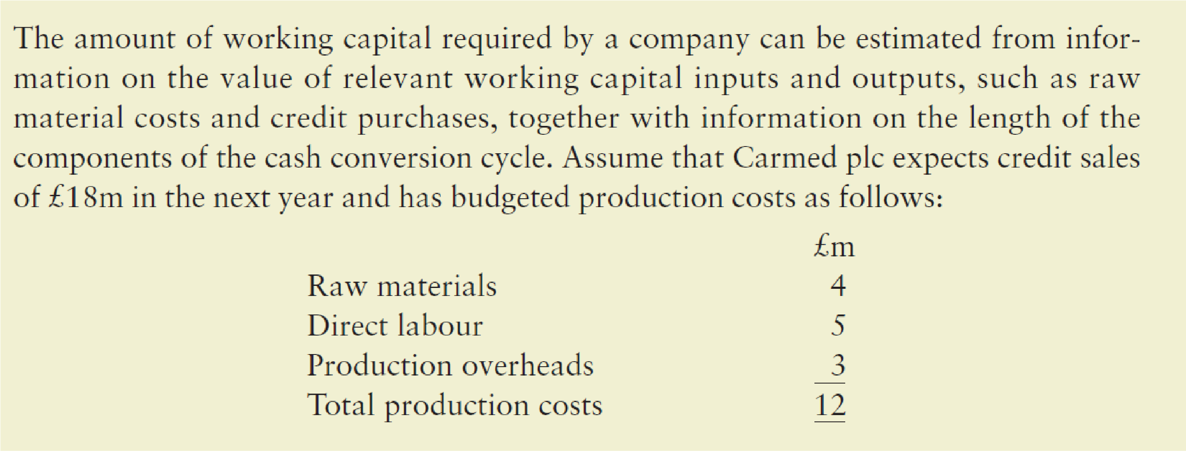
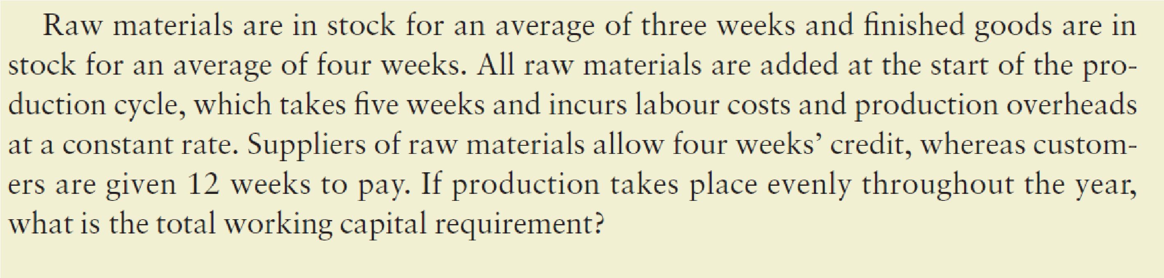
Task 1: Read the extract on this slide and calculate the total working capital requirement for the firm.

Slide 17
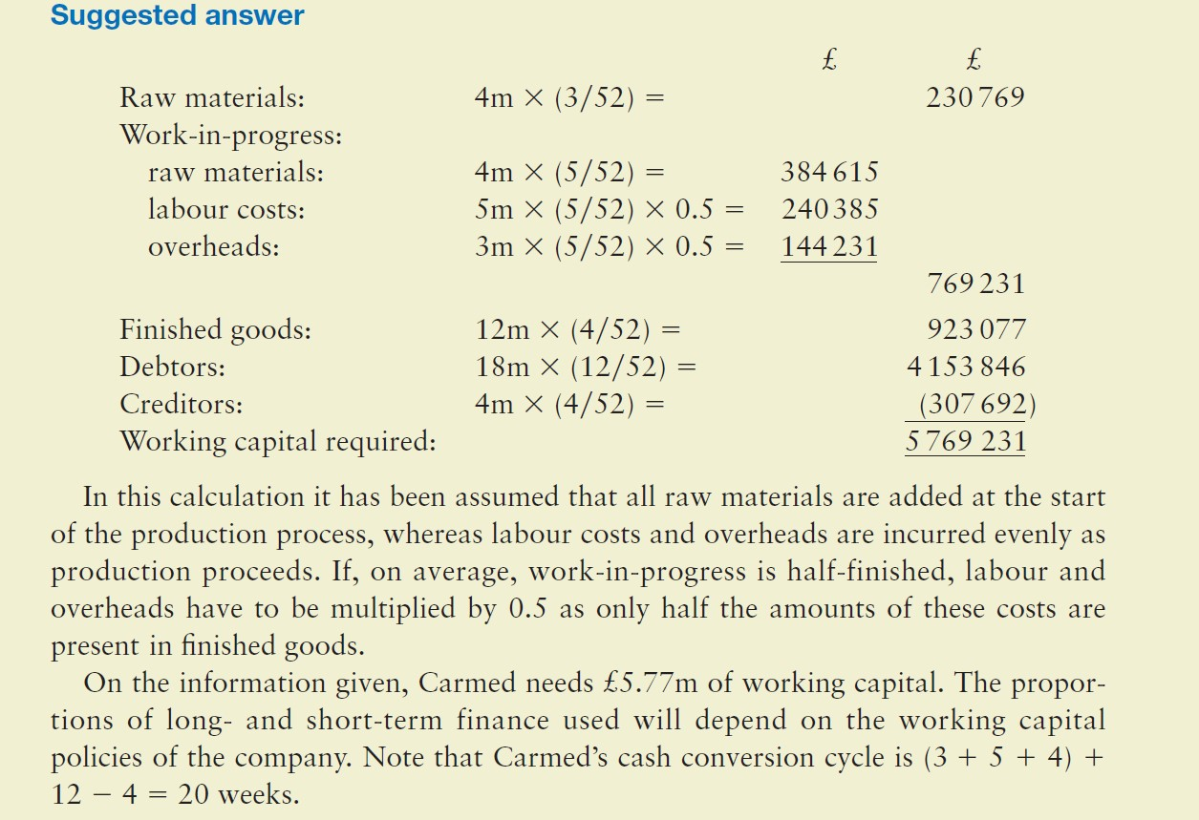

Slide 18

Any Questions?
Thank you!

