Slide 1
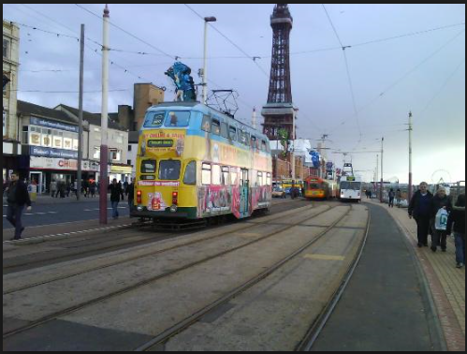
TRANSPORT DE-REGULATION
https://www.google.com/search?q=transport+deregulation&source=lnms&tbm=isch&sa=X&ved=0ahUKEwjTgrbru6neAhUSW8AKHWfdDYsQ_AUIDygC&biw=1301&bih=538&dpr=1.05#imgdii=4mkHqeW_wzvCRM:&imgrc=HqqX3Bd5xlFZXM:&spf=1540741098921

Slide 2
In Europe, own-account transport was originally defined in the 1957 resolution of the ECMT (European Council of the Ministers of Transport).
According to this resolution a movement of goods is to be considered transport for own account if it is performed by a natural or legal person:
• Using vehicles either owned by him or put to his exclusive disposal for internal transport movements under the conditions laid down in national laws and regulations or in bilateral agreements if it concerns international transport.
• For his own requirement and to move goods either owned by him or sold, bought, borrowed, loaned, let out on hire or hired, produced, processed or repaired by him, provided that such transport is ancillary to the main activities of the firm.
Council directive 74/149/EEC published in the OJ L 084 of 28/03/1974 extends the first Council Directive of 23 July 1962 to own-account transport.
However the first directive that defines own-account transport is council directive 80/49/EEC published in OJ L 18 24/1/1980, amended by regulation 881/92.
It specifies that carriages for which the following conditions arise must be exempt from any transport quota or authorization system (see the text for more on these as they apply to the for-hire segment):

Slide 3
The goods transported are owned by the firm or have been sold, bought let out on hire or hired, produced, extracted, processed or repaired by the firm.
• The purpose of the journey is to carry the goods to or from the firm or to move them for its own requirements.
• The motor vehicles used are driven by employees of the firm
• The vehicles carrying the goods are owned by the firm or have been bought by it on deferred terms or hired provided that in the latter case they meet the conditions of Council Directive 84/647/EEC of 19 December 1984 (amended by Dir. 90/398/EEC) on the use of vehicles hired without drivers for the carriage of goods by road.
• Carriage is ancillary to the overall activities of the firm.

Slide 4
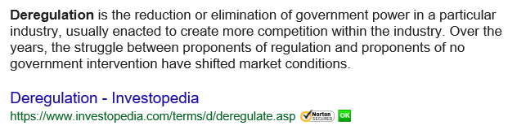

Slide 5
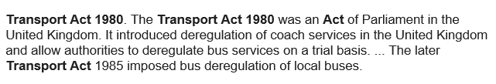

Slide 6
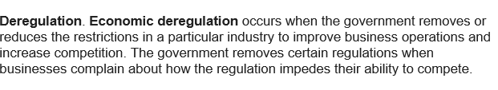

Slide 7
Background
The deregulation of the interstate trucking industry took place, in the USA, with the Motor Carrier Act of 1980, which removed entry barriers and eliminated price-setting bureaus.
A number of studies have established how this deregulation has led to lower transport prices, changes in the organization of labour, and changes in the concentration and organisation of the industry (Rose 1985 and 1987, Joskow and Rose, 1989, Winston et al.,1990, Ying and Keeler, 1991, Boyer 1993, Peoples and Peteraf, 1995 and 1999).
At that same time, in the European Union, a complex series of bilateral and multilateral agreements still governed both the amount of road transport that could be done between countries and the prices that could be charged for such transport.
This was the case despite the fact that the 1957 Treaty of Rome establishing the European Economic Community stated that a common transport policy had to be achieved by December 1969.
file:///F:/deregulation%20International%20trucking.pdf

Slide 8
In fact, the deregulation of international road transport in the European Union did not begin until the mid-1980s.
Moreover it was much more gradual than in the USA, having been completed, or at least mostly completed, only at the end of the 1990s.
Finally, the stated reasons to deregulate international transport in the European Union, and some of the concerns surrounding such deregulation, were different
from those associated with U.S .deregulation.
In particular, instead of emphasising potential efficiency gains, an important motivation for deregulation in the European Union was the desire to eliminate government discrimination based on nationality of the freight transport provider.
Not surprisingly, individual member countries thus worried about potential market share losses in deregulated sectors.
These differences in stated goals and concerns, in turn, affected the form and speed of the deregulation process.

Slide 9
Due in part to timing and duration of the deregulation, and in part to data issues discussed below, the effects of deregulation of the trucking industry in the European Union (EU from now on) have not received much attention in the literature.
The European Union is different from the USA in many ways, some of which are
very obvious, but some can usefully be restated.
First of all the EU is an association of individual countries that do not share a common language, common taxes or common business environments.
The European Union is a supranational power that oversees international transport while each country retains jurisdiction over its own domestic transport (as long as its policies do not discriminate by nationality of the carrier).
As a result national and international markets obey rules that can be very different..

Slide 10
To appreciate the basic characteristics of international road transport regulation and deregulation in Europe, it is useful to recognise that, as stated earlier, the EU has jurisdiction only over the international component of the European road transport market.
Each country still can set its own rules for transport that begins and ends within its borders.
Second, as in the USA, regulations in this market have been imposed on both entry and price.
Not every European country regulated both the prices at which shipments could take place and the number of licenses that were available to carriers for international transport, but most of them did one or the other.
Third, and lastly, during periods of heavy regulation the own-account sector was relatively unregulated

Slide 11
However now that the for-hire sector has been mostly liberalised, the continuing
regulations on the own-account transport make it the most regulated segment of the industry.
To this day, transporters for own account were not allowed to carry third-party freight generally, and for-hire back hauls specifically, defined as hauls that take the carrier back to the country of origin but that do not involve the carrier’s own goods.
At the beginning of the 1980s, for-hire road haulage between EU member states was authorized in one of four ways:
Under bilateral agreements between member states.
These agreements either allowed free movement of goods or imposed quotas on the number of movements. If a journey involved transit through a third country, then a permit might be needed from that country as well.
Under these bilateral agreements, the transport permit granted to a carrier could be limited to a certain period or a certain number of journeys.

Slide 12
Bilateral agreements applied to both the for-hire and the own-account sector (Bernadet 1997 and Scharf and Smolders 1999) until 1980 and thereafter only to the for-hire sector.
These permits were the norm for all international European transport (within and outside of the EU) until the late 1980s.
From the mid 1990s onward, they were only needed for transport outside of the EU, and they have remained the norm for transport to and from Eastern European countries.
Note that the European Union had only nominal control over bilateral agreements between member states.

Slide 13
2. Under Community permits.
These permits, or quota arrangements, were instituted in 1969, and allowed a limited number of vehicles to operate freely within the Community.
Each country was allocated a quota and decided how to distribute it among its national motor carriers.
The permits allowed unlimited international journeys during one year.
However, until the late 80s they accounted for only about 5% of international road transport (Whitelegg, 1988; Bernadet, 1997 and Degli Abbati, 1987).
The first two tables in Appendix B show how the number of community quota authorisations changed between 1969 and 1992.
By 1993, the for-hire segment was deregulated in that limitations on the number of these permits were lifted. Own-account transport within the EU, in contrast, was declared free of quota or authorisation requirements in 1980.

Slide 14
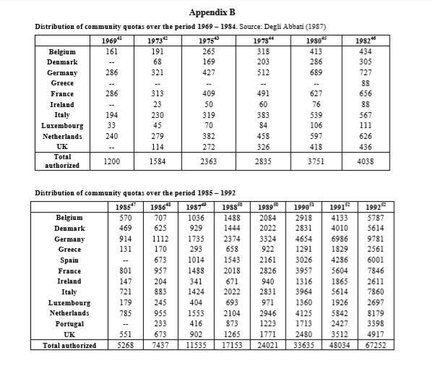

Slide 15
3. Under European Conference of Ministers of Transport (ECMT) quota arrangements.
These quotas are similar to Community quotas but apply to most ECMT countries.
These permits are available only for the for-hire transport sector, and are quite limited in number.
In 1994 the total number of such authorisations was 4100, less than the amount that was available in 1973 to the (then) nine member of the EU.
They are currently – and were throughout the period - mostly used for transit from European Community countries to non-EU countries rather than within the EU.

Slide 16
4. For types of transport exempt from quotas.
This was the case in particular for goods that travelled in part by rail, for some exempt commodities and for transport with Switzerland, Andorra, Monaco and Lichtenstein, countries that are part of the ECMT, but not the EU, and that completely liberalised access of freight carriers to their territory prior to the start of our data period.
This also applied to all trucks with a payload weight smaller than or equal to 3.5 tons.
Moreover all for-hire transport within 25 km on either side of a border as the crow flies has been exempt from any authorization or quota requirement.

Slide 17
In addition to these quotas or ‘entry’ regulations, carriers involved in international road transport also faced pricing restrictions.
Bilateral agreements between member states typically specified price-brackets (that is a minimum and a maximum price) at which transactions could occur.
These price brackets officially became ‘suggested’ prices in 1984, but member states could choose to maintain compulsory rates.
In January 1990, prices were allowed to be set through market negotiation between the shipper and the carrier.
However, even when these price brackets were officially binding, they never appear to have been enforced (Bayliss and Coleman, 1994 and Degli Abbati, 1987 p. 98).

Slide 18
Carriers involved in international road transport between EU members faced a number of other regulatory constraints that were relaxed during the 1980s and 1990s.
First, there were lengthy controls at borders up until 1990 when these were eliminated.
Second, carriers faced very strict restrictions on cross-trade transport and a complete prohibition on cabotage. Crosstrade transport is defined as international road transport performed by a motor vehicle registered in a third country.
Such transport was only authorized under Community quotas. As the availability of such quotas increased, the restrictions on cross-trade transport became less stringent.
Cabotage, on the other hand, is defined as transport within a member state that is performed by a carrier registered in a different country.
The prohibition against cabotage was lifted gradually.

Slide 19
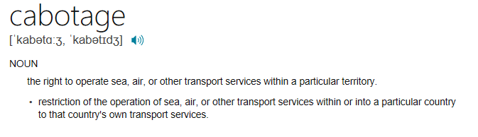
https://www.bing.com/search?q=define+cabotage&form=EDNTHT&mkt=en-gb&httpsmsn=1&refig=6169b240763c422fcca8b45570ff1afa&sp=1&ghc=1&qs=AS&pq=define+cabotage&sc=2-15&cvid=6169b240763c422fcca8b45570ff1afa&cc=GB&setlang=en-GB

Slide 20
You can carry out a limited number of cabotage jobs in another EU member state if you’re a UK haulier with a Community Authorisation.
The jobs must follow a journey where goods were transported from the UK or another member state.
Cabotage is the haulage of goods for hire or reward in one member state by a vehicle registered in a different member state.
As a goods vehicle operator, when you get a standard international licence you’ll automatically get a Community Authorisation.
When and where UK hauliers can carry out cabotage You can only carry out up to 3 cabotage jobs in 7 days within the host member state.

Slide 21
EU member states which allow cabotage are:
Austria Belgium Bulgaria Cyprus Czech Republic Denmark Estonia
Finland France Germany Greece Hungary Ireland
Italy Latvia Lithuania Luxembourg Malta Netherlands
Poland Portugal Romania Slovakia Slovenia Spain Sweden
Hauliers from these countries can also carry out cabotage jobs in the UK, subject to the same conditions. You may have to register for and pay VAT in the country where the cabotage journey took place.
Your right to carry out cabotage may be removed temporarily or permanently if you breach safety rules.

Slide 22
The set of rules concerning who could carry what where existed despite the fact that discrimination based on the nationality of the carrier was supposed to be illegal among EU member countries.
Indeed, the 1957 Treaty of Rome that established the European Economic Community stated that a common transport policy had to be achieved by December 1969.
This was still not the case in the early 80s, so in 1985 the Court of Justice ruled that member states had to enact legislation in order to achieve a free international market for road freight transport.
Following this ruling a progressive liberalisation started taking place.
In 1987, the number of community permits was greatly increased: specifically, the number of Community authorisations increased by 40% each year between 1987 and 1992.16
All limitations on the number of permits were eliminated in 1993 with the introduction of Community licenses, which are 5-year renewable licenses allowing a carrier to transport anywhere within the EU.

Slide 23
Later in 1990, controls at borders within the European Union were eliminated, cutting down times for international road transport.
Also, in July 1990, a limited number of permits to perform cabotage operations were introduced which were restricted to for hire carriers only.
Specifically, between July 1990 and July 1991 the EU created 15,000 authorisations (equivalent to 2,500 yearly permits).
This number was increased by 10% in 1991-1992 and another 10% in 1992-1993. The final solution to the cabotage issue was adopted with EU regulation 3118/93 which stated that starting on 1 January 1994 the number of cabotage authorisations were to be increased systematically until 1 July 1998 when the need for cabotage authorisations would be eliminated.
Note that in 1994, EU regulation 792/94 also authorised own-account carriers to perform cabotage operations. Prior to that date, own-account continued to face a complete prohibition on cabotage.

Slide 24
During this same time period, there were few changes in the regulation of other modes of international transport in the EU.
Rail freight transport remained fairly heavily regulated throughout the period of this study though legislation enacted in the 1990s set the ground rules for a slow liberalisation to occur in the rail freight industry starting in March 2003.
Seaports were neglected by EU policy during the 1970s and 1980s.
In the early 1990s investments in ports increased significantly.
Also, the amount of freight transported through inland waterways did not substantially change during the 80s and 90s although the adoption of containerisation allowed this mode of transport to become much more efficient and to considerably reduce the number of vessels used.
Prior to liberalisation the regulatory regime imposed high costs on the transport of goods across borders by road, both because of the need to secure permits and because of time consuming border controls. This likely led carriers to make detours, add inefficient hauls, perhaps refuse certain hauls (for example hauls that did not originate or end in the country where the carrier was registered), and so on. In fact, largely due to the various constraints imposed by the regulatory regime, about 40% of the trucks crossing borders were traveling empty in the EU during the late 1980s

Slide 25
To the extent that liberalisation, be it the growth in the number of authorisations or the liberalisation of cabotage and cross-trade transport, has allowed carriers to combine loads more efficiently, or to use more direct or otherwise better routing.
It should reduce the cost of international road transport relative to local road trucking and to other modes of freight transportation.
Assuming that these reduced costs are passed on to consumers in the form of lower prices, deregulation will lead to significant growth in international road transport due to its lower relative price.
The choice between for-hire and own-account haulage for a shipper involves a number of trade-offs.
Shippers whose loads need to be highly coordinated with production needs or whose customer service requirements are high may tend to use own account haulage (Hubbard, 2001, Baker and Hubbard, 2003, Nickerson and Silverman, 2003).
For-hire carriage, however, will typically be more cost efficient. Specifically, for-hire carriers are better able to maintain high loading factors for their trucks and reduce the trucks’ idle time (thereby reducing their unit cost) for a number of reasons.

Slide 26
First, for-hire firms tend to be less sensitive to demand volatility because they serve the transportation needs of a portfolio of firms.
Second, in the period under study in Europe, private carriers were not allowed to take on third-party freight.
Finally, even when private carriers can take on third-party freight, for-hire firms are better able to identify and coordinate complementary demands. In order to find hauls and backhauls a carrier has to build expertise in the market and a web of potential shippers (see e.g. Baker and Hubbard, 2003).
A firm whose primary activities lies outside of trucking is less likely to be successful at regularly identifying and pricing good matches for its hauls.
Private carriers will therefore end up typically with a higher percentage of empty backhauls.

Slide 27
While the decision to outsource transportation needs, depends on a number of factors, liberalisation has only affected specific aspects of this equation.
In the 1960s and 1970s, both own-account and for-hire carriers were subject to the same permit requirements.
In the early 1980s, however, a Council directive exempted own-account transport from any quota or authorisation requirement.
Consequently, the increased availability of community licenses that occurred through liberalisation in the 1980s had an impact only on the for-hire segment, reducing its cost relative to the already liberalised private haulage.
These lower costs, assuming they were passed on to consumers of road transport in the form of lower prices, should make the ‘buy’ option relatively more attractive to shippers.
Licensing deregulation, occurred throughout the 1980s and early 1990s, to increase the proportion of international road transport performed by for-hire carriers.

Slide 28
Another aspect of deregulation that may affect the relative reliance on for-hire and private haulage relates to cabotage.
Changes in regulation for cabotage were implemented initially for for-hire haulage only, and then for own-account haulage.
If such regulations were constraining, and the amount of deregulation economically significant, one would expect the deregulation to have a positive effect on the proportion of for-hire during the period of preferential treatment (1991-1994).
National governments in Europe are often concerned that changes in regulation will go to the advantage of other countries.
In the case of international road freight transport deregulation, there were two major concerns.
First of all, large countries that had been strictly regulated, such as France and Germany, were afraid that deregulation would favour carriers of countries that were more open, such as the Netherlands and Belgium.
Second, they were concerned that large amounts of international trucking would be captured by carriers of countries with low labour costs, such as Portugal and Spain.

Slide 29
Prior to liberalisation the distribution of international road transport activities across member countries was determined predominantly by each country’s set of bilateral agreements.
This gave an advantage to transporters registered in countries with more extensive sets of agreements.
They could provide a larger amount of international transport services relative to trucking companies in countries with fewer agreements. As deregulation progressed, two opposing forces affected the distribution of road transport activities across countries.
On the one hand, carriers from countries that were operating under a more liberalised regime – i.e. with more bilateral agreements - prior to liberalisation may have been more efficient and therefore in better position to take advantage of the deregulated environment.
On the other hand, deregulation reduced the importance of a transporter’s country of origin in securing freight, allowing carriers of countries with originally fewer agreements to take advantage of the deregulated environment.

Slide 30
Bus passenger journeys outside London have fallen by 32.5% since 1986, but within the capital they have risen by 99%
The IPPR thinktank argues bus deregulation has failed because outside London bus passenger journeys have fallen and fares are rising faster than inflation.
Millions of bus passengers who rely on services outside London have been let down by a lack of competition and the failure of deregulation, a report warns.
They include the poorest fifth of all households, who cannot afford cars and yet who end up taking more taxi journeys each year than any other income group because of the unreliability and high fares of their local buses.
The report from the IPPR thinktank, Greasing the Wheels: Supporting and Improving Britain's Rail and Bus Services, calls for local transport authorities modelled on Transport for London to be introduced across the country, with powers to introduce more successful London-style bus regulation.

Slide 31
It is nearly 30 years since local bus services in Britain were deregulated by the Conservatives under the Transport Act 1985 to revive the flagging fortunes of an industry in decline.
It was believed that by encouraging and opening up competition, services would improve, fares would fall and cross-subsidies would be removed.
But the IPPR says the policy has largely failed because outside London bus passenger journeys have fallen and fares are rising faster than inflation.
One in eight people working in Britain rely on a bus to get to work, the report points out, with passengers making more than three times as many bus journeys as rail journeys – more than 5bn each year.

Slide 32
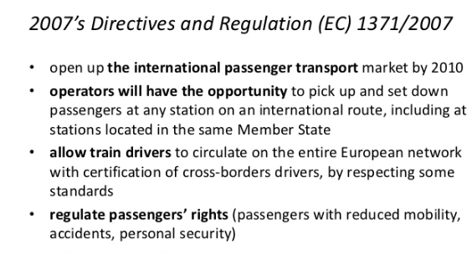

Slide 33
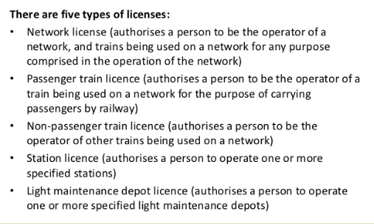

Slide 34
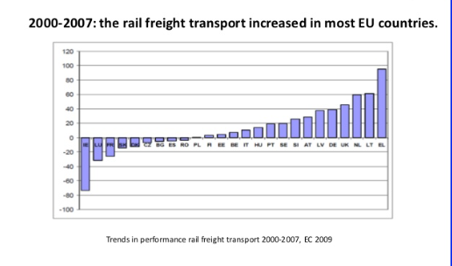

Slide 35
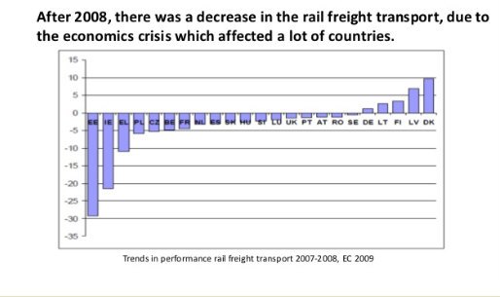

Slide 36
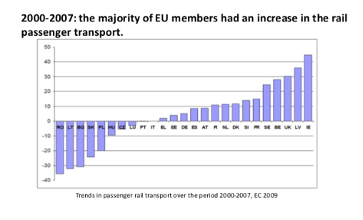

Slide 37
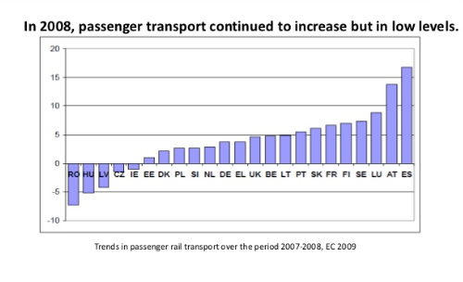

Slide 38
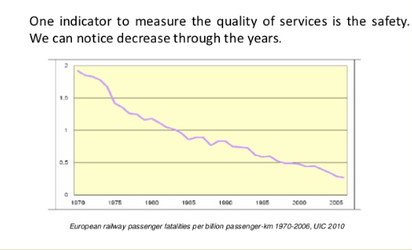

Slide 39
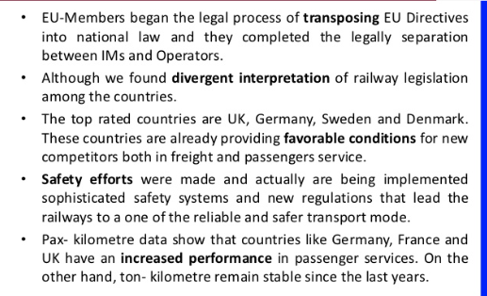

Slide 40
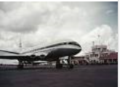
After decades of country-sponsored protectionism, Europe's passenger air services sector has entered an era of liberalisation.
Motivated by a desire to promote a less regulated economic environment and lower air travel prices, the European Union introduced in 1987 legislation aimed at dismantling government regulation of the Community's airline industry.
By April 1997, the deregulation process was largely complete.
http://www.saisjournal.org/posts/european-airline-deregulation

Slide 41
On paper, the initiative has achieved its desired end-product: companies and not governments now decide which cities receive what level of air service and at what price.
The new regime has also heightened competition between airlines and catalysed more air service throughout the Community.
While gratifying, these celebrated results leave unanswered numerous important questions as to the efficacy of Brussels' initiative: how successful has the intervention been in promoting enhanced competition in the sector, catalysing more service provisions, and, most importantly, lowering the prices faced by European passengers?

Slide 42
The move towards liberalisation of the airline industry gained its first major victory in 1978 when the U.S. Congress passed the Airline Deregulation Act after observing that protection and promotion of US carriers was actually harming the consumers it aimed to protect - as prices charged were increasingly incompatible with justifiable costs.
The Act immediately generated benefits for American consumers and, less predictably, the domestic airline industry.
With the introduction of bona fide competition onto routes that had previously offered consumers one or perhaps two options, fares plummeted, falling 21 percent (adjusted for inflation) between 1978 (when deregulation went into effect) and 1988. Elicited by this drop in fares was a tremendous surge in traffic, as passenger boarding climbed from 245 million to 455 million.
For the airlines' part, the end of regulation also signalled the end of their obligation to operate efficiency stifling point-to-point networks, which carriers replaced with the eminently more efficient hub-and-spoke route networks

Slide 43
These shortcomings, as well as the incredible financial instability that saw numerous American airlines-both established in and new to the sector-overextend themselves into bankruptcy, seemed to confirm long-held European beliefs that regulation was necessary.
However, one country-the United Kingdom- saw it differently.
Focusing on the gains achieved, and dismayed by poor performance at home and by other European airlines, a House of Lords Select Committee on the future European Community noted in a 1980 report that "the interests of the [European] consumer appear to be sacrificed to the prestige of flag carrying national airlines and the protected environment in which they operate.“

Slide 44
Although UK deregulation of airlines has lagged significantly behind developments in the United States, European Community (EC) reforms have lagged behind even more.
Thus, whereas substantial deregulation occurred in the UK in the mid 1980s, major European Community reform in airlines is a phenomenon of the l990s.
The UK can also be distinguished from most of the other Member States of the EC by virtue of the fact that its major national carrier is fully, privately owned.
The national carriers of other member states of the EC can be divided into those that are 100% state-owned (e.g. Air France, Aer Lingus), those that are majority state-owned (e.g. Lufthansa, Alitalia) and those in which there is a substantive but minority state holding (egs. KLM, Luxair).
In many ways the privatization of BA at the beginning of 1987 is the decisive event in the history of the UK industry over the past twenty years, not only because of the direct impacts of the transfer of ownership but also because government policies on issues of deregulation and liberalization have been much influenced by the flotation
http://www.esri.go.jp/jp/archive/dis/dis060/dis060b.pdf

Slide 45
Arguably, privatisation itself is a form of deregulation: although in principle state-owned enterprises can be required to operate as fully commercial operations, in practice they are frequently used as instruments to achieve certain types of political or public policy goals.
Privatisation therefore typically involves abandonment by the state of some of its very specific policy instruments.
Where such new regulations are substantial in scope it is, therefore, more accurate to talk of regulatory reform rather than of deregulation.
In respect of airlines, however, the flotation of BA did not lead to the creation of any new agency -- the Civil Aviation Authority (CAA) continued to operate as the industry’s main regulatory body in much the same way as it had previously.
And the reduction in the Department of Transport’s control over the industry consequent upon BA’s privatisation can therefore properly be viewed as a form of deregulation.

Slide 46
The distinction between promoting competition and deregulation is an important one in the European context.
In the UK, for example, the new regulatory agencies created during the privatisation programme have been given powers and duties to promote competition, so that in some dimensions the degree of regulation has actually increased.
The CAA is the body responsible for both the economic and technical regulation of the industry, including matters such as issuing domestic route licences and deciding which UK airlines to designate on particular routes under bilateral international agreements.

Slide 47
Privatisation and deregulation in the UK: chronology of main events.
1969 Edwards Committee recommends the creation of a second-force UK airline to
compete with the state-owned BOAC and BEA. White Paper endorses the Edwards Committee proposals, leading to the formation of BCal and limited route transfers to the new airline.
1972 Formation of BA through a merger between BOAC and BEA.
1976 White Paper concludes that there should be no competition between UK carriers on long-haul scheduled services.
1980 Civil Aviation Act is passed, shifting policy to a more pro-competition stance.
Among other things, the Act gives the CAA a direct duty to further the interests of users of airlines and to have particular regard to the benefits that might arise from licensing two or more UK airlines on the same route. The Act also gives the Government rights to sell shares in BA.
1981 Lord King becomes chairman of BA.
1982 Launch of an extensive cost cutting programme, including employment reductions, suspension of unprofitable routes and disposal of surplus assets.
1984 Publication of the CAA review of the industry and of the Government White Paper

Slide 48
Airlines Competition Policy, leading to further deregulation of domestic markets. British Airways is converted from a public corporation to a "public limited
company" (i.e. a joint stock company) in readiness for privatisation.
1985 Privatisation is postponed pending settlement of US anti-trust litigation concerning operations on North Atlantic routes.
1986 Anti-trust litigation is settled.
1987 BA is privatised via an offer for sale and shares start trading on 11 February.
Announcement of merger between BA and British Caledonian followed by a Monopolies and Mergers Commission investigation leading to approval of the merger.
1989 BA attempts and fails to acquire 20% of Sabena World Airlines (the Belgian flag carrier).
1992 BA acquires 49.9% of TAT European Airlines (a French domestic carrier) and 49% of Deutsche BA (a renamed German domestic carrier).
1993 BA acquires 25% of Quantas (one of the two major Australian carriers).
Announcement of BA plans to acquire a 19.9% stake in USAir.

Slide 49
European Community Policy.
Although a Common Transport Policy has existed since the foundation of the European Community, the airline industry was initially excluded from the full application of this policy.
As a result, Member States of the EC controlled their own domestic industries, and international agreements (including between Member States) evolved bilaterally under the Chicago Convention of 1944.
Even today there is no single regulatory body governing inter-State air transport.

Slide 50
Thatcher government began reforming Britain's share of European commercial aviation, both internally and within the Community.
These ends were achieved by the complete privatisation of British Airways in 1987, and by the loosening of bilateral air agreements with several key countries.
The British noted that the bilateral agreements, which traditionally restricted air service between two countries to a single carrier from each on any given route, served to keep competition at an absolute minimum.
Indeed, in 1987, of the 988 routes existing within the European Community, only 136 were served by more than two carriers, 12 and carriers were allowed to keep capacity below market level (thereby elevating prices faced by travellers).
A case in point is provided by the since-voided agreement between Britain and France and its effect on the London-Paris market.

Slide 51
The busiest air route in Europe in 1983 with 2.1 million passengers, the London ­ Paris market was essentially operated as a duopoly with absolute collusion.
Given the high demand, both airlines operated several frequencies with large aircraft, an action that would normally lower prices as the seat-cost for a flight is reduced substantially with large aircraft utilisation
Indeed, the lower costs, high yields (which accrue from the fact that the route is heavily travelled by business people and is only 215 statute miles), and relatively high load factors of the route should have resulted in a fare 10-20 percent lower than the European average.
However, the lack of competition meant that Air France and British Airways enjoyed the ability to charge passengers one of the highest fares (on a fare/ kilometre basis) in Europe.

Slide 52
To change this situation, UK policy makers prevailed upon officials from the Netherlands and then Ireland to liberalise their respective aviation accords with Britain so as to eliminate government interference in: the number of carriers allowed to serve the markets; the amount of capacity supplied to the markets; and the level of fares offered.
While the effects of the UK's agreement with the Netherlands were impressive, it was the results of the 1986 treaty with Ireland (the UK-Ireland market is much larger than that between Britain and the Netherlands) that truly highlighted the possibilities of airline liberalisation in Europe.
Duly impressed by the gains illustrated by the American and especially the British liberalisation initiatives, the European Community inserted itself into the process to become a force for change in the sector in the early 1980s.
Using the 1957 Treaty of Rome as its foundation, the increasingly self-assured EC began tearing down the protective measures constructed and maintained by the Continent's national transport entities.

Slide 53
A good illustration of the working of European policy is to be found in the first airline merger to be examined by the European Commission, the merger between BA and BCal in 1987 .
Authority to act in this case derived from Article 86 on the basis of the dominant position that would be enjoyed by the enlarged BA in landing slots at London’s main airports (Heathrow and Gatwick).
The Commission used its powers to extract undertakings from BA to release a certain number of slots to new entrants wishing to establish services on European routes.
A similar approach has been adopted in later airline mergers, including Air France/UTA, KLM/Transavia, Air France/Sabena and BA/TAT (the last two of which were handled via the new Merger Regulation)

Slide 54
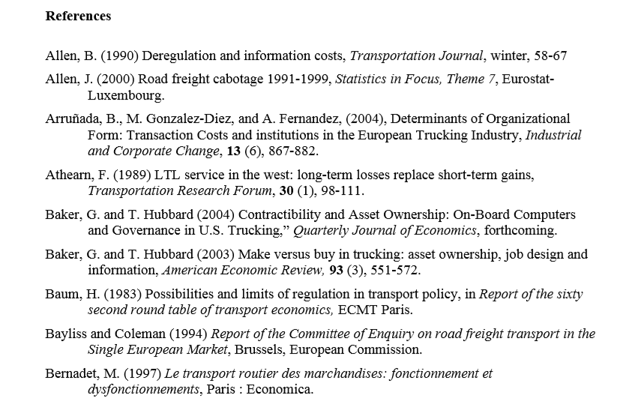

Slide 55
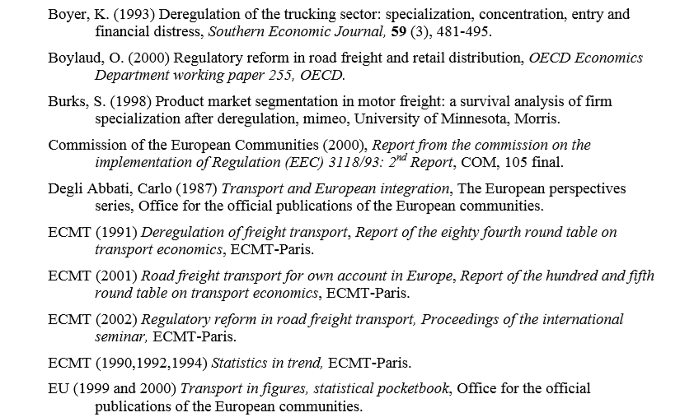

Slide 56
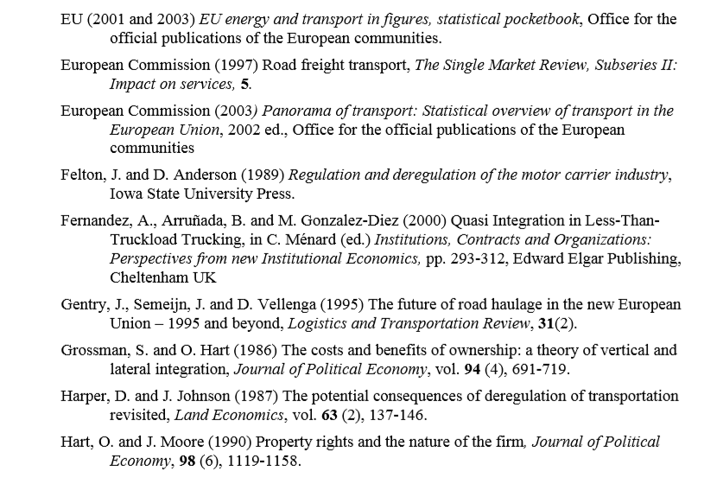

Slide 57
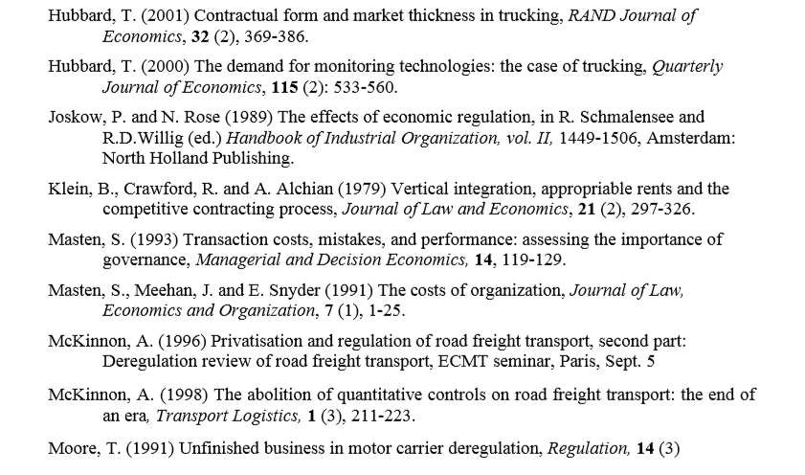

Slide 58
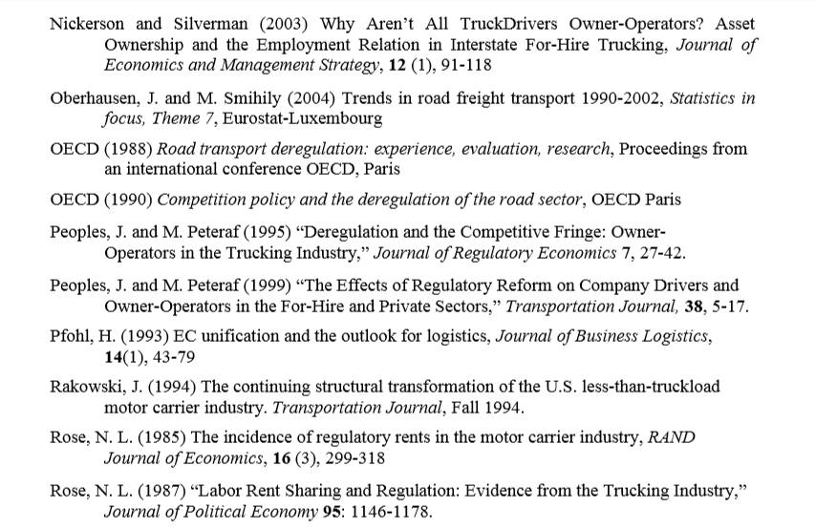

Slide 59
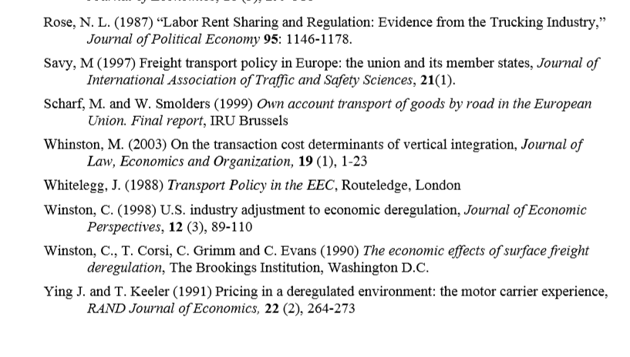

Slide 60
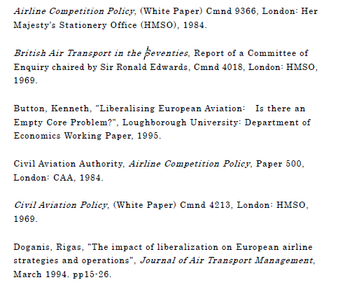

Slide 61
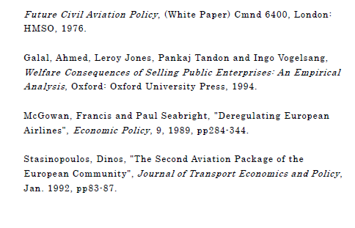

Slide 62
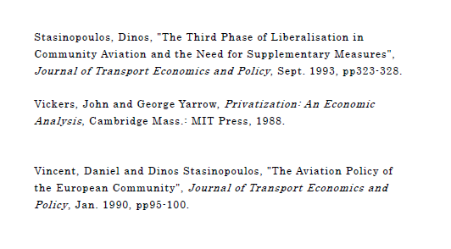

Slide 63
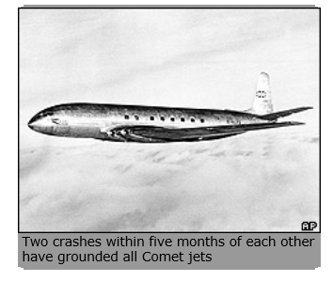
ANY QUESTIONS
1954: 'Metal fatigue' caused Comet crashes
The public inquiry into the Comet airliner disasters has heard that metal fatigue was the most likely cause of two recent crashes. The first crash happened in January, when 29 passengers and a crew of six lost their lives off the Italian island of Elba.
The Comet's certificate of airworthiness was withdrawn after the second crash, just three months later. Fourteen passengers and seven crew died when the plane went down off the coast near Naples

