Slide 1

Restaurant Review (MADBUNS)
Introduction to Gastronomy
(BMGM4001)
Amdadur Rashid Masum (Student ID: 2128870)
Teacher: Ffion Cumberpatch BA (Hons) CertHE MIH

Slide 2
Contents
Introduction
Establishment
​Marketing & Facilities
Dining Experience
Other Observations
Pictures of my visit
​Conclusion
References

Slide 3
Introduction
"Once you try it, you will love it"(Weinryb, 2022).
So, the whole concept of Madbuns started with these three blokes from Swansea who were constantly on the hunt for the most mind-blowing burger in town.
Never visited before, went there with three other friends, heard lot about this place from friends. So, 20th November 2023 we visit Madbuns.

Slide 4
Establishment
Hey there! Let's talk about Madbuns Incorporated, the buzzing startup that took the scene by storm on February 19th, 2021 (GOV.UK, n.d.).
Madbuns is quick-service restaurants(Kent, 2018).

Slide 5
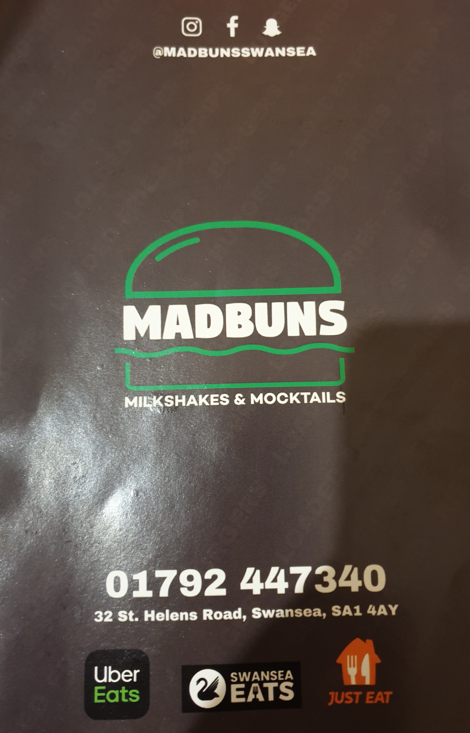
Marketing &Facilities
>Madbus have Small dinning in area (capacity 20seats).
Also, Customer can order takeaway and deliveries.
>Customer can order via telephone/UberEATS/SwanseaEats/Just Eat.
If Customer want to order online its take you to SwanseaEats site.
>They also connect with customer via social platform like Instagram, Facebook, snapchat.
>It's located on 32 St Helen's Rd, Swansea SA1 4AY (Google, n.d.), also have bus stop opposite the shop. >There is no car park, but you can park side of road anytime up to a 2 hour.

Slide 6
Dining Experience
Welcoming
ordering
eating
Using washroom
Bills
According to (Tenifa, 2022)
Clarify and verify Order. Waiter arrived to take order with smile on his face, I have order Tower of London (smashed beef, lettuce, ketchup, cheese, fried egg and turkey rushers), chips and mojitos, my friend's order other different burgers, drinks and sides.
Our bill was 58 pound. Per head costing 14.50, on the other hand Medium Big Mac Meal costing £5.69(Jenne, 2023). Its little Expensive but service and food quality make this stunning value.
Its good size and clean but its little cold, they could have put the heating on .It is very important to have very clean washroom because, according to (ECJ, 2018) 97% Brits wont visit won't return (2012 adults participate).
The staff at MadBuns Welcoming is hailed as friendly, accommodating, and super welcoming. It seems like they go above and beyond to make sure their customers feel right at home. According to (https://waybackburgers.com/franchising/, 2020) first impression set the tune.
Food arrived after 20 munities we order; it was smoking hot when its arrived. It is very different and flavorful, I have thoroughly enjoyed it also portion is very big, my friends also enjoyed their meal. I believe it's because of local sourcing, locals source make food fresh, tastier and sustainable (SarahRe, 2023).

Slide 7

Other observation
Vegetarian options
Food hygiene
Drinks and vegan options
Nice to see there is some vegetarian options(Madbuns, n.d.).
It is important to have vegetarian options to get wider audience. According to (Dulhunty, 2019) increasing of health consciousness, people becoming more vegetarian.
Food hygiene is 4 star, which is good (Agency, 2023), if they improve little bit more, they can get 5 star.
There is some mocktails on the menu, tried mojito, very refreshing. Also, other soft drinks available.
On the vegetarian section there is one item is vegan (Plantacious) ,
According to research (Vegconomist, 2023) Vegan Food market growing Rapidly.

Slide 8
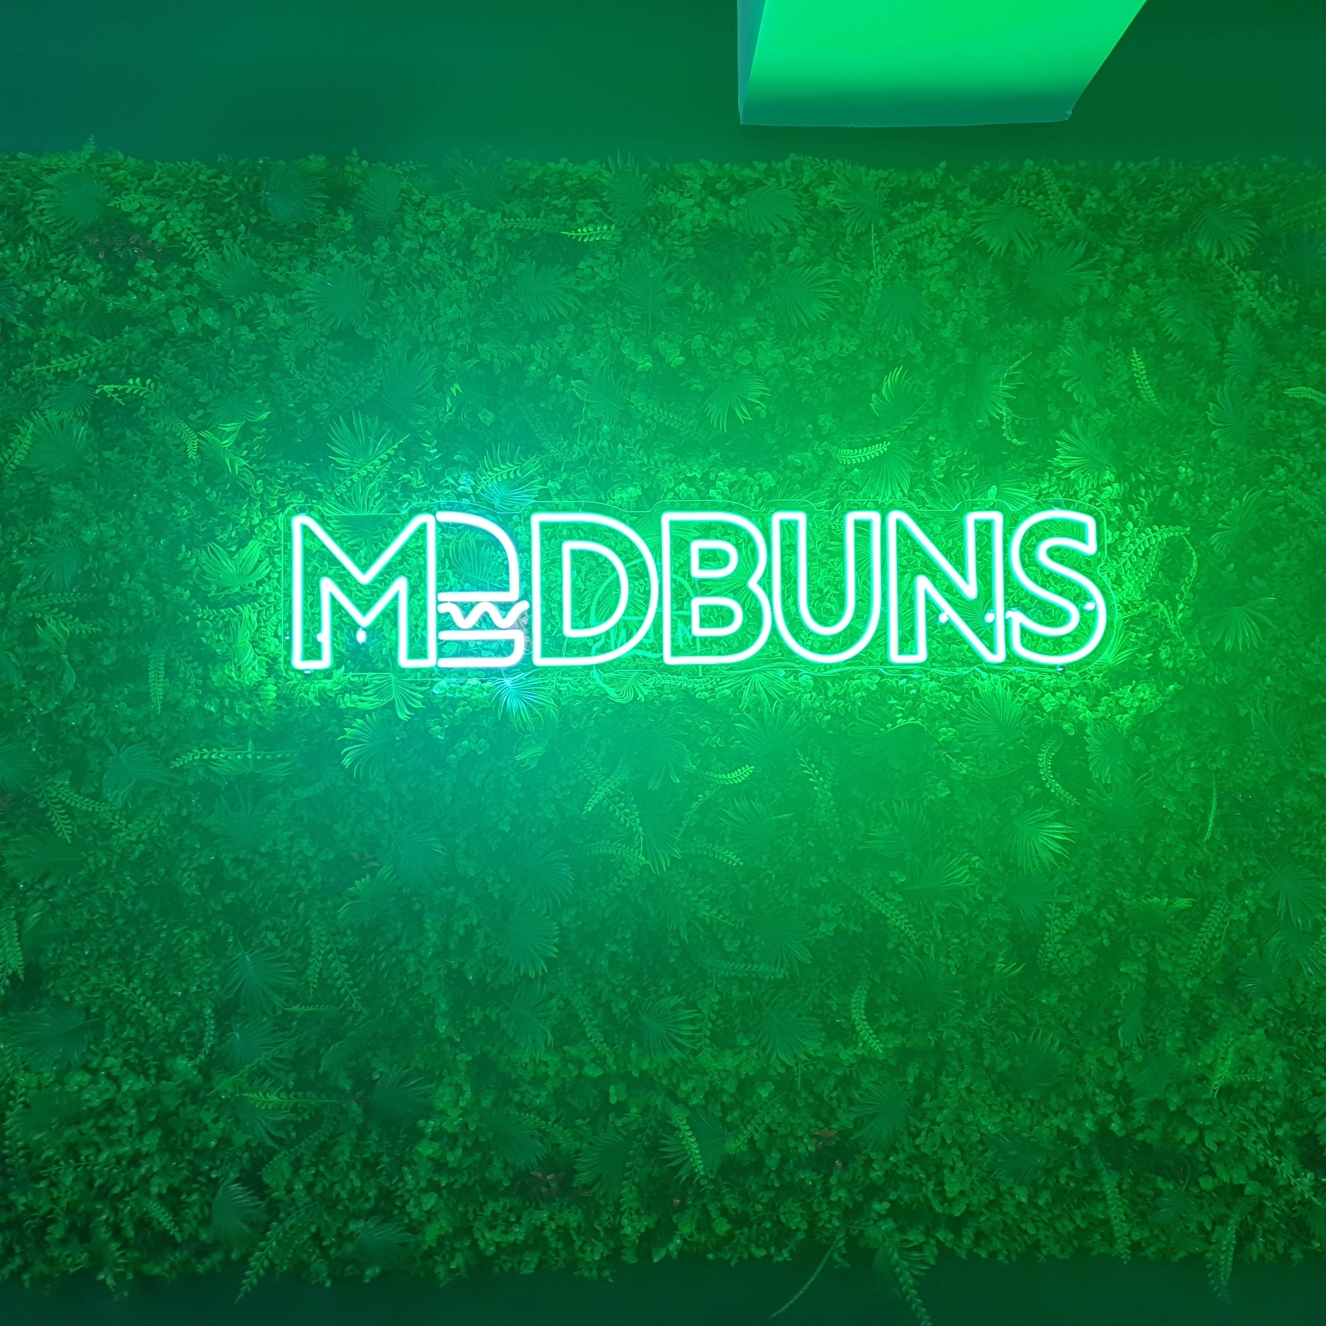
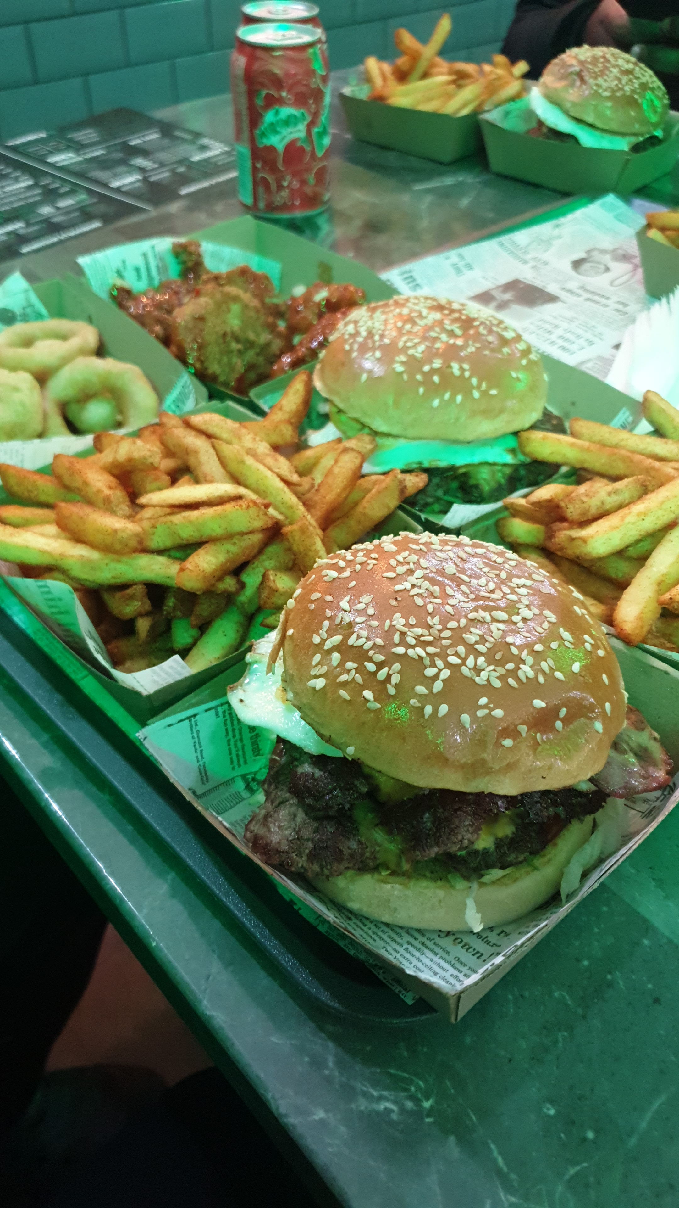
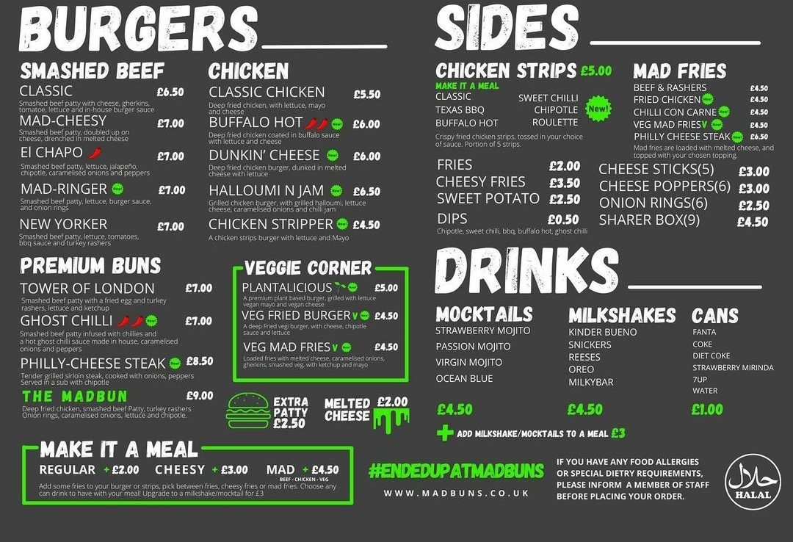
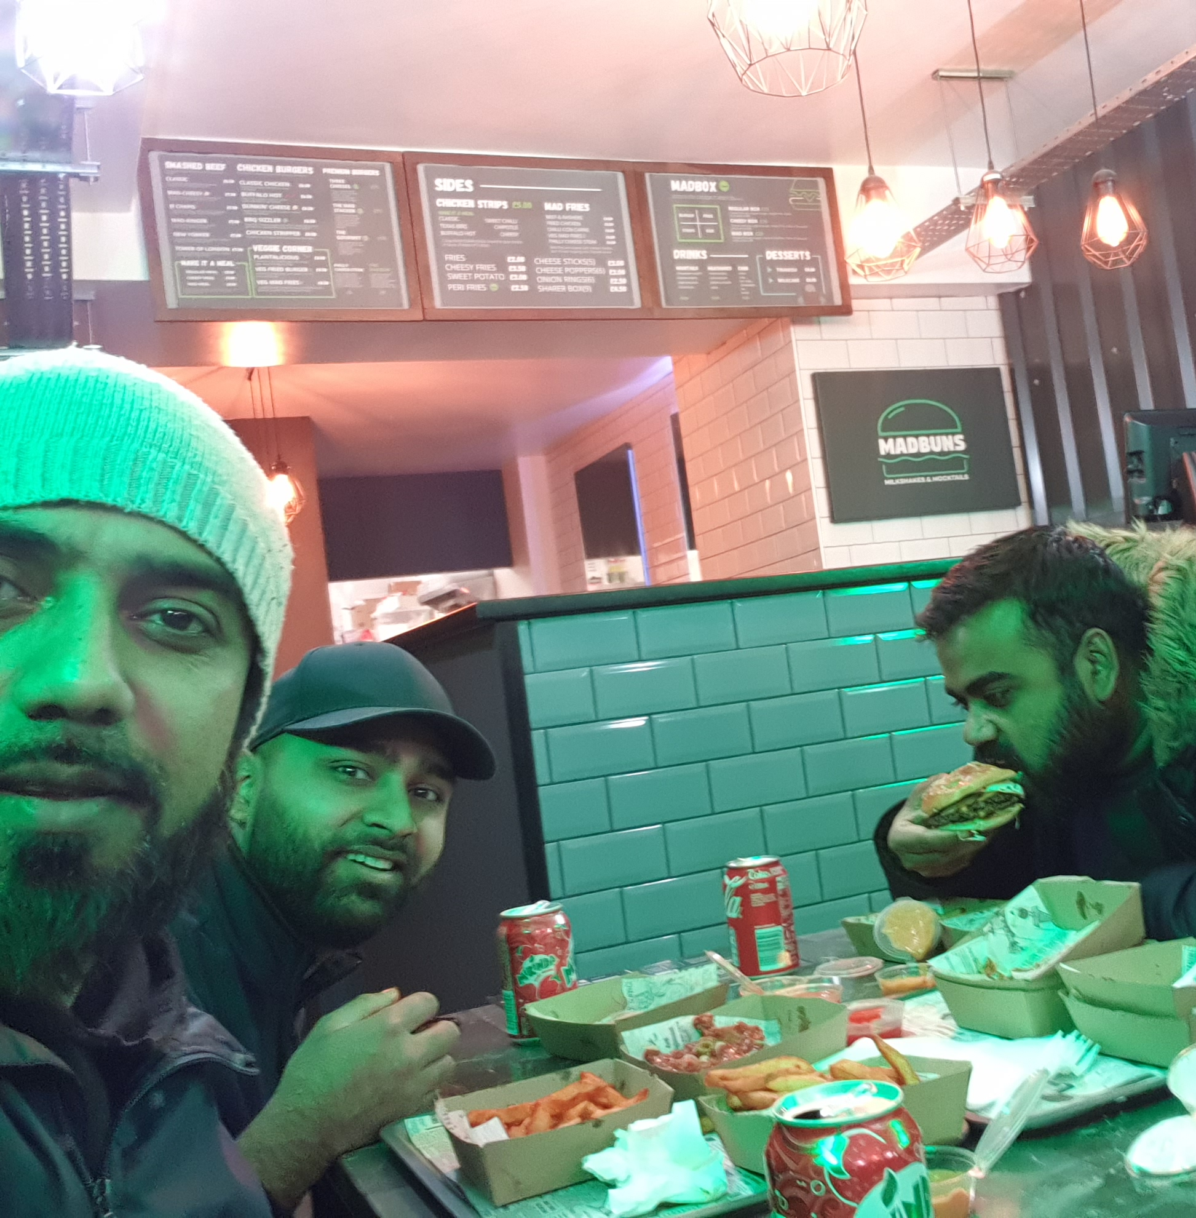
PICTURES OF MY VISIT
Logo
Food on the table
MADBUNS MENU
Happy customer

Slide 9
Conclusion
>From the moment I walked in, the warm and inviting ambiance set the stage for a delightful dining experience. As I perused the diverse menu options, it became evident that this establishment prides itself on quality ingredients and innovative spice combinations.
>The attentive staff ensures prompt service and is knowledgeable about the menu offerings, effortlessly accommodating dietary restrictions or preferences (Rohrer, 2019).
>On the negative side comparing with competitors Madbuns price is very expensive., despite providing very different kind of burgers, Direct competition refers to businesses that compete for the same target market and offer very similar products and services.(SavorEat, 2022).
>Surprisingly, there is no food review on Trip Advisor, but they got good connection on social platform.
>All in all, this food review concludes with a resounding recommendation for anyone seeking an unforgettable culinary adventure with exceptional quality and service at this fantastic restaurant.

Slide 10
Reference list
Agency, F.S. (2023). Madbuns Ltd | Rating Business Details | Food Hygiene Ratings. [online] ratings.food.gov.uk. Available at: https://ratings.food.gov.uk/business/1386822 [Accessed 4 Dec. 2023].
Dulhunty, K. (2019). 6 reasons why restaurants should include vegetarian and vegan dishes on their menu. [online] www.linkedin.com. Available at: https://www.linkedin.com/pulse/6-reasons-why-restaurants-should-include-vegan-dishes-lucia-sander#:~:text=Having%20these%20culinary%20offerings%20is [Accessed 4 Dec. 2023].
ECJ (2018). Dirty Washrooms Deter 97 Per Cent Of Brits From Returning To A Restaurant - ECJ. [online] www.europeancleaningjournal.com. Available at: https://www.europeancleaningjournal.com/magazine/articles/latest-news/dirty-washrooms-deter-97-per-cent-of-brits-from-returning-to-a-restaurant [Accessed 4 Dec. 2023].
Google (n.d.). Google Maps. [online] Google Maps. Available at: https://www.google.com/maps/place/Madbuns/@51.6178261 [Accessed 4 Dec. 2023].
GOV.UK (n.d.). MADBUNS LTD overview - Find and update company information - GOV.UK. [online] find-and-update.company-information.service.gov.uk. Available at: https://find-and-update.company-information.service.gov.uk/company/13214454 [Accessed 4 Dec. 2023].
https://waybackburgers.com/franchising/. (2020). How to Greet Customers in a Restaurant: 5 Essential Tips - Wayback Burgers Franchising. [online] Available at: https://waybackburgers.com/franchising/blog/how-to-greet-customers-in-a-restaurant-5-essential-tips/.
Jenne, E. (2023). Cost of Meals at Nando’s, McDonald’s, Burger King, KFC and Pizza Hut in 2023. [online] My London. Available at: https://www.mylondon.news/whats-on/food-drink-news/fast-food-chain-prices-2023-27471735 [Accessed 4 Dec. 2023].
Kent, D. (2018). Different Styles of Service in the Restaurant Business. [online] Portsmouth Travel. Available at: https://www.wynwoodportsmouth.com/different-styles-of-service-in-the-restaurant-business/ [Accessed 5 Dec. 2023].
Madbuns (n.d.). Burgers | Madbuns Ltd | Wales. [online] My Site 1. Available at: https://www.madbuns.co.uk/ [Accessed 4 Dec. 2023].
Rohrer, V. (2019). How to Accommodate Dietary Restrictions. [online] Smart Meetings. Available at: https://www.smartmeetings.com/tips-tools/117873/how-to-accommodate-dietary-restrictions [Accessed 6 Dec. 2023].
SarahRe (2023). Burger Week, Local Sourcing and Inspiration: A Q&A with Catherine of Naïve and Nostalgic. [online] What Chefs Want! Available at: https://www.whatchefswant.com/2023/07/14/burger-week-naive-feature/ [Accessed 4 Dec. 2023].
SavorEat (2022). How to Leverage Competitive Analysis To Beat Competition in the Food Industry. [online] SavorEat. Available at: https://savoreat.com/how-to-leverage-competitive-analysis-to-beat-competition-in-the-food-industry/ [Accessed 7 Dec. 2023].
Tenifa, S. (2022). 10 Ways to Improve Order Accuracy in Your Restaurant - RizePoint. [online] rizepoint. Available at: https://rizepoint.com/10-ways-improve-order-accuracy-restaurant/ [Accessed 7 Dec. 2023].
Vegconomist (2023). UK Vegan Food Market Grows 9.58% as 40% of Consumers Demand Plant-Based Options - vegconomist - the vegan business magazine. [online] Vegconomist. Available at: https://vegconomist.com/market-and-trends/uk-vegan-food-market-grows/ [Accessed 6 Dec. 2023].
Weinryb, D. (2022). 100+ Top Restaurant Slogans and Taglines (2022). [online] TouchBistro. Available at: https://www.touchbistro.com/blog/restaurant-slogans-and-tagline-ideas/ [Accessed Dec. 4AD].

