Slide 1
“Death by PowerPoint”

Slide 2


Haleema Qureshi
2112158@student.uwtsd.ac.uk
I am currently studying full time in university.
University of Wales Trinity Saint David Birmingham Campus

Slide 3
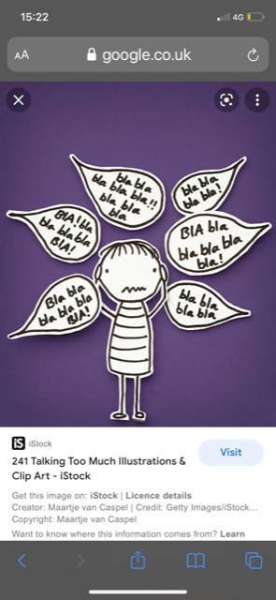
Rules for message
Texts should be condensed
Not complicated
One message per slide

Slide 4

Rules for contrast
Contrast Control Focus
Visual aid : colours, graphs

Slide 5

Rupet Natalia
2109475@student.uwtsd.ac.uk
I work as a Team Leader in a tissue factory.
I am a curious person.
University of Wales Trinity Saint David Birmingham Campus

Slide 6

Rules for Font size
Recommended style fonts
Arial, Tahoma and
Verdana
Titles size
- Verdana 40 points
Subtitles size
- Verdana 32 points
Content text size
- Verdana 24 points
Incorrect font sise
- not recommended Verdana 12 points
Notes:
test1

Slide 7
Rules for senteces
Key words
Maximum 30 words per slide
6 – 8 lines per slide

Slide 8

Alexandra Craciun
2109141@student.uwtsd.ac.uk
I am the mother of 4 wonderful children
University of Wales Trinity Saint David Birmingham Campus

Slide 9
Rules for background
Dark background
Same background for each slide
Do not use multiple backgrounds
Changing the style is distracting

Slide 10

Thank you
for
your attention

Slide 11
Do you have any questions ?

