Slide 1
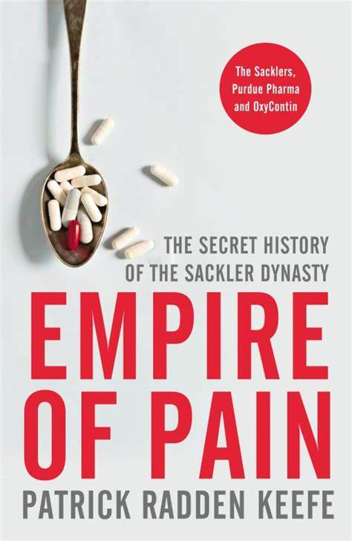
Sackler Family
Big pharma
Opioids and addiction
The impact was known and predictable
The drugs were brilliantly and very successfully marketing in the USA
Their spread has been incredible
Their impact devastating

Slide 2
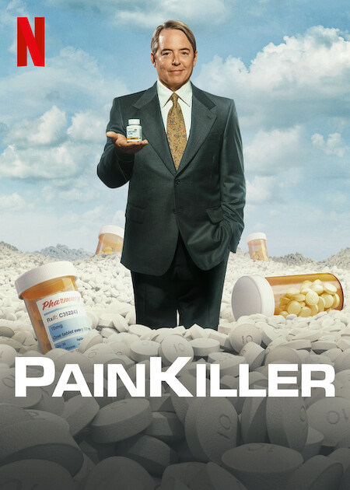
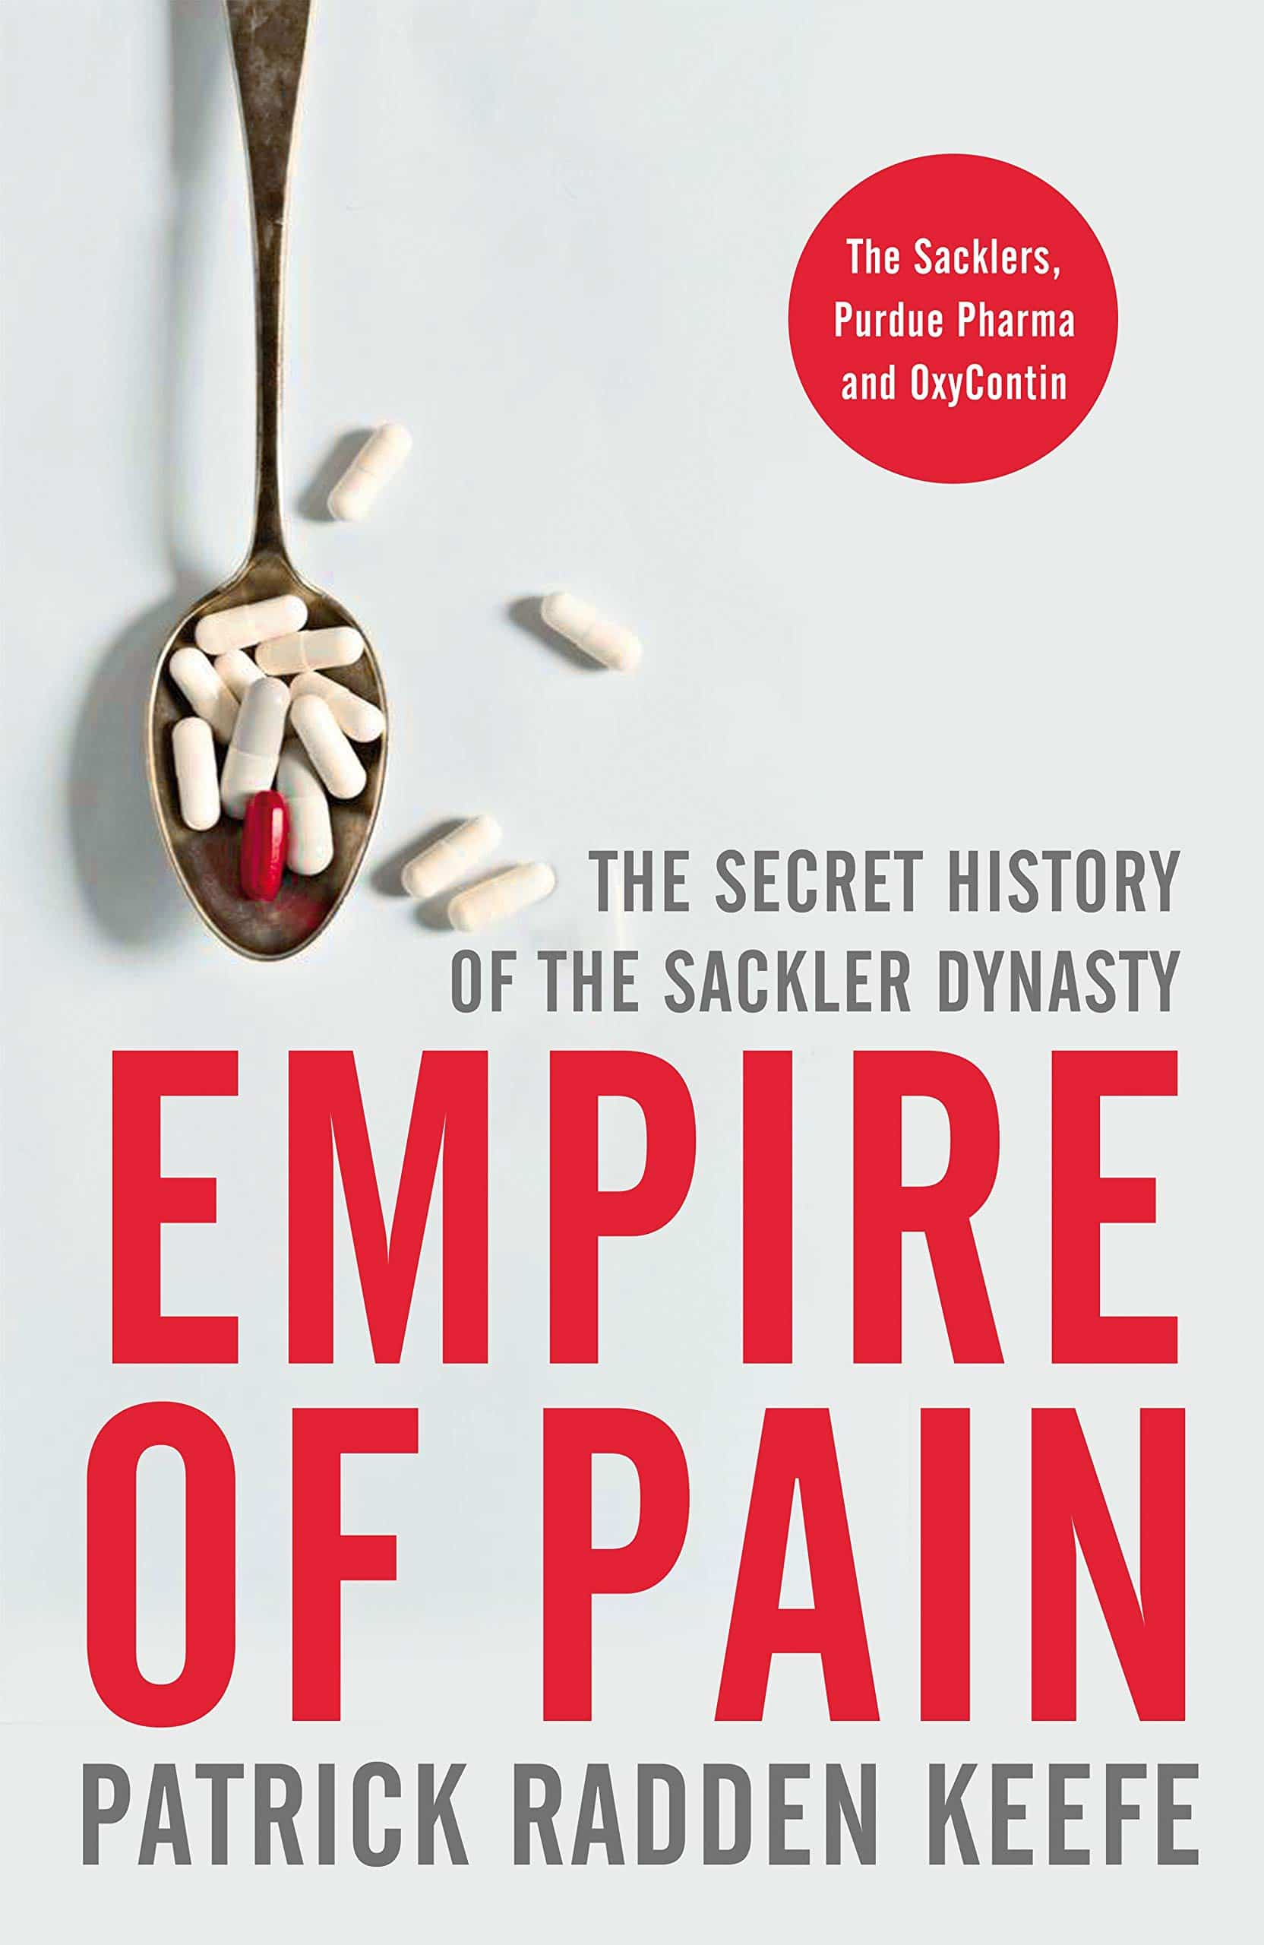
Substance Misuse and Big Business

Slide 3
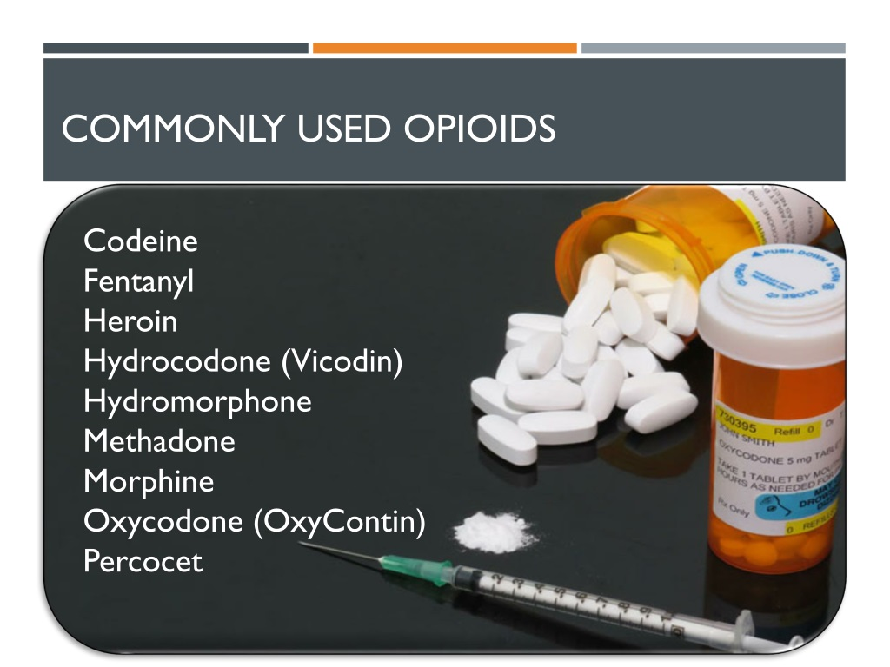
Profit from Misery
The availability and promotion of opioids
Genius of the Sackler family
Opioids and addiction
$15 billion empire built on human misery
Huge pressures on communities, policing, health and public services

Slide 4
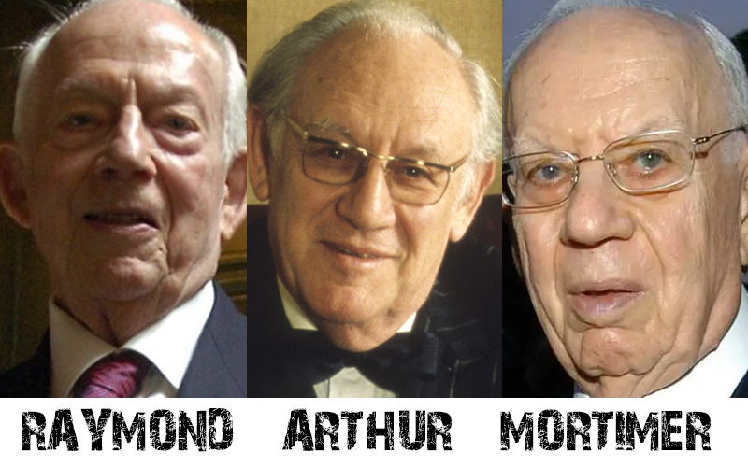
Arthur Sackler (1913-1987)
Born in Brooklyn, with brothers Mortimer and Richard. Family owned a grocery store. Mum keen on medical education and all three became doctors
1929 Great Depression
Arthur was an innovator, supplemented his salary at the Creedmoor Psychiatric Hospital with pharmaceutical work
Keefe 2021

Slide 5
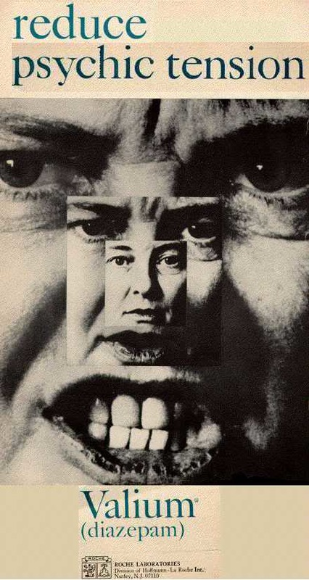
Direct Marketing Worked!
Eli Lilly gave out free stethoscopes; Roche free textbooks, Pfizer organised golf tournaments with logo stamped golf balls
AS created the Journal of Clinical and Experimental Psychobiology – so he could publish authoritative articles
AS bought Purdue Frederick in 1952 for $50k
Aggressive search for the next big thing: drugs to be marketed as cure for emotional stress and pressures
Diazepam, Valium – the first $100m drug (Valere – to be in good health)
AS commission from Roche
Keefe 2021

Slide 6
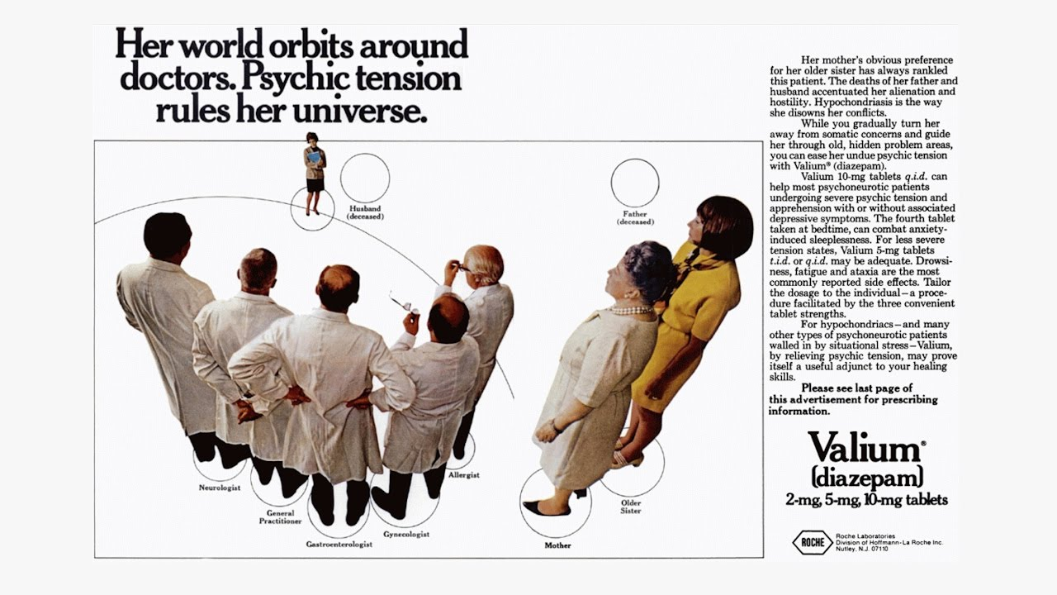

Slide 7
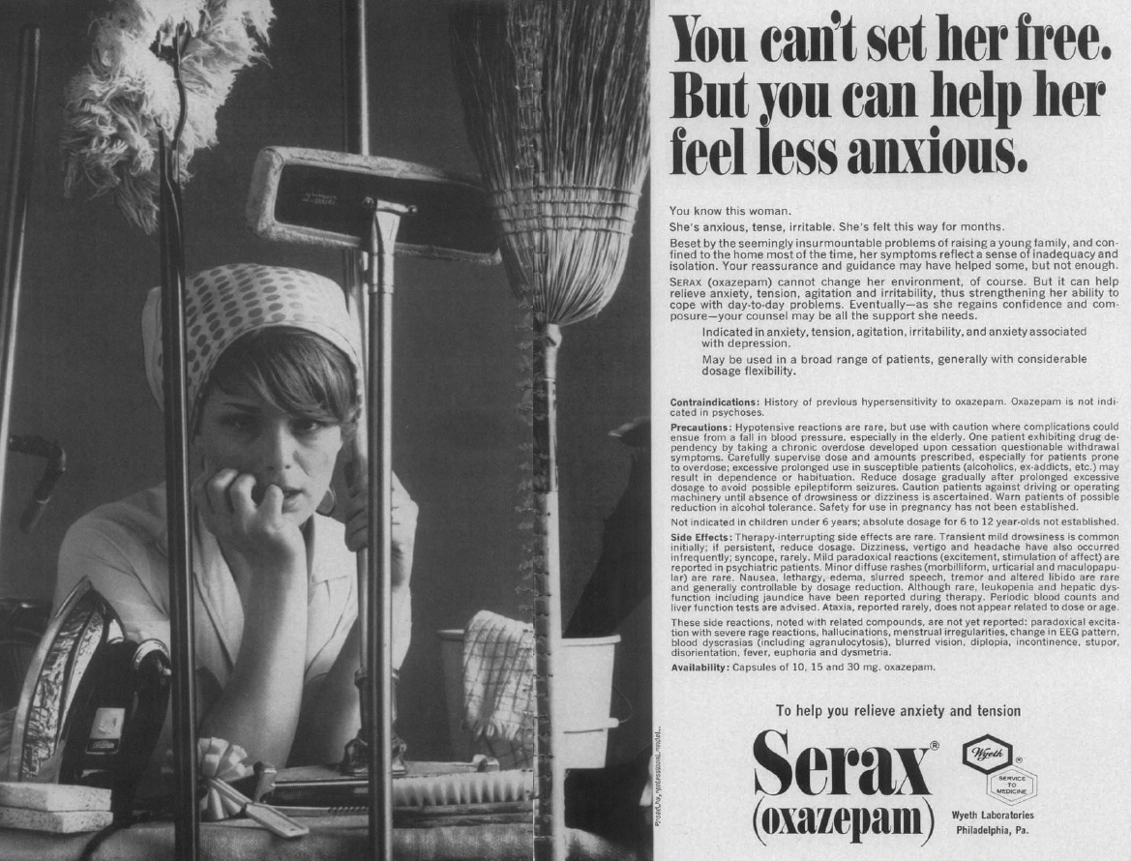

Slide 8
Oxycontin
Use of Opium dates back to ancient Greece and Hippocrates who prescribed the drinking of white poppy juice mixed with nettle seeds
A staple of the British Empire. Opium Wars with China 1839-1860
Shelley and Byron – morphine
After the American Civil War – by 1898 250k Americans addicted to morphine
1910 Pres Theo Roosevelt appointed an opium commissioner (Dr Hamilton Wright).
He said it was, “the most pernicious drug known to humanity.”
MS Contin worked but when the patent run out anyone could make it
Oxycontin (Oxycodone) was the result – a huge, quick pain reliever
Twice as potent as morphine and hugely addictive - doctors were concerned
Keefe 2021

Slide 9
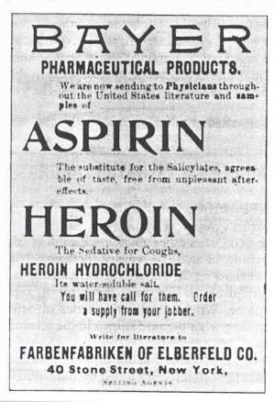
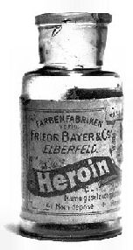
Beyer early 20th century
German company Beyer refined morphine into heroin (invented by addict Heinrich Dreser), same team created aspirin
Marketed as a wonder drug: all the benefits of morphine with no side effects, and even sold as a morphine addiction cure
Heroin x6 more powerful than morphine and just as addictive
Bayer stopped making it in 1913
Keefe 2021

Slide 10
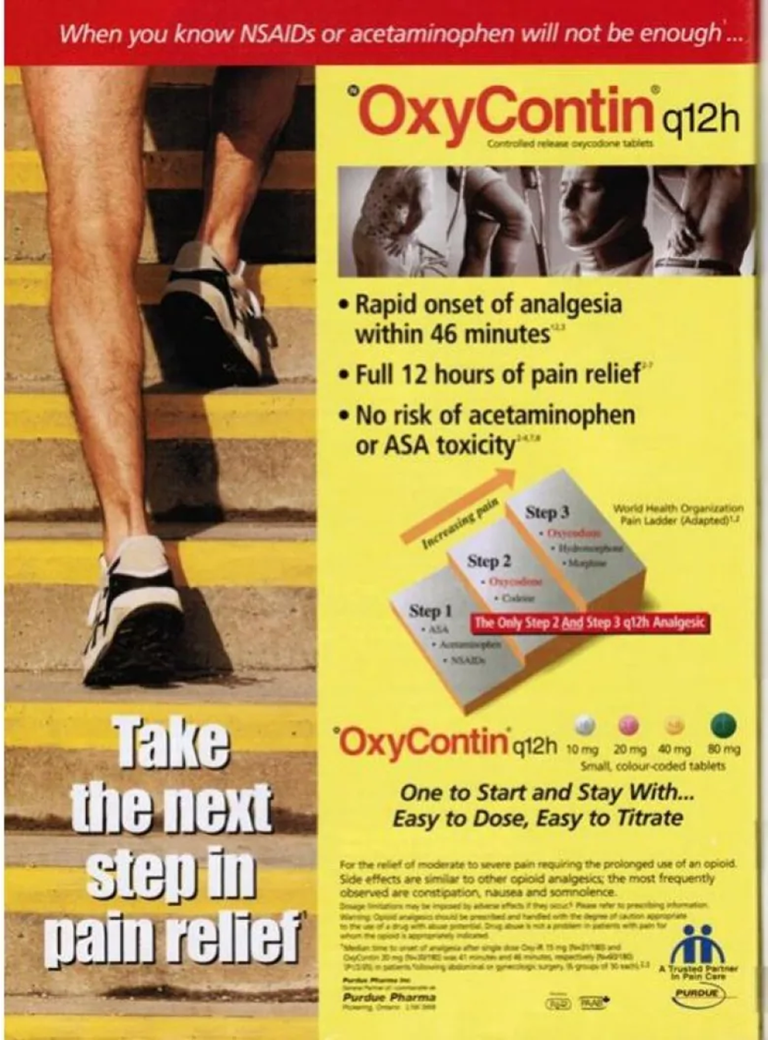
Purdue and Oxycodone
Morphine had negative connotations with terminal illness
Oxycodone was perceived more favourably than morphine and weaker. In fact, it was twice as potent!
AS followed the Bayer route – ignore the truth and do not correct the misunderstandings of American doctors
Keefe 2021

Slide 11
“If Purdue wanted to market a powerful opioid like OxyContin for less acute, more persistent types of pain, one challenge would be the perception, among physicians, that opioids could be very addictive. If OxyContin was going to achieve its full commercial potential, the Sacklers (Richard) and Purdue would have to undo that perception.”
Keefe 2021: 184

Slide 12
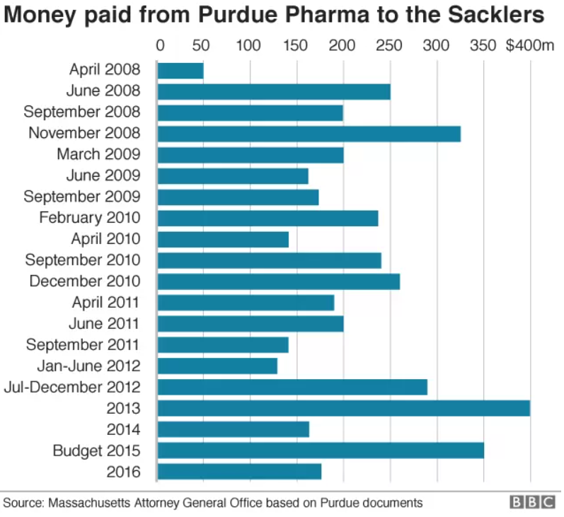
Big business
Marketed cleverly: if you are dying of cancer does addiction matter?
Addiction is about the mindset of the patient not the drug or the prescriber!
Their target was the 50m Americans who suffered chronic pain
They groomed and paid ‘revisionist physicians’
Good looking, charming medical reps paid by prescriptions and dose
Keefe 2021

Slide 13

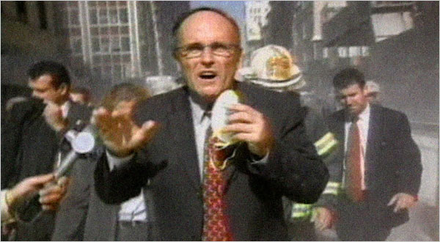
Stamp of approval
Curtis Wright of the FDA has concerns but Purdue bought his support
Approved in 1995 Oxycontin hit the market
Wright then joined Purdue Pharma on $400k in the first year
Former New York Mayor Rudi Guliani (1994-2001) wanted to make money quickly after 911, joined Purdue and within 5 years $17m income and $50m in assets
Keefe 2021

Slide 14
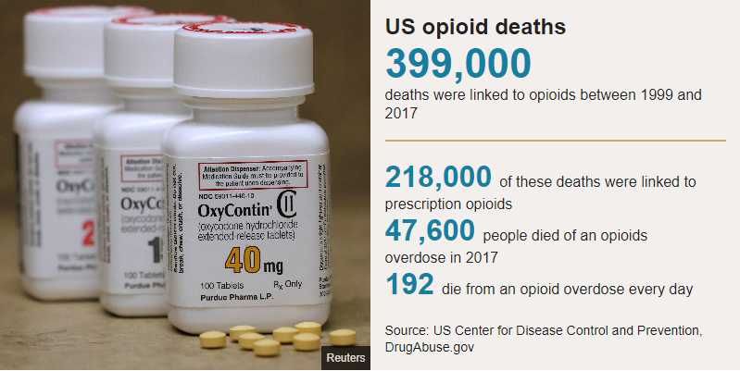
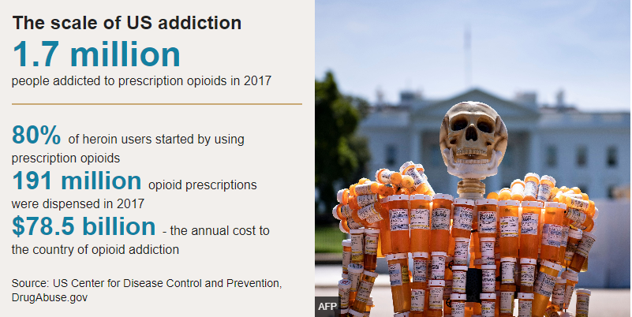
BBC 2019

Slide 15
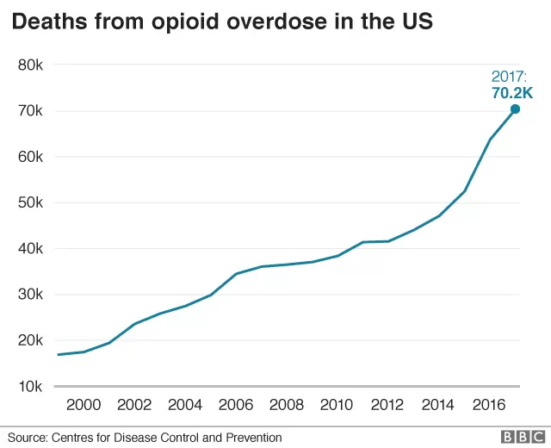

Slide 16
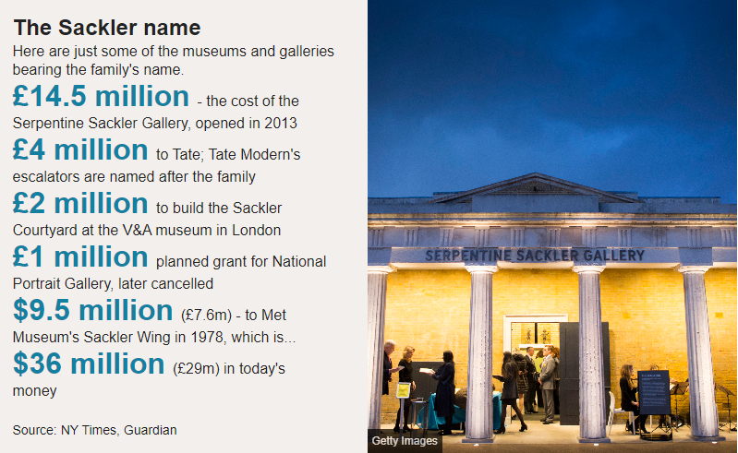
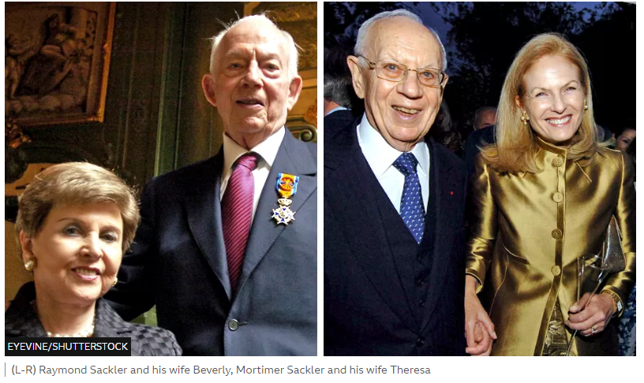
BBC 2019

Slide 17



