Slide 1
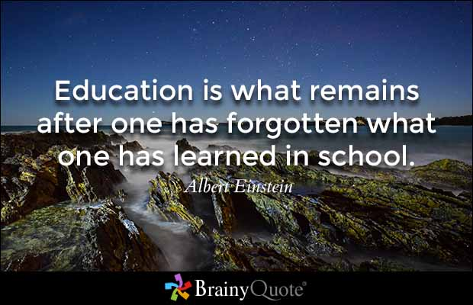
ECES6023C
Hinsoddau Dysgu
Learning Climates
Sesiwn 2 / Session 2

Slide 2

Deilliannau Dysgu/ Learning Outcomes
Mynd i’r afael yn feirniadol ag ymchwil cyfoes a damcaniaethau seicolegol a dysgu allweddol er mwyn gwerthuso effeithiolrwydd amrywiaeth o strategaethau dysgu ac addysgu.
Critically engage with contemporary research and key psychological and learning theory in order to evaluate the effectiveness of a range of teaching and learning strategies.

Slide 3
Deilliannau Dysgu/Learning Outcomes
Dangos dealltwriaeth feirniadol o’r sgiliau proffesiynol sydd eu hangen i gynllunio, addysgu ac asesu ar gyfer cynnydd effeithiol a pharhaus mewn dysgu ac addysgu.
Demonstrate a critical understanding of the professional skills required to plan, teach and assess for effective and sustained progress in teaching and learning.

Slide 4
Deilliannau Dysgu/Learning Outcomes
Dadansoddi yn feirniadol elfennau ymddygiad effeithiol ar gyfer dysgu a chymhwyso damcaniaethau rheoli ymddygiad perthnasol mewn amrywiaeth o gyd-destunau addysgol.
Critically analyse the components of effective behaviour for learning and to apply relevant behaviour management theory in a range of educational contexts.

Slide 5
Heddiw/Today
Elfen holl bwysig o amgylchedd dysgu llwyddiannus:
Addysgu’n effeithiol
A valuable component of a successful learning climate:
Educating effectively

Slide 6
Amgylcheddau Dysgu Effeithiol Effective Learning Environments
Gwyliwch y fideo.
Adlewyrchwch:
  Pa weledigaeth o addysg a welir yma?
  I ba raddau rydych yn cytuno gyda’r portread yma?
  Pa gwestiynau/materion sy’n codi o’r portread yma?
Watch this short video.
Reflect:
  What vision of education is portrayed here?
  To what extent do you agree with this portrayal?
  What issues/questions around education does this portrayal raise?

Slide 7
Darlun traddodiadol o addysgu’n effeithiol
Traditional view of educating effectively
Pupils expect teachers to teach. They value lucid exposition, the clear statement of problems and guidance in their solution. Personal qualities of kindness, sympathy and patience are secondary, appreciated by pupils if they make the teacher more effective in carrying out his primary, intellectual task . . . there appears to be little demand by pupils that teachers shall be friends or temporary mothers and fathers.
(Musgrove and Taylor, 1969: 17 cited in Arthur and Cremin, 2010 )
Pa mor wir yw’r farn hon am addysgu’n effeithiol heddiw?
How accurate is this view of educating effectively today?

Slide 8
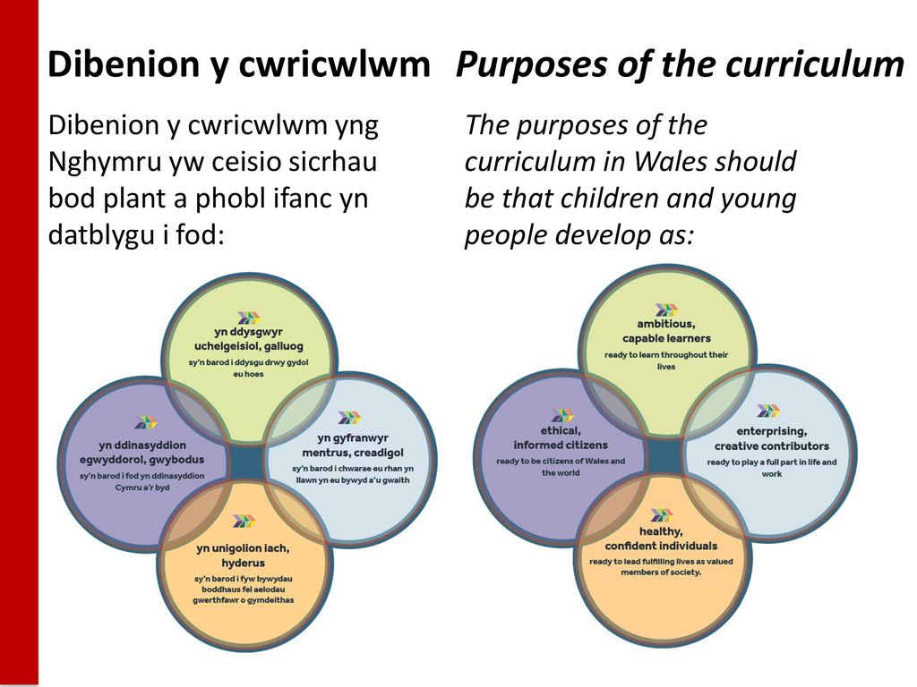
Rydym eisiau MWY dros ein plant
We want MORE for our children
Donaldson, 2015

Slide 9
Os mai dyna yw dysgwr effeithiol…
…beth yw athro effeithiol?
Deall sut mae ffactorau seicolegol a chymdeithasol yn effeithio dysgu
Arbenigedd pwnc a methodoleg
Sgiliau dosbarth sefydlog.
Y gallu i ddal sylw ac ysbrydioli plant i fod yn ddysgwyr annibynnol
Donaldson, 2015

Slide 10
So if that’s what a good learner looks like…
…what does a good teacher look like?
Understanding of how social and psychological factors influence learning.
Excellent subject and methodological expertise.
Sound classroom craft skills.
Ability to engage and inspire children to become independent learners.
Donaldson, 2015

Slide 11
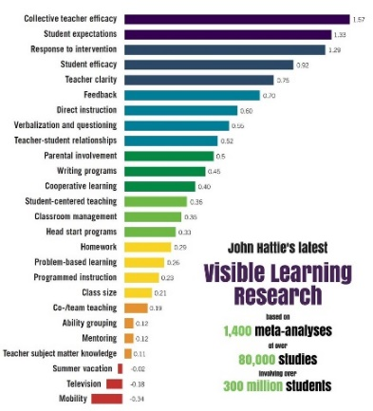
John Hattie
Visible Learning / Dysgu Gweledol (Summary)
Dadansoddiad meta o dros 180,000 darn o ymchwil
Prif negeseuon:
  Mae athrawon effeithiol yn barod i newid. Maent yn defnyddio dulliau sy’n cael effaith ac yn addasu pam nad ydynt yn gweithio.
  Mae angen i dysgu i fod yn weledol. Ydy athrawon yn glir am beth maent yn dysgu? Ydy disgyblion yn deall beth maent eu fod i ddysgu?
Meta analysis of 180,000 studies
Key messages:
  Effective teachers are ready to adapt. Instead of focusing on the teaching methods they use, they focus on the effects they have on students and change things where needed.
  Teaching and learning need to be made ‘visible’ – are teachers clear about what they are teaching? Do students know whet they are supposed to be learning?

Slide 12
Tasg/Task
Mewn grwpiau gwnewch restr o 10 dylanwad allweddol ar ddysgu gan blant yn yr ystafell ddosbarth.
Er enghraifft, perthnasoedd cadarnhaol rhwng athrawon a disgyblion
Trefnwch eich rhestr gyda’r pwysicaf yn rhif 1
A wnaethoch i gyd gytuno ar y drefn?
In groups make a list of 10 key influences on children’s learning in the classroom.
For example, positive teacher pupil relationships
Order your list 1 being most important
Did you all agree on the ordering?

Slide 13
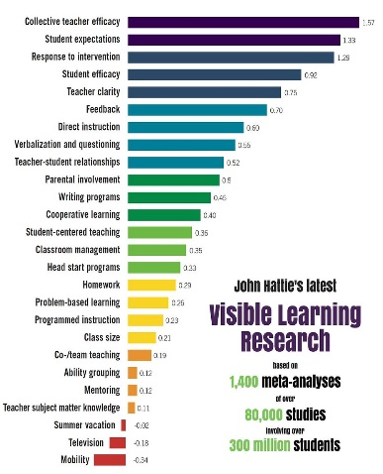
Influences on student learning
John Hattie 1999-2009 – research from 180,000 studies covering almost every method of innovation
Effect Size
Feedback 0.73
Teacher-Student Relationships 0.72
Mastery Learning 0.58
Challenge of Goals 0.56
Peer Tutoring 0.55
Expectations 0.43
Homework 0.29
Aims & Policies of the School 0.24
Ability Grouping 0.12

Slide 14
Influences on student learning
John Hattie 1999-2009 – research from 180,000 studies covering almost every method of innovation
Effect Size
Feedback 0.73
Teacher-Student Relationships 0.72
Mastery Learning 0.58
Challenge of Goals 0.56
Peer Tutoring 0.55
Expectations 0.43
Homework 0.29
Aims & Policies of the School 0.24
Ability Grouping 0.12
Cymharwch eich rhestr ag un Hattie. Oes unrhyw beth annisgwyl? Pam?
Compare your list to that created by Hattie. Does anything surprise you? Why?

Slide 15

Addysgwyr Effeithiol
Dysgu fel gweithgaredd broffesiynol.
Mae’r term yn cynnwys nifer o nodweddion a welir mewn athro effeithiol :
  Lefelau uchel o wybodaeth berthnasol ynglyn a’r hyn sy’n cael ei ddysgu a’r plant sy’n derbyn y wybodaeth;
  Gwybodaeth am, a sgil wrth ddefnyddio amrediad o strategaethau i alluogi dysgu;
  Y gallu i fod yn hyblyg a meddylgar yn y dosbarth, gan gymryd i ystyriaeth anghenion ac ymatebion y dysgwyr wrth iddynt ddatblygu eu gwybodaeth;
  Dealltwriaeth o bwysigrwydd agweddau dysgwyr tuag at yr hyn y maent yn ei ddysgu a’i gallu i ddylanwadu a datblygu’r agweddau hyn;
  Y gallu a’r parodrwydd i ddysgu wrth amrywiaeth o ffynonellau ynglyn a’r hyn sy’n gwneud addysgu effeithiol a gallu addasu ymarfer i gydymffurfio a’r dysgu parhaus hyn. (Arthur and Cremin, 2010)

Slide 16
Effective Educators
We can view teaching as a professional activity.
This term implies a number of attributes within the teacher, including:
  high levels of relevant knowledge about what is being taught and the children to whom it is being taught;
  knowledge of, and skill in using, a range of strategies to enable learning;
  the capacity to engage flexibly and thoughtfully in the classroom, taking into account the needs and responses of the learners as they develop and manifest themselves;
  an understanding of the importance of learners’ attitudes towards what they are learning and an ability to influence and develop these attitudes;
  the ability and willingness to learn from a variety of sources about effective teaching and to adapt practices to fit this ongoing learning.
  (Arthur and Cremin, 2010)

Slide 17
Adroddiad – ‘What makes great teaching?’
Report - What makes great teaching?
Pedagogical content knowledge
Quality of instruction
Classroom climate
Classroom management
Teacher beliefs
Professional behaviours
Coe et al, 2014
“Great teaching is defined as that which leads to improved student progress”
Evidence of impact on student outcomes:
Cryf/Strong
Canolig/Moderate
Ychydig/Some

Slide 18

“Good quality teaching will likely involve a combination of these attributes manifested at different times; the very best teachers are those that demonstrate all of these features”.
(Coe et al, 2014)

Slide 19
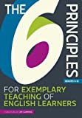
Chwe Nodwedd Galton
Galton’s Six Principles
Clear statement of learning objectives
Extended questioning during whole class discussion
More active pupil participation
Increased cooperation between pupils by working in pairs and groups
Less use of corrective and more informing feedback
More use of the assessment for learning approach
Whenever possible exploration precedes instruction and examples are situated in contexts that are meaningful to the pupils.

Slide 20
Chwe Egwyddor
CWRICWLWM
ADDYSGEG
ASESU
CWESTIYNU
ASESU AR GYFER DYSGU
AMCANION DYSGU
CYFRANOGIAD DISGYBLION
GWAITH PÂR/GRŴP
ADBORTH

Slide 21
Six Principles
CURRICULUM
PEDAGOGY
ASSESSMENT
QUESTIONING
ASSESSMENT FOR LEARNING
LEARNING OBJECTIVES
PUPIL PARTICIPATION
PAIR/GROUP WORK
FEEDBACK

Slide 22
Pause for Thought
Munud i feddwl
Hattie
Coe et al
Galton

Slide 23

Gweithredu/Putting it into Practice
Yn y darn nesaf, byddwn yn ystyried rhai ffyrdd ymarferol mae addysgwyr yn medru defnyddio’r wybodaeth yma i sicrhau dysgu ac addysgu effeithiol.
Next, we will look at some practical ways that educators can apply concepts about effective teaching and learning to their classroom practice.

Slide 24
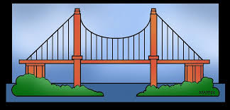
Gweithredu Gwybodaeth Flaenorol
Activating Prior Knowledge
Mae disgyblion yn ymddiddori yn y pwnc – sbardun i ddal sylw plentyn.
Mae’n cefnogi dysgwyr wrth symud o beth maent yn gwybod yn barod i beth sydd i ddod.
Pa ddamcaniaethydd sy’n gysylltiedig a hyn.
Pupils ‘tune in’ – can also be a hook to engage children’s interest.
Helps learners to connect what they already know to what is to come.
Can you link this to a theorist?

Slide 25

Amlygu’r Dysgu
Making the Learning Explicit
“Objectives express what we intend the pupils to learn in terms of knowledge, concepts, skills and attitudes. More tangibly, ‘learning outcomes’ may also be used to state what the children will be able to do as a result of the teaching and learning programme. Such statements may be used to formulate sequences or ladders of success criteria on a gradient of complexity or ‘difficulty’. Teachers and children can thus use these to review their progress and to help in understanding the level of challenge in a task. A further refinement could be to specify ‘must’, ‘should’ and ‘could criteria as a bridge between curriculum planning and assessment for learning.”
Pollard et al, 2014
Pam mae angen amcanion dysgu? Why do we need learning objectives?

Slide 26
Amlygu’r Dysgu
Making the Learning Explicit
Amcanion Dysgu
  Rhannwch unrhyw esiamplau rydych wedi arswyli.
Gwyliwch y clip. Pa more effeithiol mae’r cyflwyniad yma o amcanion?
Learning Objectives
  With a partner, share any examples of how you may have seen these used.
Watch the following clip. How effective is this presentation of learning objectives?

Slide 27
Tuedda athrawon i adnabod yr hyn y disgywlir i blant wneud yn hytrach na’r hyn y disgywlir iddynt ddysgu.
Pa nodau dysgu isod sy’n cyfeirio at ddysgu disgyblion?
1 Creu addurn Nadolig
Gallu dehongli siart cylch
Gwella sgiliau taflu pel
Cwblhau cwestiwn 3 yn y llyfr testun Mathemateg
Trafod pa fwydydd sy’n dda i ni
Gwybod pryd i ddefnyddio ‘y’ ac ‘yr’ yn gywir
Tynnu llun a labelu diagram o gylched trydan syml

Slide 28
Teachers tend to identify what pupils will do not what they will learn.
Which of the following tell pupils about learning?
1 To make a Christmas decoration
To be able to interpret a pie-chart
To improve ball throwing skills
To complete exercise 3a in your maths text book
To discuss what foods are good for us
To know when to use ‘a’ and ’the’
To draw and label a diagram of a simple electric circuit

Slide 29
Iaith Deilliannau Dysgu
Language of Learning Objectives
Some key action words when specifying learning objectives:
Low level (transmission): to recall, define, identify, state, recognise, name, list, measure
Medium level (application): to use, show, perform, explain, illustrate, predict, interpret
Higher level (understanding): to classify, design, organise, compose, discover, summarise, conclude, separate
Geiriau gweithredu allweddol wrth bennu amcanion dysgu:
Lefel isel (trosglwyddo): adalw, diffinio, dynodi, datgan, adnabod, enwi, rhestru, mesur
Lefel ganolig (cymhwyso): defnyddio, dangos, gwneud, esbonio, darlunio, rhagfynegi, dehongli
Lefel uwch (deall): dosbarthu, dylunio, trefnu, cyfansoddi, darganfod, crynhoi, gorffen, gwahanu

Slide 30
Defnyddio geiriau gweithredu allweddol
Using key action words
e.e. Cyfrif hyd at gant mewn degau a defnyddio’r dull hwn i wneud cyfrifiadau syml yn fwy cyflym. (lefel isel i ganolig)
e.e. Dysgu cerdd ar y cof a dangos dealltwriaeth drwy actio rhannau cymeriadau amrywiol yn y naratif. (lefel isel i ganolig)
e.g. To count up to one hundred in tens and to use this method to perform simple calculations more rapidly. (low to medium level)
e.g. To memorise a poem and demonstrate comprehension by acting out the parts of various characters in the narrative. (low to medium level)

Slide 31
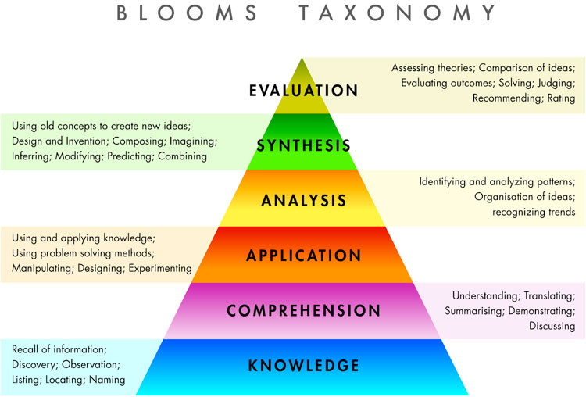
Tasg: Ar ddiwedd cyfres o wersi mae eich disgyblion blwyddyn 2 yn ysgrifennu disgrifiad o dŷ ysbrydion. Ysgrifennwch y nodau dysgu ar gyfer y wers.
Task: At the end of a period of teaching, the children in your year 2 class will be writing a description of a haunted house. Write the learning objectives for the lesson.
Alford, Herbert & Fragenheim 2006).

Slide 32

Talk for Learning
Siarad ar Gyfer Dysgu
Gwyliwch y clip.
Adlewyrchwch ar unrhyw esiamplau o ddysgu ac addysgu da a arsylwyd.
Sut mae’r athro yn defnyddio siarad ar gyfer dysgu? Beth yw’r effaith?
Watch the following clip
Reflect on any examples of general effective teaching and learning practice noticed.
How does the teacher use talk for learning? What is the effect?

Slide 33

Effective Questioning
Cwestiynu Effeithiol
Beth yw pwrpas cwestiynu yn y dosbarth?
Gwyliwch y clip.
Ysgrifennwch restr o’r hyn sy’n gwneud cwestiynu effeithiol.
What is the purpose of questioning in the classroom?
Watch the following clip.
Write a list of what constitutes effective questioning in the classroom.

Slide 34
Bibliography
Llyfryddiaeth
Arthur, Cremin, (2010) Learning to teach in the Primary School. Available online at: https://www-dawsonera-com.ezproxy.uwtsd.ac.uk/readonline/9780203854624 (accessed 28/10/16)
Coe, R., Cesare, A., Higgis, S. & Major, L. (2014) What Makes Great Teaching? Sutton Trust: Durham University. Available at: https://www.suttontrust.com/wp-content/uploads/2014/10/What-makes-great-teaching-FINAL-4.11.14.pdf (Accessed 26/6/17)
Galton, M. (2010) Using a Framework of 6 Key Principles to Increase the Effectiveness of Smaller Classes Maurice Galton Faculty of Education, University of Cambridge UK. Available online at:
http://slideplayer.com/slide/7002004/ (accessed 9/9/16).
Hattie, J (2008) Visible Learning for Teachers, Routledge: Oxon.

