Slide 1
PSYCHOLOGY IN HEALTH AND SOCIAL CARE
MOODLE NUM : BMHP4003
LECTURER- DIYA GANGULY
INFANCY

Slide 2
APPENDIX
Introduction by Sandra 2018256
Infancy Cognitive Development by Eunice 2018973
Emotions by Sandra 2018256
Behavioral patterns by Zita Melinda 2011317
Theory infant cognitive development slide 1 by Maria 2009505
Theory infant cognitive development slide 2 by Jane Actor 2020570
Conclusion – by Jane Actor 2020570
References

Slide 3
Introduction
This presentation’s objective is to choose a stage of development and explain it in detail through theory and sub categories of human behavior. We have come together as a group and chosen topics to explain well.
It is laid out by explaining human cognition, emotions, behavioral patters and theory to explain stages of infancy in detail.
Notes:
(Sandra)

Slide 4
Infancy Cognitive Development
Cognitive development or brain development - means the learning process of memory language thinking and reasoning .
Babies are not only growing physically during the first 2 years of life, but also cognitively (mentally)
In the first year, babies learn to focus their vision, reach out, explore, and learn about the things that are around them
Notes:
Babies come into the world with many innate abilities, or abilities that are present from birth.
Newborns can also hear, smell, touch, taste, and see, and these sensory abilities develop quickly.
Baby's brain develops through use — by baby interacting, observing and doing things.
Brain development is part of cognitive development.
we can help baby's development by creating a stimulating environment with different types of activities that offer them baby the chance to play.
we can play and spend time with our baby by: singing together for example. Every day while they interact with and learn about their environment they are creating new connections .

Slide 5
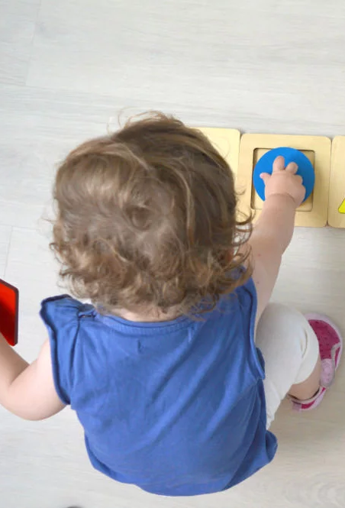
The importance of cognitive development
Child’s cognitive development can help us to choose the right activities to further boost thinking, remembering and reasoning abilities.
To promote cognitive development, it is important that we actively engage in quality interactions on a daily basis for example :
Talking with baby and naming used objects
Letting baby explore toys
Answering your child’s “why” questions
2021 ADAM & Mila
Notes:
Cognitive Skills (Thinking and Learning)
can follow a two-step command ("Pick up your toy and put it on the shelf.")
can name many body parts
can pick out pictures in a book
starts to engage in pretend play, such as feeding a baby doll
matches shapes
We should also allow child to explore different ways of solving problems
Encouragement or allow child some time to figure out things
There is a strong connection between the development a child undergoes early in life and the level of success that the child will experience later in life .

Slide 6


EMOTIONS
Emotions in an infant is like a rollercoaster. (1)
They start to show emotions from an age of 2-3 months in the form of smiling, crying constantly etc.
Other emotions such as anger, surprise and fear are along the months from2-6.
Around 9-10 months the emotions constantly change

Slide 7
Around age of 12 months infants start to realize and become aware of the emotions and facial expressions of adults and everyone around them.
They begin to develop emotional connection at this age. For example jealousy
They start to recognize who touches or pick them up. Stranger anxiety.
Babies also learn how to manage and regulate their emotions well at this stage.
Notes:
Elaborate on jealousy and give an example. + elaborate on stranger anxiety. (Sandra) fro example when the baby is young and is in contact with a stranger you can see the emotions change

Slide 8
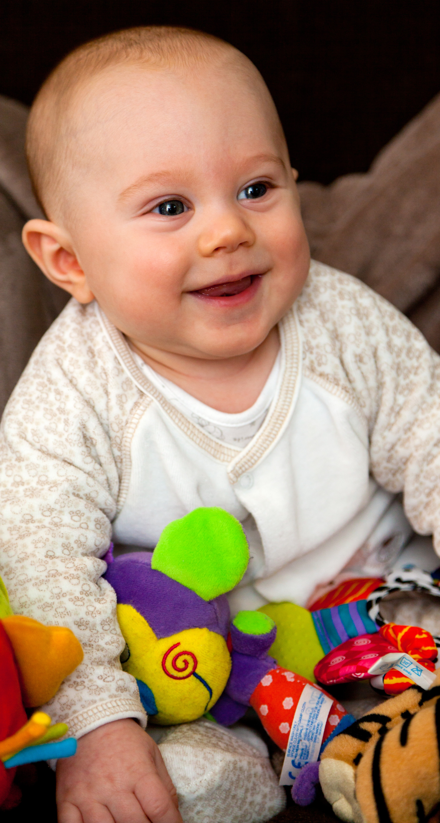
BEHAVIOUR PATTERNS
Babies’ early experiences and relationships stimulate their brains, shaping the way they see and respond to the world. As your baby’s awareness of the world grows through these experiences, your baby develops and learns, and you’ll see many changes in behaviour.

Slide 9
Understanding infant behavior
Common behavior concern
Overstimulation
Fears
Crying and colic
Responding to baby's behavior

Slide 10
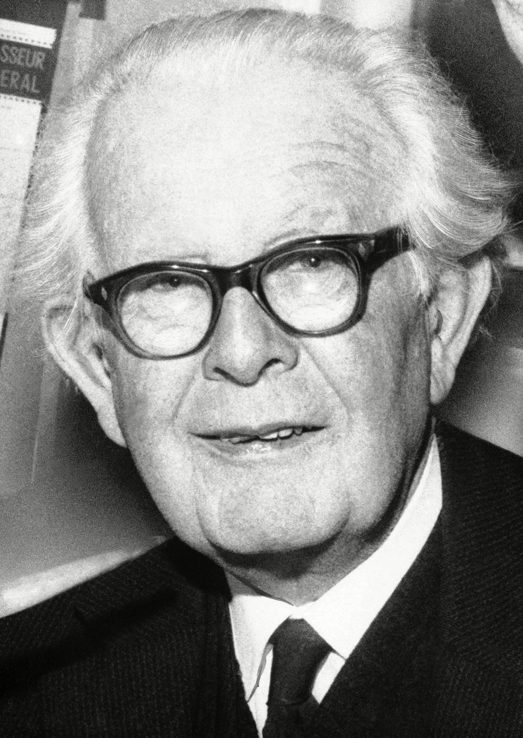
Theories of lifespan
There are number of theories of lifespan, the one we will be focusing on today is piaget's stages of cognitive development.
In Piaget's theory there are 4 stages: Sensorimotor, Preoperational concrete operational and formal operational.
In the case of infancy it focuses on the sensorimotor stage of development, which ranges from birth to 2 years of age.
During this stage of development rapid cognitive growth occurs.
Infants develop an understanding of the world via sensory coordination(sight and hearing) and motor actions(touching and grabbing).
Main development at the sensorimotor stage is the acknowledgement that objects exist and that events happen in the world.

Slide 11
Research. Based in this area beginning of 20th century, and jean Piaget gave a big contribute theory of cognitive development. After that the investigation on this field had a big jump, many psychologist dept research on different area of cognitive evolution like brain, talking and discernment, bring up number of news theory as neo Piagetian of cognitive development (3)

Slide 12
Jean Piaget’s Cognitive Development
Jean Piaget’s Theory of cognitive development proposes that children transition by 4 stages of mental development.
His theory zooms into the understanding of how Children obtain knowledge, also based on the understanding the nature of intelligence.
These are the 4 stages of mental development are;
Sensorimotor step:- That range from birth up to two year olds.( learn through movement and touch).
Pre-opertational stage: range from the age two to seven year old.(they are egocentric).
Concrete operational stage: ranges from the age Seven to eleven.(they start to think logical).
Formal operational stage: ranges from the age Twelve plus.( they begin to think advanced/abstractly

Slide 13
CONCLUSION
Infancy is therefore an important stage in human development as it is a period of time when growth is so rapid and the consequences of neglect is so damaging.
It is a stage where a child doubles the birth weight by 5 months and triples it by 12 months of age thereby increasing their length by 50% by the end of the first year of life.

Slide 14
References
(1)Emotions- https://www.mentalhelp.net/infancy/emotional-social-development-and-understanding/
(Picture 1) https://cdn.pixabay.com/photo/2017/06/09/17/26/baby-2387661_960_720.jpg
(Picture 2) https://www.publicdomainpictures.net/pictures/150000/velka/smiling-baby-1454863685rUF.jpg
Infant cognitive development (1) OAKLEY (2004) new York routledge
(2) Esgate A groome D.Baker K heathcate (2005) Introduction to applied cognitive psychology, New York
(3) brenner JG 1994 Infancy
Infant development technology; https://www.allpsychologycareers.com/psychology/infant-developmental-psychology/
Barry Bogin, (2012): The Evolution of Human Growth; Human Growth and Development, second edition.
National Library of Medicine: Infant – new born development, https://medlineplus.gov/ency/article/002004.htm
https://helpmegrowmn.org/HMG/HelpfulRes/Articles/WhatCognitiveDev/index.html
https://www.gracepointwellness.org/461-child-development-parenting-infants-0-2/article/10114-infancy-cognitive-development-language-development

Slide 15
Infant development technology; https://www.allpsychologycareers.com/psychology/infant-developmental-psychology/
Barry Bogin, (2012): The Evolution of Human Growth; Human Growth and Development, second edition.
National Library of Medicine: Infant – new born development, https://medlineplus.gov/ency/article/002004.htm
Cognetive development
Behavioral pattern (raising children.net understanding behaviour of babies)

