Slide 1

Management Functions at
McDonald's
Applying Henry Fayol’s Theory
Module code and name: Introduction to
Leadership and Management LCBB4015
Group Members:
Cristina Madalina Panaite - 2413348
Huda Ibrahim - 2329476
Jaskirat Singh - 2509298
Alex Eros - 2008584
Lecturer Name: Dr. Koushik Das Sarma

Slide 2



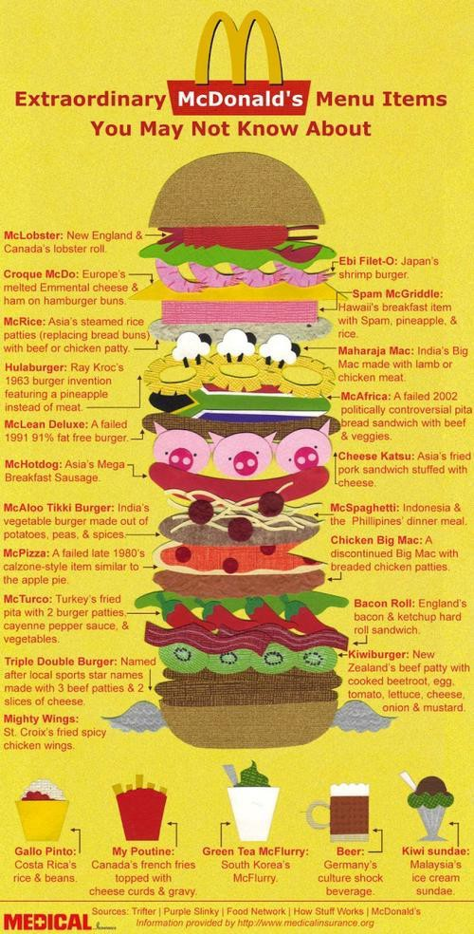
TABLE OF CONTENT
Introduction to McDonald's
Challenges faced by McDonalds
Henry Fayol's Five Functions of Management
Financial Performance and Strategic Stability
Planning at McDonald's
Organising at McDonald's
Comanding at McDonald's
Coordinating
Controlling
Critical Evaluation of Fayol’s Theory
Conclusion
References

Slide 3









Introduction to McDonald's
Founded in 1940, USA
Operates in 100+ countries
Over 40,000 restaurants globally Revenue exceeding $25 billion (2023) (McDonald's, 2023)

Slide 4

Challenges faced by McDonalds
High Employee Turnover – Frequent staff
changes require constant hiring and training.
Customer Service Pressure – Fast service expectations during peak hours can lead to stress and mistakes.
Health & Nutrition Criticism – Ongoing public
concerns about unhealthy food options.
Strong Competition – Competing with other
fast-food chains and delivery services.
Maintaining Food Quality & Consistency – Ensuring the same standards across all locations.
Workplace Pressure – Managing busy shifts,
time targets, and customer complaints.
Rising Costs – Increased prices of ingredients, labour, and utilities.

Slide 5








Henry Fayol’s Five Functions of Management

Slide 6


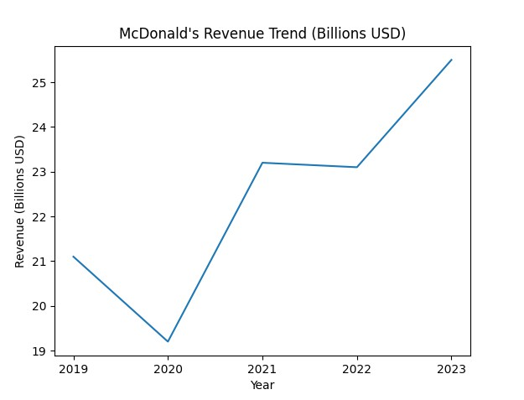
Financial Performance and Strategic Stability
Revenue growth reflects long-term planning
Resilience post-COVID recovery
Strong global brand positioning
(McDonald's, 2023)

Slide 7
Organising at McDonald's
CEO
Geographical
Leadership
US
IOM
IDL
Regional
Functional
McDonald's demonstrates effective organization with a divisional structure, global hierarchy, and functional departments. This includes:
*A clear hierarchical chain of command: crew members report to shift managers, who report to store managers, regional managers, and ultimately corporate executives
*Supply chain management — a highly coordinated global system ensuring consistent ingredient sourcing, logistics, and distribution.
*Staff scheduling — optimised using standardised procedures to cover peak periods efficiently.
*Division into functional departments (e.g., HR, Marketing, Operations, Finance) and geographic/business segments (e.g., U.S., International Operated Markets

Slide 8
Pros and Cons of McDonald’s Organisational Approach
Positives:
* Ensures brand consistency, quality, and standards across markets by tightly controlling and monitoring global operations.
Specialized functional departments and a clear hierarchy enable efficient coordination and economies of scale.
*Facilitates global implementation of policies, procedures, and innovations (e.g., menu changes, supply chain updates).
*Lets divisions focus on market-specific strategies while maintaining central oversight
*Mechanistic structures for fast-food operations promote predictability and low-cost production of standard outputs.
Negatives:
*Centralised elements can slow responses to local market changes and emerging trends.
*Overgeneralizing strategies across regions may overlook cultural or consumer differences.
*Top-down control and formal roles may limit creativity and innovation.
Corporate standards and local franchise operations may differ in some cases (e.g., international adaptations).
*Dynamic environments may slow decision-making compared to flatter or organic structures.

Slide 9
Commanding
Commanding
at MacDonalds :
Shift managers lead daily operations
Clear instructions during busy hours
Training employees for
food safety
Definition :
Directing employees’
work
Giving clear instructions
Supervising performance
Ensuring discipline and standards

Slide 10
Evaluation :
Advantages :
Modern view :
Disadvantages :
Clear direction for employees
Focus on leadership, not authority
Can reduce employee creativity
Faster decision- making
Risk of over-control
Communication and motivation
Improved efficiency
Possible stress in high pressure shifts
Strong leadership
Supportive management style

Slide 11




Coordinating
Application to McDonald’s:
Definition
Coordination between marketing and operations during product launches (McDonald’s Corporation, 2024).
Coordinating ensures all organizational activities and departments work together towards common objectives (Robbins and Coulter, 2022).
Global headquarters aligning with franchisees to maintain brand consistency (McDonald’s Corporation, 2024).
Supply chain coordination ensures timely delivery of ingredients worldwide (McDonald’s Corporation, 2024).
2/22/2026
11

Slide 12
Disadvantages:
Evaluation
Advantages:
Enhances efficiency and teamwork (Robbins and
Coulter, 2022).
Can slow decision-making in large multinational structures (Johnson, Scholes and Whittington,
2023).
Maintains global consistency across markets (McDonald’s Corporation,
2024).
Over centralization may reduce local flexibility.
Modern Perspective:
Digital systems and real-time data sharing improve cross-functional coordination
(McDonald’s Corporation, 2024).
Reduces duplication of
effort and operational conflict (Johnson, Scholes and Whittington, 2023).
Increasingly use collaborative, team-based structures rather than rigid hierarchies (Robbins
and Coulter, 2022).
2/22/2026
12

Slide 13


Controlling
Definition
  Controlling involves monitoring performance, comparing results to standards, and
taking corrective action where necessary (Robbins and Coulter, 2022).
⸻
Application to McDonald’s:
•
  Monitoring key performance indicators (KPIs) such as sales and service speed
(McDonald’s Corporation, 2024).
•
  Financial performance tracking and compliance reviews (McDonald’s Corporation,
2024).
•
  Customer satisfaction measurement through feedback systems (McDonald’s
Corporation, 2024).

Slide 14
Evaluation
Disadvantages:
Excessive monitoring may reduce employee
motivation (Robbins and Coulter, 2022).
Over-reliance on quantitative metrics may overlook human factors (Johnson, Scholes and Whittington, 2023).
Advantages:
Protects brand reputation (McDonald’s
Corporation, 2024).
Ensures quality and operational consistency.
Identifies issues early for corrective action
(Robbins and Coulter, 2022).
Modern Perspective:
The Balanced Scorecard approach integrates financial and non-financial performance measures (Kaplan and Norton, 2021).
Modern control systems emphasizes performance support rather than strict supervision (Robbins
and Coulter, 2022).
2/22/2026
14

Slide 15






Critical Evaluation of Fayol’s Theory

Slide 16
Conclusion
Fayol’s five functions remain relevant in contemporary organizations such as
McDonald’s.
•
Coordinating ensures global alignment and operational consistency.
Controlling maintains performance, quality, and profitability.
However, modern organizations operate in dynamic and uncertain environments.
Introducing a Contemporary Perspective:
Unlike Fayol’s structured, hierarchical approach, transformational leadership focuses on adaptability and cultural change, suggesting that effective modern management combines classical functions with inspirational leadership.

Slide 17
References
Daft, R.L. (2020) Management. 14th edn. Boston: Cengage.
Fayol, H. (1949) General and Industrial Management. London: Pitman.
Johnson, G., Scholes, K. and Whittington, R. (2023) Exploring Strategy. 13th edn. Harlow: Pearson.
Kaplan, R.S. and Norton, D.P. (2021) ‘Using the balanced scorecard as a strategic
management system’, Harvard Business Review, 99(1), pp. 2–9.
McDonald’s (2023) Annual Report 2023. Chicago: McDonald’s Corporation.
McDonald’s Corporation (2023) Global Impact Report 2023. Available at: https://corporate.mcdonalds.com (Accessed: 19 February 2026).
McDonald’s Corporation (2024) Annual Report 2024. Chicago: McDonald’s Corporation.
Mintzberg, H. (1973) The Nature of Managerial Work. New York: Harper & Row.
Northouse, P.G. (2022) Leadership: Theory and Practice. 9th edn. Thousand Oaks: Sage.
Robbins, S.P. and Coulter, M. (2018) Management. 14th edn. Harlow: Pearson. Robbins, S.P. and Coulter, M. (2022) Management. 15th edn. Harlow: Pearson.

