Slide 1



Entrepreneurship
Name: Maiyara Mabel Florian Santana (2113112)
Lecturer:Masud Ibrahim

Slide 2
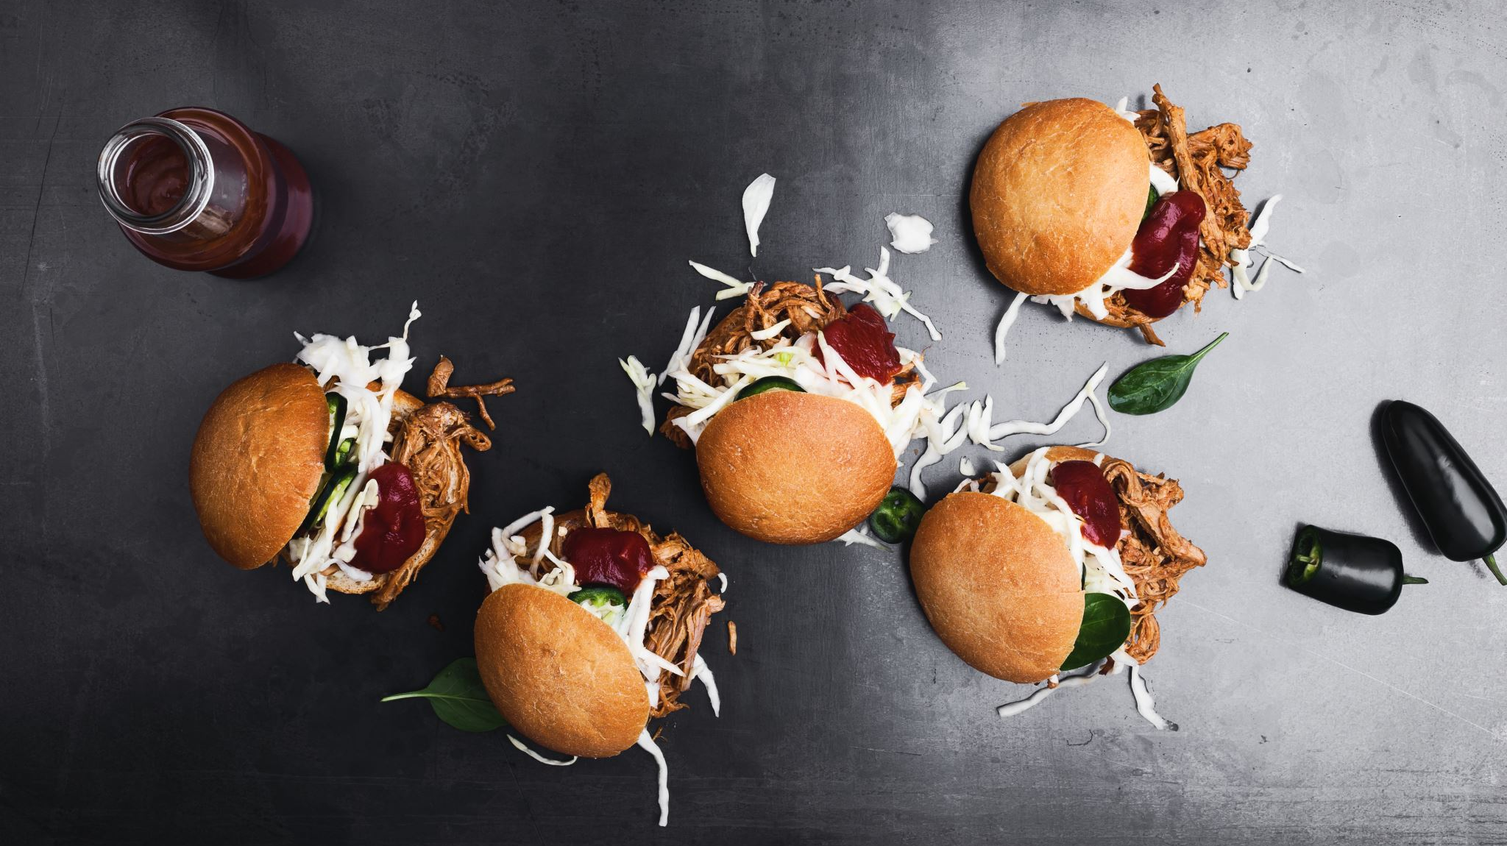
Introduction
Mandarin Marvel is a start-up fast food restaurant chain located in Birmingham, UK.

Slide 3

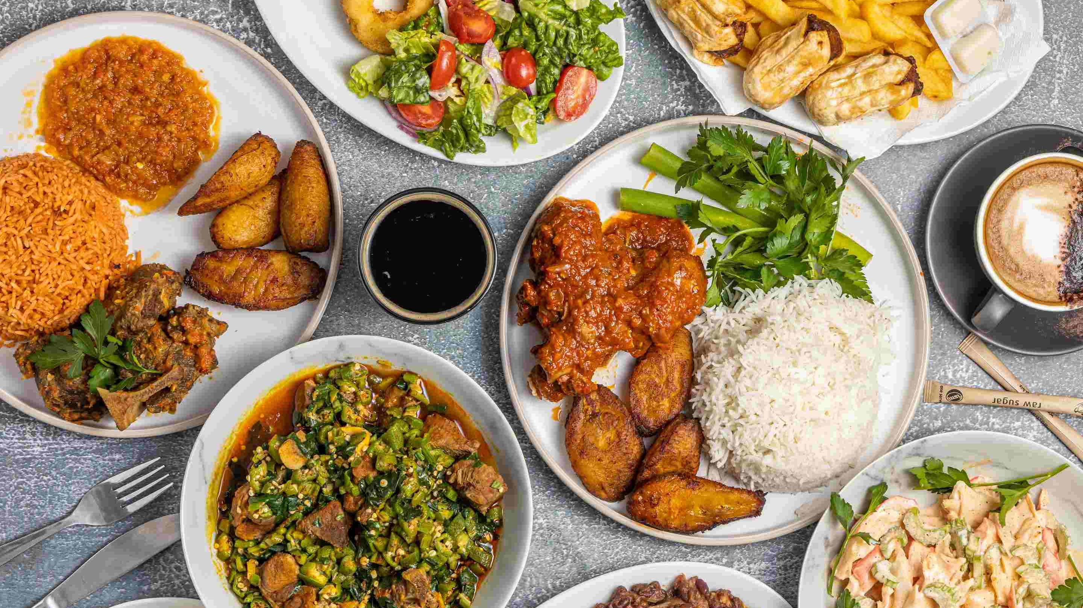
Company Overview
. Mandarin Marvel is a local restaurant chain, that focus surely in providing both Chinese and western food cultures.

Slide 4

Ownership & legal format
Leon Fermin
(CEO)
Darlington Chambers
(Chef Marketing Officer)
Paul Stewart
(CTO)
Aylin Turibu
(Chief Financial Officer)
John Franc
(Chief Operation Officer )

Slide 5
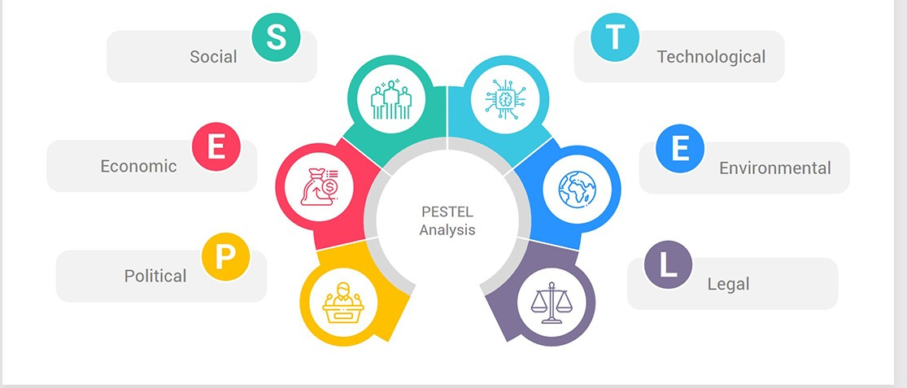
Pestel analysis

Slide 6
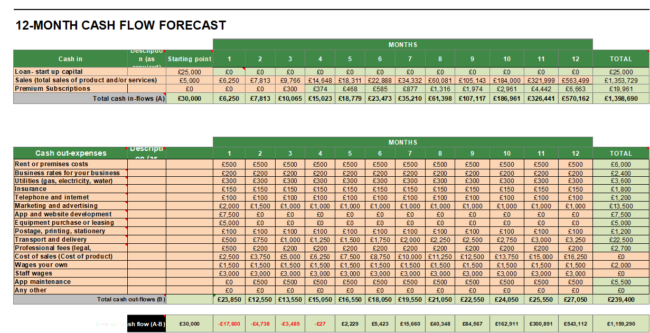
Cash flow

Slide 7
Reference list
1. AVIKO. Fast Food Industry UK. Available at: https://www.aviko.co.uk/blog/fast-food-
industry-ukk [Accessed 23 June 2024].
2. Bolet, D., Osuna, J. and Lyon, J., (2018). Understanding Brexit: Impacts at a local level. Available at: Kaldor_Brexit_Report_Southampton_Published_v4.pdf (lse.ac.uk) [Accessed on 22nd June, 2025]
3. Brown, R., Liñares-Zegarra, J. and Wilson, J.O., (2019). The (potential) impact of Brexit on UK SMEs: regional evidence and public policy implications. Regional Studies. Available at: (PDF) The (potential) impact of Brexit on UK SMEs: regional evidence and public policy implications (researchgate.net) [Accessed on 22nd June]
4. Coyne, A., (2021). UK announces new law to ban ‘junk-food’ advertising. Available at: https://www.just-food.com/news/uk-announces-new-law-to-ban-junk-food-advertising// [Accessed 23 June 2024].
5. IBIS World. (2023). Takeaway & Fast-Food Restaurants in the UK - Market Research Report. Available at: https://www.ibisworld.com/united-kingdom/market-research-reports/takeaway-fast-food-restaurants-industry/ [Accessed 21st June 2024].
6. Khiatani, J, V., (2022). Packaging Materials Regulations in the United Kingdom: A Summary.Availble at: https://www.compliancegate.com/packaging-materials-regulations-united-kingdom/ [Accessed 23rd June 2024].
7. Kotin, M., (2020). HOW TECHNOLOGY IS CHANGING THE FAST FOOD INDUSTRY. Available at: https://dodobrands.io/post/technology-changing-fast-food// [Accessed 23rd June 2024].
8. Kumar, I., Rawat, J., Mohd, N. and Husain, S., (2021). Opportunities of artificial intelligence and machine learning in the food industry. Journal of Food Quality. Available at: (PDF) Opportunities of Artificial Intelligence and Machine Learning in the Food Industry (researchgate.net) [Accessed on 19th June]
9. Lark, R., (2022). 5 Ways the Fast Food Industry Affects the Environment. Available at: https://environment.co/fast-food-affect-environment/#:~:text=Fast%20food%20is%20the%20primary,operational%20needs%20and%20state%20regulations
10. Macrotrends. (2024). Birmingham Metro Area Population 1950-2024. Available at:https://www.macrotrends.net/global-metrics/cities/22936/birmingham/population [Accessed on 18th June 2024]
11. Mintel Reports. (2024). UK Fast Food Restaurants Market Report 2023. Available at: https://store.mintel.com/report/uk-fast-food-restaurants-market-report [Accessed 19th June 2024].
12. Mintel Reports. UK World Cuisines Market Report (2022). Available at : https://store.mintel.com/report/uk-world-cuisines-market-report [Accessed 23rd June 2024].
13. Office for National Statistics (2024) Population estimates for the UK, England and Wales, Scotland and Northern Ireland: mid-2023. Available at: https://www.ons.gov.uk/peoplepopulationandcommunity/populationandmigration/populationestimates [Accessed 23rd June 2024].
14. PwC. Understanding Chinese consumers. Available at: https://www.pwccn.com/en/issues/consumers.html [Accessed 21st June]
15. Statista (2024) Online Food Delivery - United Kingdom. Available at: https://www.statista.com/outlook/374/156/online-food-delivery/united-kingdom [Accessed 23rd June 2024].
16. Statista. (2024). Market sise of the fast food and takeaway industry in the United Kingdom from 2013 to 2023, with a forecast for 2024. Available at: https://www.statista.com/statistics/1282676/fast-food-and-takeaway-industry-market-sise-uk// [Accessed 15th June 2024].
17. Statista.(2023). The market sise of the fast food and takeaway industry in the United Kingdom from 2013 to 2022, with a forecast for 2023. Available at: https://www.statista.com/statistics/1282676/fast-food-and-takeaway-industry-market-sise-uk/#:~:text=In%202022%2C%20the%20market%20amounted,forecast%20to%20reach%2022.04%20billionn [Accessed 15th June 2024].
18. TUC (Trades Union Congress) (2024) Gig economy workforce in Britain 2024. Available at: https://www.tuc.org.uk/research-analysis/reports/gig-economy-workforce-britain-2024 [Accessed 23 June 2024].
19. UK Department for Community and Local Government. The way forward: an independent review of the governance and organisational capabilities of Birmingham City Council: Supporting Analysis. Available at: https://assets.publishing.service.gov.uk/media/5a7597c740f0b67f59fce182/Birmingham_Evidence_Pack__for_publication__FINAL.pdf [Accessed 20th June 2024]
20. Weston Recruitment. The Rise in Popularity of Pan-Asian Restaurants. Available at: https://www.westonerecruit.co.uk/news/the-rise-in-popularity-of-pan-asian-restaurants/ [Accessed on 15th June, 2024]
21. Xie, A., (2019). Dose of Asianess | Do Asians not care about customer service? Available at: https://www.linkedin.com/pulse/do-asians-care-customer-service-angel [Accessed on 23rd June,2024]

