Slide 1

Tamworth Mobile Auto Care Ltd
Certificate in Higher Education Business Skills for the Workplace.
Level 4
Enterprise and Entrepreneurship - LCLM 4006
Individual Business Plan Presentation
Student: Andrzej Kyrcz
Student number: 2419584
Lecturer: Fouziya Farheen

Slide 2
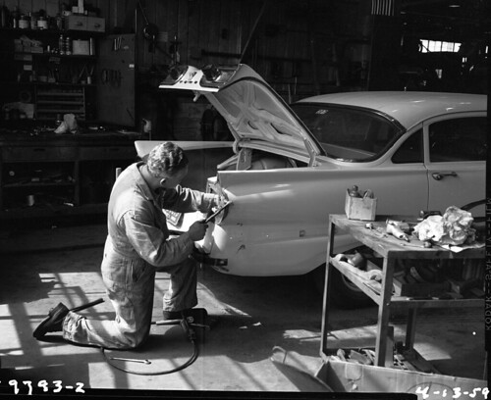
BUSINESS PLAN
Tamworth Mobile Auto Care Ltd
This Photo by Unknown Author is licensed under CC BY

Slide 3
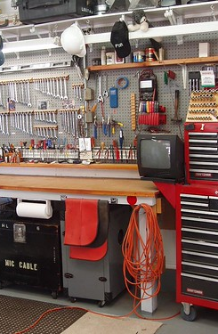
Business Idea
Mobile car repair and maintenance service
  Operating in Tamworth and surrounding areas
  Repairs at customer home or workplace
  MOT preparation + collection and return service
  Legal Structure: Private Limited Company (Ltd)
  Growing vehicle demand in the UK (SMMT, 2023)
  Consumer preference for convenience (RAC, 2023)
This Photo by Unknown Author is licensed under CC BY-ND

Slide 4

Unique Selling Point
Customers do not travel to a garage I travel to them
  Time-saving and convenient service
  Transparent pricing
  Competitive labour rate - £55 per hour
  Lower overhead costs than traditional garages
  Competitive advantage theory (Porter, 2008)
  Marketing differentiation (Kotler and Keller, 2016)
This Photo by Unknown Author is licensed under CC BY-SA-NC

Slide 5

Key External Factors (PESTEL)
Economic:
Cost-of-living increases demand for affordable services
Social:
Busy lifestyles create need for convenience
Technological:
Modern diagnostic tools enable mobile repairs
External environment analysis (Johnson et al., 2020)

Slide 6

Marketing Strategy
Digital Marketing:
  Google Business Profile
  Local SEO and customer reviews
  Partnerships
  MOT testing centres and local businesses
  Digital consumer behaviour (Statista, 2024)
  Small business marketing strategy (Burns, 2020)
This Photo by Unknown Author is licensed under CC BY

Slide 7

Funding Requirements
Total Funding
Required: £28,000
  - Van - £12,000
  - Tools and Diagnostics - £7,000
  - Insurance - £2,000
  - Marketing - £1,500
  - Spare Parts - £2,000
  - Break-even expected in Year One
  New venture financial planning (Scarborough and Cornwall, 2019)
  Entrepreneurial finance theory (Storey, 2016)
This Photo by Unknown Author is licensed under CC BY-SA

Slide 8

Conclusion
Strong demand for convenient vehicle services
Low overhead mobile business model
Competitive pricing and transparency
Break-even expected in Year One
Clear potential for future growth

Slide 9

Thank you

Slide 10
References:
Burns, P. (2020) New Venture Creation: A Framework for Entrepreneurial Start-ups. 3rd edn. London: Palgrave Macmillan.
Companies House (2024) Private Limited Company Incorporation Guidance. London:
Companies House. Available at: https://www.gov.uk/limited-company-formation (Accessed: 26 February 2026).
DEFRA (2023) Environmental Regulations for Automotive Businesses. London: Department for Environment, Food and Rural Affairs.
HSE (2023) Health and Safety in Motor Vehicle Repair. London: Health and Safety Executive.
Johnson, G., Scholes, K. and Whittington, R. (2020) Exploring Strategy. 12th edn. Harlow: Pearson.
Kotler, P. and Keller, K.L. (2016) Marketing Management. 15th edn. Harlow: Pearson.
Mason, C. and Brown, R. (2014) “Entrepreneurial ecosystems and growth-oriented entrepreneurship”, OECD Background Paper. Paris: OECD Publishing.
Office for National Statistics (ONS) (2021) Census Data for Tamworth. London: ONS.
Office for National Statistics (ONS) (2023) UK Economic Indicators. London: ONS.
Porter, M.E. (2008) “The five competitive forces that shape strategy”, Harvard Business Review, 86(1), pp. 78-93.
RAC (2023) Consumer Behaviour in Garage Services. London: RAC.
Scarborough, N.M. and Cornwall, J.R. (2019) Essentials of Entrepreneurship and Small Business Management. Harlow: Pearson.
SMMT (2023) UK Car Parc Data. London: Society of Motor Manufacturers and Traders.
Statista (2024) Automotive Aftermarket Consumer Trends in the UK. Hamburg: Statista Research Department.
Storey, D.J. (2016) Understanding the Small Business Sector. London: Routledge.

