Slide 1
Contract & legal responsibilities
Lara Hopkinson
Senior Lecturer
Architecture, Built and Natural Environment

Slide 2
Topics for today
Environmental law introduction
  Philosophy
  Liabilities
  Why is it important?
  Specific Acts / Regulations to be aware of

Slide 3

Why do YOU think it is important??

Slide 4
Environmental law
Developed significantly
Common law approach:
  Protecting private interest in land
  Disputes relating to land (activities, restricting use)
Regulatory framework expanded due to membership of EU
General philosophy:
“Polluter Pays Principle”
  Includes owners and occupiers of land

Slide 5
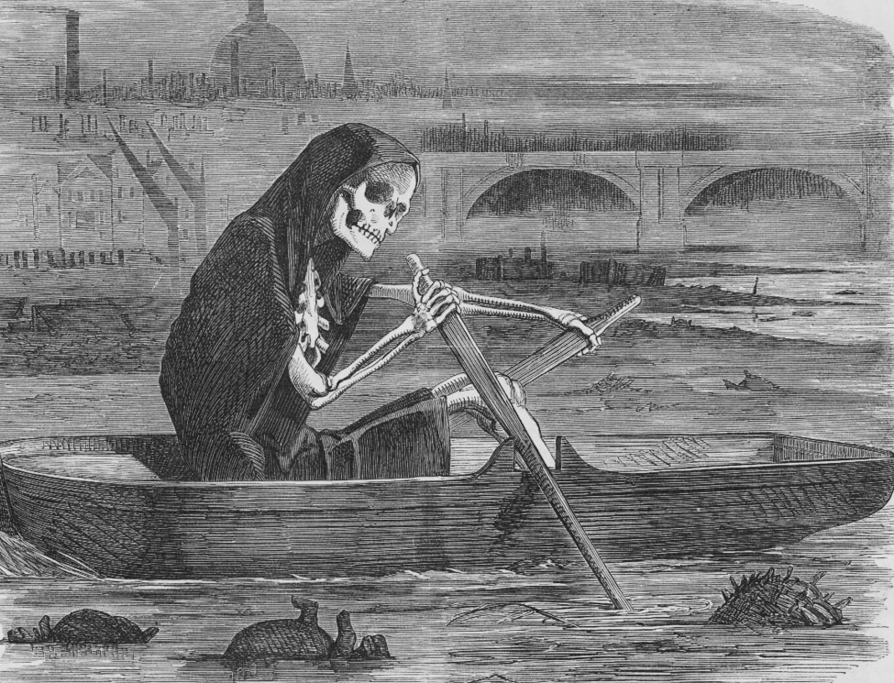
Great Stink of London 1858
Source: Wikipedia

Slide 6
Liabilities
Criminal:
  Breach of statutory controls / legislation AND
  Cause significant harm
Offences are “strict liability”
  No proof required, just that harm occurred
Remedies applied:
  Fines, imprisonment, suspended sentences, community service orders…
  Fines – from £100 to unlimited (£3m)
  Custody – up to 5 years…

Slide 7
Liabilities
Civil:
  Breaches of contract
  Breaches of tort law (esp. nuisance)
Enables regulators to deal with offences outside of court
Regulatory Enforcement and Sanctions Act 2008
Offenders can:
  Put things right (an undertaking)
  Take steps to curb pollution (notices)

Slide 8
Further implications
Issues of personal liability
  EPA 90, WRA 91, HASAWA 74
  Personal responsibility to directors & senior managers
  Company guilty of environmental offence
  Claim will be issued against both
  Woodhouse v Walsall Metropolitan Borough Council [1994]
  Prosecution of Phillips and Thomas, 2013

Slide 9
Environmental crime challenges
Infrequent
  2004 report – 10,000 prosecutions annually
  0nly 10% of known crimes end up in court
  Local authorities deal with it
Level of sentencing
  Historically - small fines
  Fixed penalty notices – no deterrent
Nature of sentencing
  Largely fines
  Imprisonment or community service only for serious crimes

Slide 10
Important Acts of Parliament
Public Health Act 1936
  Deals with accumulation of waste on land
Clean Air Act 1956, superseded 1968 and 1993
  Passed in response to the Great London Smog 1952
Control of Pollution Act 1974 (COPA)
  Covered variety of environmental issues
Health and Safety at Work Act 1974
  Covers certain emissions to atmosphere & control of dangerous substances

Slide 11
Further developments…
Environmental Protection Act 1990 (EPA 90)
  Part 1 - Permitting
  Part 2 – Waste on land (2a contaminated land)
  Part 3 – Statutory nuisance
  Part 4 - Littering
Water Resources Act 1991 (WRA 91)
Environment Act 1995 (EA 95)
  Part 1 – Setting up the regulator
  Part 2 – contaminated land
  Part 4 – Air quality management

Slide 12
Regulatory details
Environment Agency (England & Wales)
  Natural Resources Wales (2013+)
Scottish Environmental Protection Agency
Responsible for polluting industries / serious crimes
Local authority
More day-to-day issues
Includes:
  Statutory nuisance (noise)
  Contaminated land in their area

Slide 13
Other important organisations
Water and sewerage undertakers
  Maintenance
  Provision of drinking water
  Regulation of trade effluent
Department for the Environment, Food & Rural Affairs (DEFRA)
  Promoting legislation
  Issuing guidance
  Determining appeals

Slide 14
Key legislative areas

Slide 15
Contaminated land
Controlled by EPA90 Pt2A
“Land where substances could cause: significant harm to people or protected species; significant pollution of surface waters or groundwater” (Gov.uk, 2015)
Pollution can be from differing sources
Classification of “special sites”
Classification of persons responsible:
  Class A: caused or allowed the contamination
  Class B: own or use the land
Remediation notice
Development / purchase of land

Slide 16
Remediation notice
Provided to the ‘appropriate person’
3-month warning of intent to issue
  Sites then normally have up to 3 years to conclude
Sets out:
  Assessment action
  Remedial treatment action
  Monitoring action
Risk assessment:
  ‘Pollutant linkage’
  Contaminant (source) with a receptor (target) through a pathway

Slide 17
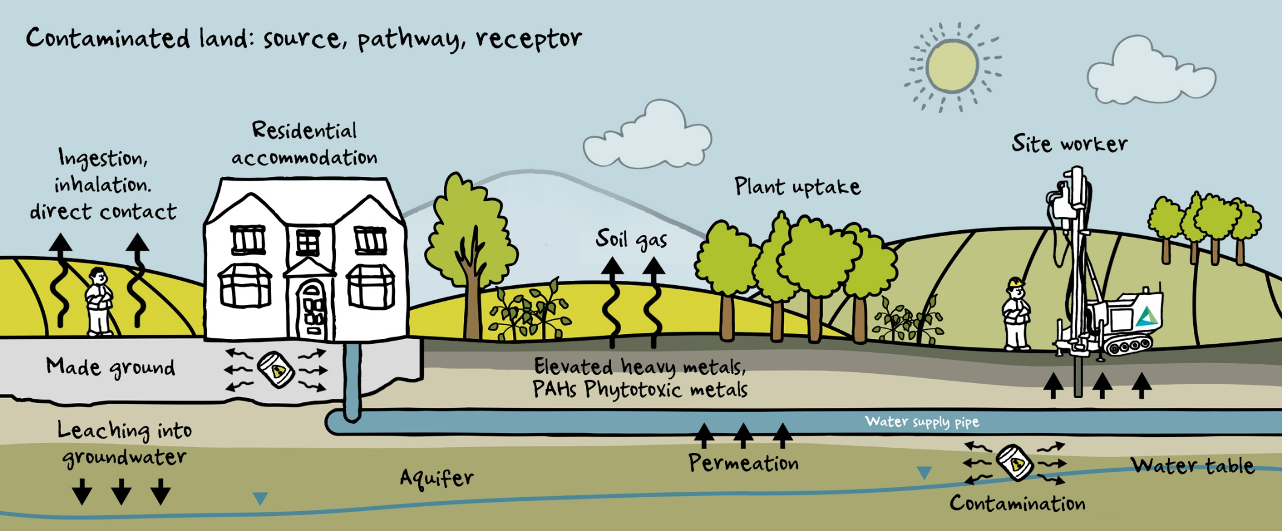
Pollutant linkage
Source: Delta Simons

Slide 18
Contaminated land – key cases
R (on the application of National Grid Gas PLC (formally Transco PLC)) v Environment Agency [2007]
  Contamination from former gasworks
Circular Facilities (London) Ltd v Sevenoaks District Council [2004]
  Contamination from landfill

Slide 19
Land and air pollution:
Waste
Controlled by EPA 90 Part 2
Classification of wastes:
  Inert
  Controlled
  Special / hazardous
“any substance or object which the holder discards, intends to discard or is required to discard”
Storage & movement require licenses
Duty of care applies

Slide 20
Hazardous waste
Includes:
  Paints, oils, inks
  Fluorescent tubes
  Asbestos
  Contaminated items
Cannot be mixed with controlled wastes
Require pre-treatment
Disposal in specific landfill

Slide 21
Waste offences
Corby Group Litigation v Corby Borough Council [2009]
  Toxic waste disposal and associated effects
R (Environment Agency) v Powerday PLC [2016]
  Historical offences relating to hazardous waste

Slide 22
Burning of construction waste
Is this legal?
NO!
Regulated by EPA90 Sec 33 (1)(c); EPA90 Sec 79; Clean Air Act 93 (Sec 2); Highways (Amendment) Act; Environmental Permitting Regulations 2016
Exempted under D7 exemption for plant waste only
Example prosecution:
  Seearo Group Ltd (2017)

Slide 23
Water pollution
Governed by WRA 91 (Part 3), regulated by EA / NRW
  Offence to cause or knowingly permit any poisonous, noxious, polluting or solid matter to enter controlled waters
  Trade effluent is governed under discharge consents
    Also for run-off if contaminated
  Abstraction also under consent
  Body corporate AND individuals can be liable
  E.g. Alphacell Ltd v Woodward [1972]
  E.g. Impress (Worcester) Ltd v Rees [1971]

Slide 24
Control of noise
Local authority control through COPA (section 60)
Covers noise and vibration
  Empowered through notice
  Can specify what is to be used and when
  Also level of noise
  Notices can be appealed
  Offence to contravene
  Can also serve abatement notice under EPA 90

Slide 25
Invasive species
What is this?
“any kind of living organism that is not native to an ecosystem and causes harm (environment, economy or human health)” (NWF, nd)
Legislated for under Invasive Alien Species (Enforcement and Permitting) Order 2019
Examples?
How can they affect construction?

Slide 26
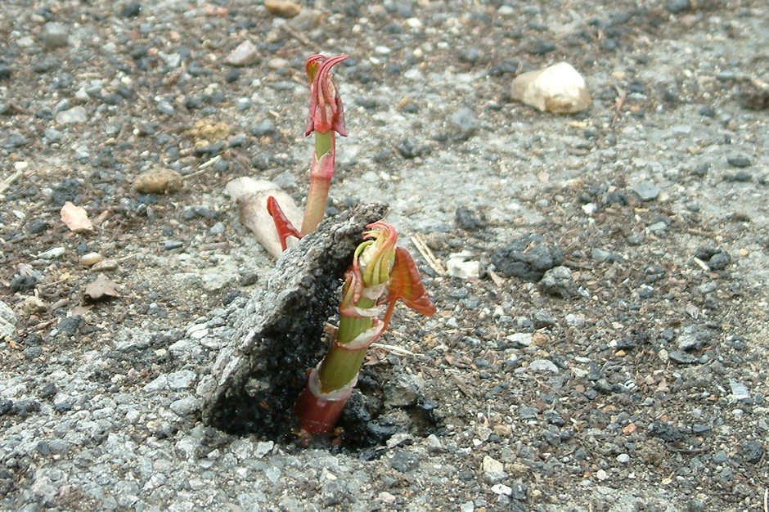

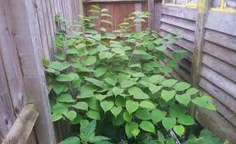
Japanese knotweed (Fallopia japonica)
Source: GB NNSS / BBC

Slide 27


Others to note…
Giant Hogweed (Heracleum mantegazzianum)
Himalayan Balsalm (Impatiens glandulifera)
Source: Construction Manager Magazine

Slide 28
Protected species
Wildlife and Countryside Act 1981, Part 1
Criminal offence to:
  Intentionally kill, injure or take a wild bird or animal
  Be in possession of any wild bird or animal or anything derived from them
  Sell or offer for sale wild birds or their eggs
  Intentionally or recklessly damage or destroy a nest, or place of shelter or rest for wild animals
  Intentionally pick, uproot or destroy wild plants
Why is this important for construction?
What can it cover?

Slide 29
Some example species
Amphibians – additional protections for Great Crested (or warty) newt and Natterjack toad
Badgers – also protected under the Protection of Badgers Act 1992
All wild birds, including their nests and eggs
Reptiles including slow worms and grass snakes
Bats – all British species are protected under the Habitat Regulations 2017
All wild plants

Slide 30
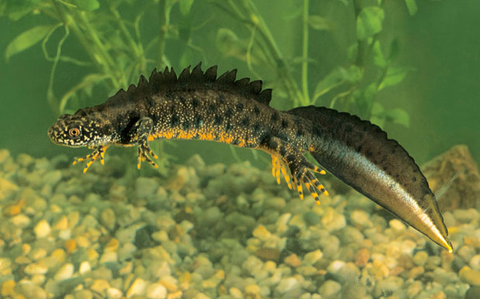
Great Crested Newts
Source: Almay

Slide 31
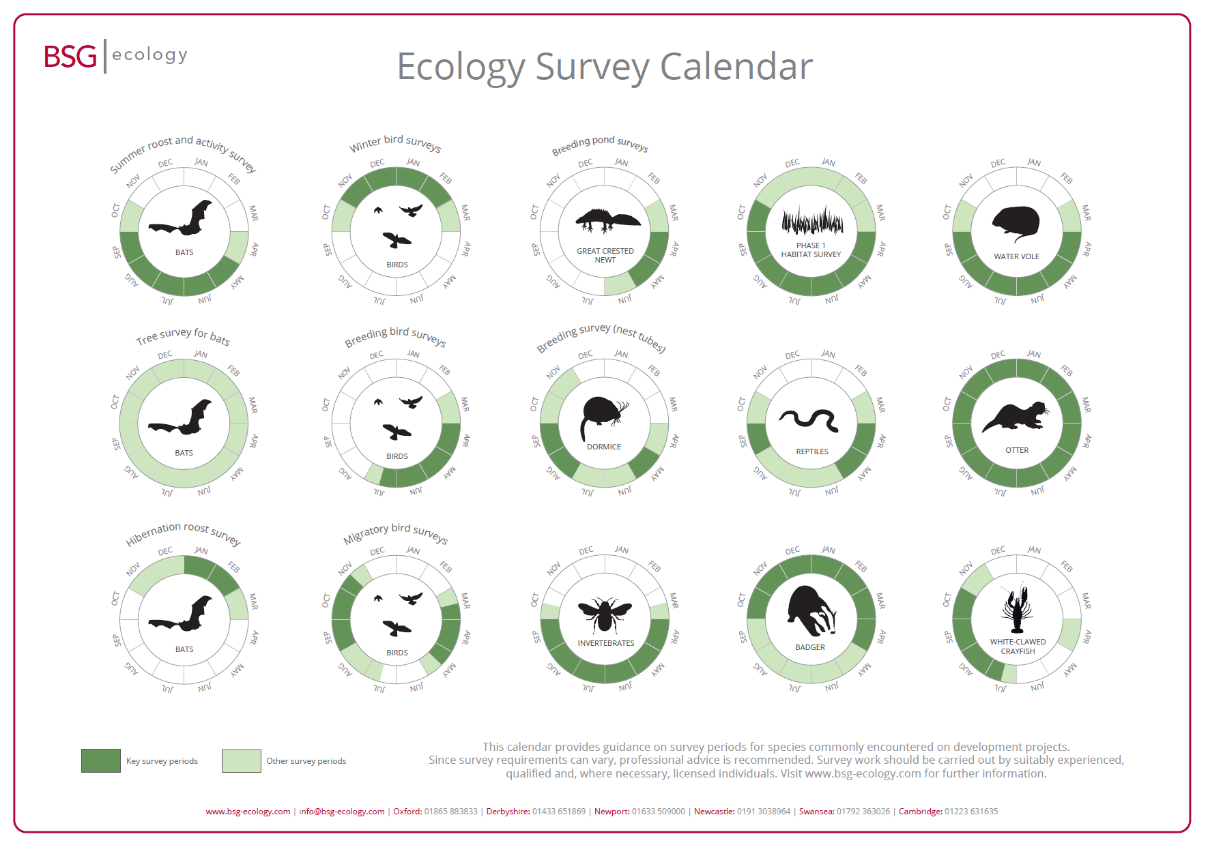

Slide 32
Retained EU Law (Revocation & Reform) Act 2023
REUL – domestic law originating from EU
  Created by EU (Withdrawal) Act 2018
REUL Act – allowed anything being retained to become ‘assimilated law’
  Key – no interpretation in line with EU principles
  587 legislative instruments revoked so far
  Known as Brexit Freedoms Bill in first drafting
At present, 33% of REUL has been reformed; appears an ongoing process

Slide 33
Useful resources
Construction Law: John UFF, 11th ed (2013)
Parliament publications (www.publications.parliament.uk)
Sentencing Council, Environmental Offenses definitive guidelines (www.sentencingcouncil.org.uk)
Law & Your Environment (www.environmentlaw.org.uk)
UK Government (www.gov.uk)
E-law resources (www.e-lawresources.co.uk)
UK Construction online (www.ukconstructionmedia.co.uk)
The Telegraph (www.telegraph.co.uk)
Designing Buildings Wiki (https://www.designingbuildings.co.uk)
Practical Law construction blog (http://constructionblog.practicallaw.com/beware-wildlife-on-site/)
Natural Resources Wales (www.naturalresources.wales)

