Slide 1
BMSK4001
Academic & Employability Skills
Basic Research Methods:
Overview
CertHE Skills for the Workplace

Slide 2
Why is Research important?
The Data in an article or report can be interrogated (examined in depth) to extract only the Information relevant to your enquiry from the article – this is known as being Discerning
Knowing how and where to seek out statistical or graphical evidence to back up your claims - or refute them - depending on the point of view of the question, adds weight to your report.
You will then be able to draw all of these strands together to produce a report arguing both sides of a question and provide evidence for each point of view if required; or to produce an evidenced report or assignment on any given topic.

Slide 3
Overview of Research and Data Handling
Initial ‘raw data’ (letters and numbers with no specific meaning) are transformed into Information
Possession of certain Information can bring Knowledge - and ultimately - Wisdom
We can act upon that Knowledge to effect change if we so wish
Data can be collected in several ways using both primary and secondary sources
Statistics can be Inferential or Descriptive and are used to produce graphs and charts to illustrate data meaningfully

Slide 4
Why collect information?
Decision-making:
Information used for decision-making is often categorised into three types:
Strategic – looking at the Big Picture
Tactical - measuring effective use of company resources
Operational - how the day to day operations are handled

Slide 5
Why collect information?
Information is used at all levels and in all contexts within organisations:
Planning: making decisions about staff, premises, equipment, customers.
Accurate and up to date information is required to enable planning to take place.
Recording:
In order to plan you must have information to base your plans on.
Organisations collect a wealth of information as part of their normal operations - they record purchases, sales, returns, deliveries etc.
Measurement:
Organisations must measure their performance in order to be successful.
Information is used as the main way of measuring performance.
This may be done by collecting and analysing information on sales, costs and profits.

Slide 6

Types of Data - Quantitative
Categorical
    Do you currently own any stocks or shares?
    Yes No
Numerical
    Discrete (whole number : no fractions): e.g., to how many magazines do you currently subscribe? ___ (Counted)
    Continuous: e.g. how tall are you? ___ (Measured)

Slide 7
Types of Data - Qualitative
Measures reasons, opinions, experiences, motivations
Helps uncover trends in thought - behaviours, preferences etc..

Slide 8

Primary Source
Collection Methods

Slide 9
Questionnaires
May be delivered in different ways:
self completion (e.g. online or postal)
telephone survey
face to face interview
May seek to discover any of the following types of information:
factual
behavioural
opinion based
attitudes
beliefs

Slide 10
Questionnaire Design
Good Design:
  Respondent knows exactly what to do
  Clear, neat, attractive layout
  Polite and professional tone
  Questions ask what you need to know – no more, no less
Poor Design:
  Too long
  Inappropriate design or language
  Poor questions

Slide 11
Questionnaire Design
  Poor Question types:
  negatives or double negatives
  ambiguous
  questions with the words ‘usually’ or ‘recently’ etc.
  leading questions
  questions that don’t itemise alternatives
  Inconsistent questions
  potentially embarrassing questions
  direct classification questions (how old are you)

Slide 12
Questionnaire Design
Avoid double-barrelled questions
A double-barrelled question combines two or more issues or attitudinal objects (the person place or thing (object) that one has feelings opinions about (attitudes) in a single question.

Slide 13
Questionnaire Design
Avoid double-barrelled questions
A double-barrelled question combines two or more issues or attitudinal objects (the person place or thing (object) that one has feelings or opinions about (attitudes) in a single question.

Slide 14
Questionnaire Design
Example
Do you think professors should have more contact with university staff and university administrators?
Clearly, this question asks about two different issues:
1. Do you think professors should have more contact with university staff?
2. Do you think that professors should have more contact with university administrators?

Slide 15
Questionnaire Design
Combining the two questions into one question makes it unclear which attitude is being measured, as each question may elicit a different attitude.
Tip: if the word “and” appears in a question, check to verify whether it is a double-barrelled question.

Slide 16
Which method to use?
The need to know how many staff would like training in IT skills development.
This requires a little information, in the same format, from a large number of staff. Use questionnaires.
The need to know in detail how people feel about a new product.
This requires detailed information on personal views. Use interviews (either individual or group).
The need to know how many shoppers enter the store each day of the week.
This requires information about consumer behaviour, most easily obtained by counting events. Use observation.

Slide 17
Secondary Source
Collection Methods

Slide 18
Trusted Sources
MINTEL –market information and analysis
National Statistics – official source of UK population and economic statistics
Ipsos MORI – specialises in researching advertising, loyalty, marketing, media and public affairs
ISER – longitudinal data (over time) on life events, employment conditions, behaviour and values
Business Source Complete via the library website

Slide 19
Secondary Data Sources
Advantages
  Can be a better use of resources
  Many datasets come from large, well-designed surveys that an individual or small company could not have done independently
Disadvantages
  Can be difficult to find appropriate data
  May not have exactly what you want
  You may have to pay for access

Slide 20
Presenting Data
The purpose of descriptive statistics is to summarise or display data so we can quickly obtain an overview.
Descriptive statistics play an important role today because of the vast amount of data readily available at our fingertips.
Descriptive Statistics enable us to accurately summarise data to obtain the “big picture” - either graphically or numerically.
The most common descriptive statistic is the average

Slide 21
Presenting Data
Inferential statistics allow us to make claims or form conclusions about a population based on a sample of data from that population.
They cover a large variety of techniques that allow us to make actual claims about a population based on a sample of data.
A population in statistics represents all possible measurements or outcomes.
A sample refers to a portion of the population that is representative of the population from which it was selected

Slide 22
Sampling
Virtually all statistical results are based on the measurements of a sample drawn from a population.
  E.g. Nielson ratings gather information on a small sample of homes for TV ratings
Measuring the entire population could be very expensive or even impossible
We can get very accurate information from samples

Slide 23
Presenting Data
Once data has been collected, it must be organised and summarised numerically.
Remember that the objective of tabulation (using tables)
and the use of graphs and charts is to summarise information in such a way as to create a simplified and clear picture of the data.

Slide 24
Presenting Data
A Frequency table is simply a table that organises numerical data values into intervals.
A frequency table is a useful way to indicate how many units fall into different groupings.
To make a frequency table, first determine the groupings, then count how many values fall in each group.

Slide 25
Frequency Table Example
Responses | 1.1 | 1.2.1 | 1.2.2 | 1.2.3 | 1.2.4 | 1.2.5 | 1.2.6 | 1.3.1 | 1.3.2 | 1.3.3 | Freq.
Excellent 5 | 2 | 4 | 3 | 4 | 2 | 2 | 4 | 1 | 2 | 0 | 23
Good 4 | 3 | 2 | 4 | 2 | 4 | 3 | 3 | 3 | 4 | 2 | 30
OK 3 | 4 | 3 | 2 | 3 | 4 | 4 | 1 | 4 | 3 | 3 | 31
Poor 2 | 1 | 2 | 2 | 2 | 1 | 1 | 2 | 2 | 1 | 4 | 18
Very Poor 1 | 1 | 0 | 0 | 0 | 0 | 1 | 1 | 1 | 1 | 2 | 7
Total Responses | 11 | 11 | 11 | 11 | 11 | 11 | 11 | 11 | 11 | 11

Slide 26
Creating a graph from the data
Create a table of the responses and the frequency and add these into two columns in Excel.
Response | Frequency
Very Poor | 7
Poor | 18
OK | 31
Good | 30
Very Good | 23
Response | Frequency
Very Poor | 7
Poor | 18
OK | 31
Good | 30
Excellent | 23

Slide 27
A Column Chart of the Frequency
Select the data in the two columns,
Click on Insert: Charts: Column and choose a type of Column.

Slide 28
Charts
Histograms
Bar charts
  Simple
  Stacked
  Multiple
Pie charts
Scatter Diagrams

Slide 29
Bar charts and pie charts
Compound bars allow several sets of data to be presented side-by-side for comparative purposes.
Stacked bars allow two or more sets of related data to be aggregated to show both individual trends and collective trends
Bar charts and pie charts are often used for categorical data
Height of bar or size of pie slice shows the frequency or percentage for each category

Slide 30
Multiple Bar Charts
A bar chart has a number of variations such as the stacked bar chart and the multiple bar chart, illustrated as follows, based on the production output of four companies over three successive months.

Slide 31
Stacked bar charts

Slide 32
Pie Charts
Pie charts use simple data to emphasise differences or similarities.
Six categories of data is the maximum that can realistically be accommodated in a pie-chart.
Pie charts are commonly used to describe data from relative frequency distributions.
Data must first be converted to degrees of a full circle.
Full circle = 360 degrees
Exploded pie charts allow you to emphasise particular elements

Slide 33
Exploded pie chart
Region: North South East West
Sales: 25 10 45 25

Slide 34
Line Graphs
Number of employees
Weekly earnings (£) 300 400 500 600 700 800
Company a 2 5 9 12 8 4
Company b 7 14 8 7 3 1

Slide 35
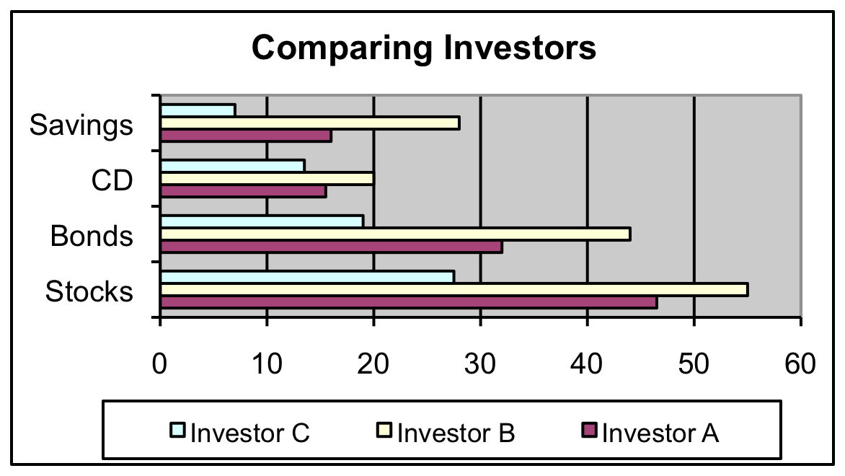
Side-by-side Bar Charts

Slide 36
Scatter Diagram - Example
Volume per day | Cost per day
23 | 131
24 | 120
26 | 140
29 | 151
33 | 160
38 | 167
41 | 185
42 | 170
50 | 188
55 | 195
60 | 200

Slide 37
Graphs
All graphs have a common structure:
A framework
Content
Labels (title, axis labels, legend)
All are equally important

Slide 38
Graphs
Framework:
The framework sets the stage – it indicates the kind of measurements being used. The framework consists of the axes.
The y-axis is vertical and represents measurements (the dependent variable)
The x-axis is horizontal and represents the things being measured (the independent variable).

