Slide 1
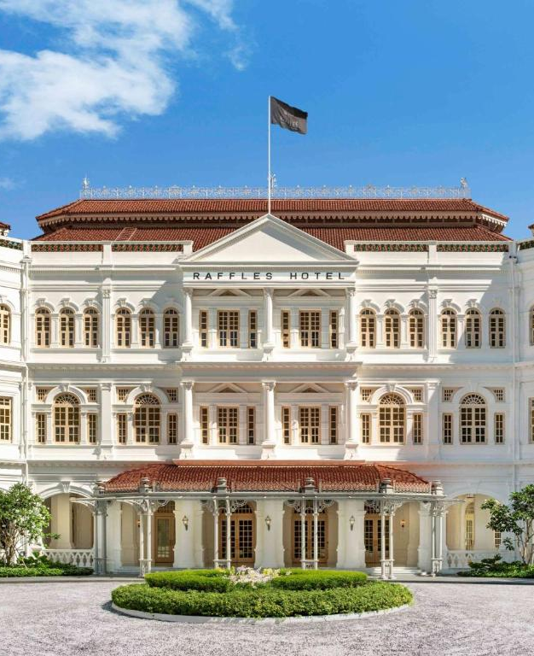
*****
Raffles Hotel:
The role and importance of hospitality & guest services within the hotel industry
Student Name:Daniela Livia Isar Student ID:2242723
Module Name: Hospitality and Guest Service Management (BMIH4003)
Lecturer’s Name: Charlotte Joyner, Dale Clarke

Slide 2
Table of contents
01
02
03
Introduction
Main Consumers
Why consumers choose Raffles?
04
Guest Services & Facilities
05
07
06
Importance of Hospitality
How Hotels Meet Guest Expectations?
Conclusion

Slide 3
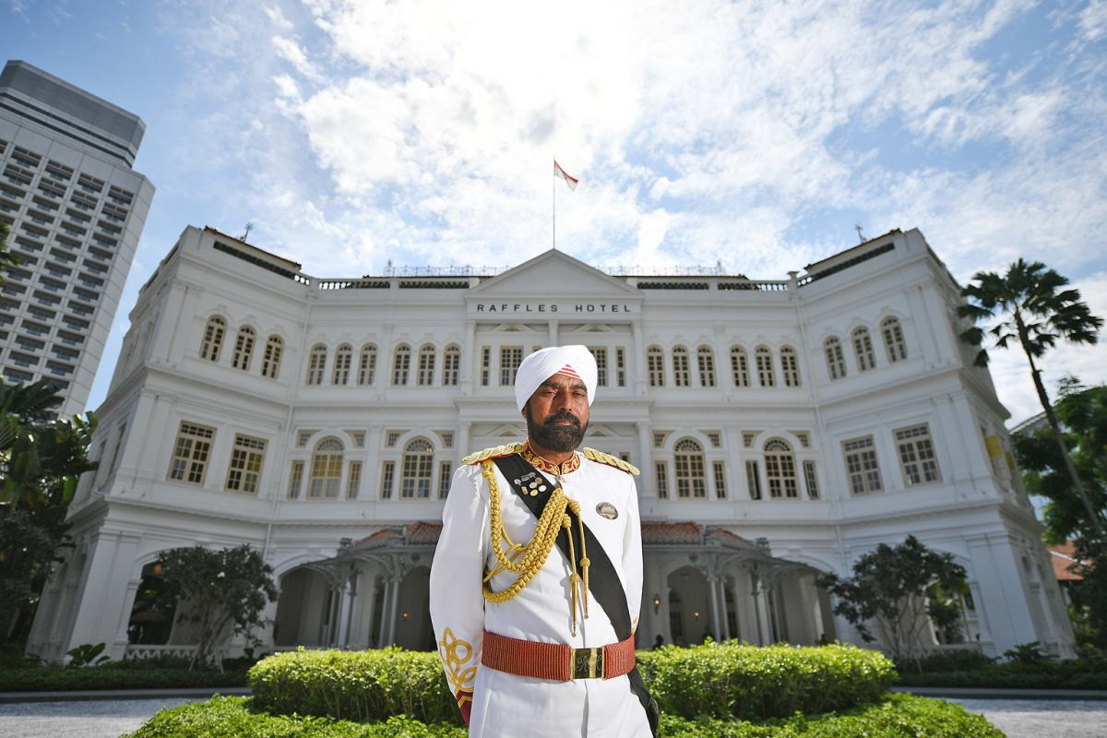
Introduction
Raffles Hotel was founded in 1887 in Singapore by four entrepreneurial Persian-Armenian brothers, the Sarkies.
It was named after the founder of modern Singapore, Sir Stamford Raffles.
From a modest 10-room hotel, it has became a global competitor in the hotel industry (Raffles, n.d.).
It is known worldwide for its unique blend of British etiquette, tropical magnificence and Asian grace.

Slide 4
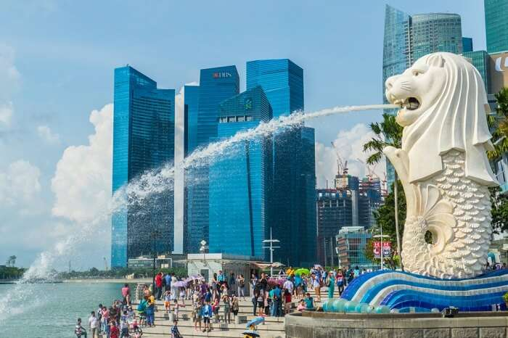
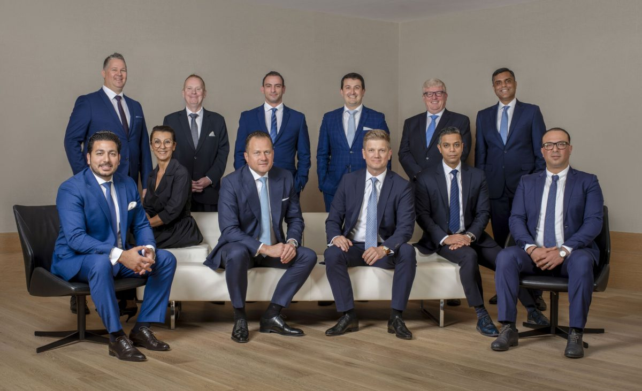
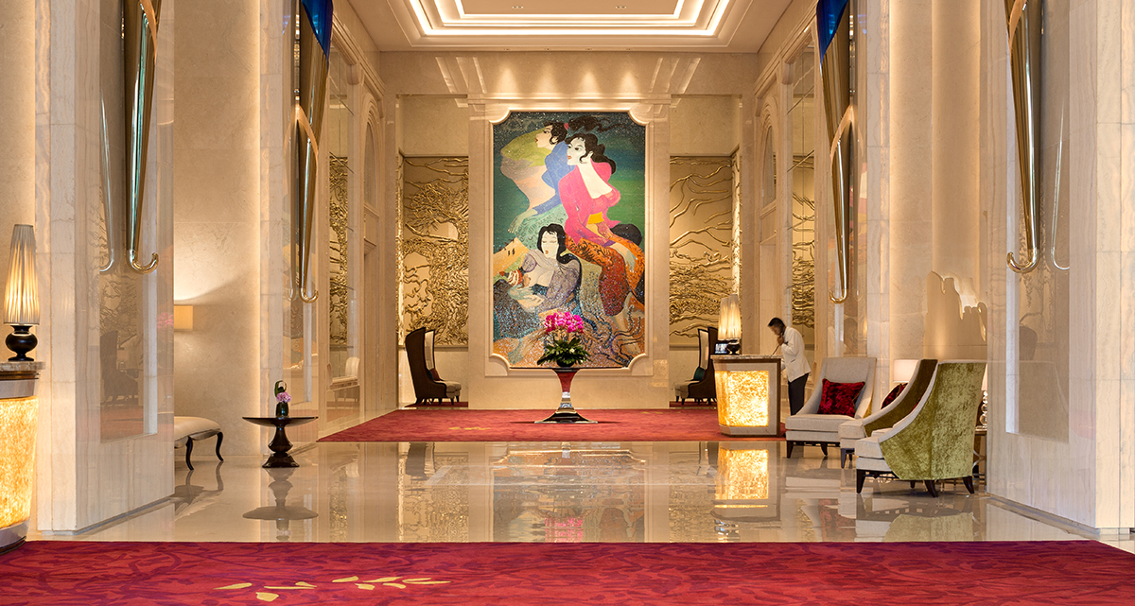
Main Consumers
High-end Tourists
Business Executives
Culture Enthusiasts
Travelers who value exclusivity and impeccable service are willing to pay a premium price for top-tier experience (Sun, 2011)
Workaholics who require not only comfortable accommodations but also a decent environment for meetings and events
Customers who value enriched history and are eager to experience a piece of Singapore’s heritage visit this hotel

Slide 5
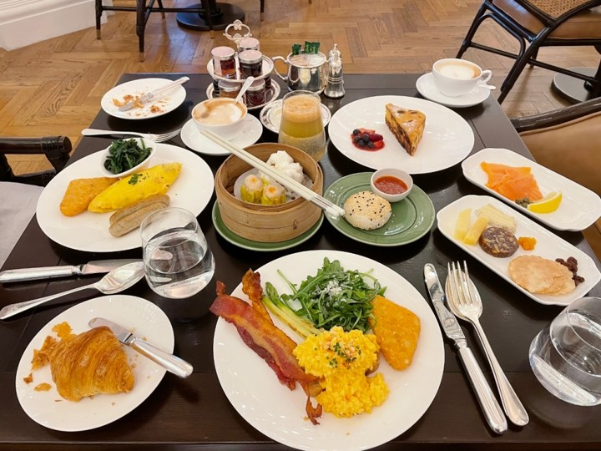
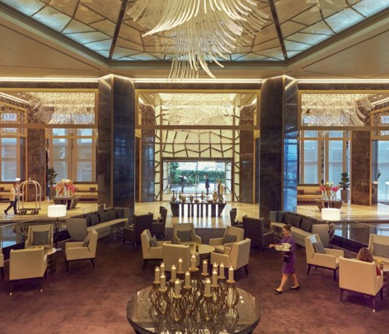
Why Consumers Choose Raffles?
Customers prioritize Raffles for their events because of its:
High Rankings
Exceptional Service
Cultural Heritage
Historical Architecture
Luxurious Accommodations
Exclusivity
Outstanding Employees
Fine Dining Experience

Slide 6
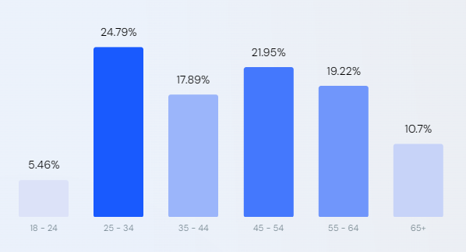
Cont…
Audience Distribution by Age Range
This audience composition reveals Raffle current market share across various audiences. Among its visitors, 50.86% are male and 49.14% female. The largest age group of visitors are 25 - 34 year old (similarweb, 2023).

Slide 7



Guest Services & Facilities (General)
Nature | Scope | Role
Hotels provide hospitality and accommodation services to guests (Hargreaves, 2015). Services are diverse and customer-centric. The nature of these services focus on quality, comfort, and convenience to ensure guest satisfaction. | The scope of guest services and facilities in hotels is both extensive and multifaceted. Lodging, food & beverage, business events, safety, and security, customer service, and sustainability are all different services that hotels provide (Suprayitno and Heng, 2021). | Enhance guest experience and provide competitive advantage to the hotel. Builds a positive brand image and increases revenue. Meets guests needs and ensures customer loyalty through compliance.

Slide 8
Guest Services & Facilities (Raffles)
Nature | Scope | Role
Service of Raffles Hotel is worldwide known for its cultural heritage and timeless elegance. Deeply rooted in historical significance. Emphasizes personalized guest experience. Provides an exclusive environment to guests who prioritize privacy. | The scope of Raffles hotel is exquisite due to its diverse guest services. From luxurious lodging services to multiple food and beverage options to numerous recreational facilities, this hotel has it all. Allows customers to experience the local history of Singapore (Tan, 2019). | The primary role of their guest services is to enhance the guest experience (Tan, 2022). Preserves Singapore’s colonial heritage. The diverse services and facilities attract new customers and enhances its reputation.

Slide 9

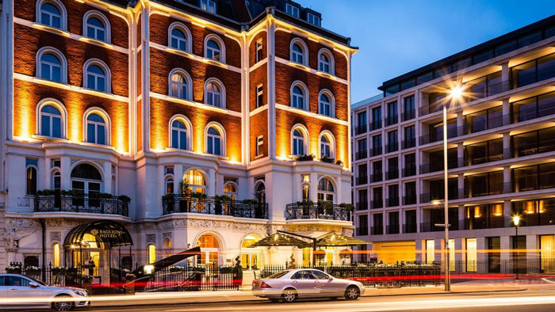
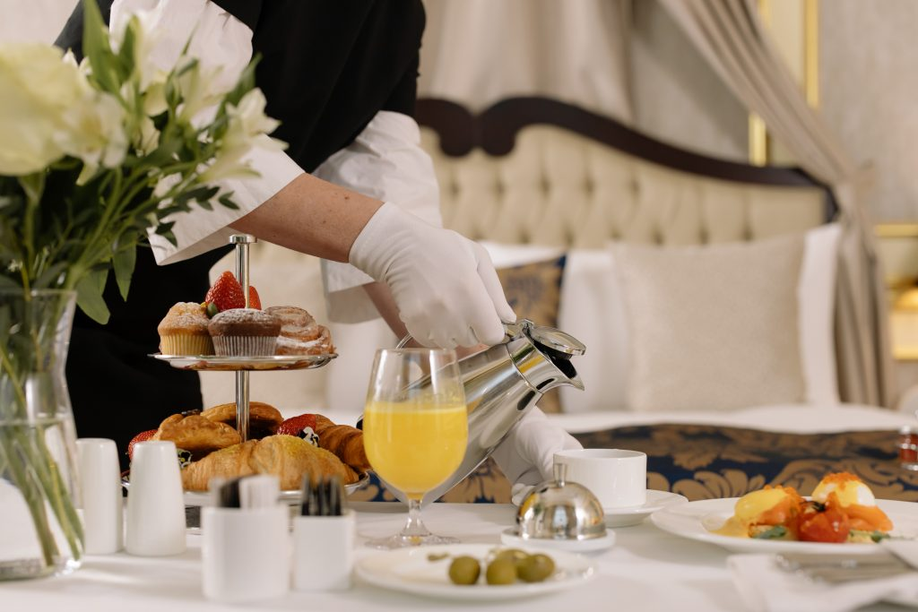
Importance of Hospitality
Hospitality in the hotel industry is a significant element that brings a lot of benefits to businesses (Hendron, 2021). These include:
Guest Satisfaction
Huge Customer Base
Positive Reputation
Competitive Advantage
Revenue Generation
Brand Differentiation
(Langer, 2022)

Slide 10

How Hotels meet Guest Expectations
Hotels meet guest expectations or needs through:
Clear Communication
Personalization
Quality Service
Well-maintained Facilities
Accurate Billing
Safety and Security
Regular Maintenance
(Chamberlain, 2021).

Slide 11
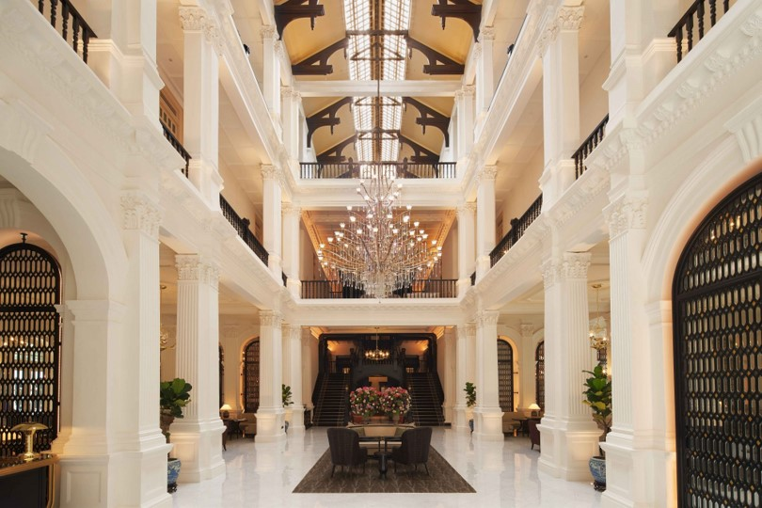
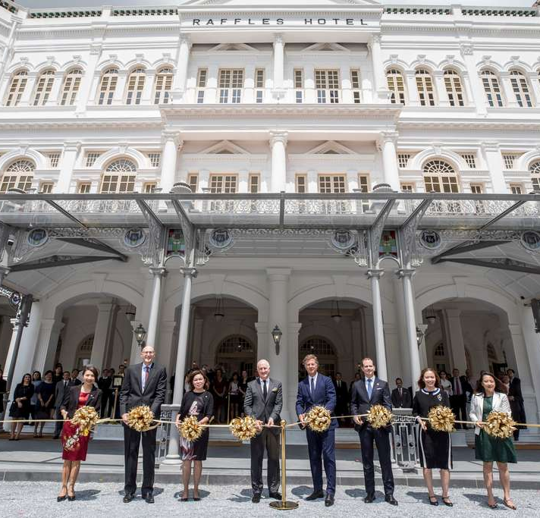
Conclusion
“Raffles is a hotel known for its cultural heritage and modern excellence. From the exceptional architecture to its luxury services, this hotel offers a personalized experience to all guests, and thus maintains a huge customer base.”

Slide 12
References
Chamberlain, M. (2021). 12 Top Guest Expectations in a Hotel: And How to Meet Them. [online] Hotefy. Available at: https://get.hotefy.com/guest-expectations-in-a-hotel-how-to-meet-them/#:~:text=to%20cover%20this.- [Accessed 6 Oct. 2023].
Hargreaves, C.A. (2015). Analysis of Hotel Guest Satisfaction Ratings and Reviews: An Application in Singapore. American Journal of Marketing Research, 1(4), pp.208–214.
Hendron, A. (2021). The Importance of the Hospitality Industry & Its Four Sectors. [online] Epos Now. Available at: https://www.eposnow.com/uk/resources/importance-of-the-hospitality-industry/.
Langer, D. (2022). How Raffles Is Setting A New Standard In Luxury Hospitality. [online] Jing Daily. Available at: https://jingdaily.com/luxury-hospitality-raffles-istanbul-customer-service/ [Accessed 6 Oct. 2023].
Raffles (n.d.). About. [online] www.raffles.com. Available at: https://www.raffles.com/about/ [Accessed 6 Oct. 2023].
similarweb. (2023). Raffles. [online] Available at: https://www.similarweb.com/website/raffles.com/#ranking.
Sun, L. (2011). The Core Competences and Strategic Management of Raffles — A Case Study of Singapore Hotel Industry. International Journal of Innovation, Management and Technology, 2(4), pp.270–273.
Suprayitno, B. and Heng, H. (2021). Significance of the Hotel and Tourism Sector on Economic Development in Singapore. Journal of Hospitality and Tourism Management, 4(2), pp.1–10. doi:https://stratfordjournals.org/journals/index.php/Journal-of-Hospitality/article/view/846.
Tan, J.H. (2022). Raffles Hotel. [online] www.nlb.gov.sg. Available at: https://www.nlb.gov.sg/main/article-detail?cmsuuid=626de813-59c0-47a3-8f5d-b4e8bdea2196#:~:text=The%20hotel%20is%20particularly%20known [Accessed 6 Oct. 2023].
Tan, S. (2019). RAFFLES HOTEL: HOW DOES OLD WORLD CHARM APPEAL TO MILLENNIALS? [online] www.linkedin.com. Available at: https://www.linkedin.com/pulse/raffles-hotel-how-does-old-world-charm-appeal-millennials-sandra-tan/ [Accessed 6 Oct. 2023].

