Slide 1
AHHI6013
Week 9
‘Margaret on the Guillotine’:
State Control and Civil Disobedience in Thatcher-Era Britain
Lecture 1: Deconstructing ‘Thatcherism’

Slide 2
Week 9 lecture outline
Tuesday lecture
Deconstructing ‘Thatcherism’
Discussion and contextualisation of ‘Thatcherism’ and ‘The Eighties’
Analyses of two key sources – Stuart Hall’s ‘The Great Turning Right Show’ (1979) and Margaret Thatcher’s speech to Conservative Party Conference, 1975
Theorisation of neoliberal state
Friday lecture
Riots, Resistance and Regeneration in Thatcher’s Britain
Analyses of primary sources relating to 1981 urban riots (see Moodle)
Discussion of urban regeneration policies in response to the riots
Discussion of conflict between local and central government, and other key social-political debates/tensions of the 1980s
Introduce theme of archives/information control as an aspect of state-citizen relations

Slide 3
Deconstructing ‘the Eighties’
“The Mods and Rockers are one of the many sets of figures through which the sixties in Britain will be remembered. A decade is not just a chronological span but a period measured by its association with particular fads, fashions, crazes, styles or a certain spirit or kulturgeist . A term such as ‘the twenties’ is enough to evoke the cultural shape of that period, and although we are too close to the sixties for such explicit understandings to emerge already, this is not for want of deviance and moral panics trying from our instant cultural historians. In the cultural snap albums of the decade which have already been collected the Mods and Rockers stand alongside the Profumo affair, the Great Train Robbery, the Krays, the Richardsons, the Beatles, the Rolling Stones, the Bishop of Woolwich, Private Eye, David Frost, Carnaby Street, The Moors murders, the emergence of Powellism, the Rhodesian affair, as the types and scenes of the sixties.”
Stanley Cohen, Folk Devils and Moral Panics: The Creation of the Mods and Rockers (Abingdon: Routledge, 2002 ed. [1972]), p. 3

Slide 4
Deconstructing ‘the Eighties’
‘The Eighties’
http://www.dailymotion.com/video/x959sf_this-is-england-toots-the-maytals-5_shortfilms

Slide 5
Deconstructing ‘Thatcherism’
‘The Eighties’
‘Thatcherism’

Slide 6
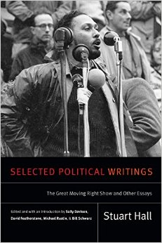
Defining Thatcherism
Stuart Hall, ‘The Great Moving Right Show ,’ Marxism Today, January 1979, pp. 14–20.

Slide 7
Defining Thatcherism
“No one seriously concerned with political strategies in the current situation can now afford to ignore the ‘swing to the Right.’
“ … The commonest response on the Left is probably to interpret the ‘swing to the Right’ as a simple expression of the economic crisis. Thus ‘Thatcherism’ is – give or take one or two elements – the corresponding political bedfellow of a period of capitalist recession: the significant differences between this and other variants of Tory ‘philosophy’ being conceived as without any specific pertinent political or ideological effects.
“This position neglects everything particular and specific to this historical conjuncture.”

Slide 8
Defining Thatcherism:
Defining The crisis
“ … In economic terms, Britain's structural industrial and economic weakness emerges in the immediate aftermath of the post-war boom. The 1960s are marked by the oscillations between recession and recovery, with a steady underlying deterioration …. By the end of the 1960s, the economy has dipped into fullscale recession – slumpflation … By the mid-1970s, the economic parameters are dictated by a synchronization between capitalist recession on a global scale, and the crisis of capital accumulation specific to Britain. Domestic politics has thus been dominated by crisis management and containment strategies: dove-tailed through an increasingly interventionist state, intervening both to secure the conditions of capitalist production and reproduction. The strategy has a distinctively corporatist character—incorporating sections of the working class and unions into the bargain between state, capital and labour, the three ‘interests’ … The ‘natural’ governor of this crisis has been the party of social democracy in power. This last factor has had profound effects in disorganizing and fragmenting working class responses to the crisis itself.”
Hall, ‘The Great Moving Right Show’

Slide 9
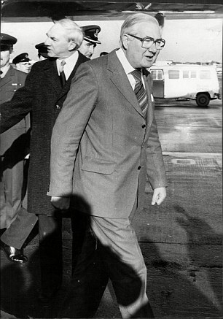
Defining The crisis
Returning to the UK from an economic summit in Guadeloupe on January 10 1979, Prime Minister James Callaghan was asked by a journalist, ‘What is your general approach, in view of the mounting chaos in the country at the moment?”
Callaghan responded: “Well, that’s a judgment that you are making. I promise you that if you look at it from outside, and perhaps you’re taking rather a parochial view at the moment, I don’t think that other people in the world would share the view that there is mounting chaos.”
https://www.youtube.com/watch?v=dX06xqN6710: 02:00

Slide 10
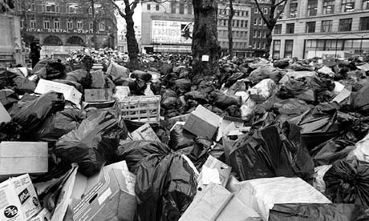
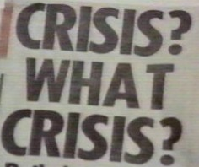
‘Winter of discontent’ (Dec 1978–Feb 1979)
Widespread strikes by public sector trade unions against pay caps of Labour government
Lorry drivers, members of the Transport and General Workers’ Union (TGWU), inc. drivers of oil tankers went on national strike
Jan 22 bibggest individual day of industrial action since the General Strike of 1926
Strikes by railway workers, ambulance drivers, nurses
Coincided with bitter weather conditions, refuse collectors, gravediggers
Leicester Square, London, 1979; Sun headline, January 11 1979

Slide 11
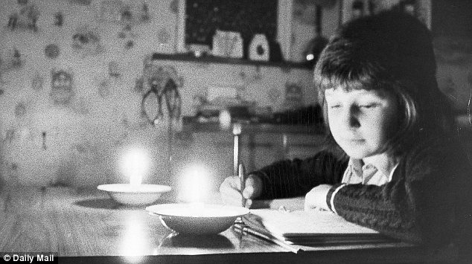
Economic Crisis
Three-Day Week, January 1 – March 7 1974
Commercial users of electricity limited to three specified consecutive days' consumption each week
Aim to conserve electricity owing to restricted supply of coal during miners’ strike and oil crisis caused by Organization of Arab Petroleum Exporting Countries (OPEC) trade embargo
Led to defeat of incumbent Conservative Government in two general elections in 1974 (1st producing Labour minority, 2nd small Labour majority)
IMF bailout, 1976
Financial crisis forced the government to borrow $3.9 billion from the International Monetary Fund
Unemployment
Unemployment reached 1.5million in 1978 – nearly treble the 1968 figure; national rate of employment exceeded 5% for the first time in the postwar era

Slide 12


‘anarchy in the uk’
Right now ha, ha, ha, ha, ha
I am an anti-Christ
I am an anarchist
Don't know what I want
But I know how to get it
I want to destroy the passerby
'Cause I want to be anarchy
No dogs body
Anarchy for the UK
It's coming sometime and maybe
I give a wrong time, stop a traffic line
Your future dream has sure been seen through
'Cause I want to be anarchy
In the city
How many ways to get what you want
I use the best, I use the rest
I use the enemy [NME].
I use anarchy
'Cause I want to be anarchy
Its the only way to be
Is this the MPLA [Popular Movement for the Liberation of Angola]
Or is this the UDA [Ulster Defence Association]
Or is this the IRA [Irish Republican Army]
I thought it was the UK
Or just another country
Another council tenancy
I want to be anarchy
And I want to be anarchy
(Oh what a name)
And I want to be an anarchist
(I get pissed, destroy!)

Slide 13
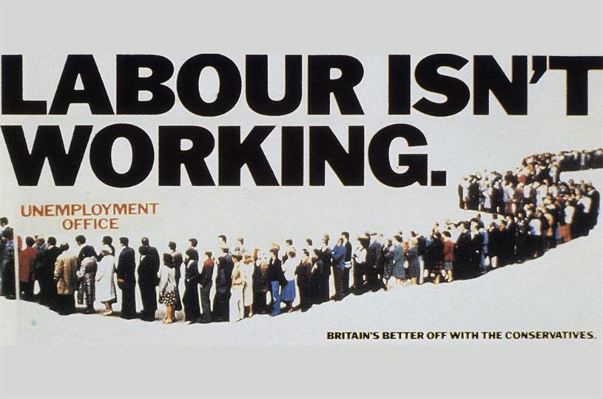
1979 General election

Slide 14
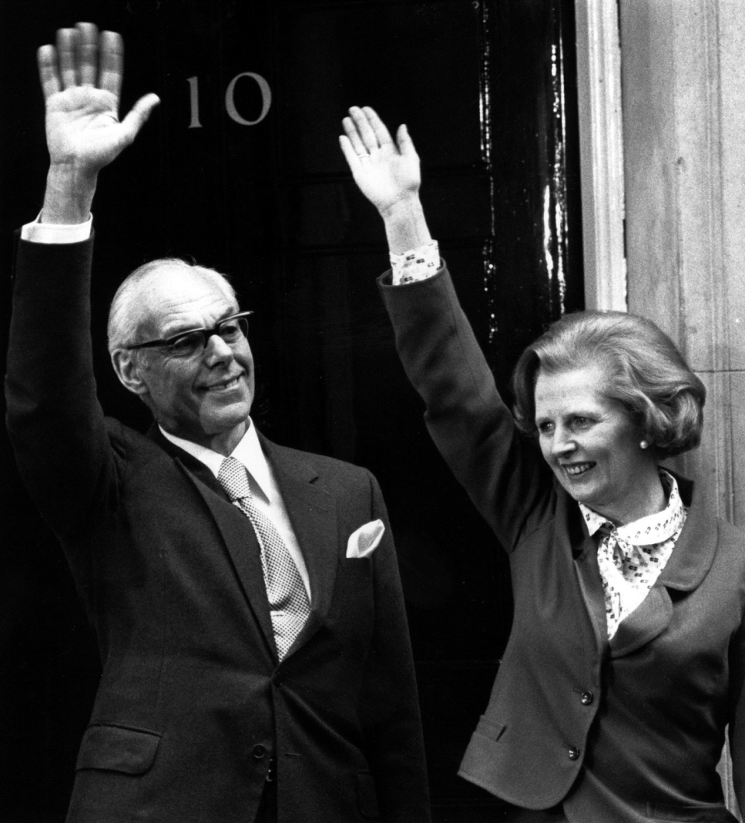
1979 General election
“I know full well the responsibilities that await me as I enter the door of No. 10 and I'll strive unceasingly to try to fulfil the trust and confidence that the British people have placed in me and the things in which I believe. And I would just like to remember some words of St. Francis of Assisi which I think are really just particularly apt at the moment. ‘Where there is discord, may we bring harmony. Where there is error, may we bring truth. Where there is doubt, may we bring faith. And where there is despair, may we bring hope’”
Margaret Thatcher, May 4 1979

Slide 15
Defining Thatcherism: end of post-WWII ‘consensus’
“‘Thatcherism’ succeeds … by directly engaging the ‘creeping socialism’ and apologetic ‘state collectivism’ of the [Edward] Heath [Conservative Prime Minister, 1970–1974] wing. It thus centres on the very nerve of consensus politics, which dominated and stabilized the political scene for over a decade. Of course, it aims for a construction of a national consensus of its own. What it destroys is that form of consensus in which social democracy was the principal tendency.”

Slide 16
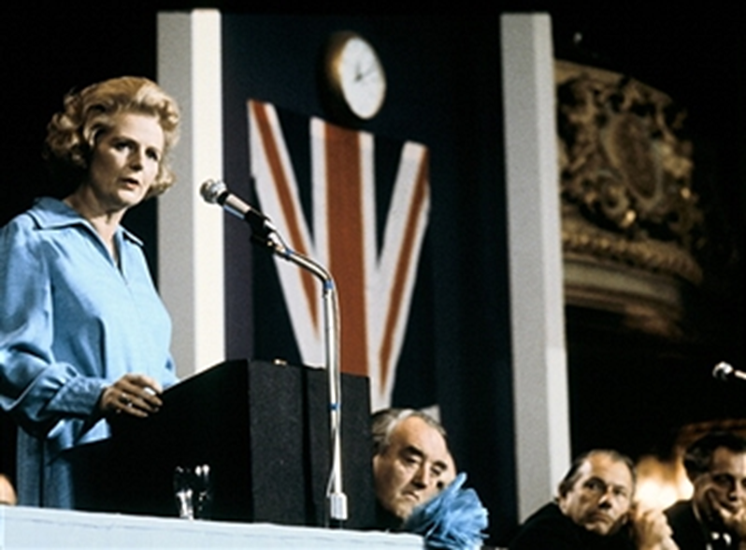
Defining Thatcherism: end of post-WWII ‘consensus’
“So let us have no truck with those who say the free enterprise system has failed. What we face today is not a crisis of capitalism but of socialism. No country can flourish if its economic and social life is dominated by nationalisation and State control.
“The cause of our shortcomings does not, therefore, lie in private enterprise. Our problem is not that we have too little socialism. It is that we have too much. If only the Labour Party … would stop trying to prove their Socialist virility by relentlessly nationalising one industry after another.”
Margaret Thatcher, Leader's speech to Conservative Party Conference, Blackpool, October 10 1975

Slide 17
Defining Thatcherism: ideological aspects
“[Another] strand in the new philosophy of the radical Right is the themes of anti-collectivism and anti-statism. ‘Thatcherism’ has given this traditional arena of conservative ‘philosophy’ expansive play. At the level of organizing theoretical ideologies, anti-statism has been refurbished by the advance of Monetarism as the most fashionable economic credo. Keynesianism was the lynch-pin of the theoretical ideologies of state intervention throughout the postwar period, assuming almost the status of a sacred orthodoxy.”

Slide 18
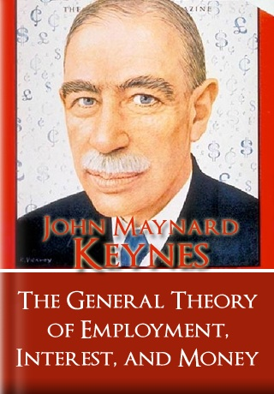

Defining Thatcherism: ideological aspects
Keynesianism
Monetarism
Underpinned Western economies from WWII through to 1970s
Emphasis on state intervention
Emphasis on state expenditure in times of economic crisis
Theory or practice of controlling the supply of money as the chief method of stabilizing the economy
Market-driven

Slide 19
Defining Thatcherism: ideological aspects
“Neither Keynesianism nor Monetarism win votes in the electoral marketplace. But in the doctrines and discourses of ‘social market values’ —the restoration of competition and personal responsibility for effort and reward, the image of the over-taxed individual, enervated by welfare coddling, his initiative sapped by handouts by the state— ‘Thatcherism’ has found a powerful means of popularizing the principles of a Monetarist philosophy: and in the image of the welfare ‘scavenger’ a well designed folk-devil.”
“ … [Thatcherism’s] success and effectivity does not lie in its capacity to dupe unsuspecting folk but in the way it addresses real problems, real and lived experiences, real contradictions – and yet is able to represent them within a logic of discourse which pulls them systematically into line with policies and class strategies of the Right.”

Slide 20

ideological aspects: road to Serfdom (1944)
“The state should confine itself to establishing rules applying to general types of situations and should allow the individuals freedom in everything which depends on the circumstances of time and place, because only the individuals concerned in each instance can fully know these circumstances and adapt their actions to them.”
“What is called economic power, while it can be an instrument of coercion, is in the hands of private individuals never exclusive or complete power, never power over the whole life of a person. But centralised as an instrument of political power it creates a degree of dependence scarcely distinguishable from slavery
“ … Who can seriously doubt … that the power which a millionaire, who may be my employer, has over me is very much less than that which the smallest bureaucrat possesses who wields the coercive power of the state and on whose discretion it depends how I am allowed to live and work?”

Slide 21
ideological aspects:
‘Anti-statism’
“Let me give you my vision: a man’s right to work as he will, to spend what he earns, to own property, to have the State as servant and not as master – these are the British inheritance. They are the essence of a free country and on that freedom all our other freedoms depend.”
Margaret Thatcher, Leader's speech to Conservative Party Conference, Blackpool, October 10 1975

Slide 22
ideological aspects:
‘Anti-statism’
“Some Socialists seem to believe that people should be numbers in a State computer. We believe they should be individuals. We are all unequal. No one, thank heavens, is quite like anyone else, however much the Socialists may pretend otherwise. We believe that everyone has the right to be unequal. But to us, every human being is equally important. Engineers, miners, manual workers, shop assistants, farm workers, postmen, housewives - these are the essential foundations of our society, and without them there would be no nation. But there are others with special gifts who should also have their chance, because if the adventurers who strike out in new directions in science, technology, medicine, commerce, and industry are hobbled, there can be no advance. The spirit of envy can destroy; it can never build. Everyone must be allowed to develop the abilities he knows he has within him, and she knows she has within her, in the way he chooses.
“Freedom to choose is something we take for granted until it is in danger of being taken away. Socialist governments set out perpetually to restrict the area of choice, and Conservative governments to increase it.”
Thatcher, Leader's speech to Conservative Party Conference, October 10 1975

Slide 23

‘NO such thing as society’
“ We have gone through a period when too many children and people have been given to understand ‘I have a problem, it is the Government's job to cope with it!’ or ‘I have a problem, I will go and get a grant to cope with it!’ ‘I am homeless, the Government must house me!’ and so they are casting their problems on society and who is society? There is no such thing! There are individual men and women and there are families and no government can do anything except through people and people look to themselves first. It is our duty to look after ourselves and then also to help look after our neighbour and life is a reciprocal business …
“There is also something else I should say to them: ‘If that does not give you a basic standard, you know, there are ways in which we top up the standard. You can get your housing benefit.’
“But it went too far. If children have a problem, it is society that is at fault. There is no such thing as society.”
Thatcher, interview for Woman’s Own transcript, September 23 1987 (published October 31 1987). Via the Margaret Thatcher Foundation (http://www.margaretthatcher.org/document/106689)

Slide 24
ideological aspects:
Anti-statism?
“If any one should murmur that I am preaching laissez faire, let me say I am not arguing, and have never argued, that all we have to do is to let the economy run by itself. I believe that, just as each of us has an obligation to make the best of his talents, so governments have an obligation to create the framework within which we can do so - not only individual people, but individual firms and particularly small firms.”
Thatcher, Leader's speech to Conservative Party Conference, October 10 1975

Slide 25

Thatcherism as neoliberal ‘govermentality’
“… [There are] specific features of this neo-liberalism which absolutely oppose them to everything one generally thinks one is criticizing when one criticizes the liberal policy of neo-liberalism.
“ … In all the texts of the neo-liberals you find the theme that government is active, vigilant, and intervening in a liberal regime, and formulae that neither the classical liberalism of the nineteenth century nor the contemporary.”
Michel Foucault, The Birth of Biopolitics: Lectures at the Collège de France, 1978–1979 (Palgrave MacMillan: Basingstoke, Hampshire, 2008), pp. 133–134.

Slide 26
Thatcherism as neoliberal ‘govermentality’
“We should not be under any illusion that today’s neo-liberalism is, as is too often said, the resurgence or recurrence of old forms of liberal economics which were formulated in the eighteenth and nineteenth centuries and are now being reactivated by capitalism for a variety of reasons to do with its impotence and crises as well as with some more or less local and determinate political objectives. In actual fact, something much more important is at stake in modern neo-liberalism. What is at issue is whether a market economy can in fact serve as the principle, form, and model for a state.”
Foucault, Birth of Biopolitics, pp. 117–118.

Slide 27
Thatcherism as neoliberal ‘govermentality’
“The point to underline is that neo-liberal governmental intervention is no less dense, frequent, active, and continuous than in any other system. But what is important is to see what the point of application of these governmental interventions is now. Since this is a liberal regime, it is understood that government must not intervene on effects of the market. Nor must neo-liberalism, or neo-liberal government, correct the destructive effects of the market on society … Government must not form a counterpoint or a screen, as it were, between society and economic processes. It has to intervene on society as such, in its fabric and depth. Basically, it has to intervene on society so that competitive mechanisms can play a regulatory role at every moment and every point in society and by intervening in this way its objective will become possible, that is to say, a general regulation of society by the market.”
Foucault, Birth of Biopolitics, p. 145

Slide 28
Thatcherism as neoliberal ‘govermentality’
BIOPOLTICS
Administration and regulation of human and non-human life at the levels of the population and the individual body.
  Modern state sought to manage conditions of birth and death, health and disease, race and sexuality, and other dimensions of human well-being in order to foster life
  Required the proliferation of new kinds of knowledge such as demography, epidemiology, criminology and statistics to constituted ‘the population’ as an object of state power

Slide 29
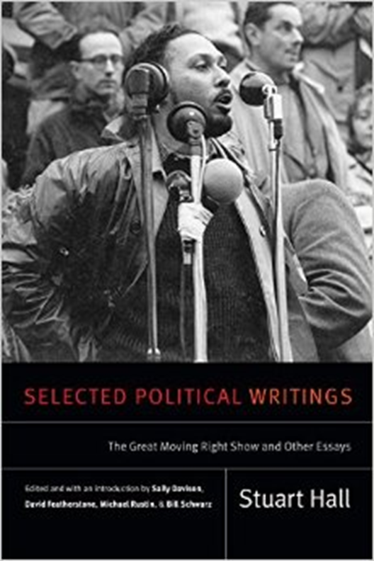
Thatcherism as ‘authoritarian popularism’
“On law and order, the themes – more policing, tougher sentencing, better family discipline, the rising crime rate as an index of social disintegration, the threat to ‘ordinary people going about their private business’ from thieves, muggers, etc., the wave of lawlessness and the loss of law-abidingness – are perennials of Conservative Party Conferences, and the sources of many a popular campaign.
“ … The play on ‘values’ and on moral issues in this area is what gives to the law and order crusade much of its grasp on popular morality and common sense conscience. Yet despite this, it touches concretely the experiences of crime and theft, of loss of scarce property and fears of unexpected attack in working class areas and neighbourhoods; and, since it promulgates no other remedies for their underlying causes, it welds people to that ‘need for authority’ which has been so significant for the Right in the construction of consent to its authoritarian programme.”

Slide 30
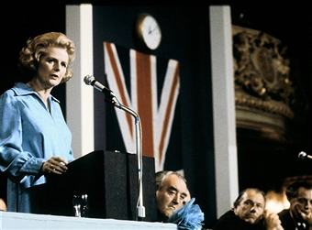
Thatcherism as ‘authoritarian popularism’
“I come last to what many would put first, the rule of law. The first people to uphold the law should be governments … The first duty of government is to uphold the law, and if it tries to bob, weave and duck round that duty when it is inconvenient, the governed will do exactly the same thing, and then nothing will be safe, not home, not liberty, not life itself.”
Margaret Thatcher, Leader's speech to Conservative Party Conference, Blackpool, October 10 1975

