Slide 1
Certificate of Higher Education in Skills for the Workplace
Academic and Employability Skills
(LCHS4001_BIRM)
Understanding Assignments & Finding information

Slide 2
Previously…
We have;
Overviewed the module
Explored note taking techniques
Identified time management strategies

Slide 3
In this session we will…..
Discuss about how to identify the requirements of an assignment
Evaluate the sources available for gathering information
Introduce relevant sources.

Slide 4
Understanding Assignments

Slide 5
Assignments: What is their purpose?
Formative Assessments
  Class tasks help you to consolidate and develop your learning.
  Class tasks demonstrate to your lecturer whether or not you understand key concepts.
  Mid-term assignments and end of term assignments allow your lecturer to assess your ability to meet the learning outcomes for the module.
  These tasks allow you to receive grading and feedback which aid you to progress through your course.
Summative Assessments

Slide 6
Different types of level 4 summative assessment
Report
Essay
Individual Presentation
Group presentation
Case studies
Annotated Bibliography
Mock interview
Supporting paper
Reflective report
Notes:
Discuss the key features of each of these types of assessment, all of which are included during the course of the Cert HE HSC.

Slide 7
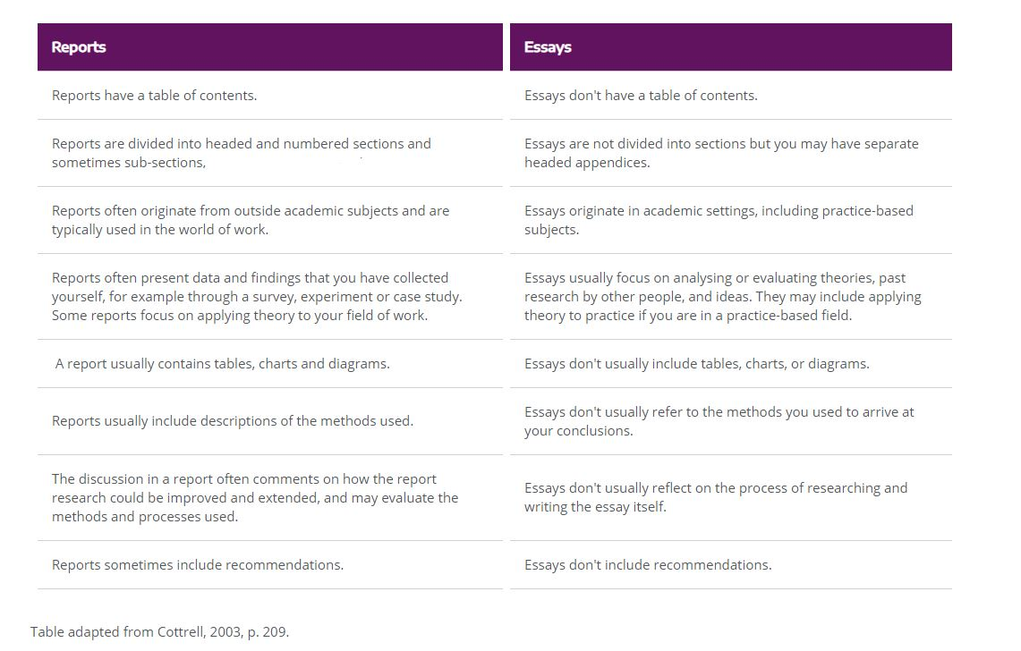
Key differences between reports and essays.

Slide 8
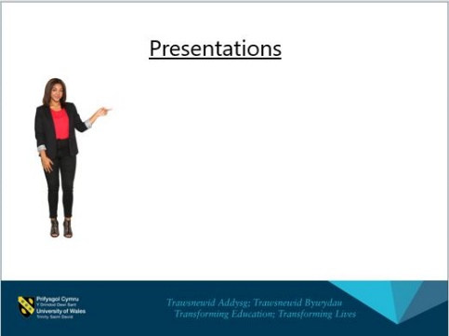
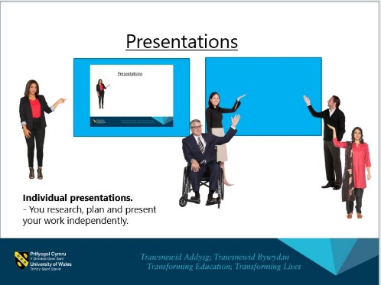





Presentations
Group presentations.
- You work as a group to research, plan and present your work.
Individual presentations.
- You research, plan and present your work independently.

Slide 9
Case Studies
Case studies are a vital research method in qualitative research.
Craig (2009, p175) describes a case study as being, “A report based on a client, situation or organisation, written and usually shared for the purpose of learning”.
By applying our learning and theory to understanding real life challenges, we are able to become more prepared for the challenges faced in our careers.

Slide 10
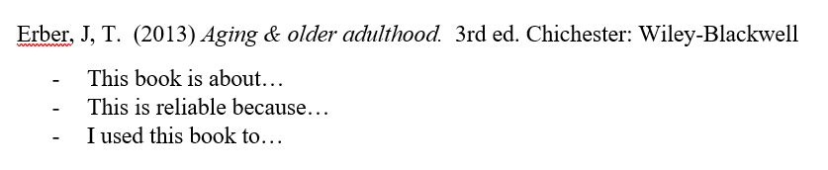
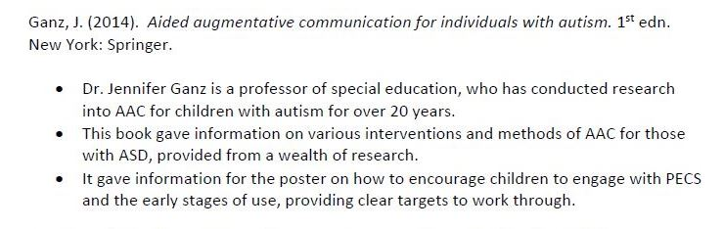
Annotated Bibliography
An annotated bibliography includes references of all of the sources that you have read and been informed by when developing your understanding. Here you can include all you have read as well as those referenced in your final work.
For each reference you should add a paragraph of annotation underneath.
Example of a student’s work.

Slide 11
Reflective writing
What does reflective writing involve?
You can use personal language, such as “I” and “We”, when talking about observations, emotions and feelings.
Looking back at past experience to perform better in the future.
Analyses, what happened and why, incorporating models and theory.
It is constructively criticising yourself, the event and often others.
It requires evidence to support what you are saying.
.
.
.

Slide 12
How to upload your work?
Let’s take a look at how to upload your assignments (document)
Your Lecturer can show you step by step
Notes:
Sts do not have to be concerned about it at this point.

Slide 13
What makes a good assignment
A good assignment....
1. Focuses on the set question/topic/task
2. Has a clear structure - easy to follow
3. Is well researched - evidence based
4. Adheres to academic conventions
5. Is correctly referenced
6. Is well presented – word limit, page numbering,
margins, line spacing, font type, spelling.

Slide 14
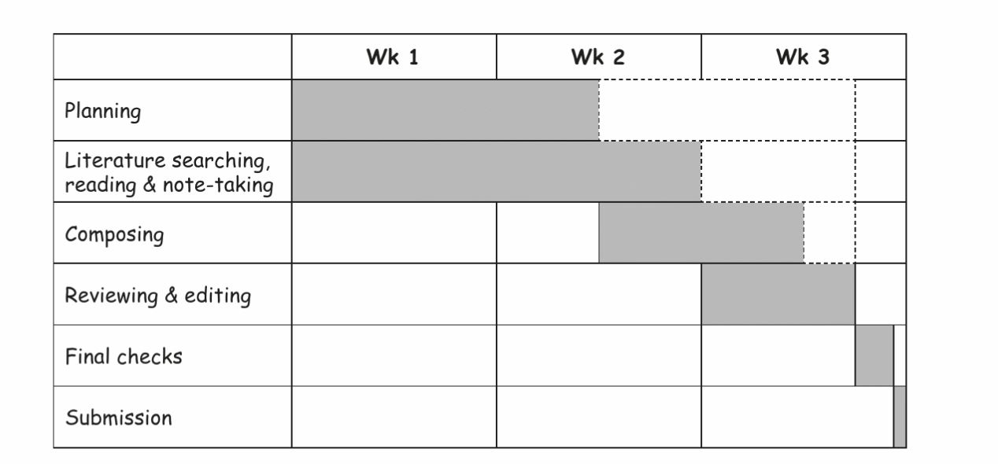
Getting Started
Timeline for completing an assignment
Day (2018, p15)

Slide 15
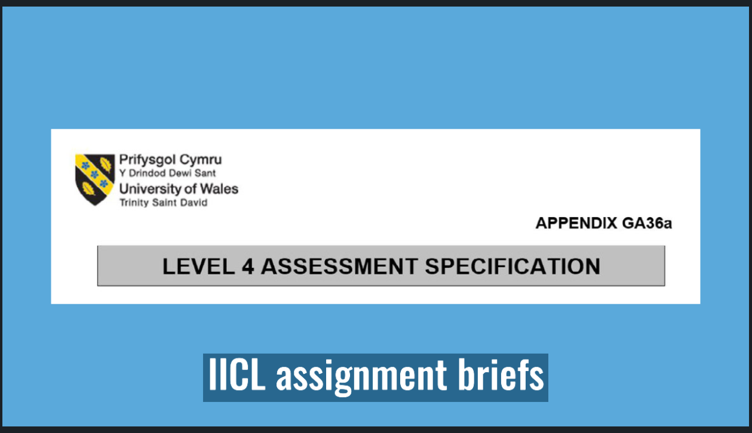
What do UWTSD briefs look like?
Click here to watch this short video about how to navigate our assignment briefs.

Slide 16
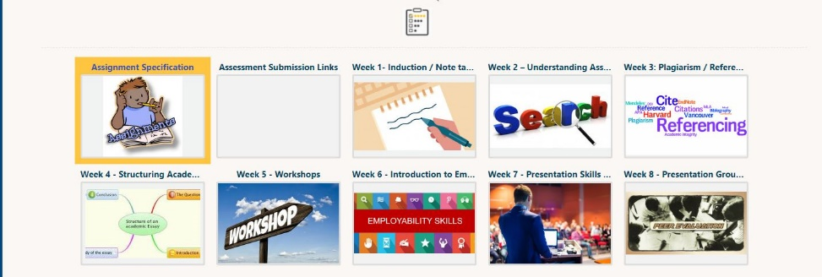

Activity 1 – Reading the assignment brief
Spend 30mins reading through the assignment brief for this module.
  Make a note of the submission dates.
  Identify the specific guidance for the tasks.
  Ask your lecturer if there are instruction words that you do not understand.

Slide 17
Break

Slide 18
Finding information

Slide 19


Where do we begin research?
The UWTSD online library can be found at www.uwtsd.ac.uk/library
Google Scholar is a useful tool for finding academic sources. https://scholar.google.co.uk/
Let look at these together now.

Slide 20
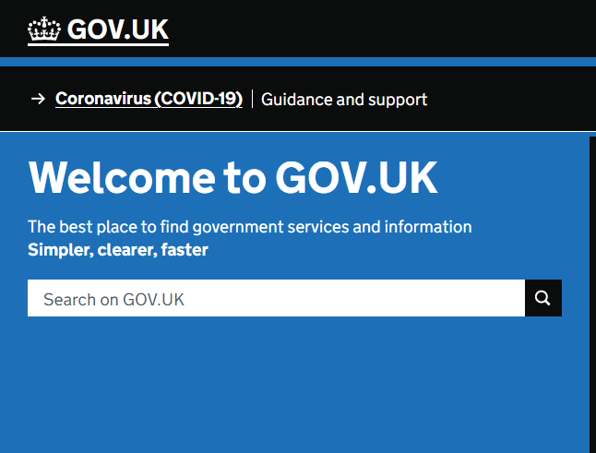
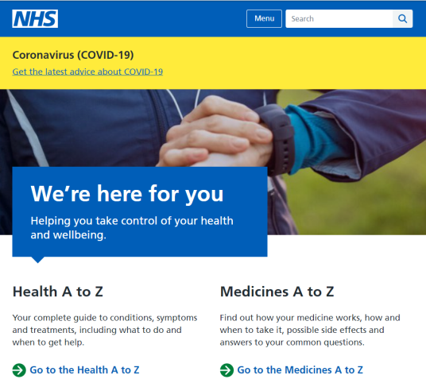
Other relevant sources.
For health and social care students there are other valuable and relevant sources that you might use.
The UK government website. www.gov.uk
The NHS website. www.nhs.uk

Slide 21


Some sources are not reliable.
Wikipedia, YouTube and blogging website can be edited by anyone and are not peer reviewed and verified.

Slide 22
Activity 2 – Find a reliable source
Use the UWTSD library or Google Scholar to find a source relevant to your assignment.
Health and social care workers need to have good people skills so they can confidently talk to the service users without making them feel uncomfortable.
Title: Drawing on relevant academic sources, explain three skills which can support health and social workers in developing rapport with service users.

Slide 23











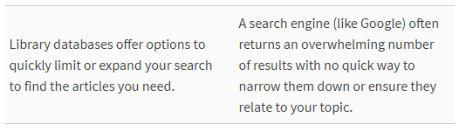


Library Vs Internet

Slide 24

Suitability of a source of information
When you search for information, you are going to find lots of it . . . but is it good information?

Slide 25
What is CRAAP test?
The CRAAP Test was developed by Blakeslee (2004). It is a list of questions to help you evaluate the information you find.
Currency
Relevance
Authority
Accuracy
Purpose
Let us look at each of these in more detail.

Slide 26
What is CRAAP test?
Currency: The timeliness of the information.
When was the information published or posted?
Has the information been revised or updated?
Does your topic require current information, or will older sources work as well?
Are the links functional?

Slide 27
What is CRAAP test?
Relevance: The importance of the information for your needs.
Does the information relate to your topic or answer your question?
Who is the intended audience?
Is the information at an appropriate level (i.e. not too elementary or advanced for your needs)?
Have you looked at a variety of sources before determining this is one you will use?
Would you be comfortable citing this source in your research paper?

Slide 28
What is CRAAP test?
Authority: The source of the information.
Who is the author/publisher/source/sponsor?
What are the author's credentials or organizational affiliations?
Is the author qualified to write on the topic?
Is there contact information, such as a publisher or email address?
Does the URL reveal anything about the author or source? examples: .com .edu .gov .org .net

Slide 29
What is CRAAP test?
Accuracy: The reliability, truthfulness and correctness of the content.
Where does the information come from?
Is the information supported by evidence?
Has the information been reviewed or refereed?
Can you verify any of the information in another source or from personal knowledge?
Does the language or tone seem unbiased and free of emotion?
Are there spelling, grammar or typographical errors?

Slide 30
What is CRAAP test?
Purpose: The reason the information exists.
What is the purpose of the information? Is it to inform, teach, sell, entertain or persuade?
Do the authors/sponsors make their intentions or purpose clear?
Is the information fact, opinion or propaganda?
Does the point of view appear objective and impartial?
Are there political, ideological, cultural, religious, institutional or personal biases?

Slide 31

Activity 3 – Use the CRAAP test
Using the source that you found in activity 2, use the CRAAP to evaluate it.
Is this a source that you will be able to use?

Slide 32
sources.
On Moodle you will find a folder entitled ‘Task 2 related
sources’.
One of these were explored together last week.
We will spend the remainder of today’s session going through these sources.
Notes:
Aid the students to navigate and read the articles within the folder.

Slide 33

Summary
Today we have explored:
  Understanding the types of assessment
  Finding relevant sources & using the CRAAP test
  Introduced the Assignment Brief
  Four of your sources for your Task 2 Academic report.

Slide 34
Reference
Blakeslee, Sarah (2004) "The CRAAP Test," LOEX Quarterly: Vol. 31 : No. 3 , Article 4.
Available at: https://commons.emich.edu/loexquarterly/vol31/iss3/4

Slide 35

Next session…..
We will look at;
Plagiarism and how to avoid it?

