Slide 1
Effective Team Working
Presentation
by
Emma Stevens
BMSK4002
2025270

Slide 2
Presentation Plan
Slide | Content
1 | Presentation Title
2 | Introduction
3 | Tuckman Team Development
4 | Belbin Team Roles
5 | Key Behaviours
6 | Trust Behaviours
7 | Group Dynamics
8 | Elements of High Performing Team
9 | Conclusion
10 | Questions
11 | References

Slide 3
Presentation Feedback
Presentation Evaluation Sheet
Module: BMSK4002 Part 1: Effective Team Working
Date | Name of Presenter:
 | Feedback
 | Weak | Fair | Good | Excellent
Prepared for Presentation
Presented in an interesting way
Objectives of the presentation are clear
Used visual aids effectively
Organised the presentation logically
Spoke loudly enough
Spoke slowly and clearly
Presented within appropriate time
Responded to questions accurately
What can I do better next time? | What went well?

Slide 4
Introduction
Today I will be discussing the importance of teams and how a team can work effectively. I will be focusing on –
•Tuckman’s Team Development (1965)
•Belbin’s 9 Team Roles
•Key Behaviors
•Elements of High Performing Teams
Trust Behaviors
•Group Dynamics
•Workplace Examples Throughout

Slide 5
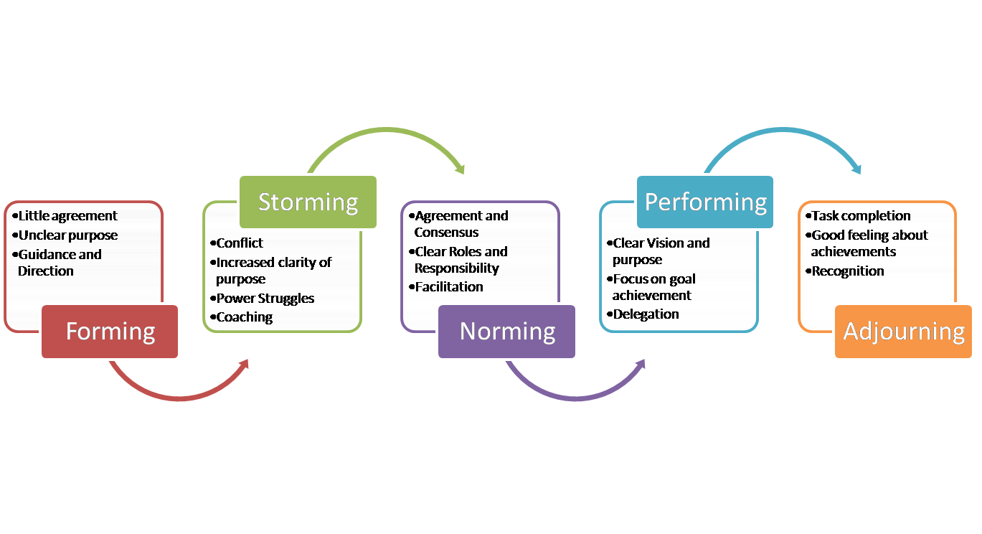
Tuckman team development (1965)
Bruce Tuckman was a Professor in Philosophical, Psychological, and Comparative Studies at Ohio State University. ​His theory shows how a team starts at the beginning of their journey together vs the end of their journey together. See diagram below
Forming: I felt I was being over polite to everyone, it felt pointless me being there as I wasn’t fully trained for 4 week’s and a lot of the procedures confused me.
Storming: I felt it took me a while to find my feet in my workplace, I was frustrated at myself and others for not explained things/procedures clearly. How ever I received coaching and I became clearer on my role.
Norming: I started receiving positive feedback from management and felt like I had a purpose/reason to be there. I was beginning to fell like part of the team.
Performing: With the positive feedback came confidence and I felt trusted by my colleagues to get the job done correctly. I was working effectively and getting good results. The good results came as we were working as a team and helping each other.
Adjourning: When ever one of the team members goes on holiday/day off/maternity I miss them and the team feels incomplete.

Slide 6
Belbin team roles
Belbin said that any team can be assessed with intelligence, dominance, extroversion/introversion and stability/anxiety. He has shown research stating that every member of the team has an individual role to play and that these specific roles will create an effective team. His 9 team roles are as stated below.
Plant – creative
Resource investigator
Co-Ordinator
Sharper
Monitor Evaluator
Team worker
Implementer
Completer/Finisher
Specialist
Belbin’s theory stats that by having a team made up of these roles that the team will work effective and produce a better quality of work but also have trust in each other to get the job done or to complete the job correctly.

Slide 7
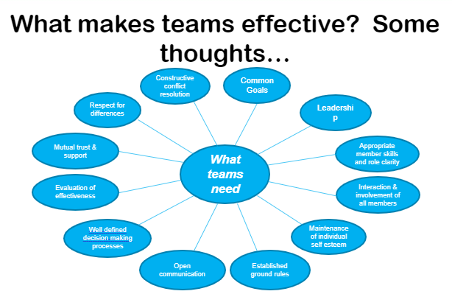
Key behaviours
Ault (2021)

Slide 8
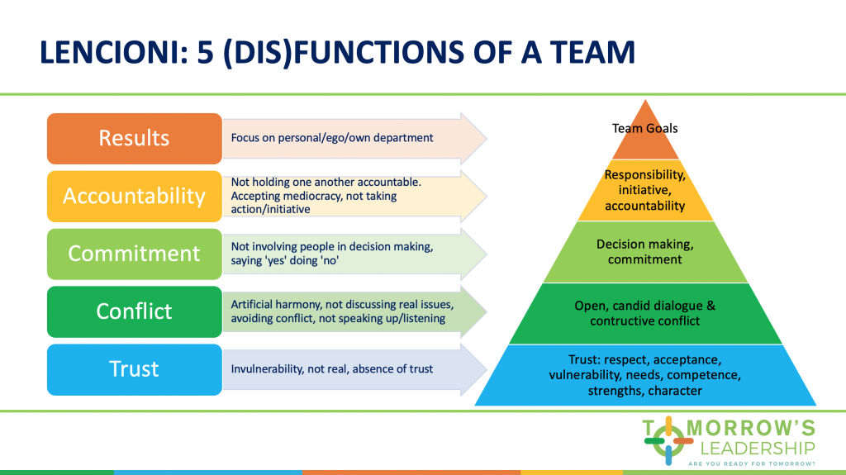
Elements of High Performing Teams
5 Dysfunctions of a team according to Lencioni (2002)
Without trust you wont be able to create an effective team – trust is the foundation.
Lencioni said that if even one member of the team cant be vulnerable – the team wont be able to work (trust each other).

Slide 9
TRUST BEHAVIOURS
“Good teams become great ones when the members trust each other enough to surrender the ‘me’ for the ‘we’.” (Anon)​
What are the key qualities and skills that we need to be able to create trust among our colleagues?
REALATIONSHIP TRUST
Confront reality
Keep commitments
Listen first
Clarify expectations
Create transparency
Demonstrate respect
Show loyalty
Practice accountability
Right wrongs
Talk straight
Deliver results
Get better
Extend trust

Slide 10
Developing good relationships
Within the team | Outside the team
Communicate often | Communicate on a daily/weekly basis (as often as needed)
Value each individual | Recognise the wider team roles
Manage conflict | Manage conflict
Involve everyone | Cooperate with other internal teams
Be loyal | Promote good customer and supplier relationships
Provide for development
Be fair and consistent
Work hard
Be assertive

Slide 11
Group dynamics – lessons from geese. Lewin (1940s)
Kurt Lewin (1940s) theory uses geese to explain his theory of team work and why we all play a part within the team and carry each other through.
He says that teams succeed when:
They stay in formation with those headed in the direction they want to go.
They are accepting of help and willing to help others.
It is rewarding to take turns doing the ‘hard work’.
They stand by when the going gets tough as well as succeeding.
They respect each others unique skills, capabilities, talents and recourses.
They understand and are willing to learn from each other.
The whole team needs to be clear on where the team is heading.
The team actively encourage each other.
They give each other individual empowerment though quality communication and encouragement.
To show how these group dynamics work I have my own workplace example.
I work in a high street bank – we are expecting a risk inspection intimately. This means everything needs to be in order and all staff will need to know the policies inside out. We have pulled together as team to quiz each other on a daily basis, either in the morning meeting or randomly throughout the day. If one of my colleagues aren’t sure of the answer I help them, reassure them and encourage them. We all know what part we play in passing the inspection both individually and together. We all know when we get the results of the inspection and it is a pass it will be very rewarding and we will all be proud of each other and what we have achieved by working as a team and trusting each other to do the job correctly and professionally.

Slide 12
conclusion
In conclusion each of the theories have many different factors of building an effective team but they all start with the foundation of trust. Trust is the key starting block to an effective team and environment. The journey we go through to create an effective team can be difficult at times but the end results are worth it in the end.

Slide 13
Michael Jordan, the basketball legend once said:
“Talent wins games, but teamwork and intelligence win championships.”
Thank you for listening.
If anyone would like to ask a question’s please feel free to ask now.

Slide 14
References:
Belbin, R. Meredith (2010), Management Teams: Why They Succeed or Fail. [E-Book] ​Chapter one. Accessed 17/05/21
Covey, S.M.R. 2006, “The speed of trust: the one thing that changes everything” Simon & Schuster, New York; London.
Julia Ault (2021) ‘What makes teams effective?’ Effective Team Working ​
and Communication ​ [Online presentation] Available at: Teams CertHE Skills for the Workplace​ BMSK4002​ Effective Team Working ​and Communication ​slide 13 (accessed 12/05/2021).
Lencioni (1940) 5 Dysfunction Of A Team [Online] Available at:https://www.google.co.uk/url?sa=i&url=https%3A%2F%2Ftomorrowsleadership.nl%2Fhow-to-overcome-the-5-dysfunctions-of-virtual-teams%2F&psig=AOvVaw0BHyg_wfG9Nrwm1achQE9O&ust=1621360763420000&source=images&cd=vfe&ved=0CAIQjRxqFwoTCJDuydWl0fACFQAAAAAdAAAAABAE. (Accessed 14/05/21).
MindTools. 2017. Improving Group Dynamics: Helping Your Team Work More Effectively. [online] Available at: https://www.mindtools.com/pages/article/improving-group-dynamics.htm. (Accessed 14/05/21).
Tuckman (1965) Short Bytes on Concept if Management [Online] available at: Management Bytes from MandE: Group Formation: Tuckman's Model (somanagement.blogspot.com). (Accessed 08/05/21).
Tuckman, B. W. and M. A. Jensen. (2010) 'Stages of small group development', International Association of facilitators. [Online] Available at: revisited. https://webspace.science.uu.nl/~daeme101/Stages%20of%20Small-Group%20Development%20Revisted.pdf (Accessed: 13 April 2021).
Tuckman, W. B. (1965) Development sequence in small groups. Psychological Bulletin, 63, pp. 384-99. [Online] Avaliable at: https://web.mit.edu/curhan/www/docs/Articles/15341_Readings/Group_Dynamics/Tuckman_1965_Developmental_sequence_in_small_groups.pdf. (Accessed on 08/05/21)

