Slide 1
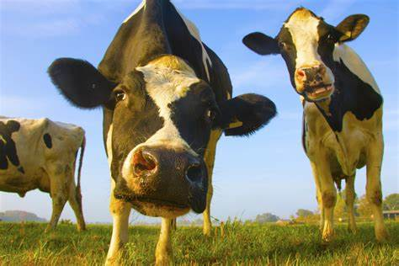
The practice of factory farming.

Slide 2
Animal welfare in factory farming
Huge numbers of animals raised in tight spaces
Force fed
Painfully bred
Minimal sunlight
Injected with antibiotics to simulate growth
Undernourished
Young taken away immediately
70% of 80 billion land animals in factory farming systems each year

Slide 3
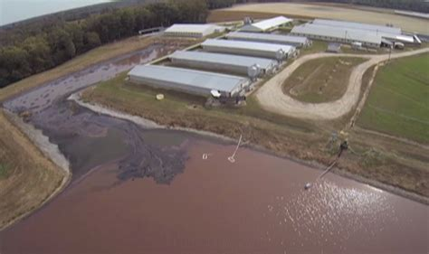
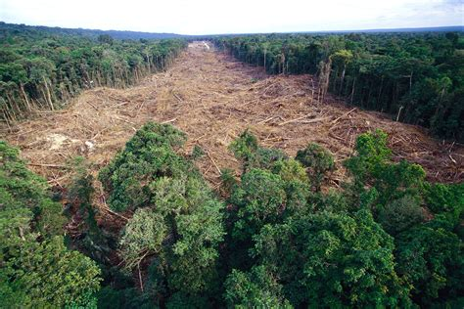
Factory farming's affect on the environment
More than a quarter of the planets ice free land is used for livestock grazing
27% of animals emissions are carbon dioxide
29% nitrous oxide
44% methane
77% of agricultural lands are used for grazing and production of animal feed.
Deforestation
Global warming/climate change
Ocean pollution
Water pollution
Economic impacts
Wildlife biodiversity

Slide 4
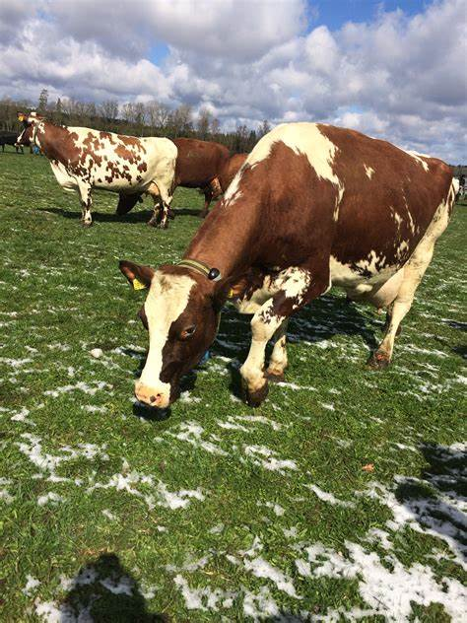
Antibiotics in factory farming
Uses the most antibiotics
Routinely administered to livestock
Make animals gain weight quickly
Breeds antibiotic resistant bacteria
Causes undernourishment, obesity and diet related non-communicable diseases

Slide 5
Rural farms against factory farming
Rural farms
Factory farms
Creates jobs within the community
Fair treatment of workers
Better treatment of animals
Money goes to the community
Cut down carbon emissions and greenhouse gases
Sustains agriculture
Fresher produce with more nutrients
Sustainable methods of production
Creates jobs for all different people
Unfair treatment of workers
Inhuman treatment of animals
Money goes to big corporations
Increases carbon emissions and greenhouse gases
Erodes agriculture
Produce not as fresh with less nutrients
Unsustainable methods of production

