Slide 1

DBA CRITICAL LITERATURE REVIEW FOR DOCTORAL RESEARCH
Amare Desta (Prof)

Slide 2

Please note
This presentation will introduce you to some aspects of research methods – but it is NOT intended to replace key reading, such as Bryman, Crotty, Creswell, Maxwell, Denscombe, Denzin, Guba and Lincoln, Easterby-Smith et al, Collis and Hussey and Cohen.
You must read key texts and beyond at doctoral level that cover the method and for this you may have to go beyond your modules reading list.
Again some slides will not be focused on and you are expected at this doctoral level to be motivated, engaged and understand the areas you need to explore.
Notes:
For him is Paradise packed with bounties, pleasure and delight and spiritual sustenance and comforts

Slide 3
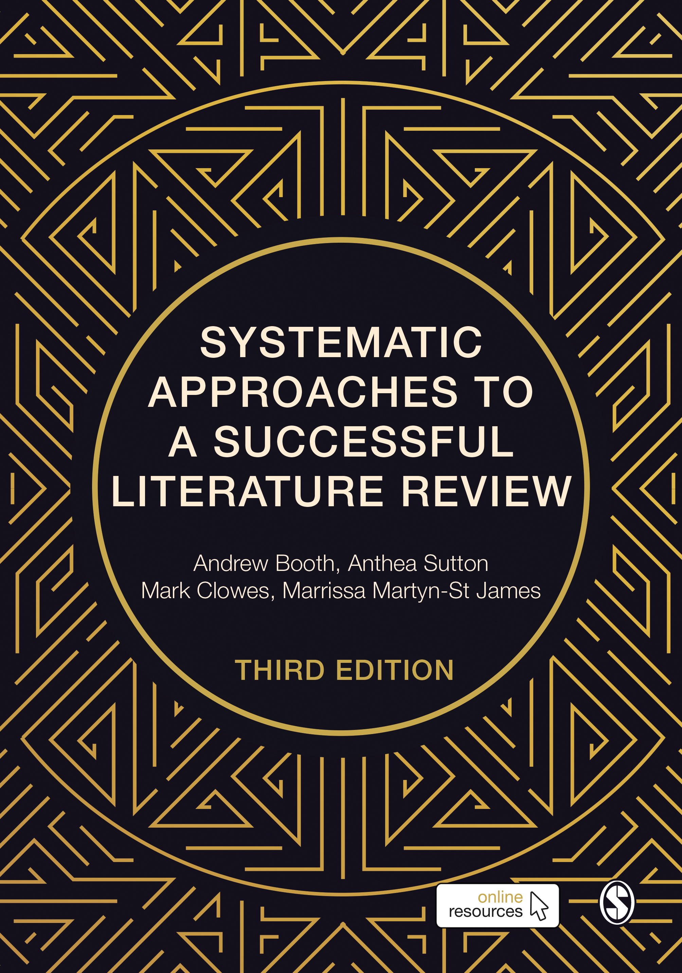
This presentation uses ….

Slide 4
In a single slide…
A good review begins with an answerable research question.
Use a framework (eg, PICOS: population, intervention, comparison, outcome, study type) to structure and define the key concepts of your research.
Processes such as descriptive mapping, concept mapping and logic models can help you refine your review scope and choose an appropriate review method.
When you are clear about what is (and is not) within your scope you will find it easier to search the literature and identify relevant studies.
Completing a review protocol when defining your scope makes it easier to plan and keep your review on track.

Slide 5
Issues to consider when deciding your scope
Is there enough available research to answer your question?
Do you have the resources needed to complete the review?
Is it a question worth asking? (does it meet the requirements of my stakeholders?)

Slide 6
Key decisions about your scope
Three decisions you need to make:
  On what specific aspect of the topic will you focus your review?
  What topics and/or types of evidence should you include and exclude?
  What type of review are you going to conduct?
To answer these questions, you need to establish the size of the existing literature
This requires a scoping search

Slide 7
Why conduct a scoping search?
Scoping searches can help you to avoid committing to a review:
  where you don’t have sufficient resource to manage all eligible studies
  for which no evidence exists (an empty review)
  for a topic area in which a high quality, comprehensive, recent review already exists.
  A scoping search usually covers 1-2 sources and is designed to estimate the size and nature of the available literature.
  See chapter 5 for advice on searching.

Slide 8
Using question frameworks: PICOS
Population | Who is facing the problem or situation to be addressed?
Intervention / Exposure | How might the situation be tackled? (intervention) OR What is happening to the population? (exposure)
Comparison | What is the alternative? (if the population were not exposed to the intervention or exposure of interest)
Outcome(s) | What outcomes of interest might happen to the population as a result of the intervention or exposure, and how will it be measured?
Study type(s) | What types of study are likely to be helpful in answering your question?

Slide 9
PICOS - example
Population | Adults in OECD countries
Intervention / Exposure | Smoking bans
Comparison | None
Outcome(s) | Prevalence of lung cancer, COPD and cardiovascular disease
Study type(s) | Epidemiological studies, cohort studies

Slide 10
Other question frameworks
SPICE (Setting – Perspective – Interest, phenomenon of – Comparison – Evaluation)
PerSPE(c)TiF (Perspective-Setting-Phenomenon of interest-Environment-Comparison-Timing-Findings)
CIMO (Context-Intervention-Mechanisms-Outcomes)
etc
Use whichever framework seems to best fit your question; the important thing is to identify the key concepts or facets of your research question so that your selection judgements remain consistent

Slide 11
Complex topics
If you are interested in complex interventions, eg, those with multiple components, it may be helpful to draw up a logic model to identify the key relationships and processes you want to investigate.
If the studies you find in your scoping search contain a high level of heterogeneity (eg, the populations or settings vary significantly) you have a choice between ‘lumping’ together studies which are very different, or ‘splitting’ them (which may limit their usefulness). Descriptive mapping of the available literature can help you to identify its key characteristics and decide which approach is best.
Examples of logic models and descriptive maps can be found in chapter 4.

Slide 12
Protocol
Writing a protocol helps to:
  Plan the stages of your review (useful for time management purposes)
  Protect against bias (by defining your process from the outset)
  Avoid scope creep (by making your scope and methods explicit)
Publishing your protocol can also help stake your claim to the review topic (to avoid unnecessary duplication of effort).
TIP: If you follow your protocol closely this can also help with writing up your review, since you have already stated your methods in advance!

Slide 13
“Take homes”
Formulate your research question using a published framework (such as PICOS) where possible.
When defining the scope of your review, think carefully about what your audience will expect and need.
Conduct a scoping search on key databases to identify the literature available.
Consider mapping the literature using a tool such as a logic model or descriptive map.
Beware of the challenges and pitfalls, such as scope creep.
Complete a review protocol with planned milestones before you start on your review

Slide 14
Now read:
Chapter 4 of the Sage Book: Defining Your Scope. In: Systematic Approaches to a Successful Literature Review, 3rd ed, 2021.
You might also find the following useful:
Stern, C., Jordan, Z., & McArthur, A. (2014). Developing the review question and inclusion criteria. AJN The American Journal of Nursing, 114(4), 53-56.

