Slide 1
Data Analysis and Visualisation
Lecture 3
Frequency distributions

Slide 2
Frequency distributions
This session we’ll look at univariate data – what it is and how we can display it
  Variables
  Scales of measurement
  Frequency distributions
  Graphing data
  The Normal curve

Slide 3
What are statistics?
Statistics are a range of techniques used for gathering, organising and analysing quantitative data
Data: quantitative information – i.e. can be expressed in numbers
Descriptive Statistics
  Used to describe a set of quantitative data
Inferential Statistics
  Used to make predictions about large groups (i.e. populations) based upon the analysis of data gathered from a smaller group (i.e. samples)

Slide 4
Variables
Variables represent things that differ between individuals or situations
  People: height, weight, blood pressure, body temperature, eye colour, shoe size, favourite colour, handedness etc…
  Computer systems: Processor, memory, chipset, network card, speed, graphics card, network speed etc…
  Businesses: number of employees, share price, sector, annual profit, profit margin, type, size etc…
Discrete variables
  Can only take on particular values, e.g. size = small, medium, large
Continuous variables
  Can take of any value, e.g. height, number of employees
Independent variables can be manipulated to see how changing them affects another dependent (related) variable
Dependent variables are measured to see how changing the independent variable affects them

Slide 5
Scales of measurement
Measurement is the assignment of numbers to variables. Different types of variables have different types of rules that determine what values can be assigned to them
Variables are measured on one of four different scales
Nominal
  Things are assigned to categories, e.g. size, gender, eye colour, country of residence, chipset
Ordinal
  Things are ranked according to magnitude, e.g. Bad→Good, First→Last, Rich→Poor, by year, by age
Ratio
  Things have a zero point and are measured from there, e.g. height, weight, network speed, number of employees
Interval
  Things with no meaningful zero point but which have equal units of measurement, e.g. IQ

Slide 6
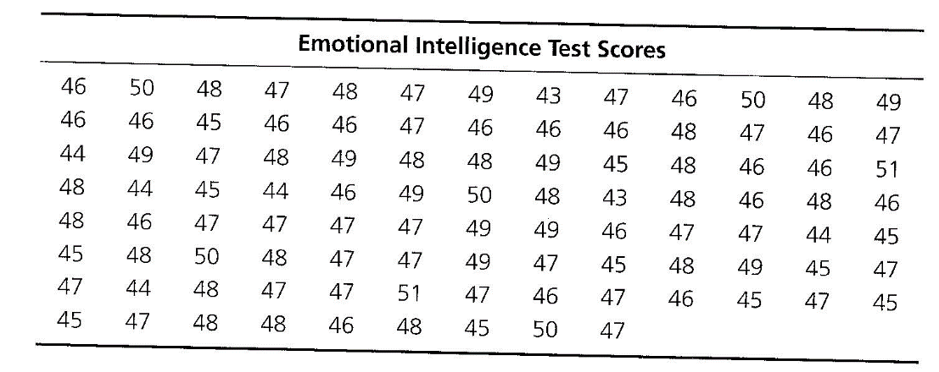
Frequency Distributions
When data is first gathered it is generally in the form of an unordered set of scores
The first thing to do with it is to organise and display it using a frequency distribution
Suppose you have an EQ test in which the students gained the following scores:
What can we say about the data? Not a lot…

Slide 7
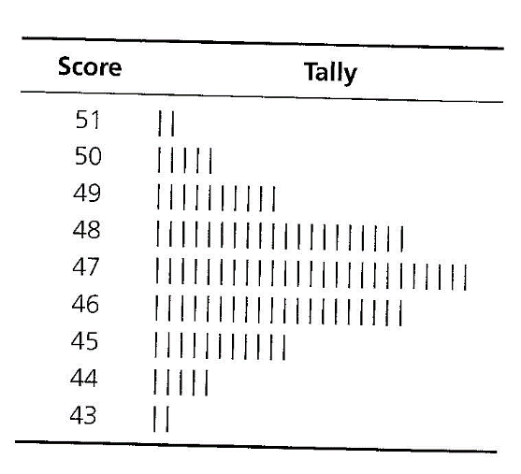
Frequency distributions
The first thing to do is to create a frequency distribution
Locate the lowest and highest scores – 43 and 51
Record all possible scores, even if they’re not present in the dataset – 43, 44, 45, 46, 47, 48, 49, 50, 51
Go through the list of scores and tally each score one by one. At the end of this process our data looks like this:

Slide 8
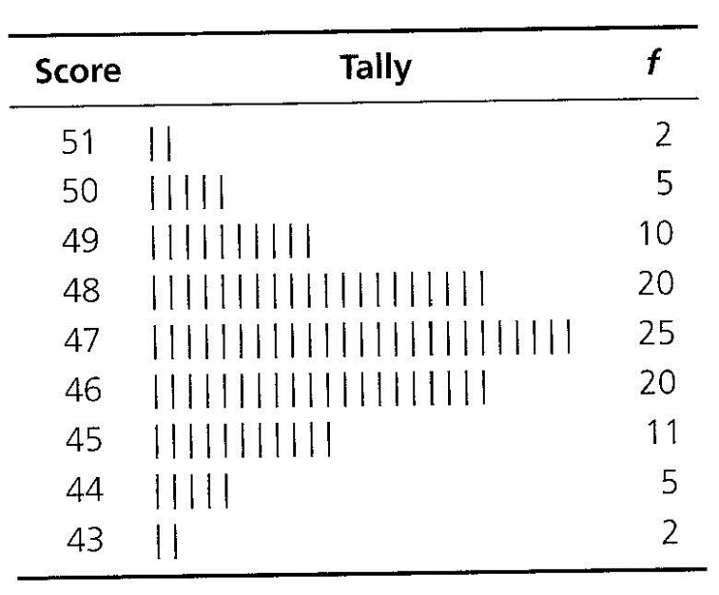
Frequency distributions
Now count the number of tallies to find the frequency
This diagram provides a lot more information than the raw data
  The data is grouped around 47
  Most data is in the 45-49 range
  The most common score was 47, with 25 students

Slide 9
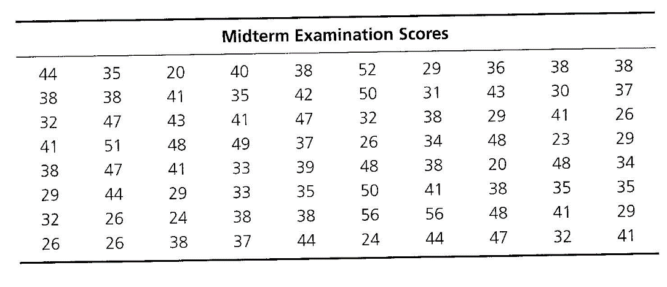
Exercise
Using the following data for a midterm exam, create the frequency distribution for the dataset:

Slide 10
Grouped frequency distributions
If scores vary more than in the previous example it can be difficult to see patterns in the frequency distribution
It may be easier to see them if there are fewer scores, so grouping the scores becomes an option
Suppose 80 students take a midterm exam

Slide 11
Grouped frequency distributions
To create a grouped frequency distribution
Find the lowest and highest scores – 20 and 56
Subtract lowest from highest to find the range –
56-20 = 36
Determine the width of each class interval so that there are ten to twenty intervals. Use an integer width whenever possible – in this case we’ll use a class interval of 3
Determine the starting point of the lowest interval. In this case it could be 18-20, 19-21, or 20-22
Record the score limits for all possible class intervals
Go through the list of scores and tally each score one by one.
Convert the number of checks for each interval into a frequency

Slide 12
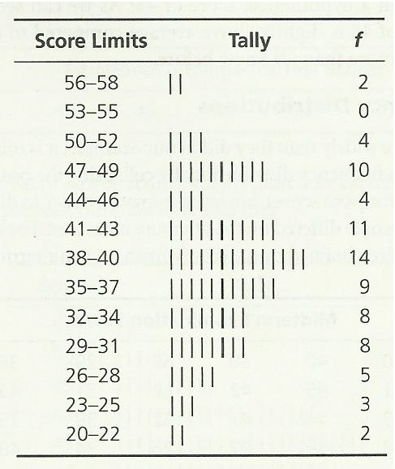
Grouped frequency distributions
Using an interval width of 3 and a starting point of 20 gives a grouped frequency distribution that looks like this:
Once the scores are placed in a group you lose information about the individual scores
Decisions about interval size and start point will alter the distribution

Slide 13
Exercise
Using the midterm exam data, create the following grouped frequency distributions:
  One with an interval width of 4 and a start point of 20
  One with an interval width of 4 and a start point of 18
What differences can you see between these distributions?

Slide 14
Graphing Data
Frequency distributions can also be displayed as bar charts (histograms) and frequency polygons
The frequency polygon is one of the most commonly-used graphs in statistics
  X-axis: Values or Intervals
  Y-axis: Frequency
Data from the EQ test

Slide 15
Graphing Data
Another graphical form that is sometimes used is the cumulative frequency polygon
This shows the number of scores occurring at and below a given point
  It is also good for showing learning curves, where you might want to know how many trials it took to reach a particular level of expertise
Data from the EQ test

Slide 16
Exercise
Using the midterm exam data, create the following grouped frequency polygons:
  One with an interval width of 4 and a start point of 20
  One with an interval width of 4 and a start point of 18
What differences can you see between these distributions?

Slide 17
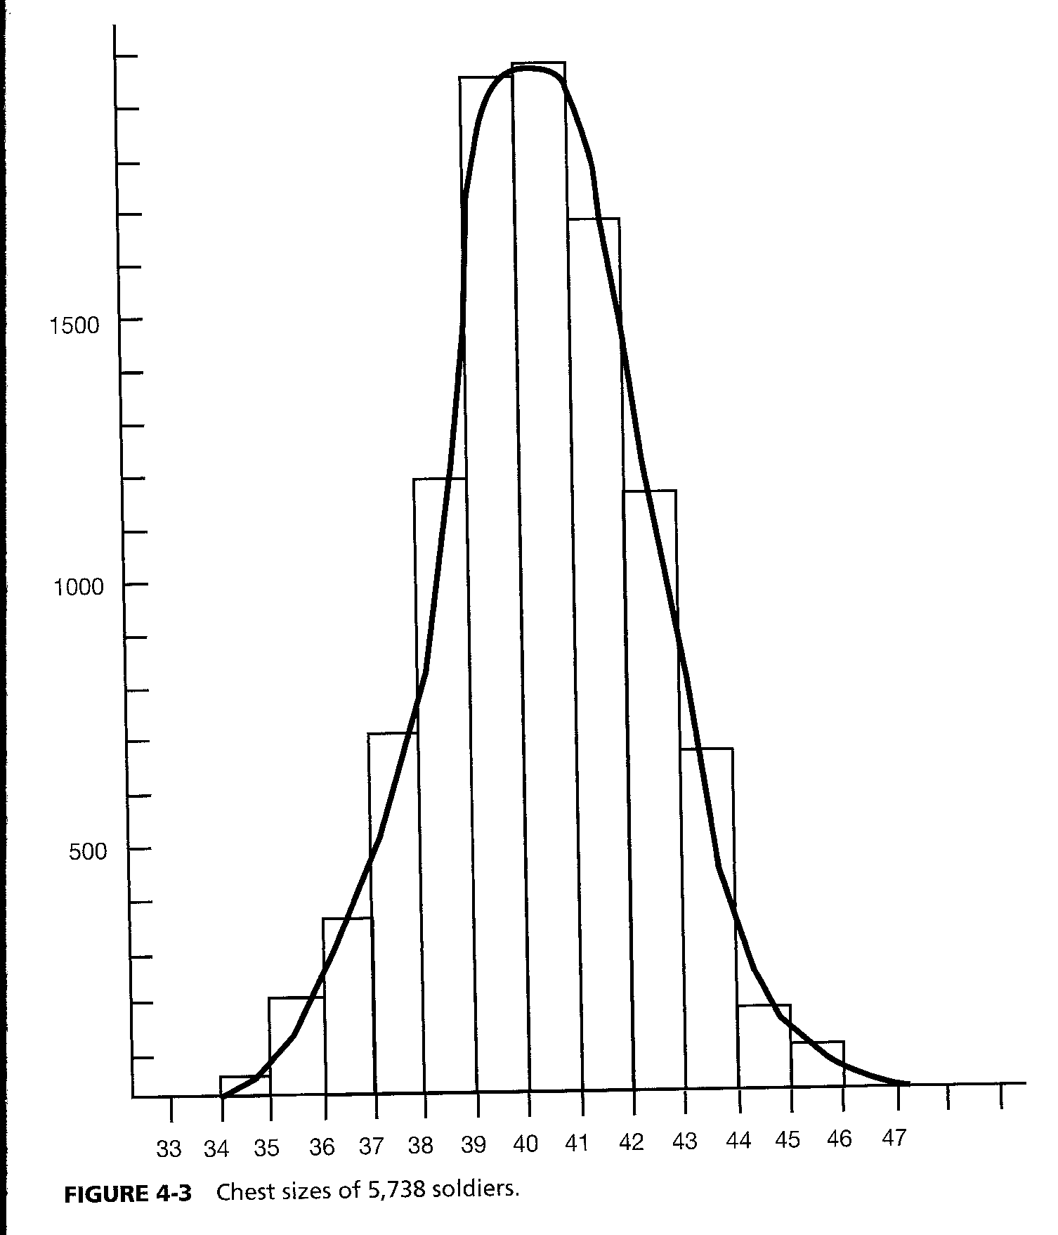
The Normal curve
Around 1870 the Belgian mathematician Adolph Quetele discovered that most measurements of people produced the same symmetrical shape of frequency polygon
The function fitted to the polygon became known as the Normal curve
This is extremely important in statistics and we’ll spend a session later on focussing upon it

Slide 18
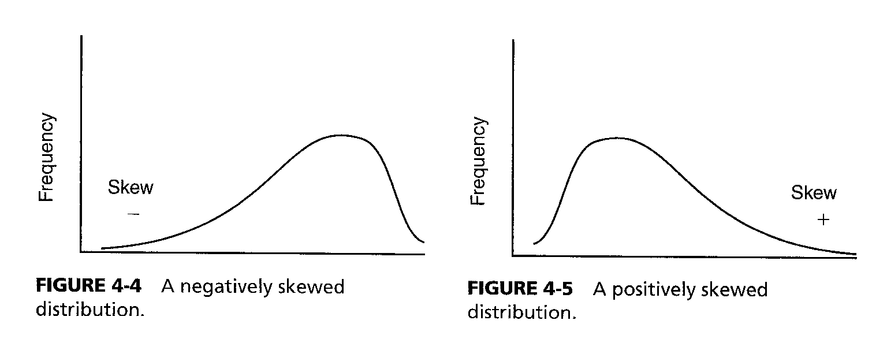
Skewed distributions
The Normal distribution is symmetrical, but some frequency curves are not
  If a test is very easy most people get high scores
  If a test is very difficult most people get low scores
Depending on which way the bulk of the scores have shifted we can say if a curve is positively skewed or negatively skewed

Slide 19
Summary
All of today’s material looked at univariate data (we’ll look at bivariate and multivariate data later on)
  Variables
  Scales of measurement
  Frequency distributions
  Graphing data
  The Normal curve
  Skewness
Next session we’ll look at how to describe this data quantitatively rather than qualitatively

Slide 20
Coming soon
Next session: Descriptive statistics
Homework: Read chapter 2 of Statistics for the Terrified.

