Slide 1
Business Plan
Title: Business Plan for Games & Gadgets
Group – D
Participants:
Saieed Hussain - 1605696
Irfan Rahim - 1605709
Ida sley - 1605823
Saif Malek Mithu - 1605868
Tutors Name: Dr Hussam Helim

Slide 2
Content
Introduction
Short brief about the company
Aim & objectives
Vision & Mission
Legal issues
Management process – Finance, Marketing, HR and Operation
PESTLE analysis
SWOT analysis
Conclusion

Slide 3
Introduction
In this short presentation we will discuss about the company and its major activities. We will try to give you a snapshot of our main operations. We will highlights the strategy of our sales and marketing.
Through SWOT and PESTLE analysis we will bring more clear pictures of our business.

Slide 4

Games & Gadgets – a London based video games and gadgets retailer. We have a retail unit in Elephant & Castle shopping centre, south London. A very busy and vibrant area in the heart of the city.
We stock all types of video games, consoles and accessories. Our ranges are from Nintendo 64 to Switch, PS1 to PS4, Xbox to latest Xbox X and many other retro games and consoles as well.
We also stock big ranges of mobiles phones, Tablets, Laptops and headphones and earphones.
We have huge stocks of films and blu-rays.
We have a technical support team for repairing phones, tablets and laptops.

Slide 5
Aim & Objectives
Aim:
Engage and entertain the local community and help them to solve their problems they face everyday with games, gadgets and phones in the long run have other retail outlets scattered around the capital.
Objectives:
To provide excellent customer services – go the extra mile.
Support and train customers to operate with new technology
Make our brand the first point of contact for the gamers and gadget geeks around the capital.

Slide 6
Vision & Mission
Vision:
- to have our brand in all major shopping malls across the capital
- Be able to offer technical support live to the globe with the vast knowledge attained as technology is the future.
Mission:
- To make our brand the first point of contact for digital entertainment and the solution for difficulties resolution centre for technology issues.

Slide 7
Legal Issues
We have 10 year open lease for the property.
We are licensed to operate the retail shop and sell games and gadgets here.
We are a registered company by company house, UK.
VAT registered so compliant in as aspects of legalities.
The premises is covered by AXA small business content cover insurance inclusive of theft, water and fire damages up to £5million.
All couriers we are in contact with also provide us insurance cover so we are confident when carrying out any business transactions.

Slide 8

Technical warranties
We offer to customers technical service warranty of up to ONE Year after purchase.
All our parts used are from official distributers.
All goods sold are signed off by qualified technicians to ensure no room for miss sold products.

Slide 9
Management Process -
Finance
Finance: business was set up from a £50,000 loan offered by Barclays bank after we presented our business plan.
Sales forecast per Annam is projected at £250K
Monthly expenditure – inclusive of rent rates and utilities as premises is owned by family member.
Gross profit – £150k
Projected net profit – £50k

Slide 10
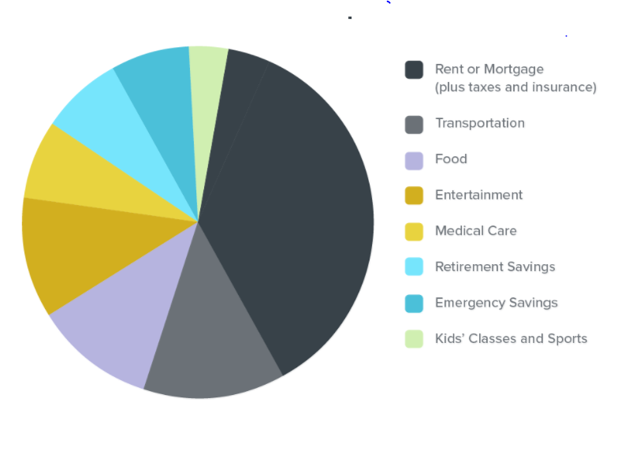
Monthly expenditure
Rent, rates
Material
labour
wages
Broadband
electricity
postage

Slide 11
Management Process-
Human Resource
Management Position:
Managing director
Director Admin
Director sales and marketing
Director finance
Staff: Store Manager, Supervisor, Sales Assistant
Recruitment: Current employee reference, vacancy notice on door,
Staff Training:
Memorandum provided to all staffs, regular training for new products before launching, monthly staff performance review

Slide 12
Management Process-
Marketing
Product – Huge range, available stock, quality product
Price – Economy pricing, low margin, increase sales volume
Place – located in a busy shopping centre, South bank and Art university are close to the centre
Promotion – Leafleting, social media marketing, Membership discount, student discount

Slide 13
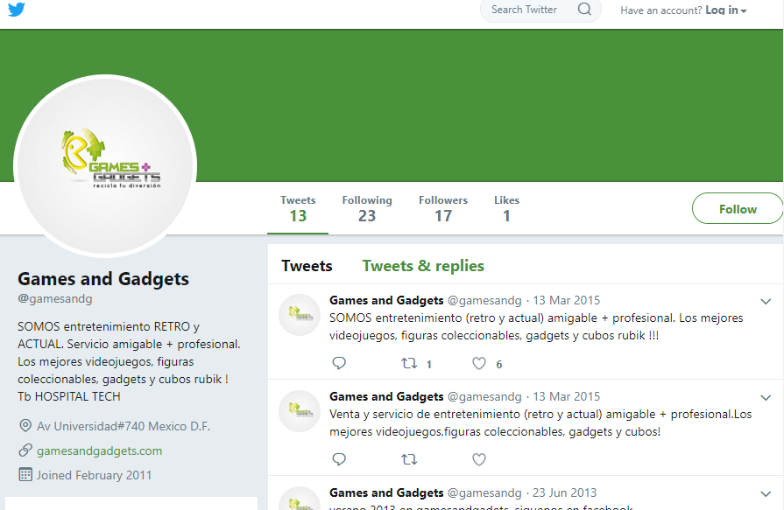



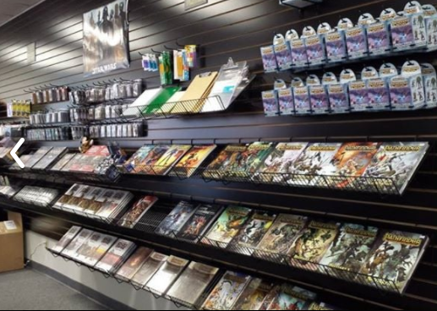
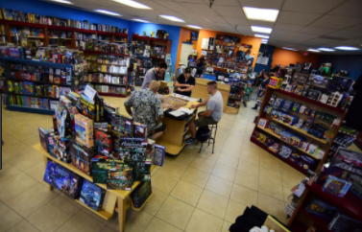
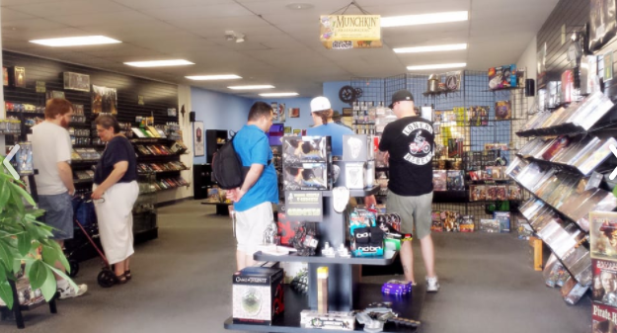
Marketing
Online GG forum and committee
Online click and collect store available
In-house promotions and offers beating competitors
Local community events and activities

Slide 14
Management Process
Operation :
We open 7 days a week
Monday to Saturday 10 AM to 6.30PM
Sunday 10.30 AM to 5 PM
We close Christmas day and New years day
Christmas Eve and New years Eve and all other
Bank Holidays follows Sunday time (10.30am – 5pm)

Slide 15
PESTLE analysis
Political Factors: VAT increase, Business Rates increase, Trade regulations between UK and EU, Govt. Policy on social welfare
Economical Factors: Disposable incomes of most buyer, Credit accessibilities, Unemployment rate, Inflation, Interest rate
Social Factors : Population demographics that includes aging in population, Change in lifestyle and trends, Educational level, Distribution of wealth

Slide 16
PESTLE analysis
Technological Factors : Innovations and discoveries, New technology and its advancement, Digital Revolution
Legal Factors: Health and safety regulations, Age rating regulations, Licensing issues
Environmental Factors: Waste disposal of certain laws, Environmental protection law, Regulation on energy consumptions, Popular attitudes on environments

Slide 17
SWOT Analysis
Strengths: Proactive team, Experiences, Location, customer service, flexible return and refund policy
Weakness: not enough stock, missing some key skills and competencies, poor time management
Opportunities: Expanding to new geographic area, expanding new product lines, personal skill development,
Threats: competitive market, slowing market growth, new trade policies with EU,

Slide 18
Conclusion
Finally, we are innovative and energetic team with clear vision and mission. Our everyday's activities are surrounded by our aims and objectives.
We know our strengths and weakness too. We can visualise the opportunities and in the same time aware of threats as well.
Our experiences, boldness and all our energy we are putting into it – we will be successful.
Any question?
Thank you for giving us the opportunity to present this business plan.

Slide 19
Group Learning Log
Date of Meeting | Place of Meeting | Time of Meeting | Members Attended | Topics Discussed/Raised | Outcomes Agreed
14-03-2018 | Lecture Room 2 | During the Class | Saeed, Irfan, Aida, Mithu | Proposal of various business idea | 1 week time to think individually
21-03-2018 | Study Area, University Campus | During the break | Saeed, Irfan, Aida, Mithu | Brain storming on various business model | Decided to go for games and gadgets business
28-03-2018 | Lecture Room 2 | During the Class | Saeed, Irfan, Aida, Mithu | Task distribution: Mithu – introduction Aida – Aim & Objectives, Vision & Mission Irfan – Management Process Saeed – SWOT & PESTLE Mithu - Conclusion | Star writing and share in whatsapp and email each other
04-04-2018 | Lecture Room 2 | During the Class | Saeed, Irfan, Aida, Mithu | Discussion on writing | More work to do
11-04-2018 | Study Area, University Campus | During the Class | Irfan, Aida, Mithu | Showing to lecturer for suggestion | Some correction made
18-04-2018 | Lecture Room 2 | During the Class | Saeed, Aida, Mithu | Designing the presentation | Role distribution
25-04-2018 | Study Area, University Campus | Before the final presentation | Irfan, Aida, Mithu | Saeed is missing. Redistribution the role and rehearse. | Redistribution the role and agreed

