Slide 1
Data Mining & Visualisation
ACCA7015
Lecture 7 – More Clustering
Prof Nik Whitehead

Slide 2
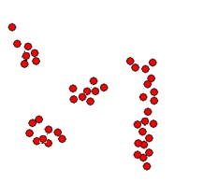
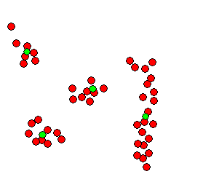
Problem of Cluster Detection
What is cluster detection?
  Cluster: a group of objects known as members
  The centre of a cluster is known as the centroid
  Members of a cluster are similar to each other
  Members of different clusters are different
  Clustering is a process of discovering clusters
: centroids

Slide 3
Problem of Cluster Detection
Outputs of cluster detection process
  Assigned cluster tag for members of a cluster
  Cluster summary: size, centroid, variations, etc.
Cluster 2: Size: 5
Centroid:(130, 51)
Variation: σ_{bodyHeight} = 10,
σ_{bodyWeight} = 14.48
Cluster 1: Size: 6
Centroid:(154, 90)
Variation: σ_{bodyHeight} = 5.16
σ_{bodyWeight} = 5.32

Slide 4
Problem of Cluster Detection
Basic elements of a clustering solution
  A sensible measure for similarity, e.g. Euclidean
  An effective and efficient clustering algorithm, e.g. K-means
  A goodness-of-fit function for evaluating the quality of resulting clusters, e.g. SSE
?
?
?
Inter-cluster distance
Internal variation
Good or Bad?

Slide 5
The Agglomeration Method
Outline of main steps
  Take all n data objects as individual clusters and build a n x n dissimilarity matrix. The matrix stores the distance between any pair of data objects.
  While the number of clusters > 1 do:
    Find a pair of data objects/clusters with the minimum distance
    Merge the two data objects/clusters into a bigger cluster
    Replace the entries in the matrix for the original clusters or objects by the cluster tag of the newly formed cluster
    Re-calculate relevant distances and update the matrix

Slide 6
The Agglomeration Method
Illustration of the method

Slide 7
The Agglomeration Method
Illustration of the method (dendrogram)
Height – distance between merged clusters
Horizontal cut – determines cluster numbers
2 Clusters
# of clusters
1
2
3
4
5
6
7
8
9
Data
Points
10

Slide 8
The Agglomeration Method
Illustration of the method (dendrogram)
Height – distance between merged clusters
Horizontal cut – determines cluster numbers
3 Clusters
# of clusters
1
2
3
4
5
6
7
8
9
Data
Points
10

Slide 9
Cluster Stability
The height at which the dendrogram is cut provides a trade-off between granularity and customization
  Low height – many small clusters
  High height – few large clusters
Cluster stability reflects whether similar data points are consistently grouped together over multiple runs of the algorithm
  Stable clusters remain separate until high merges, with large vertical gaps
  Unstable clusters merge quickly at low dissimilarity levels and appear as weak side branches

Slide 10
The Agglomeration Method
Illustration of the method (dendrogram)
Height – distance between merged clusters
Horizontal cut – determines cluster numbers
# of clusters
Strong
1
2
3
Weak
4
5
6
7
8
9
Data
Points
10

Slide 11
The Agglomeration Method
Agglomeration schemes
  Single link: the distance between two closest points
  Complete link: the distance between two farthest points
  Group average: the average of all pair-wise distances
  Centroids: the distance between the centroids

Slide 12
The Agglomeration Method
Strengths and weaknesses
  Strengths
    Deterministic results
    Multiple possible versions of clustering
    No need to specify the value of a k beforehand
    Can create clusters of arbitrary shapes (single-link)
  Weaknesses
    Does not scale up for large data sets
    Cannot undo membership like the K-means

Slide 13
Limitations of Basic Solutions
Limitations of the Agglomeration Method
  With different merging schemes
A
B
C
D
A
B
C
D
A
C
B
single-link favours merging A and B because of closeness
Group-average-link favours merging A and B because of connectivity
single-link favours merging A and B because of closeness

Slide 14
Exercise
Using wine.arff
Load the data into Weka and remove the class attribute
Run Hierarchical Clustered
  Use Visualize tree to view output
Test different linkage methods
  Single
  Complete
  Average
Observe the cluster output in each case and see how cluster membership changes (you may want to screenshot each tree for ease of comparison)
Where do the biggest changes occur?

Slide 15
Hard v. Soft Clustering
Hard clusters
  Each object assigned to one cluster
  Clear segmentation
  Easy to interpret
Soft clusters
  Overlapping behaviours
  Mixed populations
  Uncertain boundaries
Real-world datasets normally provide softer clusters than we might like, e.g. a customer might be 60% in ‘budget shoppers’ but also 40% in ‘premium shoppers’

Slide 16
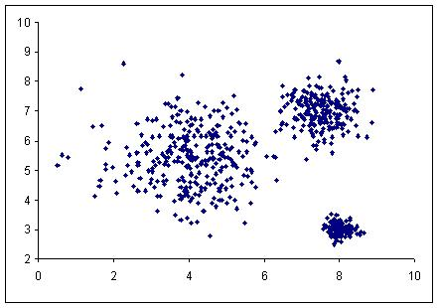
Expectation Maximisation/GMM
Background of Model-based Clustering
  Data set as the result of a statistical process. Clustering is to find the best-fit statistical model
  Mixture Model Approach represents the model in terms of a collection of multivariate distributions
  Each distribution (represented by mean and covariance) describes a cluster of ellipsoidal shape.
  Estimates cluster probability distributions
  Produces membership likelihoods, not absolute assignments

Slide 17
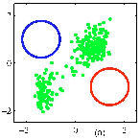
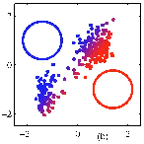
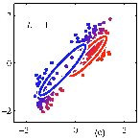

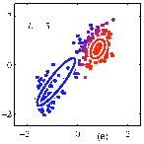
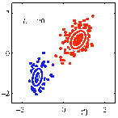
Expectation Maximisation/GMM
Algorithm Illustration:
Initialisation
Expectation
Re-estimates
Expectation
Re-estimates
Converge
Adapted from Source: http://www.slideshare.net/butest/lecture-18-gaussian-mixture-models-and-expectation-maximization

Slide 18
Proximity Measures Revisited
Problems of Pairwise Proximity Measures
  Measurement may not be effective in
    Data are more scattered in high dimensionality spaces
    Data densities may be of different degrees
    Certain types of data such as time-series
b
A
a
b
b
a
c
B
Is b really that much closer to a than c?
Should b belong to cluster A or B?
Should a and b belong to the same cluster?
Are the two waves really that different?

Slide 19
Proximity Measures Revisited
Shared Nearest Neighbours (SNN)
  Similar data objects share common nearest neighbours
  The more common nearest neighbours there are, the more similar the two data objects are
    e.g. Points A and B have 4 common nearest neighbours (out of 7)
A
B
Adopting SNN in clustering algorithms

Slide 20
Proximity Measures Revisited
Time-Series and Sequential Data
  A time-series or sequential data record consists of measurements at a sequence of time points
  Direct comparison of the measurements of two time-series records at the time points fail to show true similarity
    e.g. Time-series A and B similar peaks, valley and plateau.
A
A
B
B
time
time
Using a distance function on fixed time points, A and B are quite different.
Using a distance function but aligning peaks and valleys, A and B are very similar.

Slide 21
Algorithm Selection
There is no universally best clustering method
  Depends on data structure, analysis goals, computational resources
Method | Strengths | Weaknesses | Best Use
K-means | Fast, simple | Needs k, sensitive to outliers | Large datasets
Hierarchical | Deterministic, interpretable | Poor scalability | Exploratory analysis
DBSCAN | Detects noise & arbitrary shapes | Parameter sensitive | Spatial or noisy data
GMM | Models overlap, flexible shapes | Computationally heavy | Probabilistic modelling

Slide 22
Exercise / Homework
Comparison of different clustering solutions
Use the wine.arff dataset
Run clustering using
  SimpleKMeans
  HierarchicalClusterer
  EM
  DBSCAN
Record the algorithm, number of clusters, SSE/likelihood, cluster sizes, the presence of noise points, plus any other observations
Questions:
  Which provided the most interpretable clusters?
  Which handled outliers best?
  Did different algorithms agree?
  Which would you recommend for a business scenario? Why?

Slide 23
Looking Ahead
Next Session: Association Analysis

