Slide 1
BMMB7026 – MANAGING MARKETING CHANGE
Introduction to Marketing Management
The Marketing Concept
Session 1

Slide 2
LEARNING OUTCOMES
Upon the successful completion of this module, the student should be able to demonstrate the ability to:
Critically analyse theoretical perspectives and approaches to change management and demonstrate their practical application in a variety of organisational environments;
Critically examine the key internal and external drivers of marketing change such as culture, leadership, power, digitalisation, economic and political pressures and the forces of competition;
Critically appraise key marketing activities and the contribution of the marketing department to the whole organisation.

Slide 3

Questions?
Recap from last week
What does the term ‘Marketing’ mean to you?
What do marketers do?

Slide 4
Marketing is “the process by which companies create value for customers and build strong customer relationships to capture value from customers in return”.
(Kotler, Armstrong, Harris and Piercy, 2013)
What is Marketing?

Slide 5
“Marketing is the management function responsible for identifying, anticipating and satisfying customer needs profitably”.
(CIM 2024)

Slide 6
“Because the purpose of business is to create and keep customers, it has only two central functions – marketing and innovation. The basic function of marketing is to attract and retain customers at a profit”.
(Drucker in Fahy & Jobber, 2019)

Slide 7
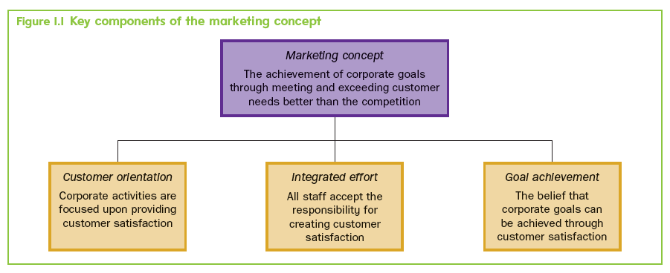
What Is The Marketing Concept?
Fahy & Jobber (2019), “Foundations of Marketing, Sixth Edition"

Slide 8
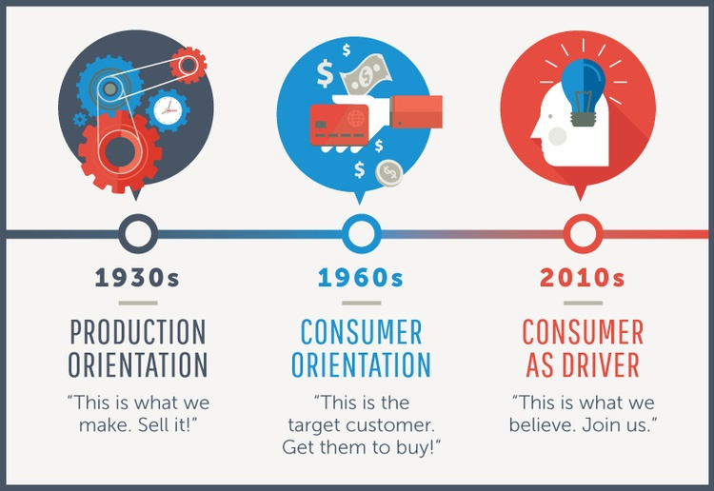
Evolution of Marketing

Slide 9
The Future of Marketing
As we embrace the evolution of marketing planning models in 2024, it’s crucial to recognize that the journey is ongoing.
The future holds even more exciting possibilities — from the integration of artificial intelligence to the exploration of new frontiers in consumer engagement.
The key is to stay agile, data-driven, and ready to adapt to whatever the future may hold.

Slide 10

Evolution of Marketing – Dr Philip Kottler

Slide 11
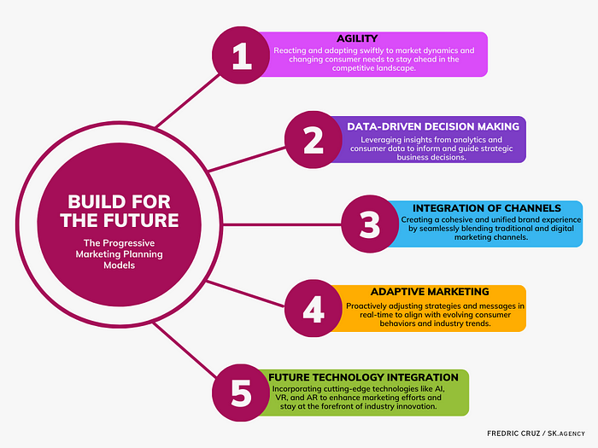
Notes:
One of the key pillars supporting the evolution of marketing planning models is the ever-expanding role of data. Successful brands no longer rely solely on historical data; they’re harnessing the power of real-time analytics to make informed decisions. Amazon, for instance, uses predictive analytics to analyze customer data and behaviours, enabling them to anticipate needs and personalize recommendations in real time, creating a highly tailored customer experience.
Nike’s use of real-time analytics during major sporting events. By monitoring social media and consumer interactions, Nike adapts its marketing messages in real time, ensuring relevance and resonance with its audience.
As digital channels continue to proliferate, successful brands are realizing the importance of a seamless blend of traditional and digital marketing. The divide is disappearing as marketers craft holistic strategies that leverage the strengths of both worlds.

Slide 12
Market-Oriented vs Internally Orientated Businesses
Market-orientated businesses | Internally orientated businesses
Customer concern throughout business | Convenience comes first
Know customer choice criteria and match with marketing mix | Assume price and product performance key to most sales
Segment by customer differences | Segment by product
Invest in market research (MR) and track market changes | Rely on anecdotes and received wisdom
Welcome change | Cherish status quo
Try to understand competition | Ignore competition
Marketing spend regarded as an investment | Marketing spend regarded as a luxury
Innovation rewarded | Innovation punished
Search for latent markets | Stick with the same
Be fast | Why rush?
Strive for competitive advantage | Happy to be me-too

Slide 13
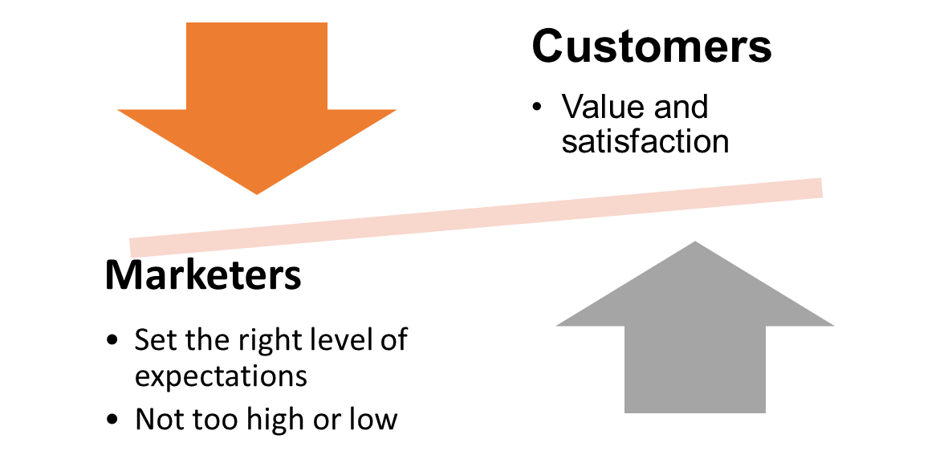
Understanding the Marketplace
and Customer Needs
Questions?
Why do marketers not always understand customer needs?
How can they better identify customer needs?

Slide 14
The Nature of Customer Value
Perceived Benefits
Product benefits
Service benefits
Image benefits
Perceived Sacrifice
Monetary costs
Time costs
Energy costs
Psychological costs
(not making
the right decision, perception of risk)
Customer Value
Value offered should exceed that of competitors

Slide 15

Forms of Customer Value
Price value – customers perceive a product as being cheaper than those offered by competitors (e.g. Ryanair, Aldi, Easyjet).
Performance value – customers look for the latest features, functionality and quality (e.g. Dyson, Tesla, Apple).
Emotional value – what is in the mind of the customers (e.g. Volvo & safety, Chanel & luxury).
Relational value – the quality of service received by a customer – a high level of trust leads to the lifetime value of a customer.

Slide 16

All kinds of organisations are now becoming proficient users of customer relationship management systems (CRMs) to get to know their customers better and to interact with them on a regular basis.ular basis.
Customer Relationship Management (CRM)

Slide 17



Examples

Slide 18
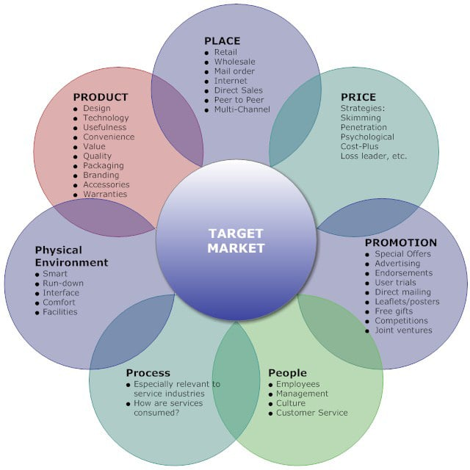
Effective Marketing Mix
The basic set of tools marketers have available to carry out tactical marketing.
The ‘4 Ps’ of product marketing (McCarthy, 1960)
Plus, the ‘7 Ps’ of services marketing (Booms & Bitner, 1981)

Slide 19
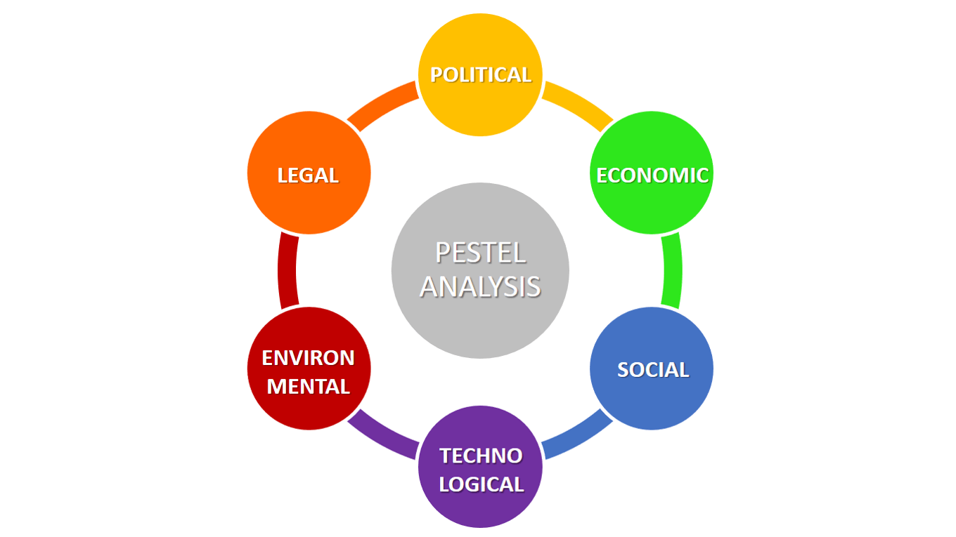

Slide 20
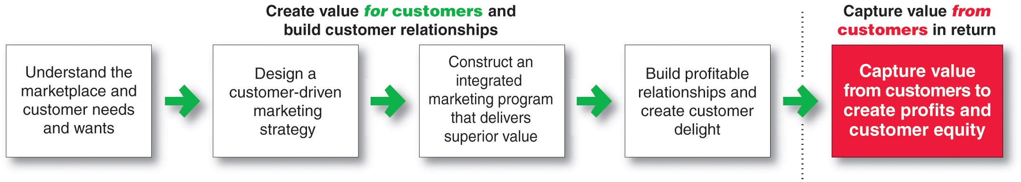
A Simple Model of the Marketing Process
Marketing is the delivery of value to customers at a profit

Slide 21

The Marketing Concept
Customer centred – market sensing and responding
Takes an outside-in perspective
Well-defined market, customer needs and integration of marketing activities
Creating lasting relationships based on customer value and satisfaction
Delivering better ‘value’ than your competitors
Customer
needs
Potential
market opportunities
Marketing products & services
Customer

Slide 22
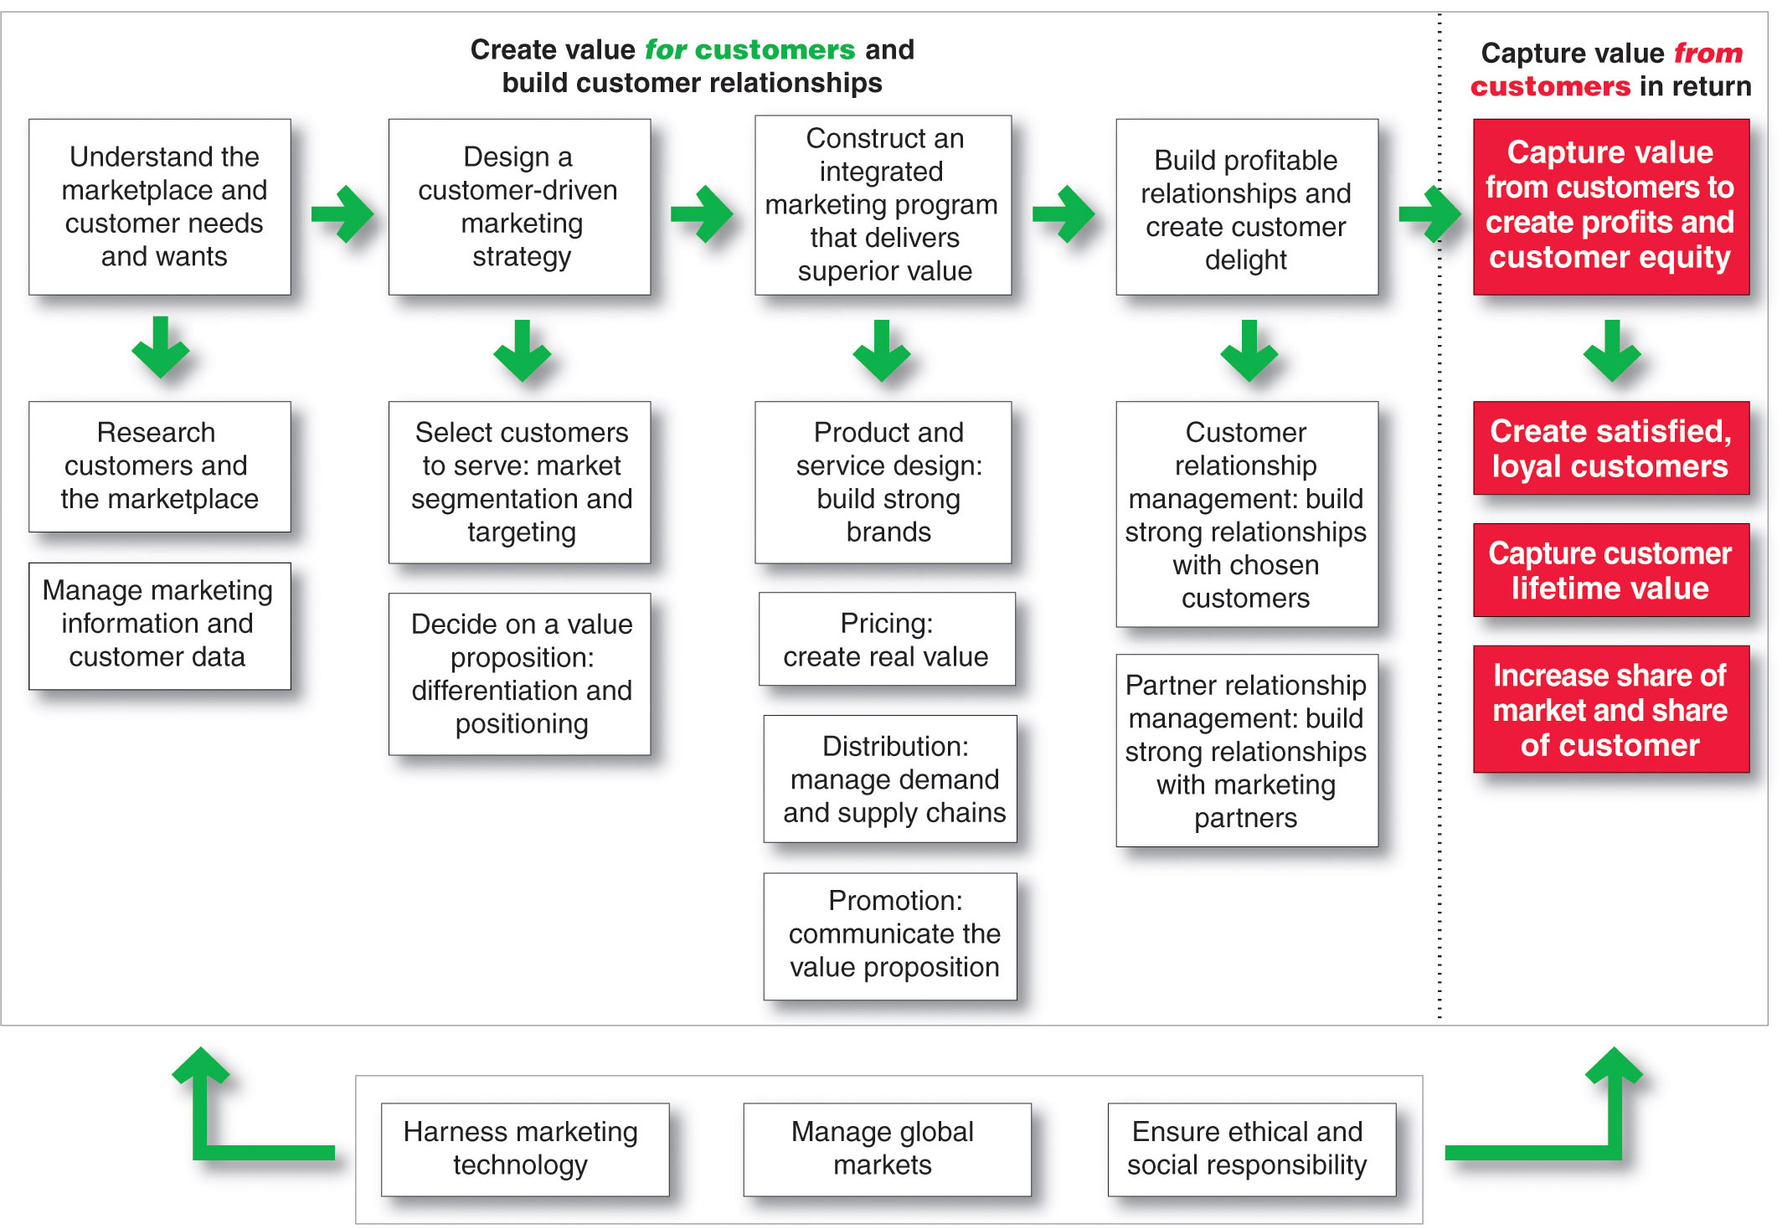
So, What Is Marketing? Pulling It All Together
Copyright ©2014 by Pearson Education
Notes:
Marketing is the process of building profitable customer relationships by creating value for customers and capturing value in return
The first four steps of the marketing process focus on creating value for customers:
The company first gains a full understanding of the marketplace by researching customer needs and managing marketing information.
It then designs a customer-driven marketing strategy based on the answers to two simple questions. The first question is “What consumers will we serve?” (market segmentation and targeting). Good marketing companies know that they cannot serve all customers in every way. Instead, they need to focus their resources on the customers they can serve best and most profitably. The second marketing strategy question is “How can we best serve targeted customers?” (differentiation and positioning). Here, the marketer outlines a value proposition that spells out what values the company will deliver to win target customers.
With its marketing strategy chosen, the company now constructs an integrated marketing program—consisting of a blend of the four/seven marketing mix elements—the four/seven Ps—that transforms the marketing strategy into real value for customers. The company develops product offers and creates strong brand identities for them. It prices these offers to create real customer value and distributes the offers to make them available to target consumers.
Finally, the company designs promotion programs that communicate the value proposition to target customers and persuade them to act on the market offering.
The first four steps in the marketing process create value for customers. In the final step, the company reaps the rewards of its strong customer relationships by capturing value from customers. Delivering superior customer value creates highly satisfied customers who will buy more and buy again. This helps the company capture customer lifetime value and greater share of customer. The result is increased long-term customer equity for the firm.
Finally, in the face of today’s changing marketing landscape, companies must take into account three additional factors. In building customer and partner relationships, they must harness marketing technology, take advantage of global opportunities, and ensure that they act in an environmentally and socially responsible way.
Essentially, over the course of the term, this is what we’ll be looking at.

Slide 23

Societal Marketing
The societal marketing concept is a marketing philosophy and approach that goes beyond traditional marketing to consider the broader impact of marketing activities on society and the well-being of individuals and communities.
It places an emphasis on responsible and ethical marketing practices that benefit not only the company and its customers but also the larger society.
Companies adopting the societal marketing concept may engage in various initiatives, such as eco-friendly product design, fair trade practices, philanthropic efforts, and cause-related marketing campaigns that support social or environmental causes. The ultimate goal is to build trust with consumers, enhance brand reputation, and contribute positively to society while achieving business objectives.

Slide 24
Key Components of the Societal Marketing Concept
Consumer Welfare: The primary focus is on meeting the needs and wants of consumers while ensuring their well-being. This involves delivering products or services that genuinely benefit customers.
Long-Term Perspective: Consider the long-term impact of their actions on society and the environment, rather than solely short-term profits.
Ethical and Responsible Behaviour: Strive to conduct business in an ethical and socially responsible manner, avoiding practices that could harm consumers, employees, or the environment.
Environmental Sustainability: Recognise the importance of environmental conservation, companies adopting this concept aim to minimize their ecological footprint, reduce waste, and promote sustainable practices.
Consumer Education: Informing consumers about product attributes, usage, safety, and environmental impact is seen as an ethical responsibility. Companies provide accurate and transparent information to empower consumers to make informed choices.
Balancing the Interests of Stakeholders: The societal marketing concept considers the interests of all stakeholders, including customers, employees, suppliers, shareholders, and the community. It seeks to strike a balance among these various interests.

Slide 25
Key Components of the Societal Marketing Concept
Social and Cultural Sensitivity: Understanding and respecting cultural diversity and social norms is essential. Marketing campaigns and practices should be culturally sensitive and avoid stereotypes or discriminatory messaging.
Community Engagement: Companies actively engage with the communities in which they operate. E.g. supporting local initiatives, contributing to community development, or addressing community concerns.
Transparency and Accountability: Companies are transparent about their practices, policies, and social responsibility initiatives. They are accountable for their actions and welcome scrutiny from stakeholders.
Compliance with Regulations: Adherence to laws and regulations related to consumer protection, environmental protection, and fair competition is a fundamental aspect of societal marketing.
Sustainable Growth: Companies aim for sustainable growth that benefits both the organisation and society, rather than pursuing growth at the expense of social or environmental well-being.

Slide 26
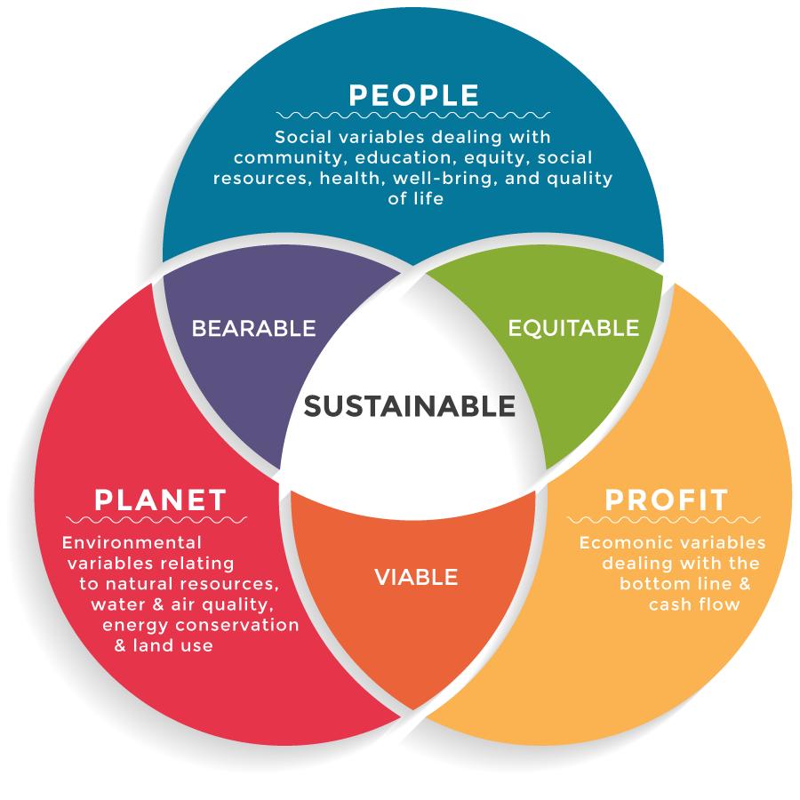
Societal Marketing Concept
Activity:
Discuss a company/organisation that you think truly demonstrates the Societal Marketing Concept
Feedback and justification for your choice.
Notes:
The most recent step in the evolution of marketing: Societal Marketing
The societal marketing concept helps to maximize profits for the organization and creates a long-term relationship with customers. It encourages developing products that benefit society in long run and satisfies consumers. So, it considers people, planet and profit / what is bearable, equitable and viable / and therefore what is sustainable. It aims to meet the present needs of consumers and businesses while simultaneously preserving the ability of future generations to meet their needs.
Societal marketing includes the concept that companies have a responsibility for the needs of society as a whole, so should include environmental impact and the impact of their products on non-users. For example, a car manufacturer might aim to make cars quieter in operation, rather than simply improving the soundproofing for its occupants and ignoring the needs of people who live near major roads.
Factors that might be involved in this philosophy often aim at being socially and environmentally responsible, addressing issues such as pollution, employment conditions, safety, corporate social responsibility… Nowadays, the societal marketing concept may be the best of the Marketing Concepts, since it looks at the long-term interests of society and thereby forms a strong basis for an effective marketing strategy. However, it is also the most difficult one of all Marketing Concepts. Companies have to balance three considerations at the same time: the company’s profits, consumer wants, and society’s interests.
https://marketing-insider.eu/marketing-concepts/

Slide 27


Slide 28


Slide 29
The Marketing Planning Process
A marketing plan answers the following questions:
Where are we now? → Marketing Audit
Where do we want to be? → Marketing Objectives
How will we get there? → Marketing Strategy & Tactics
How will we know when we get there? → Action & Control

Slide 30
The Marketing Planning Process
Business mission & strategy
Environmental & customer analysis
Marketing objectives
Marketing strategy
Marketing actions
Marketing performance

Slide 31
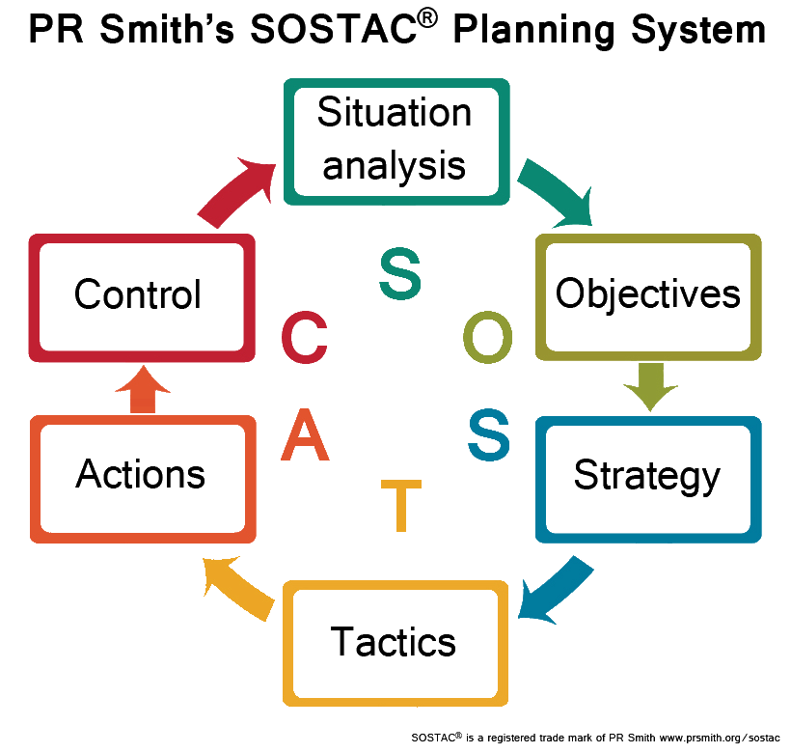

Slide 32


Slide 33

Any Questions?

