Slide 1

FOOD SAFETY & HYGIENE TRAINING
Cinnamon Kitchen
Food Safety Training Session
BMGM6003 – Staff Development Training
Lecturer: Antoinette Milne
Presented by: Amdadur Rashid Masum
Student ID: 2128870
16/03/2026
Use of Generative AI in Assessment
For this assessment, Generative AI tools (ChatGPT) were used to support the research process. This included assisting with identifying relevant academic sources, exploring bibliography, and helping to summarise, compare and review information from various materials. All final work has been reviewed, interpreted and written by the author to ensure accuracy and academic integrity.
Notes:
This presentation introduces a food safety and hygiene training session designed for staff working at Cinnamon Kitchen. The aim of this session is to reinforce the importance of safe food handling practices and to ensure that all employees understand their responsibilities in maintaining high hygiene standards.
Food safety is essential within the hospitality industry because improper food handling can lead to foodborne illnesses, reputational damage, and legal consequences for businesses. According to the Food Standards Agency, food businesses must follow strict hygiene practices to protect consumers and comply with UK legislation.
This training session therefore focuses on improving staff knowledge, strengthening safe practices, and supporting compliance with food safety regulations.

Slide 2
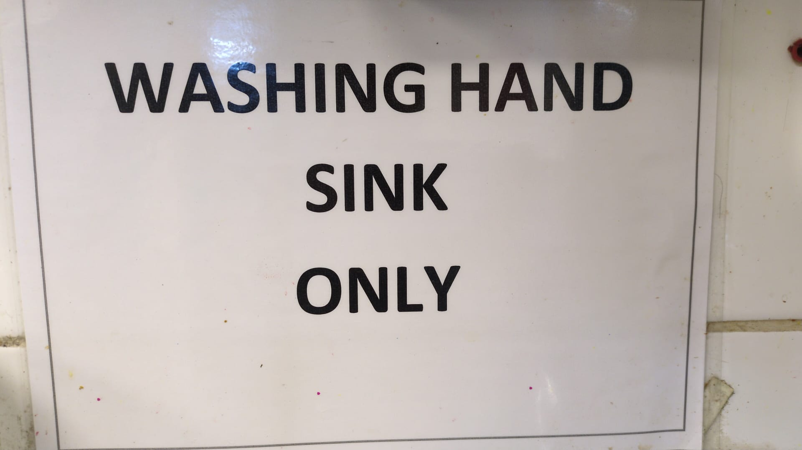
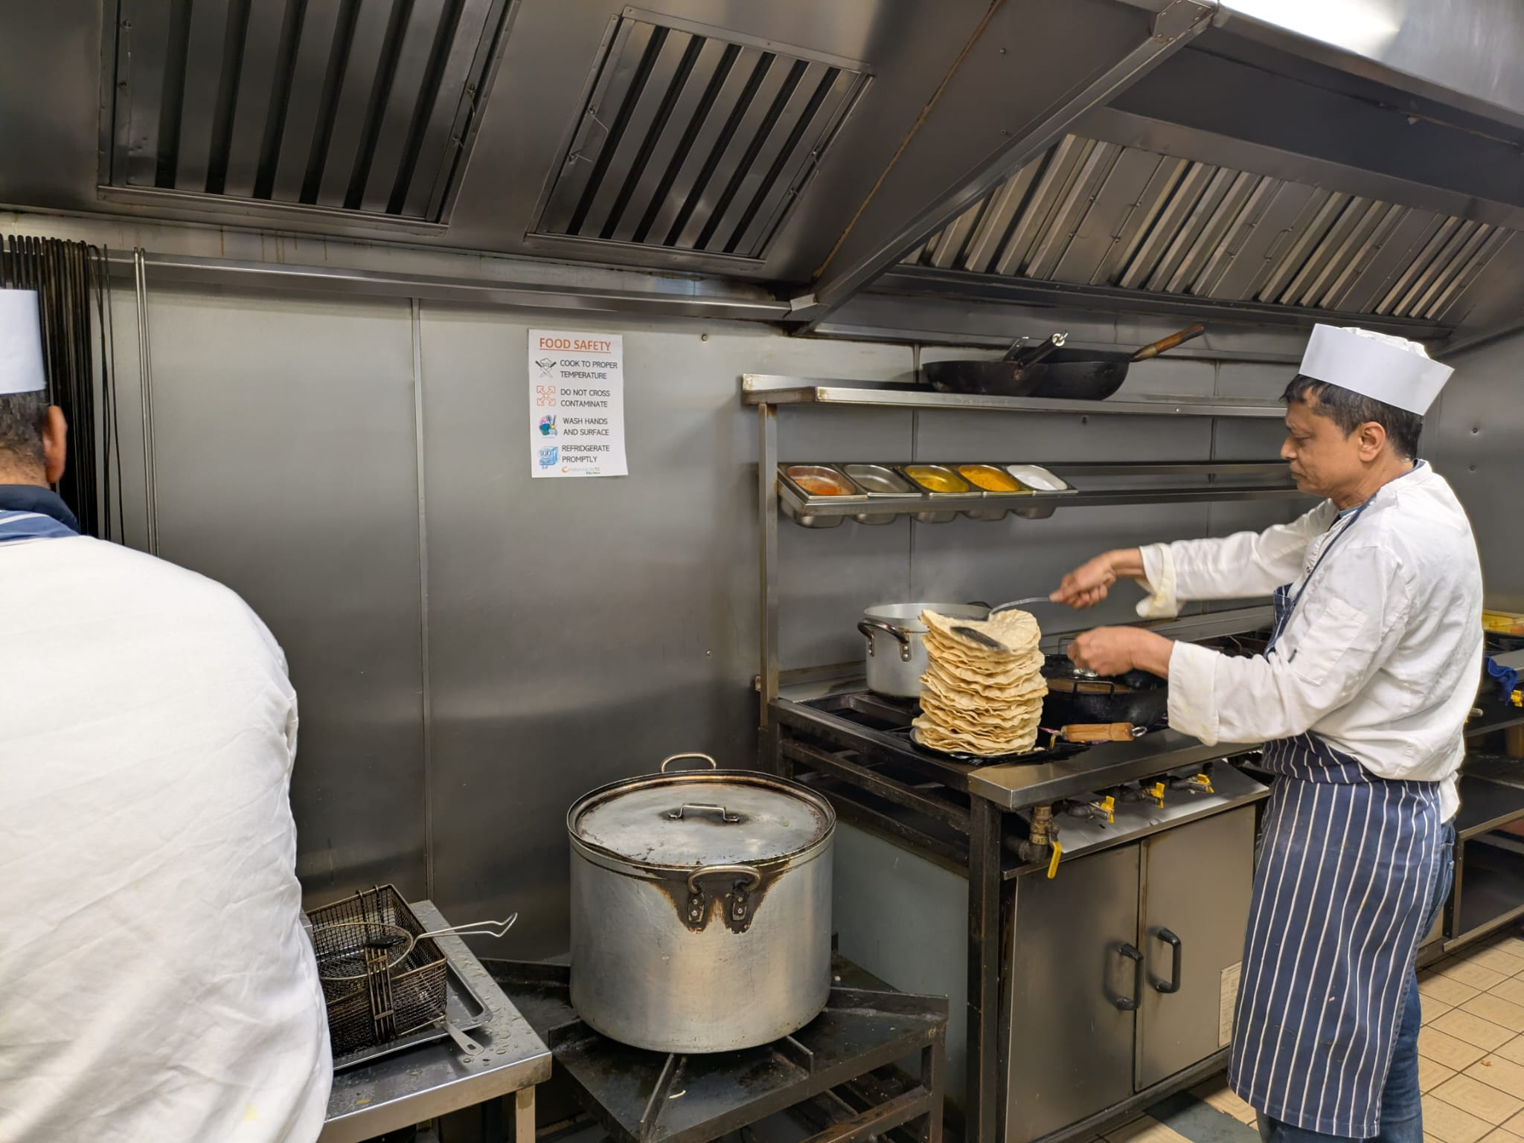
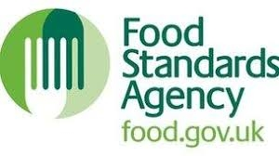
Agenda
LEARNING OBJECTIVES
THE IMPORTANCE OF FOOD SAFETY
OVERCOMING HYGIENE RISKS
SAFE FOOD HANDLING PRACTICES
ESSENTIAL HYGIENE EQUIPMENT
TEMPERATURE CONTROL
ALLERGEN AWARENESS
REAL CASE: ALLERGIC REACTION RISK
REAL CASE: RESTAURANTS FINED FOR ALLERGEN FAILURES
BENEFITS OF SAFE FOOD PRACTICES
ACTION PLAN
TRAINING EVALUATION
QUIZ
CONCLUSION
REFERENCES
Notes:
This training session will cover several important areas related to food safety and hygiene in the restaurant environment.
The session begins with an overview of why food safety is essential within the hospitality industry. It will then introduce the key hygiene principles that all staff must follow when preparing and handling food.
Following this, we will review current performance indicators within the restaurant and identify areas where improvements can be made. The session will also include examples of correct practices, practical explanations of hygiene procedures, and discussion of the documentation used to monitor food safety performance.
The training will conclude with an action plan to help ensure that these procedures are consistently applied in daily operations.

Slide 3
LEARNING OBJECTIVES
By the end of this training session, staff will be able to:
• Understand the importance of food safety in restaurant operations,
• Identify common food safety hazards in the kitchen,
• Apply correct hygiene and food handling procedures,
• Monitor food safety practices through documentation and checks,(Food Standards Agency(FSA), 2025).
• Contribute to maintaining safe food standards at Cinnamon Kitchen.
Train employee to understand the importance of Health and Hygiene and engage them to practice more and more (Armstrong and Taylor, 2023).
According to Kirkpatrick and Kirkpatrick (2006), clearly defined learning outcomes support the assessment of training effectiveness and employee performance improvements.
Notes:
Learning objectives help ensure that training sessions have clear outcomes. In workplace learning, setting defined objectives helps employees understand what knowledge and skills they are expected to develop during the session.

Slide 4
THE IMPORTANCE OF FOOD SAFETY
Food safety is essential for:
• Protecting customer health,
• Maintaining business reputation,
• Complying with legal regulations,
• Preventing foodborne illness.
An estimated 2.4 million people in the UK experience foodborne illness each year (Food Standards Agency(FSA), 2022).
Foodborne illness occurs when contaminated food is consumed, often due to improper food handling, poor hygiene practices, or incorrect temperature control. According to the World Health Organization (WHO, 2024), foodborne illnesses are a major public health concern worldwide.
Notes:
Food safety plays a critical role in the hospitality industry because it directly affects customer health and the reputation of the business.
Foodborne illness occurs when contaminated food is consumed, often due to improper food handling, poor hygiene practices, or incorrect temperature control. According to the World Health Organization, foodborne illnesses are a major public health concern worldwide.
Maintaining high hygiene standards helps reduce contamination risks and ensures that food served to customers is safe to consume. For restaurants, strong food safety practices also protect the organisation from legal risks and potential financial losses.

Slide 5
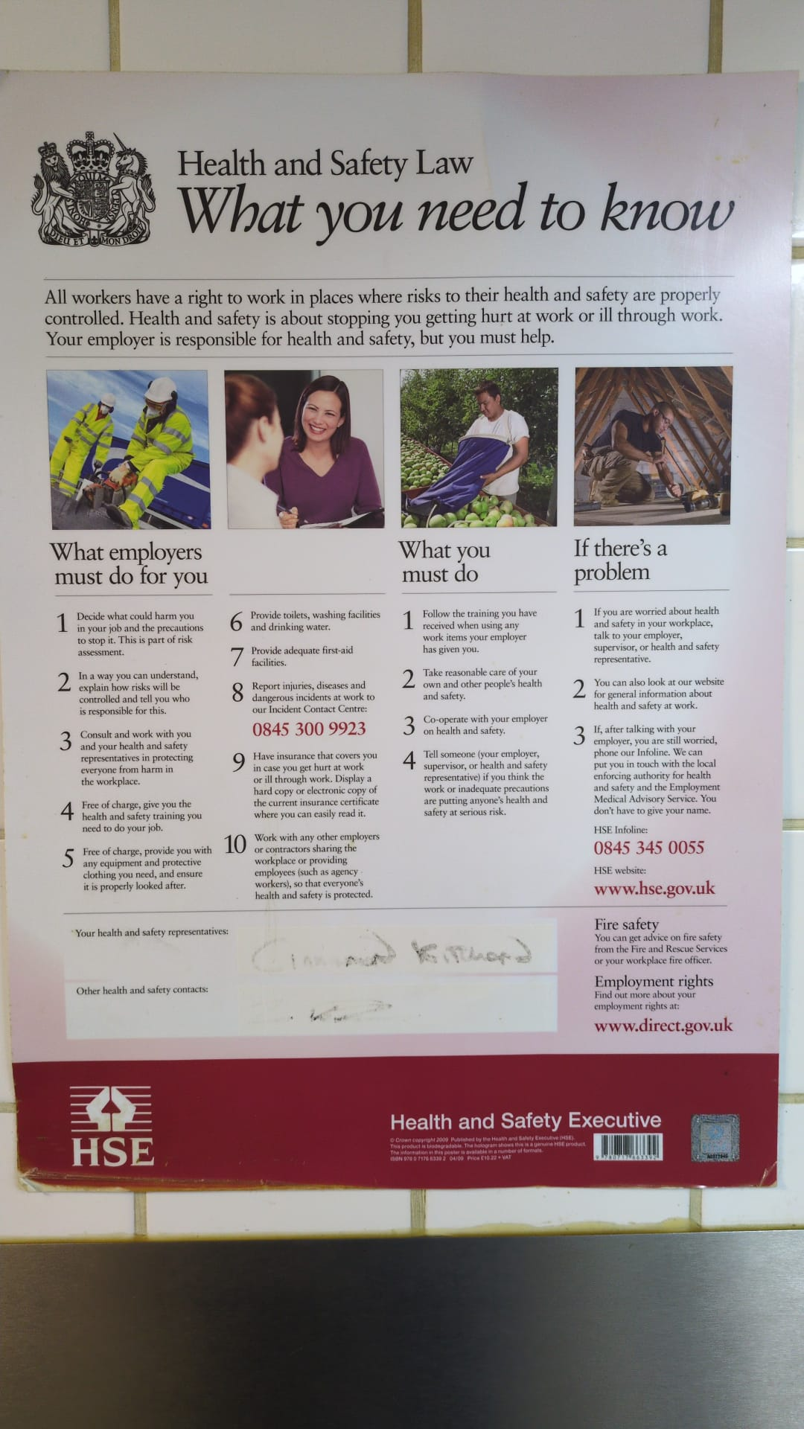
OVERCOMING HYGIENE RISKS
According to (WHO, 2024)Key food safety risks include:
• Cross-contamination
• Incorrect food storage
• Poor personal hygiene
• Inadequate cleaning procedures
Preventative strategies (Food Standards Agency(FSA), 2017):
• Proper food handling practices
• Temperature monitoring
• Structured cleaning routines
HACCP
Notes:
Food safety risks are commonly associated with contamination during food preparation and storage. One of the most common risks is cross-contamination, which occurs when harmful bacteria are transferred from raw food, surfaces, or equipment to ready-to-eat food.
To prevent these risks, restaurants use structured food safety systems such as Hazard Analysis and Critical Control Points, commonly known as HACCP. This system helps businesses identify hazards and implement preventative control measures.
Guidelines provided by the Food Standards Agency recommend regular monitoring of food preparation processes and strict adherence to hygiene procedures to minimise contamination risks.

Slide 6
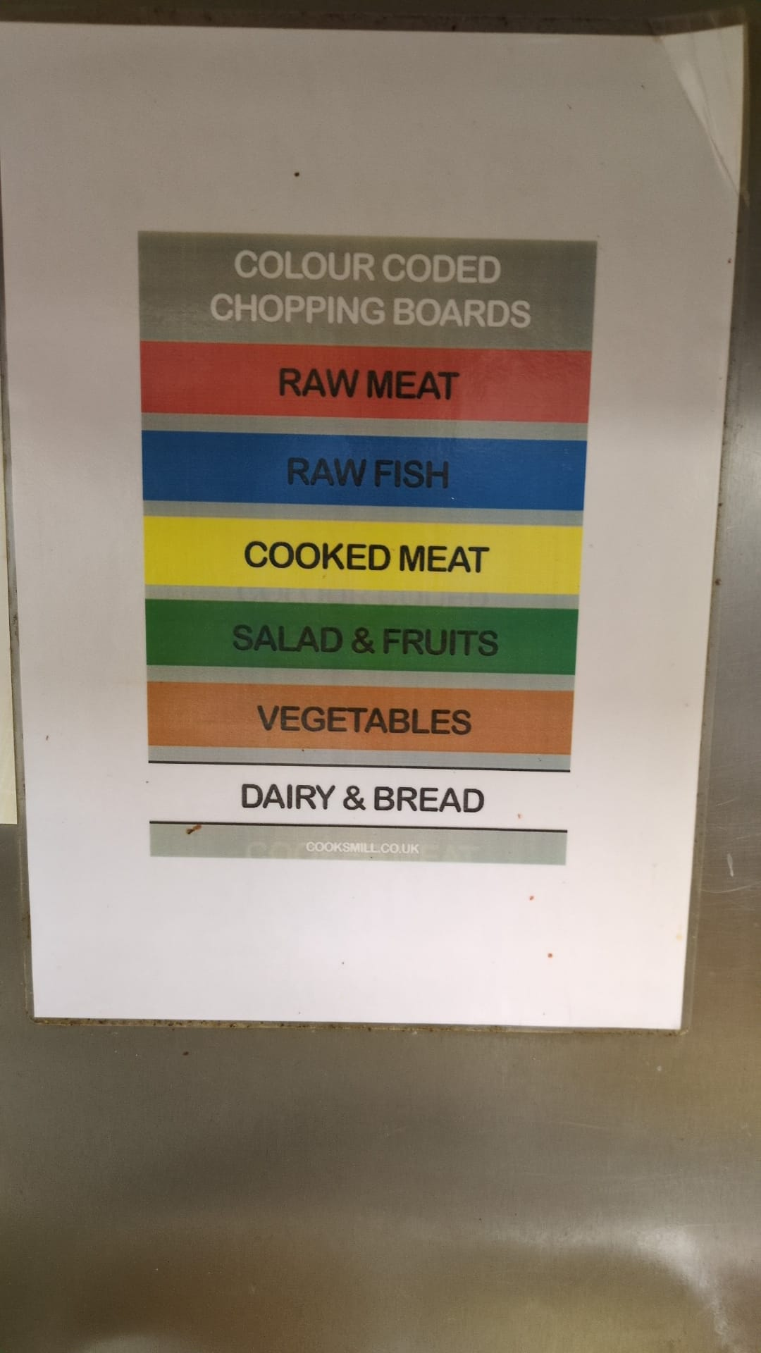
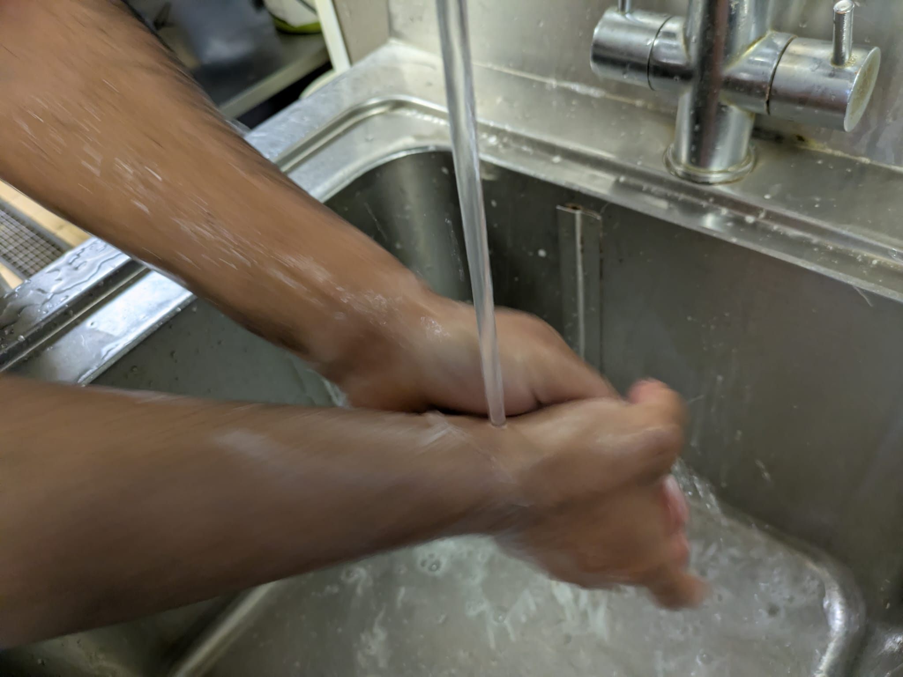
SAFE FOOD HANDLING PRACTICES
Essential practices include(Food Standards Agency(FSA), 2025):
• Maintaining proper hand hygiene
• Using designated colour-coded boards
• Separating raw and cooked foods
• Cleaning work surfaces frequently
• Reporting potential hazards
Notes:
Safe food handling practices form the foundation of food hygiene within professional kitchens. Proper handwashing is one of the most effective ways to prevent contamination. Staff should wash their hands at key stages, such as before handling food, after handling raw ingredients, and after cleaning tasks.
The use of colour-coded chopping boards helps prevent cross-contamination by separating different food types, such as raw meat, cooked food, vegetables, and fish.
Regular cleaning and reporting potential hazards are also important responsibilities for all staff members, as maintaining a clean working environment reduces the risk of bacterial growth.

Slide 7
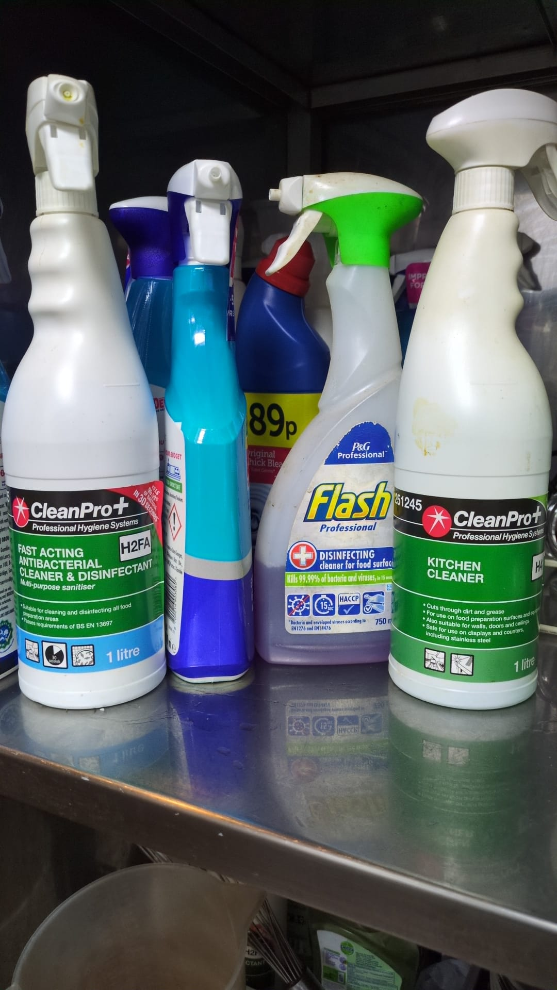
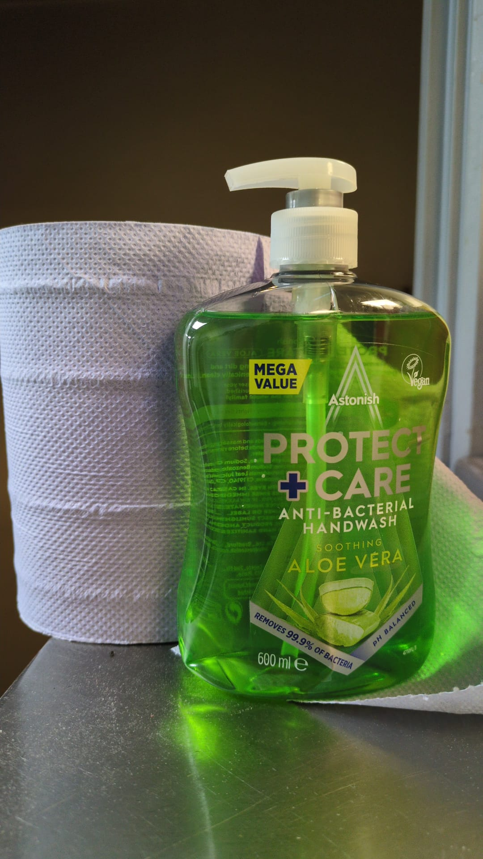
ESSENTIAL HYGIENE EQUIPMENT
Key equipment used in the kitchen:
• Colour-coded chopping boards
• Sanitising chemicals
• Temperature probes
• Cleaning cloths
• Personal protective equipment (PPE) (Nurhayati Khairatun, Siti et al., 2021).
Notes:
Using the correct equipment helps staff maintain safe food preparation procedures. Colour-coded chopping boards reduce the risk of cross-contamination by separating food categories.
Temperature probes are used to check that food is cooked and stored at safe temperatures. These probes must be properly calibrated to ensure accurate readings.
Personal protective equipment, including gloves, aprons, and hair restraints, also plays an important role in preventing contamination during food preparation.

Slide 8
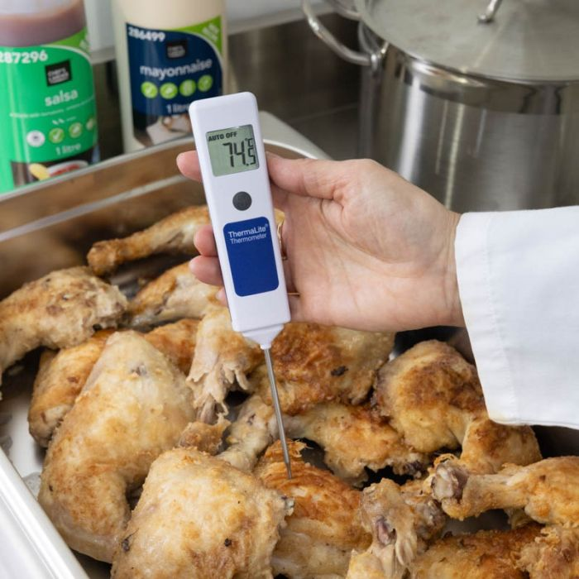
TEMPERATURE CONTROL
Temperature control is one of the most critical aspects of food safety. Harmful bacteria multiply rapidly when food is stored within the temperature danger zone, which is typically between 5°C and 63°C(Food Standards Agency(FSA), 2025).
Safe temperature practices:
Hot food holding: 63°C or above
Cooking temperature: 75°C or above
Cold storage: 5°C or below
Temperature monitoring helps prevent bacterial growth.
Notes:
Temperature control is one of the most critical aspects of food safety. Harmful bacteria multiply rapidly when food is stored within the temperature danger zone, which is typically between 5°C and 63°C.
For this reason, hot foods must be kept above 63°C and chilled foods must be stored below 5°C. Cooking food to at least 75°C helps ensure that harmful bacteria are destroyed.
Regular temperature monitoring allows staff to verify that food safety standards are being maintained throughout preparation, cooking, and storage.

Slide 9
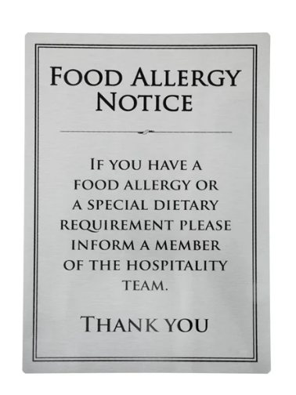
ALLERGEN AWARENESS
Food allergens represent a serious risk to customers with allergies or intolerances. Even small amounts of allergenic ingredients can cause severe allergic reactions. Staff must therefore understand how to prevent cross-contact between allergenic and non-allergenic foods. It is also important that employees are able to provide accurate allergen information when customers ask about ingredients(Food Standards Agency (FSA), 2025).
Key allergen responsibilities:
• Know common allergens
• Prevent cross-contact
• Provide accurate information to customers
• Follow allergen labelling procedures
Notes:
Food allergens represent a serious risk to customers with allergies or intolerances. Even small amounts of allergenic ingredients can cause severe allergic reactions.
Staff must therefore understand how to prevent cross-contact between allergenic and non-allergenic foods. It is also important that employees are able to provide accurate allergen information when customers ask about ingredients.
Guidance from the Food Standards Agency emphasises the importance of clear allergen management procedures in food businesses.

Slide 10
REAL CASE: ALLERGIC REACTION RISK
Real Case Study: Fatal Allergic Reaction
A tragic incident in London shows how serious food allergies can be.
A 12-year-old girl experienced a serious allergic reaction after consuming a milkshake that had been contaminated with traces of nuts.
The milkshake had been prepared in a blender that was not properly cleaned after making a previous drink containing nuts. The girl was taken to hospital but sadly died following the reaction (LEIGHDAY, 2025).
This case demonstrates the importance of strict allergen management and proper cleaning procedures in food businesses. he investigation also found several breaches of food safety law, including failing to provide allergen information and failing to control allergen contamination during food preparation. The café operator later pleaded guilty to multiple food safety offences and was fined £18,000 (Miller, 2025).
Notes:
The investigation also found several breaches of food safety law, including failing to provide allergen information and failing to control allergen contamination during food preparation. The café operator later pleaded guilty to multiple food safety offences and was fined £18,000 (Miller, 2025).

Slide 11
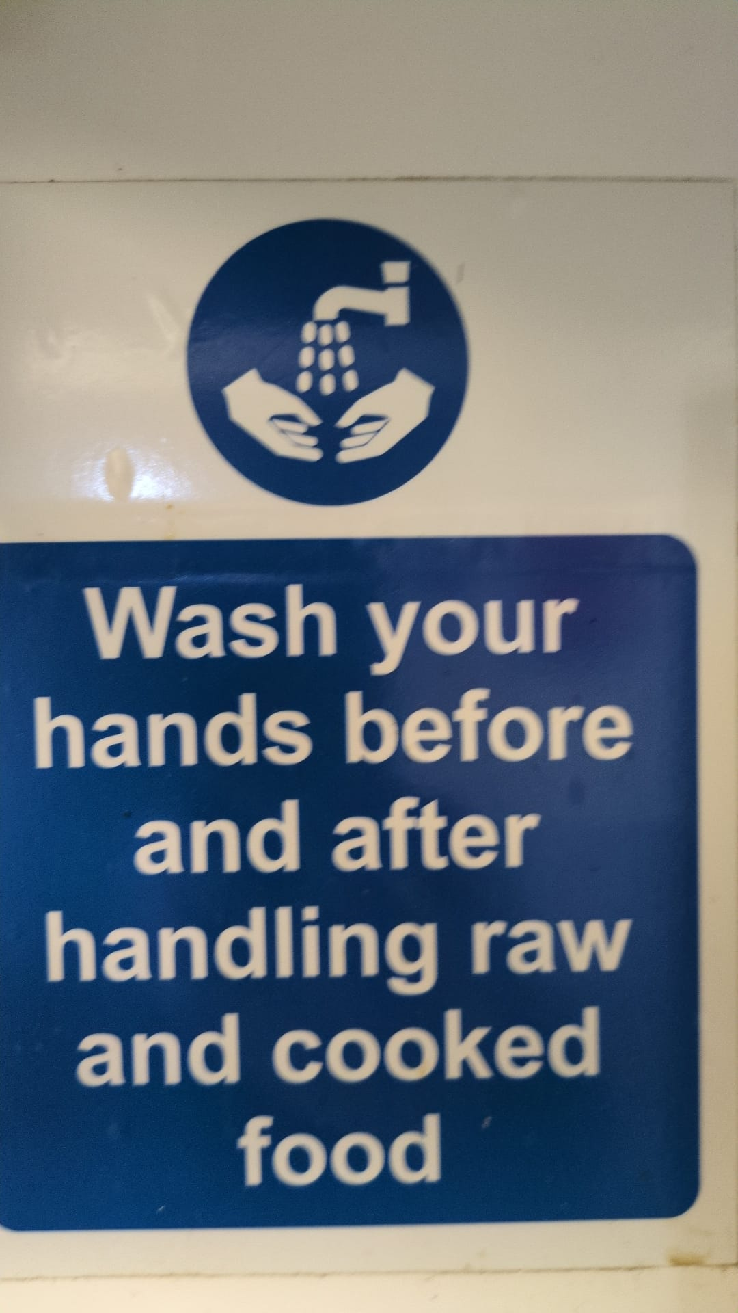
REAL CASE: RESTAURANTS FINED FOR ALLERGEN FAILURES
Real Case Study: Swansea Allergen Safety Breach
Trading Standards officers in Swansea investigated several restaurants after customers with allergies were served meals containing undeclared allergens.
During undercover checks, officers informed staff that they had food allergies and asked whether the meals were safe. Staff reassured them that the food did not contain the allergens. However, laboratory testing later confirmed that the meals contained allergens such as gluten, milk, and egg (Swansea Bay News, 2025).
As a result, the restaurants were prosecuted under the Food Safety Act 1990 and the General Food Regulations 2004, and the owners were fined thousands of pounds for serving unsafe food (abc Food Law, 2025).
Notes:
This case demonstrates the potentially serious consequences of poor allergen management. For customers with severe allergies, consuming even small amounts of an allergen can trigger a life-threatening reaction. It also highlights the importance of proper staff training, clear allergen information, and accurate communication with customers.

Slide 12
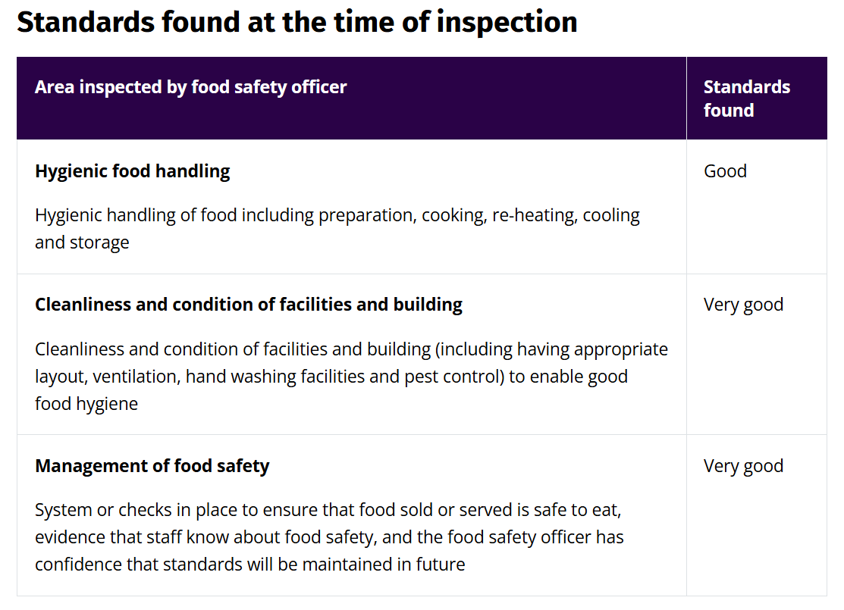
BENEFITS OF SAFE FOOD PRACTICES
Strong food safety practices:
• Protect customers
• Improve customer confidence
• Support legal compliance
• Enhance professional standards
Five-star food & hygiene rating carry out all of this above for Cinnamon Kitchen Ltd (Food Standards Agency(FSA), 2023).
Notes:
When staff consistently follow safe food handling practices, the restaurant benefits in several ways. Customer trust increases because diners feel confident that their food is prepared safely.
Additionally, maintaining high hygiene standards helps the business comply with food safety regulations and avoid potential penalties or enforcement actions.
Strong food safety practices also contribute to a positive workplace culture where employees take pride in maintaining professional standards.

Slide 13
ACTION PLAN
Maintain high hygiene standards at Cinnamon Kitchen, the following actions will be implemented (Kolb, 1984):
• Follow correct handwashing and personal hygiene procedures at all times
• Use colour-coded equipment to prevent cross-contamination
• Monitor and record food temperatures regularly
• Complete cleaning schedules and sanitation checks daily
• Ensure accurate allergen communication with customers
• Report any food safety hazards immediately to management
These actions will help ensure consistent food safety standards and continuous improvement in kitchen operations (Djekic and Smigic, 2025).
Notes:
Following this training session, the restaurant will continue monitoring food safety performance through regular audits and documentation checks.
If necessary, additional refresher training will be provided to ensure that staff maintain high hygiene standards.
Continuous monitoring and reinforcement of food safety procedures are essential to maintaining safe and consistent kitchen operations.

Slide 14
TRAINING EVALUATION
The effectiveness of the training will be evaluated through (Honey and Mumford, 1986):
• Staff feedback after training
• Observation of hygiene practices in the kitchen
• Monitoring food safety KPIs
• Review of temperature logs and cleaning records
Training evaluation helps determine whether the training session has successfully improved staff knowledge and behaviour. One widely used framework for evaluating training programmes, which evaluates the effectiveness of training across four levels: reaction, learning, behaviour, and results (Djekic and Smigic, 2025).
Notes:
In this case, improvements in hygiene compliance and documentation accuracy will indicate whether the training has had a positive impact on staff performance.

Slide 15

Quiz(O’Regan, 2024):
Circle one answer per question.
The “danger zone” is: a) 0–100°C b) 5–63°C c) 10–80°C
Raw chicken and salad can be prepared on the same board if washed with cold water.
True / False
Minimum safe cooking temperature: a) 60°C b) 75°C c) 85°C
Cleaning removes dirt; disinfection kills bacteria.
True / False
You must wash your hands: a) Before starting work b) After handling raw meat c) After the toilet d) All of the above
For more Test click Link below: https://www.highspeedtraining.co.uk/hub/food-safety-awareness-quiz/
Notes:
There is lots of website available to practice Health and Hygiene quiz test like HighSpeedTraining. This helps to improve skills and sharpen the knowledge.

Slide 16
Conclusion:
Food safety is a critical responsibility in professional kitchen environments.
Maintaining high standards of hygiene helps protect customer health, ensure legal compliance, and support the reputation of the restaurant (Beardwell and Thompson, 2017).
This training session has highlighted the importance of:
• Maintaining personal hygiene and safe food handling practices
• Preventing cross-contamination in food preparation
• Monitoring food temperatures and storage conditions
• Following documentation and food safety procedures
Consistent application of these practices will help staff contribute to a safer working environment and improve overall food safety performance at Cinnamon Kitchen(Cinnamon Kitchen Ltd, 2025).
Notes:
In conclusion, food safety is a fundamental aspect of restaurant operations and requires consistent attention from all members of staff. Maintaining strong hygiene practices helps prevent foodborne illness, protects customers, and ensures compliance with UK food safety regulations.
Training sessions such as this one play an important role in improving staff knowledge and reinforcing correct workplace behaviours. According to Food Standards Agency guidance, regular staff training is essential for maintaining effective food safety management systems.
By applying the procedures discussed in this training session, employees can contribute to improved hygiene standards and overall operational performance within the restaurant.

Slide 17
Reference list
abc Food Law (2025). News | ABC Food Safety. [online] Abcfoodlaw.co.uk. Available at: https://www.abcfoodlaw.co.uk/news/three-restaurants-fined-after-serving-unsafe-meals-to-allergy-sufferers/?utm_source=chatgpt.com [Accessed 7 Mar. 2026].
Armstrong, M. and Taylor, S. (2023). Armstrong’s Handbook of Human Resource Management Practice. 16th ed. Kogan Page.
Beardwell, J. and Thompson, A. (2017). Human Resource Management : a Contemporary approach. 8th ed. Harlow, England: Pearson.
Cinnamon Kitchen Ltd (2025). Cinnamon Kitchen Indian Restaurant Aberavon Sea Front – Exquisite Indian Cuisine with Stunning Sea Views. [online] Cinnamonkitchenpt.co.uk. Available at: https://cinnamonkitchenpt.co.uk/ [Accessed 1 Mar. 2026].
Djekic, I. and Smigic, N. (2025). Revisiting Key Performance Indicators That Evaluate Food Safety Management Systems: a Short Review. Foods, [online] 14(21), p.3742. doi:https://doi.org/10.3390/foods14213742.
Food Standards Agency (FSA) (2025). Allergen Guidance for Food Businesses. [online] Food Standards Agency. Available at: https://www.food.gov.uk/business-guidance/allergen-guidance-for-food-businesses [Accessed 13 Mar. 2026].
Food Standards Agency(FSA) (2017). Hazard Analysis and Critical Control Point (HACCP). [online] Food Standards Agency. Available at: https://www.food.gov.uk/business-guidance/hazard-analysis-and-critical-control-point-haccp [Accessed 9 Mar. 2026].
Food Standards Agency(FSA) (2022). FSA Research Suggests New Higher Estimates for the Role of Food in UK Illness. [online] Food Standards Agency. Available at: https://www.food.gov.uk/news-alerts/news/fsa-research-suggests-new-higher-estimates-for-the-role-of-food-in-uk-illness [Accessed 12 Mar. 2026].
Food Standards Agency(FSA) (2023). Cinnamon Kitchen | Rating Business Details | Food Hygiene Ratings. [online] ratings.food.gov.uk. Available at: https://ratings.food.gov.uk/business/576604 [Accessed 11 Mar. 2026].
Food Standards Agency(FSA) (2025). Safer food, Better Business (SFBB). [online] Food Standards Agency. Available at: https://www.food.gov.uk/business-guidance/safer-food-better-business-sfbb [Accessed 13 Mar. 2026].
GOV.UK (2026). Food Safety Act 1990. [online] Legislation.gov.uk. Available at: https://www.legislation.gov.uk/ukpga/1990/16/contents [Accessed 13 Mar. 2026].
Honey, P. and Mumford, A. (1986). The Manual of Learning Styles. Maidenhead, Angleterre, Ardingly House.
Kirkpatrick, D.L. and Kirkpatrick, J.D. (2006). Evaluating Training Programs: the Four Levels. San Francisco, Ca: Berrett-Koehler.
Kolb, D.A. (1984). Experiential Learning: Experience as the Source of Learning and Development. Upper Saddle River, New Jersey: Pearson Education Inc.
LEIGHDAY (2025). Family of Girl Who Died after Allergic Reaction Welcome Fine. [online] Leigh Day. Available at: https://www.leighday.co.uk/news/press-releases/2025-news/family-of-12-year-old-girl-from-london-who-died-after-severe-allergic-reaction-to-a-milkshake-containing-nuts-welcome-fine-and-community-order-for-cafe-operator/ [Accessed 10 Mar. 2026].
Miller, V. (2025). London Café Fined following Death of Girl from Allergic Reaction. [online] The Caterer. Available at: https://www.thecaterer.com/news/london-cafe-fined-following-death-of-girl-from-allergic-reaction?utm_source=chatgpt.com [Accessed 10 Mar. 2026].
Nurhayati Khairatun, Siti, Abu, Z., Mutalib, A. and Ungku, F. (2021). Food Safety Practices in the Restaurant Industry. IGI Global.
O’Regan, V. (2024). Test Yourself on Christmas Food Safety. [online] The Hub | High Speed Training. Available at: https://www.highspeedtraining.co.uk/hub/food-safety-awareness-quiz/ [Accessed 8 Mar. 2026].
Swansea Bay News (2025). Swansea Restaurants Fined after Serving Unsafe Meals to Allergy Sufferers. [online] Swansea Bay News. Available at: https://swanseabaynews.com/swansea-restaurants-fined-after-serving-unsafe-meals-to-allergy-sufferers/ [Accessed 9 Mar. 2026].
WHO (2024). Food Safety. [online] Who.int. Available at: https://www.who.int/news-room/fact-sheets/detail/food-safety [Accessed 8 Mar. 2026].

