Slide 1

Critical Thinking in Health & Social Care
Module: LCHS4009
Presented by: NASREEN BEGUM
Student ID: 2008171
Lecturer: Soban Sadiq
Notes:
Introduce yourself naturally and explain you'll discuss critical thinking and why it matters.

Slide 2
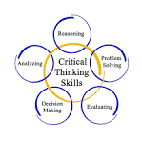
Introduction
Critical Thinking in Health and Social Care
First-year Health & Social Care student
Future Social Worker
Why critical thinking matters
Real-life application
Notes:
Briefly explain your background and presentation objectives.

Slide 3

What is Critical Thinking?
Critical Thinking
Thinking carefully before making decisions
Looking at facts and evidence
Considering different viewpoints
Solving problems fairly
Reflecting before taking action
.
Notes:
Explain critical thinking in your own words and mention university case studies.

Slide 4
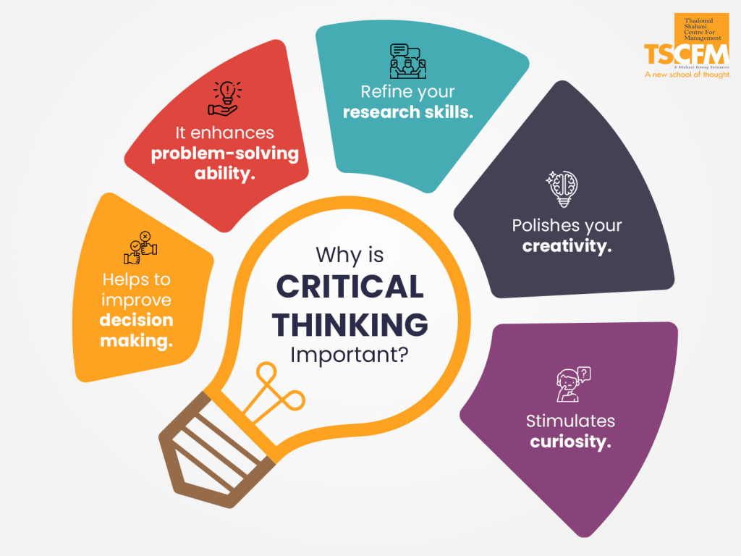
Importance in Professional Practice
Critical thinking helps professionals to:
Make safe decisions
Protect vulnerable people
Improve quality of care
Solve problems
Work professionally
Notes:
Discuss why it matters for service users, colleagues and organisations.

Slide 5
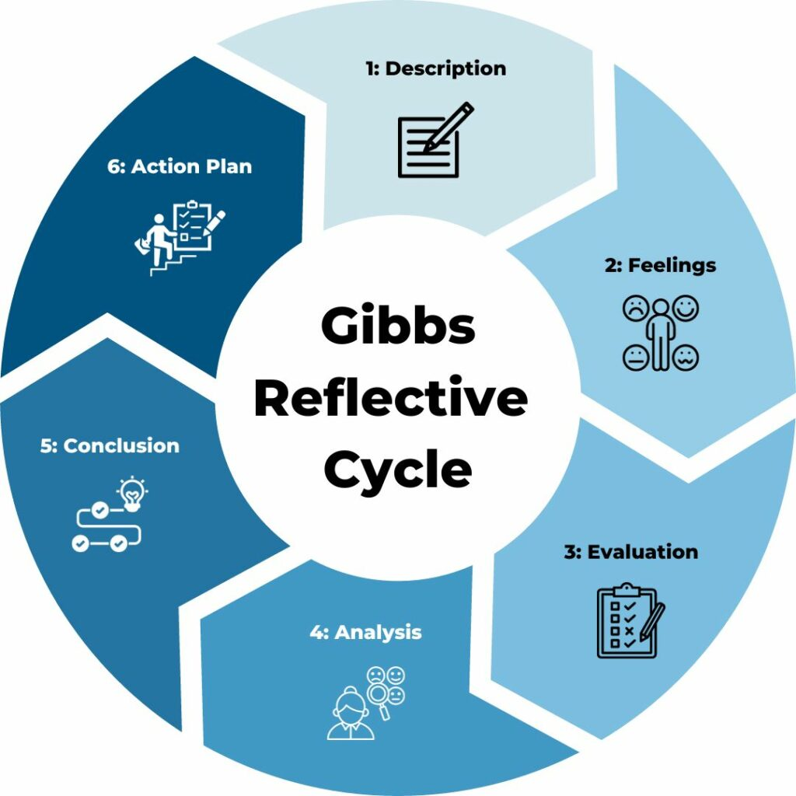
Gibbs' Reflective Cycle
Gibbs' Reflective Cycle
Description
Feelings
Evaluation
Analysis
Conclusion
Action Plan
Notes:
Explain how reflection improves future decision-making.

Slide 6
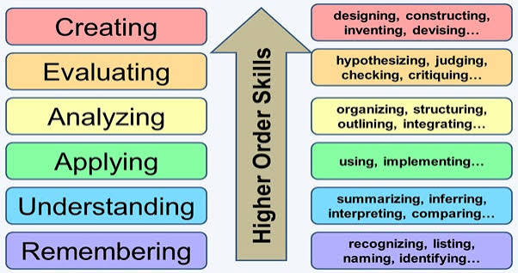
Applying Critical Thinking
Home visit to an older adult.
Observe
Gather information
Assess risk
Discuss with colleagues
Make informed decision
Notes:
Walk through the scenario and explain how you'd avoid assumptions.

Slide 7

My Future Career
Build confidence
Evidence-based decisions
Lifelong learning
Better support for service users
Notes:
Reflect on developing this skill as a first-year student.

Slide 8

Conclusion
Critical thinking improves safe, ethical decisions
Essential for social work
• It protects service users.
It is essential for social work
Notes:
Summarise key messages and thank the audience.

Slide 9
References
Cottrell (2023)
Gibbs (1988)
Social Work England (2023)
Notes:
Remember to cite these sources in your spoken presentation if needed.

