Slide 1
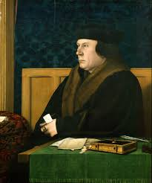
Creating Cromwell
An analysis of the historical novel’s position and potentiality through a study of Hilary Mantel’s Wolf Hall trilogy

Slide 2
Mantel’s approach, techniques, and impact
The historical novel’s potential contribution to the study and understanding of, and engagement with, the past
How a range of authors approach the writing of historical fiction, particularly in their approach towards accuracy and/or authenticity
Historical fiction’s possible place on a spectrum of historiography

Slide 3
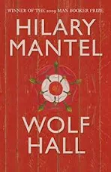
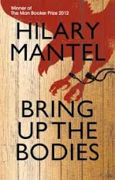
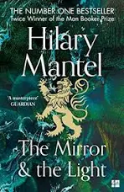
The Wolf Hall Trilogy

Slide 4
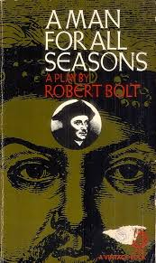
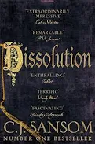
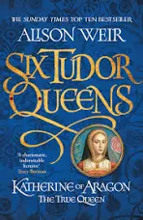
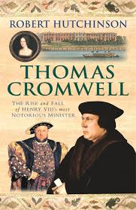
Cromwell through the ages
Fiction:
sly and cunning; sinister; a ‘great black spider’; ‘a warty toad’
the antithesis of Thomas More
Famously Machiavellian in Robert Bolt’s 1960 play A Man for All Seasons
Non-fiction:
Hutchinson describes him as trampling underfoot ‘the mangled bodies of those he had exploited or crushed’
a stooge who enabled the worst of Henry VIII’s behaviours

Slide 5
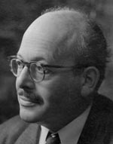
G. R. Elton
Elton on Cromwell: ‘Wherever one touches him, one finds originality and the unconventional…he disdained pomp and cultivated a plain accessibility which reflected his genuine interest in other people. An exceptionally lively mind hid behind the formidable façade and expressed itself in vigorous and witty speech, his conversation charmed even his enemies, and he had great natural gifts as an orator’.
(Elton, Reform and Reformation, pp. 169-70)
Copyright: Royal Historical Society

Slide 6
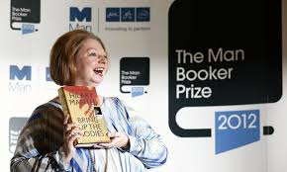
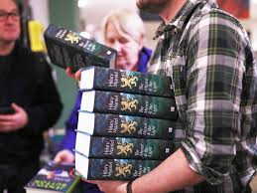
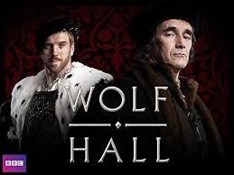
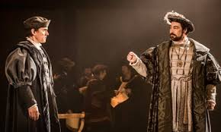

Slide 7
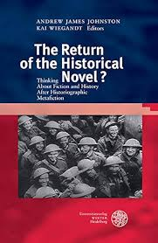
Cultural Memory
The idea of a widely held perception of the past shaped by input, impression and experience
A ‘storehouse of images’ which constitutes public perception of an historical figure
Renata Brosch, ‘Thomas Cromwell, Our Contemporary: The Poetics of Subjective Experience as Intersubjective Ethics in Wolf Hall’, in Johnston, A. J. & Wiegandt, K. (eds.) The Return of the Historical Novel?: Thinking About Fiction and History After Historiographic Metafiction (Germany: Universitätsverlag Winter, 2017).

Slide 8
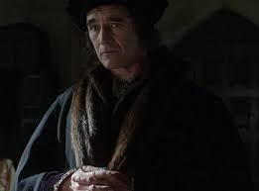
Mantel’s Cromwell: a radically different representation
‘Liz, he thinks, didn’t you fight? If I had seen your death coming, I would have taken him and beaten in his death’s head; I would have crucified him against the wall’ (Wolf Hall, p. 102)
‘grief comes in waves. Now it threatens to capsize him’ (Wolf Hall, p. 154)
‘Offer after offer was made, and More took none’ (The Mirror and the Light, p.65)

Slide 9
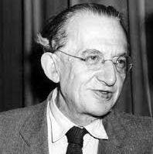
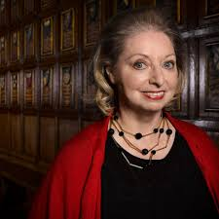
‘World-historical figure’: Cromwell is depicted as an individual whose actions changed the course of history
Complicated chronologies: ‘duplicate not the historian’s chronology but the way memory works: in leaps, loops, flashes’
(Mantel, H., (2012) ‘How I came to write Wolf Hall’, The Guardian, 7th December)

Slide 10
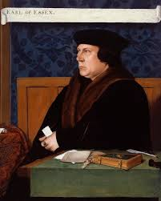
Focalisation: Cromwell is an ‘internal character-bound focaliser’
Proximity: a sense of the reader standing just behind Cromwell
Analepsis: a literary device in narrative, in which a past event is narrated at a point later than its chronological place in a story (flashback)
Ekphrasis: the use of detailed description of a work of visual art as a literary device
Copyright: National Portrait Gallery, London

Slide 11
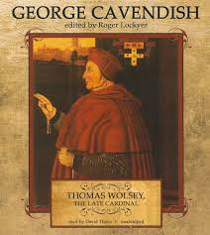
Mantel’s representation of the past
Wants to provide a ’sense of being in the room’’
Pronouns and paratexts
Metafictional commentary: a narrative’s self-reflective commentary on its fictional nature (which often draws attention to its own artificiality)
Intertextual material: ‘‘I like,’ he says, ‘the way you remember the exact words. Did you write them down at the time? Or do you use some licence?’ (Wolf Hall, p. 78)

Slide 12

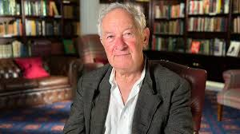
Critics
Stephen Greenblatt: ‘a magnificent structure made out of mud’
Paul Kaufman: ‘Perhaps it is fair for fiction to distort so ascertainably, yet I should think that historians will want to have a dissent on the record’
Simon Schama: ‘Sure, he was a good family man. So was More. So was Himmler.’

Slide 13
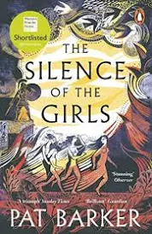
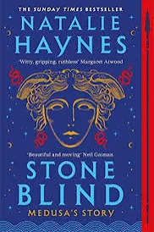
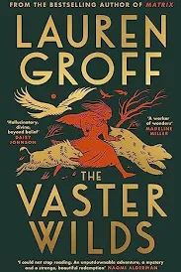
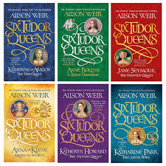
Representing the under-represented

Slide 14
Are there historical novels you’ve read which have changed your perception of a person, place, or period?
Have you read something which has chosen as its focus a person/people you haven’t encountered before?
How did the author achieve their representation, and were you convinced by it?
Is there a novelist who has tried to do this and not been successful?

Slide 15
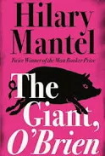
Accuracy or authenticity?
Mantel: ‘This is not a true story, though it is based on one’ (The Giant O’Brien, ‘Note’)
Accurate: consistent with the sources, with a focus on historical veracity
Authentic: the impression of accuracy, successfully convincing readers that the representation captures the past

Slide 16
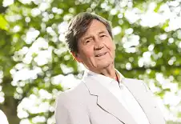
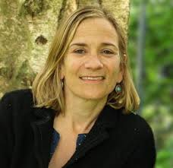
Melvyn Bragg: ‘fiction must be the driver and the defence’
Alison Weir: ‘you can make things up, which I have only done when I felt I could legitimately do so’
Ian McEwan: ‘novelistically realised’ is acceptable, reinvention is not
Philippa Gregory: uses para-texts such as book lists to hold herself ‘responsible’
Tracy Chevalier: ‘elasticity’ in relation to the facts, but nothing ‘false’

Slide 17
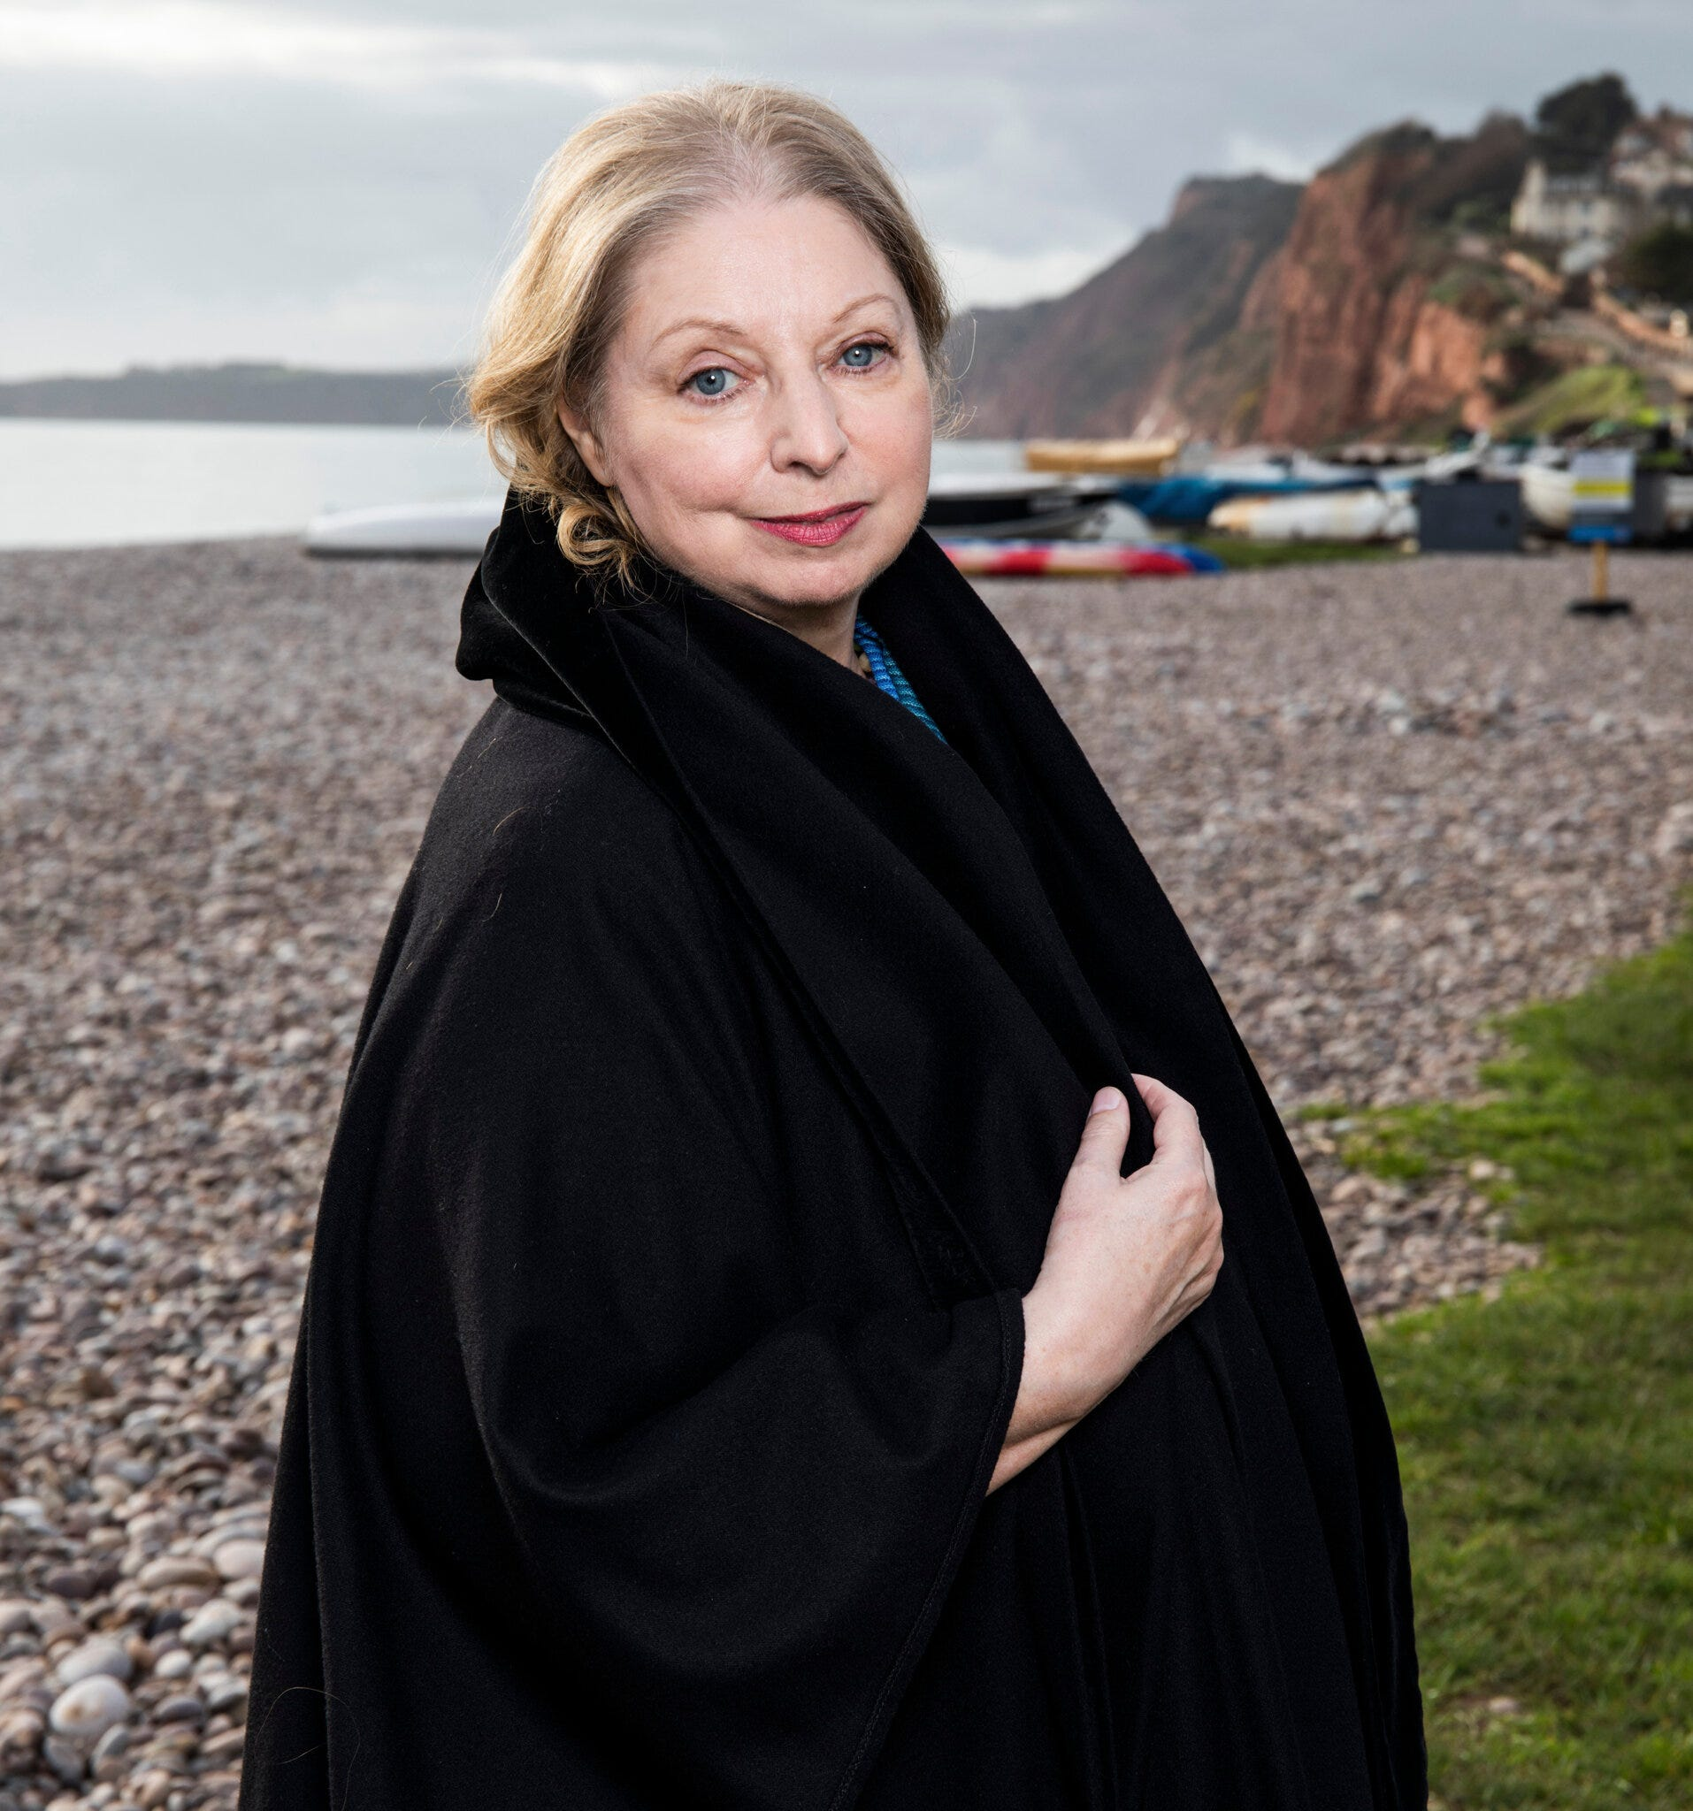
‘History is always changing behind us, and the past changes a little every time we retell it. The most scrupulous historian is an unreliable narrator…Once that is understood, the trade of the historical novelist doesn’t seem so reprehensible or dubious; the only requirement is for conjecture to be plausible and grounded in the best facts one can get’.
(‘Booker winner Hilary Mantel on dealing with history in fiction’, The Guardian, 17th October)

Slide 18
those who treat history as a landscape in which to plant fictional events and people (Thomas Malory)
those who accept historical context but fill in circumstantial detail (Philippa Gregory)
those who ‘only invent when no authentic record survives’ (Hilary Mantel)
those who construct accessible ‘tertiary’ sources (Alison Weir)
academics who also vary from ideologically driven to consensus builders, manuscript- as opposed to primary-source-based (G. R. Elton)

Slide 19
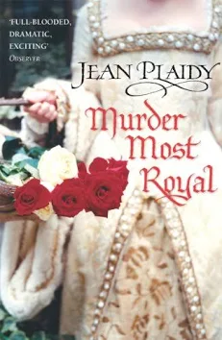
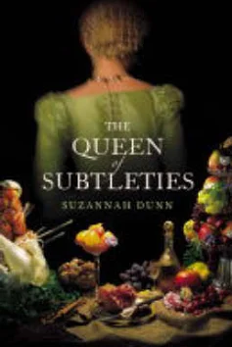
‘hitherto’
‘It’s not you, it’s me’; ‘You asking?’

Slide 20
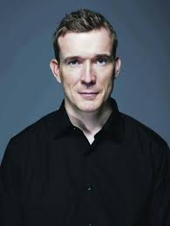
Bygonese
Technique coined by David Mitchell, the author of Cloud Atlas
Inaccurate (but plausible) language, focussed on its effect on readers rather than adherence to the likely language of the time
A hybrid approach adopted by Mantel who combines modern contractions with words which conjure the past
A language that is familiar to readers but reminiscent of the past, resulting in the impression of authenticity

Slide 21
Should authors be striving for accuracy or authenticity? Is it an either, or?
If they’re aiming for accuracy, how much licence does an author have to invent (if any)?
Can a historical novel be too authentic, misleading readers into believing things about the past that the author has invented?
Alternatively, was Henry James right when he claimed that historical fiction could never be authentic?

Slide 22
A spectrum of historiography?
Hayden White’s ‘truth-reality distinction’:
‘history’ attempts to provide the ‘true’, fiction the ‘real’
the ‘real’ is everything that can be truthfully said about its actuality (the ‘true’) plus ‘everything that can be truthfully said about what it could possibly be’ (White, ‘Introduction: Historical Fiction, Fictional History, and Historical Reality’, Rethinking History 9(2-3) (2005))
Keith Jenkins: there’s no ‘real account’, no version of history that ‘allows us to check all other accounts against it…no fundamentally correct ‘text’ of which other interpretations are just variations; variations are all there are’ (Jenkins, Rethinking History, 1991)

Slide 23
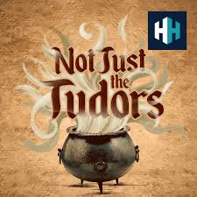
Malcolm Gaskill:
‘fictive historical narrative’ - not fiction, because things aren’t made up, but an interpretative look at the sources in which he makes choices about what to include
‘the reader has to trust the writer, the historian, that no violence is done to the integrity of the story’
He takes ‘small liberties’ including things that are ‘absolutely plausible, if not absolutely definite’
Argues that if his writing had ‘constantly been hedged round with doubts’ he would have lost the spirit he was trying to convey
(Not Just the Tudors podcast, ‘Witches and Puritans’, 25th October 2012).

Slide 24
Spectrum, or individual disciplines?
Are historiography and the historical novel two separate genres, forever distinct, each excluding the other? Or might they be two ends of a spectrum?
Where do we draw the line?
‘Poetic function’: writing which focuses on the form, or aesthetics, of the language used rather than principally on its content (and where this is dominant)
White argues such work is ‘literary’ and he includes both academic ‘history-writing’ and some historical fiction in this category

Slide 25
Do you have examples of historical novels you’ve read which you would include on a spectrum of historiography?
Or those which you definitely wouldn’t?
Do you think historical fiction which wouldn’t feature on such a spectrum still shares some of the potential of the genre to expand interest in history? On balance, is it a benefit or hindrance to the study of the past?

Slide 26


