Slide 1
Contemporary Themes In the Hotel and Hospitality Sector
Assignment Two Conference Presentation
Module Tutor- Natalie Braisford
Student Name-Carmen Dragu
Student ID-2117510

Slide 2
Table of contents
Slide 3: Introduction
Slides 4-7: Literature Review
Slides 8-10: Application to the Hotel and Hospitality Sector
Slides 11-12: Evaluate Future Policy and Management Options
Slide 13: Conclusion
Slide 14: Reference List

Slide 3

Introduction
According to Perkin and Abraham (2021) digital transformation refers to the fundamental changes in the operational ways of an organisation through the integration of technologies.
The importance of this theme is underscored by its alignment with consumer preferences, regulatory requirements, and the long-term viability of the industry.
Notes:
Digital transformation has gained significant traction as a critical theme for the hotel and hospitality sector amidst increasing environmental awareness.
In the online segment, sales are expected to increase significantly by 12.23% between 2019 and 2029 (Statista, 2024). Further as of July 2024, 95% of the tourist attraction relied on some form of digital communication (Statista, 2024). This presentation will shed light on the trend of digitalisation tourism and its alignment with the British Tourism industry

Slide 4

Literature Review
Institutional Theory
The institutional theory posits that organisations are influenced by the social contexts in which they operate and they tend to adopt similar practices and structures (Bhuiyan et al., 2023).
The persistence of these issues has subjected the hospitality industry towards the adoption of technologies that contribute towards environmentally sustainable practices.
Notes:
Khatter (2023) has considered the impacts of global warming and the reduction of biodiversity as significant challenges for the tourism industry.
The uncertainty and ambiguity created by this situation also influence some organisations to imitate the industry leaders for the best practices, which translates to convergence of approaches. Therefore, this lays the foundation for the development of industry-wide standards and certifications which are responsible for promoting sustainable practices.

Slide 5
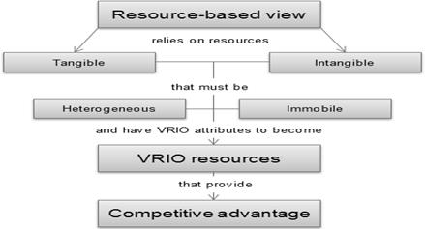
Literature Review (Continued)
Resource-Based View (RBV)
The Resource-Based View (RBV) is generally used by organisations to analyse and interpret their resources which can later be utilised by the firm to attain competitive advantages (Lubis, 2022).
According to Soler (2022) innovation can act as a competitive advantage for hotels by controlling the guest experience through technology.
Notes:
Technologies like smart thermostats and smart lighting used in hotels are valuable as they contribute to the sustainable goals of the business. They are also rare as the early adopters of the technology can make a name for themselves within the industry. However, Soler (2022) states that hotels have faced difficulties in implementing technology as the hospitality industry is too slow to adopt it. Despite the significant benefits provided by technologies like cloud sharing, only 20-20% of the Fortune 100 companies in the world have integrated such systems.

Slide 6
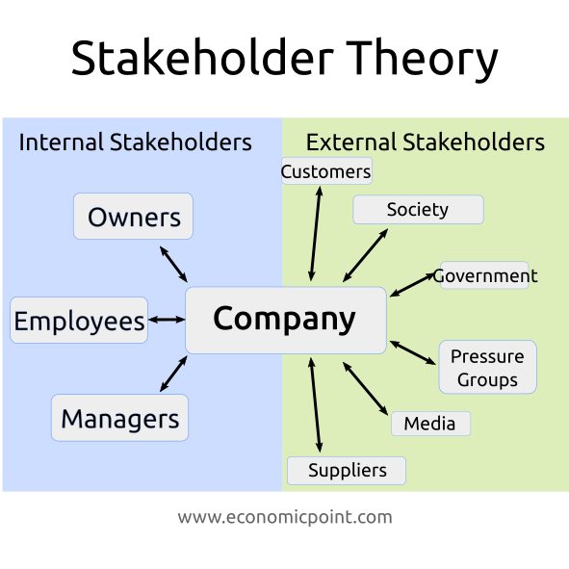
Literature Review (Continued)
Stakeholder Theory
Langrafe et al. (2020) state that the stakeholder theory is characterised by a number of ideas, and one among them is that organisations encompass various groups of networks between different stakeholders.
According to Khatter (2023) the stakeholders of the organisation have the potential to contribute to the pursuit of the firm towards their goals by acknowledging the impact of digitalisation on their interests.
Notes:
This underscores the importance of organisations from the tourism industry to manage relationships with various stakeholders, including employees, customers, suppliers, and communities with the help of technology.
The firms from the tourism industry therefore can build strong relationships with these stakeholders with practices fostering technological integration.

Slide 7
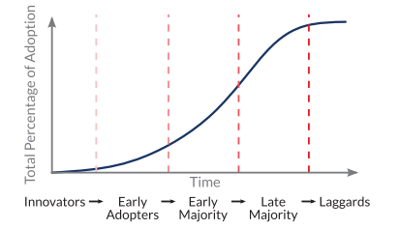
Literature Review (Continued)
Diffusion of Innovation Theory
According to Call and Herber (2022) the lenses of Diffusion of Innovation Theory can be leveraged to explain the variations present in the adoption rate and breadth of innovations.
The larger hotel chains in comparison to them have implemented the smart technologies due to the presence of corporate mandates and shareholder pressure and therefore can be considered early adopters.
Notes:
The practices of integrating technology to attain sustainability and comfort within the tourism sector can be considered innovations. These are in response to the changing societal values and regulatory pressures. As per Khatter et al. (2019) the hotels irrespective of their size focussed on waste management, tackle the environmental issue of significant waste generated by the hospitality industry. Further, most of the hotels demonstrated their efforts to reduce human interaction by implementing both humanoid and non-humanoid robots. However, Khatter et al. (2019) found that the Smaller, independent hotels acted as the laggards who failed to provide information on sustainability and other aspects on their websites, potentially due to limited resources and expertise.

Slide 8
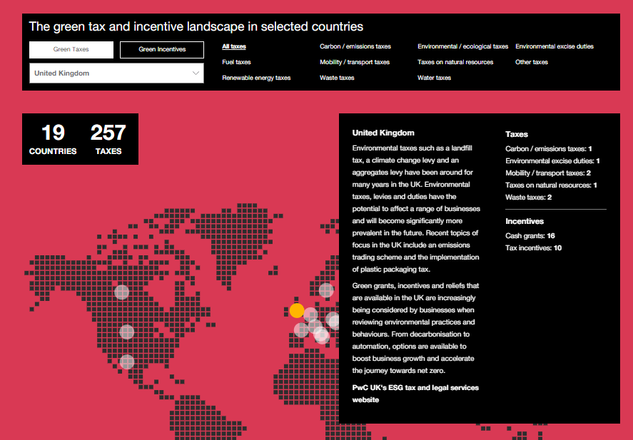
Application to the Hotel and Hospitality Sector
The government's regulations and incentives regarding digitalisation can have significant positive outcomes for the tourism industry.
For example, Green taxes, green cash grants and green tax incentives are proliferating within the industry as governments look to attain their environmental goals (PWC, 2024).
Notes:
In the UK there are a total of 16 cash grants and 10 tax incentives, which are driving the adoption of green technologies in tourism positively (PWC, 2024). The offerings and marketing strategies of the hotels have been influenced by Shifts in consumer preferences like growing preference for personalised experiences. For instance, 71% of the people in the UK have demonstrated their preference for hotels which offer technology to minimise contact with the staff (Oracle, 2022). The industry has been further disrupted by the emergence of technologies like online booking platforms, mobile apps, social media and Artificial intelligence. Businesses, with the integration of such technologies, have been able to reduce costs. The provision of the Environment Act 2021 has positively impacted the business landscape as the hotels have been required to implement technologies in order to adhere to this legal framework.

Slide 9
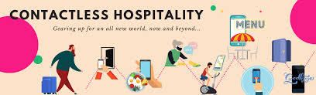
Application to the Hotel and Hospitality Sector (Continued)
Analysis of the impact through theoretical Lenses
As stakeholder theory suggests that stakeholders of a company have the potential to contribute to the attainment of organisational goals, addressing stakeholders' needs can be vital in this context (Khatter, 2023).
In this case, considering that 71% of people have preferred contactless services, offering contactless services through online booking platforms, kiosks and more has been beneficial for organisations (Oracle, 2022).
Notes:
However, the presence of high interest and corporate tax rates have affected the borrowing costs for hotels (taken from assignment 1). Consequently, the businesses have lost their ability to invest in renovations, expansions, or new properties. Moreover, compliance with various regulations like the Data Protection Act has become more difficult for businesses, as the cases of cyber-attacks amplified over the years with digitalisation.
Analysis of the impact through theoretical Lenses
On the other hand, diffusion of innovation theory demonstrates the way innovation is adapted and various types of people in terms of adopting these technologies. As Khatter et al. (2019) mentioned smaller enterprises are laggards in this context as they lack the required money. In this regard, high corporate tax and such can further affect their technological integration. However, governmental policies can be favourable in influencing this choice of organisations.

Slide 10
Application to the Hotel and Hospitality Sector (Continued)
Technology | Examples | Positive impact | Negative impact
Online Booking Platforms | Booking.com, Expedia, and Airbnb | Increased reach and customer acquisition Improved revenue management and pricing flexibility automate payment processing, enhance cash flow and debt elimination (Hajji, 2023) | Dependence on third-party platforms Commission fees charged by booking platforms
Property Management Systems (PMS) | Opera, Mews, and Hotelier | Centralised management of reservations, guest information, and operations Improved efficiency and reduced errors Increased resident satisfaction (McCarthy, 2024) | High initial investment costs The learning curve for staff
Notes:
Mobile Apps
Marriott Bonvoy, Hilton Honors, and Accor ALL
Personalised guest experiences
Seamless mobile check-in and check-out
Provides the guest with complete control of room and location smart features (Haji, 2023)
Dependence on guests having smartphones
Potential for app glitches or compatibility issues
Self-Service Technology
Kiosks for check-in, ordering food, and payment
Reduced wait times for guests
Increased operational efficiency
Potential for technical difficulties or user errors
Loss of personal interaction with staff

Slide 11

Evaluate Future Policy and Management Options
Prioritise Technology Investment: Businesses are required to allocate sufficient resources so that investments in cutting-edge technologies become feasible.
Focusing on Data Protection technology for cybersecurity: It is necessary for businesses to take adequate and immediate measures to protect the valuable insights and information of their guests and their businesses as well.
Notes:
By utilising the above research findings, businesses from the tourism and hospitality sector can be offered the following recommendations to leverage digital transformation effectively:
Prioritise Technology Investment:
Additionally, considering the sustainability preferences of customers, investing in sustainable technologies can ensure enhanced commitment to environmental protection. Hence, along with enhancing operational efficiency, it will appeal to all customers.
Focusing on Data Protection technology for cybersecurity:
Implementing a robust cybersecurity measure will enable companies to offer high-end experiences to customers while garnering their trust and loyalty.

Slide 12

Evaluate Future Policy and Management Options
(Continued)
Enhancing employment policies: It will be in favour of businesses to modify their employment policies to ensure a balance between their human workforce and technological adoption.
Offering Feedback Opportunities to Guests: To enhance the effectiveness of digital technologies, it will be beneficial for organisations to offer feedback mechanisms where customers can provide their valuable inputs.
Notes:
Enhancing employment policies:
The policy can also include mandatory training for employees regarding the enhancement of their competencies in handling advanced technologies.
Offering Feedback Opportunities to Guests:
Through this, organisations can take the required measures to improve areas of lack and make the service more enhanced.

Slide 13
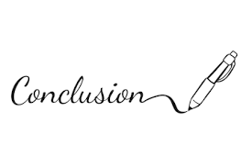
Conclusion
Customer demands for personalised services, contactless services and more and the uncertain business world have driven digital transformation in the hospitality sector.
Based on the above analysis, hospitality businesses have been utilising advanced technologies such as AI, robotics, contactless technologies and more to ensure higher operational efficiency and seamless customer services.
Notes:
Moreover, the popularisation of online booking platforms, service robots, mobile applications and more has made businesses more inclined to leverage these technologies to increase sales and performance. However, a number of challenges such as data breach issues, high corporate tax rates and more can affect this transformation. Therefore, enhancing employment policies, offering feedback mechanisms, investing in data security and more have been recommended.

Slide 14
Reference List
Bhuiyan, F., Rana, T., Baird, K. and Munir, R. (2023) Strategic outcome of competitive advantage from corporate sustainability practices: Institutional theory perspective from an emerging economy. Business Strategy and the Environment, 32(7), pp.4217-4243.
Call, D.R. and Herber, D.R. (2022) Applicability of the diffusion of innovation theory to accelerate model‐based systems engineering adoption. Systems Engineering, 25(6), pp.574-583.
Hajji, J. (2023) Exploring Online Booking And Mobile Apps For Hotel Management In The Digital Age. Available at: https://www.forbes.com/councils/forbesbusinesscouncil/2023/03/07/exploring-online-booking-and-mobile-apps-for-hotel-management-in-the-digital-age/#:~:text=Online%20bookings%20automate%20payment%20processing,is%20busy%2C%20absent%20or%20asleep.(Accessed: 15 October 2024).
Khatter, A. (2023) Challenges and solutions for environmental sustainability in the hospitality sector. Sustainability, 15(15), p.11491.
Notes:
Khatter, A., McGrath, M., Pyke, J., White, L. and Lockstone-Binney, L. (2019) Analysis of hotels’ environmentally sustainable policies and practices: Sustainability and corporate social responsibility in hospitality and tourism. International Journal of Contemporary Hospitality Management, 31(6), pp.2394-2410.
Langrafe, T.D.F., Barakat, S.R., Stocker, F. and Boaventura, J.M.G. (2020) A stakeholder theory approach to creating value in higher education institutions. The Bottom Line, 33(4), pp.297-313.
Lubis, N.W. (2022) Resource based view (RBV) in improving company strategic capacity. Research Horizon, 2(6), pp.587-596.
McCarthy, D.H. (2024) 4 Core Advantages Of Implementing Technology For Property Management. Available at: https://www.forbes.com/councils/forbesbusinesscouncil/2024/04/03/4-core-advantages-of-implementing-technology-for-property-management/.(Accessed: 15 October 2024).
Oracle (2022) UK Travellers Want High-Tech, Low-Touch Hotel Stays, New Oracle Survey Shows. Available at: https://www.oracle.com/uk/news/announcement/oracle-hospitality-in-2025-consumer-research-study-2022-06-01/#:~:text=71%25%20agree%20that%20they're,their%20phone%20or%20a%20chatbot. (Accessed: 15 October 2024).
Perkin, N. and Abraham, P. (2021) Building the agile business through digital transformation. Kogan Page Publishers.
PWC (2024) Green Taxes and Incentives Tracker. Available at: https://www.pwc.com/gx/en/services/tax/green-tax-and-incentives-tracker.html s(Accessed: 15 October 2024).
Soler, M. (2024) Technology in Hospitality, Evolution, Innovation and Guests. Available at: https://www.hospitalitynet.org/opinion/4102024.html (Accessed: 15 October 2024).
Statista (2024) Revenue share of sales channels of the travel and tourism market worldwide from 2019 to 2029. Available at: https://www.statista.com/forecasts/1239068/sales-channels-travel-tourism-worldwide (Accessed: 15 October 2024).
Statista (2024) Share of visitor attractions that used digital communication channels in England from 2020 to 2023, by type. Available at: https://www.statista.com/statistics/1271503/visitor-attractions-digital-communication-channels-england-by-type/ (Accessed: 15 October 2024).

Slide 15


