Slide 1
THE ROLE AND IMPORTANCE OF QUALITY SERVICE, HOSPITALITY AND GUEST SERVICES IN THE HOSPITALITY INDUSTRY BASED ON MOXY HOTELS
Student’s Name: Iuliana Gabriela Vasile
Student number: 2022387
Lecturer: Kathryn Flynn
Module:Hospitality and Guest Services (BMIH4003)
Date:27/01/2023

Slide 2
Contents Table
  Introduction
  Moxy Hotel’s Main Consumers
  The Nature, Scope, And Role Of The Guest Services And Facilities Provided To Guests By Moxy Hotel
  The Need To Consider The Role And Function Of Guest Services In General
  The Importance Of Hospitality And How Hotels Meet/Exceed Guest Expectations
  Conclusion
  Bibliography

Slide 3
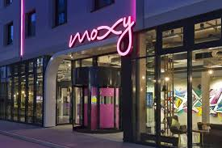
Introduction
Quality service, hospitality, and guest services are essential in ensuring that guests have a positive experience (Morrison, 2022).
Moxy Hotels which is a leading multinational brand of Marriott International, is keen on offering adequate quality service, hospitality, and guest services to its guests (Moxy Hotels, 2023).
Outlook picture of Moxy Hotels. Source: Queer in the World, 2023.
Notes:
Notably, quality service involves providing guests with attentive, friendly, and efficient service (Morrison, 2022).
Hospitality refers to the overall experience that guests have, including the atmosphere and ambiance of the establishment.
Guest services include a wide range of services and amenities that guests may need or want, such as concierge services, room service, and transportation arrangements (Morrison, 2022).
Moxy Hotels offers a unique experience to its guests through a variety of services and amenities tailored to the needs of the millennial traveller. For example, the hotels offer free Wi-Fi, which is a must-have for many travellers. Additionally, Moxy Hotels have self-check-in kiosks, which allows guests to check-in and check-out quickly and easily without having to wait in line, and also guests can check-out through a mobile application, which is very convenient (Moxy Hotels, 2023).

Slide 4
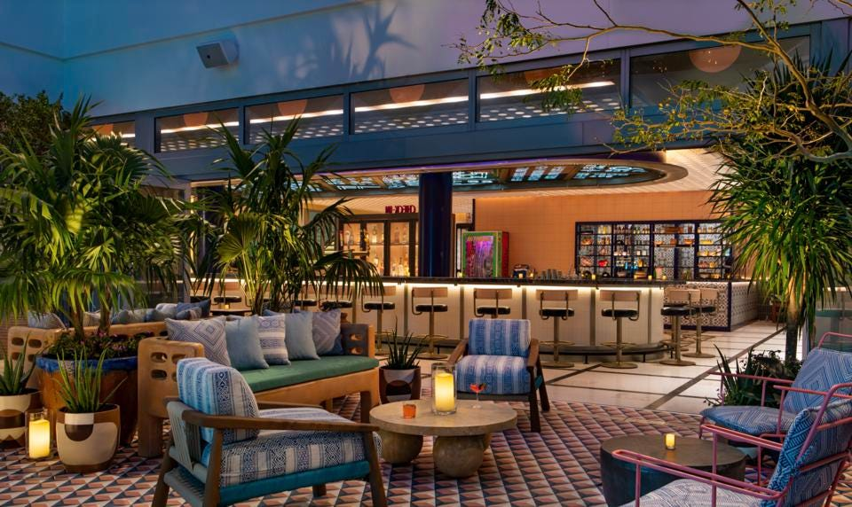
Moxy Hotel’s Main Consumers
Moxy Hotels tends to be more focused on value, convenience, and social atmosphere that mostly attract:
Young adults and millennials (Williams, 2022).
Solo travelers and backpackers (Moxy Hotels, 2023).
Groups of friends and other social groups (Moxy Hotels, 2023).
Business travelers (Moxy Hotels, 2023).
A glimpse of Maxy Hotels facility for guests. Source: Tell, 2021.
Notes:
Young adults and millennials include those looking for an affordable, yet stylish and trendy place to stay while on vacation or business travel, the hotels are designed to appeal to them with modern and stylish guest rooms, a vibrant social atmosphere and a variety of services and amenities tailored to the needs of the millennial traveller, such as free Wi-Fi (Williams, 2022).
Solo travellers and backpackers are those looking for a convenient and affordable place to stay and enjoy budget-friendly options that still provide all the necessary amenities for a comfortable and convenient stay. For instance, the hotels provide free Wi-Fi, which allows guests to stay connected with friends and family. The hotels also have a lively and social atmosphere, which can be appealing to solo travellers looking for a fun and social experience (Moxy Hotels, 2023)..
Groups of friends and other social groups are those who come in teams, looking for a fun and lively atmosphere. Hotels such as Moxy Hotel Berlin Ostbahnhof in Germany offers a variety of communal spaces, such as a lounge area and a terrace, where guests can socialise and enjoy the city views (Moxy Hotels, 2023).
Business travellers are those looking for necessary amenities to fit their business engagements within. Some of the facilities offered for this class include free high-speed Wi-Fi, meeting and conference facilities like in the Moxy Hotel Milan Lotto in Italy, which has a meeting room that can accommodate up to 25 people (Moxy Hotels, 2023).

Slide 5
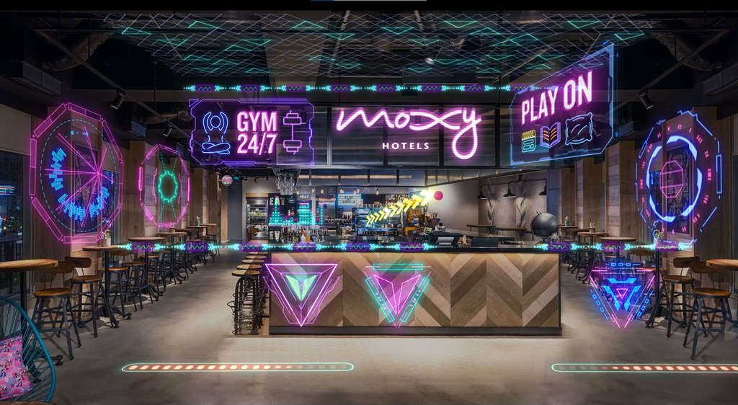
The Nature, Scope, And Role Of The Guest Services And Facilities Provided To Guests By Moxy Hotel
These guest services and facilities include:
Room amenities,
Social spaces,
Food and Beverage,
Fitness and wellness (Moxy Hotels, 2023).
Check-in and check-out (Williams, 2022)
Additional support services (Moxy Hotels, 2023).
A picture showing availability of GYM and play services at Moxy Hotels. Source: Marriott, 2022.
Notes:
The guest services and facilities include:
Room amenities: Moxy Hotels offer comfortable, stylish and well-designed guest rooms, with free Wi-Fi, flat-screen TVs, and private toilets (Moxy Hotels, 2023).
Social spaces: Moxy Hotels have a strong focus on social spaces, such as lounges, bars, and common areas, where guests can relax and socialise with other travellers (Moxy Hotels, 2023).
Food and Beverage: Moxy Hotels offer on-site restaurants and bars, which serve a variety of food and drinks, including local specialities and craft beers (Moxy Hotels, 2023).
Fitness and wellness: Moxy Hotels offer fitness centres, sauna or other wellness facilities for guests to use during their stay (Moxy Hotels, 2023).
Check-in and check-out: Moxy Hotels offer self-check-in kiosks, and check-out can also be done through a mobile application, making it convenient for guests (Williams, 2022).
Additional support services: Moxy Hotels also offer additional services such as laundry, valet parking, concierge service, and transportation arrangements to help make guests' stay as comfortable and convenient as possible (Moxy Hotels, 2023).

Slide 6
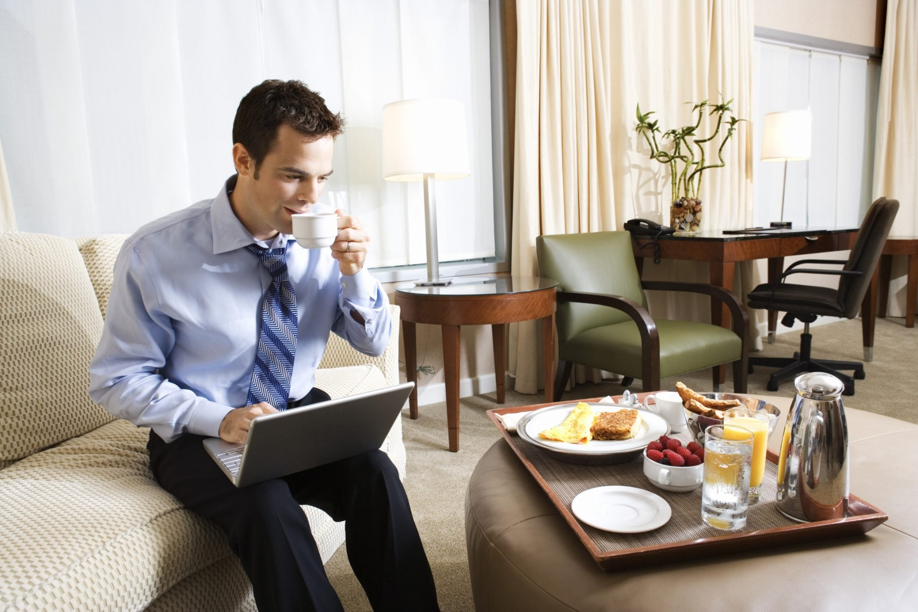
The Need to Consider the Role and Function of Guest Services in General
Reasons why it is important to consider the role and function of guest services:
Customer satisfaction (Juanamasta et al., 2019).
Competitive advantage (Sheth, Jain, and Ambika, 2020).
Brand reputation.
Employee engagement (Sheth, Jain, and Ambika, 2020).
An impression of guest services at a hotel. Source: Google pictures
Notes:
Reason for a consideration of the role and function of guest services:
Customer satisfaction: By ensuring that guests are satisfied with their stay, guest services can increase customer satisfaction and loyalty, which can ultimately lead to increased revenue and long-term success for the business (Juanamasta et al., 2019).
Competitive advantage: offering of unique and superior services can make an establishment can attract and retain customers who are looking for a specific type of experience (Sheth, Jain, and Ambika, 2020).
Brand reputation: Positive experiences with guest services can lead to positive reviews and word-of-mouth recommendations, which can help to attract new customers.
Employee engagement: When employees feel that their work is meaningful and that they are making a positive impact on guests' experiences, they are more likely to be engaged and motivated in their work (Sheth, Jain, and Ambika, 2020).

Slide 7
The Importance of Hospitality and How Hotels Meet/Exceed Guest Expectations
Importance of hospitality:
Creates a positive and memorable experience for guests.
Leads to increased customer satisfaction and loyalty (Karim and Rabiul, 2022).
Helps attract new customers (Chang and Lin, 2022).
Meeting and exceeding guest expectations may entail:
Understanding and tailoring hotel services and amenities to meet customer needs (Kabadayi et al., 2019).
Providing excellent customer service.
Offering a wide range of services and amenities (Torres and Sipe, 2020).
Notes:
Hospitality is an aspect that encompasses the atmosphere and ambiance of the hotel, as well as the level of service and amenities provided (Chang and Lin, 2022).
Hospitality helps to:
A hotel that goes above and beyond to personalise the guest experience, such as by sending a personalised welcome note to guests in their room or offering complimentary champagne and chocolates, can create a memorable experience that guests will remember long after they've checked out (Chang and Lin, 2022).
In terms of increased customer satisfaction and loyalty, a hotel that prioritises hospitality can see a guest who has a pleasant and enjoyable stay at a hotel return for future stays and recommend the hotel to others (Karim and Rabiul, 2022)..
A strong focus on hospitality can help a hotel stand out and attract new customers. For example, a hotel that is known for its exceptional customer service, personalised touches, and comfortable accommodations can differentiate itself from other hotels in the area and attract guests looking for a higher level of hospitality (Chang and Lin, 2022).
Hotels meet/exceed guests expectations by:
Ensuring that they understand what the customers need, through research and providing just that, thereby enticing them to continue coming (Hu et al., 2019) and (Kabadayi et al., 2019).
Providing excellent customer service where the attendants pay attention to each customer and serve them with friendliness and efficiency.
Availing a wide range of services and amenities is also a way that customers meet or exceed the expectations of the customers because it enables take care of almost everything that the customers may need in such a facility (Torres and Sipe, 2020).

Slide 8
Conclusion
Quality service, hospitality and guest services are essential for hotels to meet their operational goals.
Moxy Hotels emphasises on quality service, hospitality, and guest services.
To meet and exceed guest expectations, hotels need to provide what customers need.
Hospitality encompasses the overall experience that guests have when staying at an establishment.
Notes:
A hotel that offers a high standard of service, hospitality, and guest services such as providing a personalized check-in experience and accommodating guests with a warm welcome, is more likely to have guests return and recommend the hotel to others and also earn adequate differentiation from other players.
Moxy Hotels observes quality service, hospitality, and guest services by offering a unique experience to its guests, with a focus on design, style, and service and provides amenities like self-check-in kiosks, free Wi-Fi, and modern and stylish guest rooms
Understanding the needs and preferences of their guests is paramount to meeting or exceeding their expectations. Some of the ways to meeting such needs include provision of excellent customer service, offering a wide range of services and amenities and maintaining a high standard of cleanliness and upkeep.
To ensure hospitality, which includes the atmosphere and ambiance of the hotel, as well as the level of service and amenities provided, a hotel should provide a warm and welcoming atmosphere, comfortable furnishings, and a high standard of cleanliness among other aspects.

Slide 9
Bibliography
Chang, T.Y. and Lin, Y.C., 2022. The effects of atmosphere on perceived values and customer satisfaction toward the theme hotel: the moderating role of green practice perception. Sustainability, 14(15), p.9153.
Hu, F., Teichert, T., Liu, Y., Li, H. and Gundyreva, E., 2019. Evolving customer expectations of hospitality services: differences in attribute effects on satisfaction and Re-Patronage. Tourism Management, 74, pp.345-357.
Juanamasta, I.G., Wati, N.M.N., Hendrawati, E., Wahyuni, W., Pramudianti, M., Wisnujati, N.S., Setiawati, A.P., Susetyorini, S., Elan, U., Rusdiyanto, R. and Astanto, D., 2019. The role of customer service through customer relationship management (Crm) to increase customer loyalty and good image. International Journal of Scientific and Technology Research, 8(10), pp.2004-2007.
Kabadayi, S., Ali, F., Choi, H., Joosten, H. and Lu, C., 2019. Smart service experience in hospitality and tourism services: a conceptualization and future research agenda. Journal of Service Management, 30(3), pp.326-348.
Karim, R.A. and Rabiul, M.K., 2022. The relationships of corporate sustainability, customer loyalty, and word of mouth: the mediating role of corporate image and customer satisfaction. Journal of Quality Assurance in Hospitality & Tourism, 0(00), pp.1-21.
Marriott, 2022. Let’s play! Augmented reality takes off at Moxy hotels with the “Moxy Universe, Play Beyond” Asia Pacific Campaign. [Online] Available at: <https://www.hospitalitynet.org/news/4111475.html> [Accessed 27 January 2023].
Morrison, A. M., 2022. Hospitality and travel marketing. Taylor & Francis.
Moxy Hotels, 2023. Ready for anything .[Online] Available at: <https://moxy-hotels.marriott.com/> [Accessed 27 January 2023].
Queer in the World, 2023. Why we love the millennial-focused Moxy Hotel Chain! [Online] Available at: <https://queerintheworld.com/moxy-hotel/> [Accessed 27 January 2023].
Sheth, J., Jain, V. and Ambika, A., 2020. Repositioning the customer support services: the next frontier of competitive advantage. European Journal of Marketing, 54(7), pp. 1787-1804.
Tell, C. (2021) Miami’s new moxy hotel is putting South Beach back on the map. [Online] Available at: <https://www.forbes.com/sites/carolinetell/2021/12/07/miamis-new-moxy-hotel-is-putting-south-beach-back-on-the-map/?sh=33aa569f5821> [Accessed 27 January 2023].
Torres, A.M. and Sipe, M.D., 2020. Hospitality service innovation: kleeding an outstanding guest experience. Journal of Next-generation Convergence Information Services Technology, 9(2), pp.149-162.
Williams, R. 2022. Marriott’s Moxy Hotels gamifies hospitality with AR experience. https://www.marketingdive.com/news/marriott-moxy-hotels-gamifies-hospitality-ar-mobile/627219/> [Accessed 27 January 2023].

