Slide 1
Practical Photovoltaic Issues
By
Andrew Thorn

Slide 2
PV Efficiencies
Crystalline PV works a little better on the red side of the visible spectrum
Thin film PV deals better with blue light than crystalline PV
The blue side of spectrum is more prevalent on cloudy days
Additionally, thin-film does not react as much to losses of voltage when it heats up

Slide 3
PV Efficiencies
When the sun gets lower in the sky, there will be more air filtering the light between the sun and us
Filtering is why, when the sun is lower, we are not as much affected by it.
This filtering effect is called air mass or AM

Slide 4
Standard Test Conditions
1000 W per square meter
25°C
1.5 AM

Slide 5
IV Curves
An IV curve test on PV in the field can often tell the health of the circuit being tested
If there are shading problems, broken diodes or other malfunctioning parts of the module an IV curve is an effective way to find the problem

Slide 6
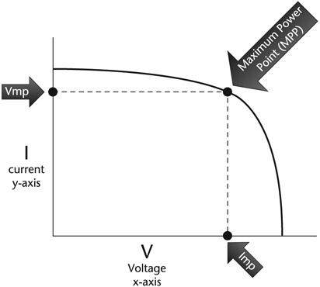
IV Curves

Slide 7
IV Curves
V_{OC} stands for open circuit voltage, which means turning off with electricity
At V_{OC} our system is turned off, since we cannot pass current when there is no connection
An IV curve tester will essentially lower the resistance to no resistance from infinite resistance to no resistance and measure all of the parameters in between

Slide 8
IV Curves
At I_{SC}, there is no voltage and therefore no power or energy
There are many places in between VO_{C} and I_{SC} where we can make power, energy and cash but there is one spot where we can make the most called the sweet spot

Slide 9
IV Curves
We call the sweet spot, where the product of voltage and current is the most power, the maximum power (MPP)
All grid-tied inverters have maximum power point tracking (MPPT)
Many charge controllers operate at the MPP with MPPT

Slide 10
Bypass Diodes
If there is a shadow over one or all of the cells in a group, then the bypass diode will take the current past the shaded group of cells, keeping the current going through the rest of the group of cells
When the module is operating, however, perhaps at V_{mp} then there will be very significant decrease in voltage
PV gets close to full voltage in low light, but not much current

Slide 11
Bypass Diodes
If there is a shadow covering a row of cells on the long edge of the module, it will take out one-third of the modules operating voltage
If that same shadow was taking a row of cells along the short edge of the module, all three of the bypass diodes in the module would kick in and there would not be a power contribution from the module
Bypass diodes will sacrifice voltage for current. Without current, there will be no power

Slide 12
Temperatures and PV
When it gets cold, PV voltage goes up; when the solar cells get hot, PV voltage goes down
Since PV is most commonly tested at 25°C, we need to know what happens when the temperatures change and we can do this by using PV module temperature coefficients or correction factors

Slide 13
Temperatures and PV
Number to use for temperature coefficients are:
Temperature coefficients VO_{C} ranges -0.3%/°C to -0.35% /°C
Temperature coefficients V_{mp} ranges -0.45%/°C to 0.5%/°C
Temperature coefficients power ranges -0.45%/°C to 0.5%/°C
The lower the coefficient, the better

Slide 14
String Sizing Exercises Data
Low design temperature -6°C
Temperature coefficient VO_{C} 0.331/°C
Open circuit voltage (VO_{C}) 37 V
Inverter maximum input voltage 600 V

Slide 15
Steps in String Sizing Exercises
Step 1: Calculate Delta T
Step 2: Multiply Delta T by temperature coefficient of V_{OC}
Step 3: Turn the percentage into a decimal
Step 4: Turn the decimal into a temperature correction factor
Step 5: Multiply the temperature correction factor by the V_{OC}
Step 6: Divide Inverter Maximum Input Voltage by cold temperature V_{OC}

Slide 16
String Sizing Examples
Low design temperature -6°C
Temperature coefficient VO_{C} 0.33%/°C
Open circuit voltage (VO_{C}) 37 V
Inverter maximum input voltage 600 V

Slide 17
String Sizing Example
Step 1: Calculate Delta T
-6 - -25 = -31°C
Step 2: Multiply Delta T by temperature coefficient of V_{OC}
-31°C x -0.33%/°C = 10.23% increase in V_{OC}
Step 3: Turn Percentage into a decimal
10.23 / 100 = 0.1023

Slide 18
String Sizing Example
Step 4: Turn decimal into correction factor
1 + Decimal value
= 1 + 0.1023
= 1.1023
Step 5: Multiply temperature coefficient factor by the V_{OC} 1.1023 x 37 V = 40.8 V_{OC} at -6°
Step 6: Divide Inverter Maximum Input Voltage by cold temperature V_{OC}
600 V/40.8 V_{OC} = 14.7
So modules in series

Slide 19
Question
Using the data below calculate the number of modules required
Low temperature -10°C
Temperature coefficient V_{OC} -0.3%/°C
V_{OC} 44 V
Inverter max input voltage 550 V

Slide 20
Question
Using the data below calculate the number of modules required
Low temperature -10°C
Temperature coefficient V_{OC} -0.31%/°C
V_{OC} 36 V
Inverter max input voltage 600 V

Slide 21
Hot Temperature String Sizing
When it gets hot, your PV voltage will go down, and when the voltage is too low, your inverter will underperform or go to sleep
When doing cold temperature calculations you rounded down at the end so that you do not go over voltage
With hot temperature string sizing you are going to round up so that your voltage does not get too low.

Slide 22
Hot Temperature String Sizing
If V_{mp} is also greater than the temperature coefficient for V_{OC} and we can use the temperature coefficient of power if the temperature coefficient of V_{mp} is not available
We need to determine that the solar cell temperature is going to be considered hotter than the ambient temperature

Slide 23
Data Required for Hot Temperature String Sizing
Hot PV cell temperature
Temperature coefficient Vmp
Vmp
Inverter low MPPT voltage

Slide 24
Example (1)
High cell temperature 60°C
Temperature coefficient V_{mp} -0.48%/°C
Vmp 30 V
Inverter low MPPT voltage 200 V
60°C - 25°C = 35°C
35°C x 0.0048 = 0.168 (16.8% lost of our voltage)
1 – 0.168 = 0.832 (Keep 83.28% Vmp)
0.832 x 30 V = 24.96 V
200 V/24.96 V = 8.01 (8 minimum)

Slide 25
Example (2)
High ambient temperature 33°C
Temperature coefficient V_{mp} -0.44%/°C
Vmp 31 V
Inverter low MPPT voltage 350 V
(33°C + 30°C)- 25°C = 38°C
38°C x 0.0044 = 0.1672 (16.72% lost)
1 – 0.1672 = 0.8328 (83.28% kept)
0.8328 x 31 V = 25.8 V
350 V/25.8 V = 13.6 or 14 minimum

Slide 26
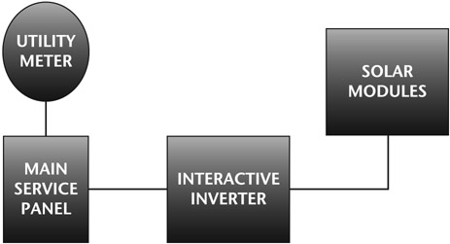
Interactive PV System with Load side Connection

Slide 27
Utility Connections
Supply side (line side) connection
Load side connection

Slide 28
Supply side/load side
When referring to load on line side connections is what is meant and is referring to whether it is the load or line side of the main breaker
Line side is always the utility and load is always the solar side

Slide 29
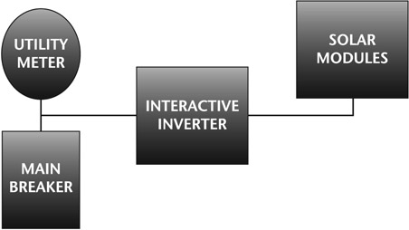
Interactive PV System with Supply Side Connection

Slide 30
Supply/load side connection
A supply side connection is usually more expensive, but we can use a larger inverter than with a load-side connection
With a supply side connection the main breaker will protect everything on the load side

Slide 31
PV System
The typical interactive inverter will get its input from the PV modules and all of the conductors on the DC side of this inverter will be sized based on doing different calculations and corrections based on the short circuit current rating of the PV module
PV has a short circuit current that is about 7% greater than current at maximum power (I_{mp}) under STC

Slide 32
PV System
With PV the short circuit current rating is done at STC
At times due to increased irradiance (brightness), which increases current and decreased temperatures, which increase voltage PV will operate above STC ratings

Slide 33
PV System
The circuits on the output side of the interactive inverter are based on the output current rating of the inverter and the voltage of the utility for interactive inverters
When we size wires on the AC output of an inverter, we do not consider anything on the DC side of the inverter

Slide 34
Batteries and Energy Storage
There is the old-style off-grid system, which was a DC coupled and had PV charging batteries through a charge controller
New styles AC coupled system where as interactive (grid tied) inverter works with a battery/charger that can also work backwards and charge the batteries with the power that the interactive inverter is making

Slide 35
Batteries and Energy Storage
A benefit of AC coupling is that it can work using standard interactive inverters
Interactive inverters are most popular and the technology is more mass-produced
Also, the interactive inverters usually have higher voltage PV source circuits, which is good for saving wire costs and going over long distances

Slide 36
Batteries and Energy Storage
Another type of inverter has what is called a secure power supply; this inverter will power a single circuit when the utility is down without batteries
When the sunsets or when your power requirements are more than the system can produce, the secure power supply will shut off

Slide 37
The 120% Rule
States
“When an inverter and the utility are connected on opposite sides of a bushbar, 125% of the inverter current plus the rating of the main breaker cannot exceed 120% of ampacity of the bushbar

Slide 38
The 120% Rule
The reason why we can exceed the bushbar ampacity at all is because if the solar and the main breakers are on opposite sides of the bushbar, then there will not be a case where there will be overcurrents on any spot on the bushbar
If the solar and the main breakers were adjacent to each other, it would be like having a big breaker that is the equivalent of the size of both breakers together

Slide 39
The 120% Rule
If we separate the breakers they will go to loads before the currents will get a chance to add up
Inverter overcurrent protection devices are based on 125% of the inverter current and then rounding up to the next common overcurrent protection device
This way gives us more in some cases, because we are not penalised for rounding up effect

Slide 40
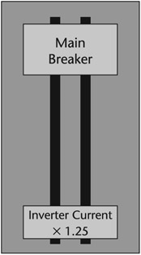
Main Breaker and Solar Breaker on Opposite Sides of Bushbar

Slide 41
The 120% Rule
Equation
120% rule = bushbar x 1.2≥ main breaker + 125%
inverter current
Inverter size derive from 125% inverter current ≤ (bushbar x 1.2) – main breaker
Inverter current ≤ (bushbar x 1.2) –
main breaker/1.25

Slide 42
The 120% Rule
To Solve for inverter power multiply by the AC voltage
Inverter power < (((bushbar x 1.2) – main breaker) /1.25) x 240V

Slide 43
Example
A building has a main breaker that is 200A and the bushbar is 225A. What would be the largest inverter you could connect

Slide 44
Example
Firstly multiply the bushbar by 1.2
225A bushbar x 1.2 = 270A allowance
Then subtract the 270A allowance from 200A main breaker
270A allowance – 200A main breaker = 70A
70A is 125% of inverter current so divide 70A/1.25 to get inverter current
70A/1.25 = 56A inverter current

Slide 45
Example
Assume 240V supply
Volts x amps = watts
240 x 56 = 13,440 watts or 13.44 kW

Slide 46
Example
We have to be sure that we put the inverter breaker on the opposite side of the bushbar from the main breaker
If the main breaker is not on a far end of the bushbar then we cannot apply the 120% rule

