Slide 1
Adidas
Contribution to Sustainability
BMSP4003
Josh Lewis - 1805618

Slide 2


Introduction to Adidas
Founded in 1942 by Adolf Dassler
Company name established from nickname ‘Adi’ and sure same Dassler ‘das’
Strong roots in Germany, operates worldwide
Employs over 57,000 people
Produces over 900million products a year

Slide 3
Sustainability History
1998 - Adidas developed its initial supplier code of conduct now know as the workplace standards.
1998 - Adidas was the first company in its industry to adopt a restricted substances policy prohibiting the use of any chemicals considered to be harmful or toxic
2001 – The company published its first sustainability report. Adidas is the only company in the sporting goods industry which publishes a report annually

Slide 4

2002 - adidas launched its environmental, health & safety guidelines, as well as the guide to best environmental practice. These are comprehensive and detailed standards for suppliers on handling, storage and disposal of chemicals, waste water treatment and effluents
2010 – adidas launched their environmental strategy further proving their commitment to environmental sustainability.

Slide 5
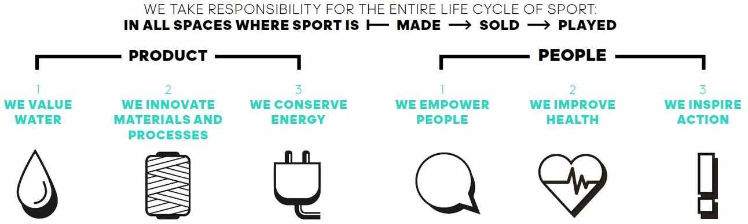

Slide 6
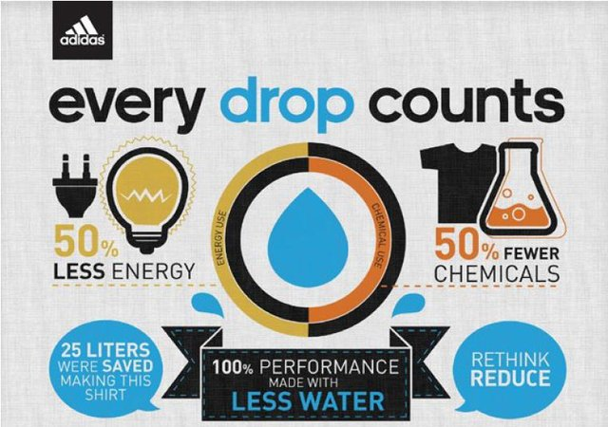
Innovation
“The ultimate goal is to have a product that delivers high performance, but which is also made in a sustainable way.” Kasper Rorsted CEO
Low waste
Dry dye
No dye

Slide 7

2020 Targets
Water:
20% water savings at our strategic suppliers
35% water savings at our apparel material suppliers
35% water savings per employee at our own sites
Further expand the use of waterless technologies for our products

Slide 8
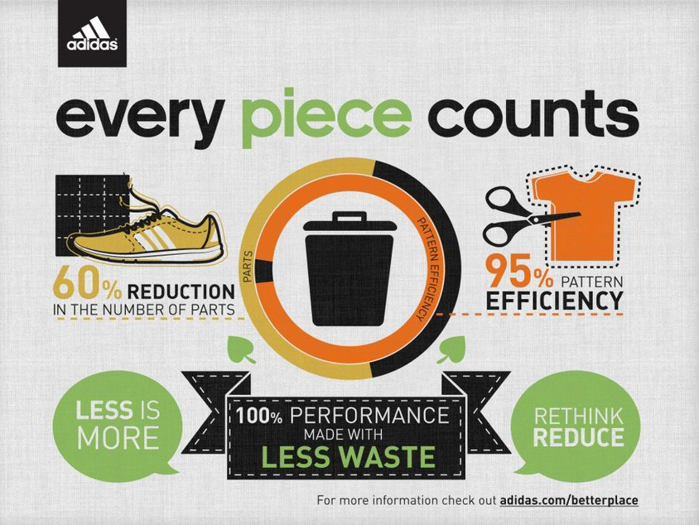
Materials & energy:
20% waste reduction at our strategic suppliers
50% waste diversion for owned operations to minimize landfill
75% paper reduction per employee at our own sites
Replacing conventional cotton, with the aim of achieving 100% sustainable cotton by 2018
20% energy savings at our strategic suppliers

