Slide 1


Advantages and disadvantages of waterfall and V lifecycle
Aisha (CNETS)
Phillip(CNETS)
Daniel (CNETS)

Slide 2
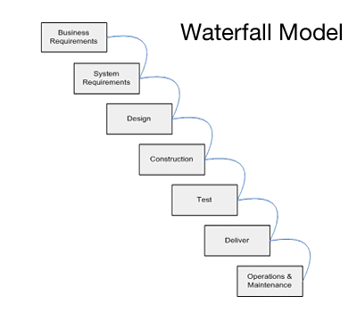
Waterfall systems
The waterfall model in software engineering was originally designed in 1970 by Winston W. Royce.
The waterfall model, also referred to as a linear-sequential model is very easy to use and understand.
In a waterfall model, each phase must be completed fully before the next phase can begin.

Slide 3
The sequential phases in a Waterfall model are: Part 1
Requirement Gathering and analysis: All possible requirements of the system to be developed are captured in this phase and documented in a requirement specification doc.
System Design: The requirement specifications from first phase are studied in this phase and system design is prepared. System Design helps in specifying hardware and system requirements and also helps in defining overall system architecture.
Implementation: With inputs from system design, the system is first developed in small programs called units, which are integrated in the next phase. Each unit is developed and tested for its functionality which is referred to as Unit Testing.
Integration and Testing: All the units developed in the implementation phase are integrated into a system after testing of each unit. Post integration the entire system is tested for any faults and failures.

Slide 4
The sequential phases in a Waterfall model are: Part 2
Deployment of system: Once the functional and non functional testing is done, the product is deployed in the customer environment or released into the market.
Maintenance: There are some issues which come up in the client environment. To fix those issues patches are released. Also to enhance the product some better versions are released. Maintenance is done to deliver these changes in the customer environment.
At the end of each phase, a review takes place to determine if the project is on the right path and whether or not to continue or discard the project.

Slide 5
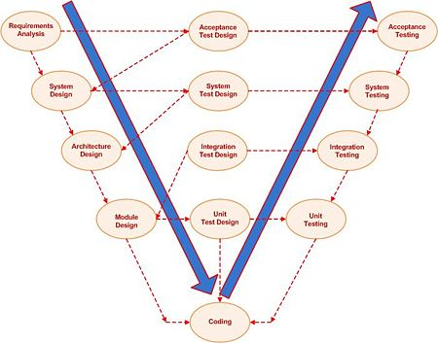
V model Systems
The V model is seen as an extension to the waterfall model without the linear approach to development, rather a V shape model to identify the key tasks involved in implementing an initial idea.
The V model is solely concentrated on project orientated projects not all organizational issues are explanatory when using this model.

Slide 6
The key stages for the V model are as follows: Part 1
Requirements analysis: This is where the project proposal is determined . Brainstorming, and determining what functions are required are explained here, such as the security level, user-friendliness of what the program will be. This is a very basic stage in the development of the finalised product.
System Design: The possibility of a design for a product/program is placed.
Architecture design: Recognises the modules to the initial requirement and the functionality to these modules
Module design: This stage breaks up the units into modules which are then decoded by the programmer

Slide 7
The key stages for the V model are as follows: Part 2
Unit testing: Breaks down the program into feasible units to be tested upon
Integration testing: Tests separate entities against each other and identifies flaws within the proposed project
System testing: Tests the program to see if the requirements met for integration are fulfilled
Acceptance testing: Puts the initial requirements against the product to see if all of the requirements are fulfilled
Release testing: Here is where a decision is made as to whether or not to implement the product for the organisation

Slide 8
Advantages and disadvantages of waterfall model
Advantages
Easy to explain to the user· Structures approach.
Stages and activities are well defined·
Helps to plan and schedule the project.
Verification at each stage ensures early detection of errors/ misunderstanding
Each phase has specific deliverables
Disadvantages
Assumes that the requirements of a system can be frozen·
Very difficult to go back to any stage after it finished.
Little flexibility and adjusting scope is difficult and expensive.
Costly and required more time, in addition to detailed plan

Slide 9
Advantages and disadvantages of V model
Advantages
Simple and easy to use.
Each phase has specific deliverables.
Higher chance of success over the waterfall model due to the development of test plans early on during the life cycle.
Works well for where requirements are easily understood.
Disadvantages
Very inflexible, like the waterfall model.
Little flexibility and adjusting scope is difficult and expensive.
Software is developed during the implementation phase, so no early prototypes of the software are produced.
Model doesn’t provide a clear path for problems found during testing phases.
Costly and required more time, in addition to detailed plan

Slide 10
Similarities between the two models
The sequential models build on the assumption that the problem to be solved can be completely understood and described before a solution is designed.
A design that satisfies all aspects of the problem can be specified before implementation.
All implementation can be done before validation and delivery.
Applicable if experienced developers’ work in a well-known problem domain, with well-known technology and with short development times as for example in software maintenance.

Slide 11
Difference between the two models
Waterfall
V Model
testing activities are carried out after the development activities are over
is a continuous process
the number of defects in the software made using waterfall model are more
the requirements of the user are fixed
changes in the software in waterfall model is a difficult
proves to be a costly affair
testing activities start with the first stage
is a simultaneous process
the number of defects in the software made using V model are less
the requirements of the user are uncertain and keep changing
changes in the software in V model isn't a difficult task
proves to be a non-costly affair

Slide 12
Conclusion
it is clear that each of the models can be used depending on the system they are being developed for.
One can choose either waterfall model or V model taking the software and the user requirements into consideration.
Often, for smaller systems, it is recommended that one use the waterfall model and for the bigger systems use the V model.

