Slide 1
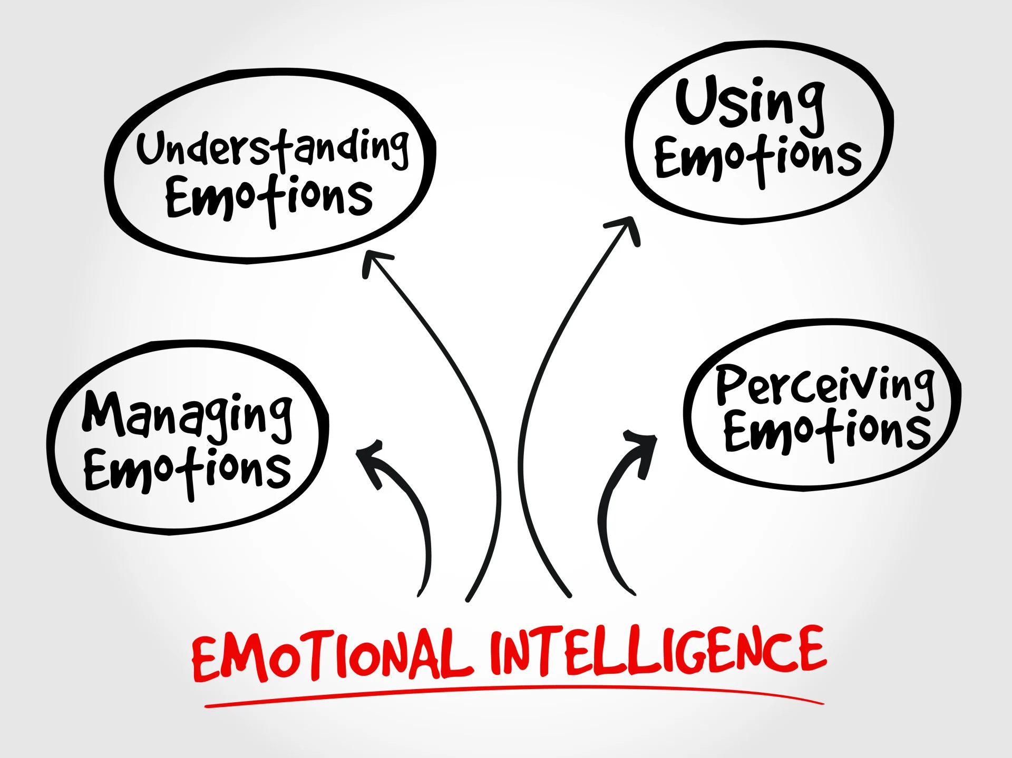

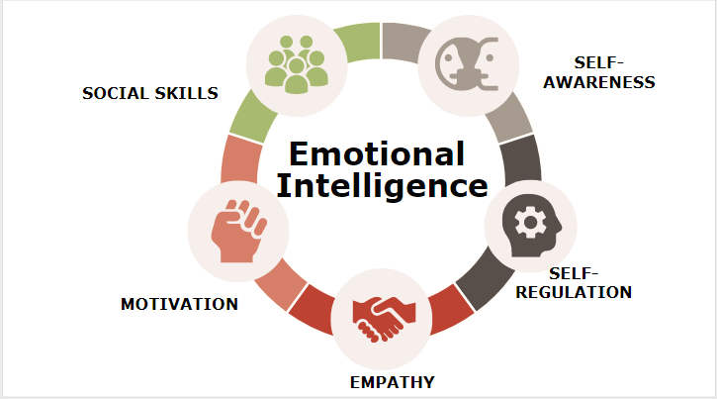
Emotional Intelligence
George Lupșa 2416879 Lecture Name:kazeem Oseni
Introduction
Emotional intelligence (EI) can be defined as the ability to identify, interpret and manage one’s own emotions. It is also the ability to recognise and manipulate the emotional states of other people during interpersonal relationships (Bru-Luna et al., 2021). In the context of academic work in a group, EI emerges as an important factor for cooperation, communication and coping with stress. Teamwork in a university group project can be characterised by a wide range of personalities, degree of commitment and communication styles. This may cause emotional friction and difficulties in coordination. EI can help students to overcome their frustration, constructively process feedback and continue working under ambiguity or disagreement (Penet and Fernandez-Parra, 2023). Models of EI by Goleman, Mayer and Salovey insist on the development of emotional competencies. These also have a direct impact on trust-building, conflict management, and the performance of the group in student teamwork situations. Therefore, EI is not merely a theoretical construct but also the ability to define academic and team performance in advanced academic scenarios in higher education.
Managing Own Emotions
Emotional Awareness and Self-Recognition
Self-regulation is a basic element of emotional intelligence. In studies that require interdisciplinary cooperation with others, stress, deadlines and interpersonal incompatible factors are normal. Emotional awareness means being able to recognise internal conditions of stress, frustration, anxiety or lack of motivation and their effect on behaviour in a group environment (Lumley et al., 2021). Emotional responses are also likely to develop among student teams as a result of the perceived imbalance of the workload or inadequate communication. This can negatively impact participation and decision-making. Following the acquisition of the skill of self-awareness, the students can recognise such emotional reactions early in life. This ability to reflect is vital in ensuring that there is stability of engagement and also to ensure that emotions are not used to derail group productivity.
Strategies for Emotional Regulation in Group Work
Employing strategic plans is essential to positively and expressively constitutes the effective management of feelings. Mindfulness techniques may help students to stay observant in the present, decrease impulsive responses when conflicts or tense conversations occur (Mayo Clinic, 2026). Post-group reflections enable people to examine their emotional stimuli and strategies other reactions against future interactions. Additionally, providing time before responding gives one cognitive room to evaluate the intensity of emotions in a rational manner. Other practices that help in dealing with stress include structured planning, time management and prioritisation of tasks. All of these help in the management of emotional stress by minimising the cumulative pressure. In group settings, they assist in sustaining professionalism and preventing any emotional reactions that interfere with group development and communication.
Impact on Group Effectiveness and Performance
The quality of group interaction is greatly enhanced when students learn to handle their feelings properly. Emotional stability improves decision-making because it enables individuals to concentrate on the purpose of the task (Awais et al., 2025). It also lessens the chances of the conflict since when the emotional control is high, the individuals involved are more likely to take the criticism. In addition, maintenance of emotional control is useful in sustained motivation. It is especially so when there is an element of academic strain or an imbalance of group development. Emotional regulation not only leads to an increased well-being of individuals but also to better teamwork, increased productivity and unified team performance.
EI in Teamwork
Understanding emotional intelligence in teamwork
Emotional intelligence has been a major factor in determining the effectiveness of students when they are used in group-based academic activities. It includes the capacity to bring together self-awareness, self-regulation, motivation, empathy and social skills for constructive navigation of the interpersonal dynamics (Frothingham, 2026). These competencies impact group interactions, mitigate responses towards challenges, and affect contributions towards shared goals in a teamwork setting. Higher emotional intelligence among students is associated with a greater likelihood of identifying emotional triggers in the collaboration process and adapting their behaviour in a way that keeps the process constructive. According to Goleman, cognitive ability cannot be viewed as enough of a skill to work effectively in a team (Ikart, 2023). It is because emotional regulation and interpersonal sensitivity influence group cohesiveness and performance.
Application of EI in managing teamwork challenges
In a group where certain aspects overlap with emotions, emotional intelligence plays a crucial role in negotiating issues like conflicting opinions, uneven distribution of work, and time pressure. Self-awareness helps the students know when their contribution is being frustrated. In contrast, self-regulation will help with the responses being controlled as opposed to an impulsive reaction (Mitsea et al., 2023). Motivation helps in ensuring regular involvement despite slow progress within a group. Empathy enables one to comprehend the attitudes and stresses of other members of the team to develop a better understanding (Drigas et al., 2023). This lowers the chances of misunderstanding and the worsening of the conflict. Social skills also help to make communication, negotiation, and coordination of tasks easier. Application of such competencies results in a more stable group with great academic results.
Generational differences and team interaction
Another dimension that impacts teamwork is the difference in communication and behavioural expectations among the generations. The students belonging to various generations can be characterised by dissimilarities in their inclination towards digital communication, feedback type, and use of emotion. Individuals can be responsive directly and immediately to others, and some can take a more reflective approach to communication. Such differences may unconsciously cause misunderstandings or an attitude of detachment in group activities. Emotional intelligence can serve to bridge these gaps by promoting flexible communication and decreasing judgmental explanations of behaviour (El Tarhouny et al., 2025). Through the use of empathy and social awareness, students will be able to view the differences between the generations. It helps in enhancing collaboration and understanding between the students in academic teams.
Figure 1: Emotional intelligence
(Source: Frothingham, 2026)
Conclusion
Emotional intelligence can be considered one of the crucial factors of successful teamwork in academic group work. It will determine the way in which students learn to deal with feelings, communicate and address human issues. Combining self-awareness, emotional control and empathy supports personal contribution to work and the performance level of the team. Such competencies can minimise conflicts, enhance the quality of communication, and add to the group cohesion. Sensitivity to intergenerational differences also helps in adaptive interaction in diverse teams. The EI building therefore comes with enhanced academic performance and with requisite employability skills that translate into successful teamwork.
Understanding Others’ Emotions
Empathy as a Core Component of Team Interaction
The capability to comprehend the emotions of others is a crucial aspect of emotional intelligence. It influences the level of communication and collaboration when working in a group. Empathy helps to distinguish emotional indicators such as voice tone, gestures and patterns of response, which indicate concerns (Daher et al., 2021). At the academic group level, when students are less confident, burdened, or confused, empathetic awareness is needed to foster the psychological safety of the team. EI people also examined the emotions of others regarding their work and the contribution they make. This establishes a more inclusive and supportive workplace.
Behavioural Practices to Strengthen Collaboration
Active listening should be taken into account as it requires complete attention to the words spoken by the people. This will foster a deeper conversation and minimise any chances of miscommunication (Cuncic, 2026). Perspective-taking is additionally conducive to teamwork as it enables people to assess situations in the eyes of a team colleague. It is particularly in the case of conflict or allocation of work. Favourable feedback is also important, as it helps convey concerns with respect and in a solution-based way instead of being critical. On a regular basis, where such behaviours are exercised, the members of the group will be in a better position to feel appreciated and understood.
Method
It includes both scholarly works on emotional intelligence and reflective experiences of student group work. The discussion has been on the theoretical frameworks, including the works of Goleman, Mayer and Salovey. This helps to explain the part that emotional competencies play in teamwork performance. Additionally, it provides an opportunity to understand how the emotional orientation determines communication, interaction, and conflict management among groups. These lessons were strictly connected with the theory to have a harmonious interpretation of practice and concept. The methodology promotes reflective motivation of emotional intelligence in practice within actual classroom collective tasks.
References
Awais, M., Ishaq, H.M. and Gillani, S.I.A., (2025). The Impact of Emotional Intelligence on Rational and Ethical Decision-Making. Scholar Insight Journal, 3(2), pp.105-121.
Bru-Luna, L.M., Martí-Vilar, M., Merino-Soto, C. and Cervera-Santiago, J.L., (2021), December. Emotional intelligence measures: A systematic review. In Healthcare (Vol. 9, No. 12, p. 1696). MDPI.
Cuncic, A. (2026). 7 Active Listening Techniques for Better Communication. [online] Verywell Mind. Available at: https://www.verywellmind.com/what-is-active-listening-3024343 [Accessed 28 Jun. 2026].
Daher, K., Saad, D., Mugellini, E., Lalanne, D. and Abou Khaled, O., (2022). Empathic and empathetic systematic review to standardize the development of reliable and sustainable empathic systems. Sensors, 22(8), p.3046.
Drigas, A., Papoutsi, C. and Skianis, C., (2023). Being an emotionally intelligent leader through the nine-layer model of emotional intelligence—The supporting role of new technologies. Sustainability, 15(10), p.8103.
El Tarhouny, S., Saif, H.A., El Sawaf, Z. and Mansour, T., (2025). Taming the flames: the role of emotional intelligence in controlling moral outrage among medical students. Frontiers in Medicine, 12, p.1702128.
Frothingham, M.B. (2026). Emotional Intelligence: Definition, Components & Examples. [online] Simply Psychology. Available at: https://www.simplypsychology.org/emotional-intelligence.html [Accessed 2 Jul. 2026].
Ikart, E., (2023). Emotional intelligence: Why its matters in change leadership and innovation in the 21st century styles of work. International Journal of Business Innovation, 2(4), p.e34732.
Lumley, M.A., Krohner, S., Marshall, L.M., Kitts, T.C., Schubiner, H. and Yarns, B.C., (2021). Emotional awareness and other emotional processes: Implications for the assessment and treatment of chronic pain. Pain Management, 11(3), pp.325-332.
Mayo Clinic (2026). Can mindfulness exercises help me? [online] Mayo Clinic. Available at: https://www.mayoclinic.org/tests-procedures/meditation/in-depth/mindfulness-exercises/art-20046356 [Accessed 30 Jun. 2026].
Mitsea, E., Drigas, A. and Skianis, C., (2023). Digitally assisted mindfulness in training self-regulation skills for sustainable mental health: a systematic review. Behavioral Sciences, 13(12), p.1008.
Paredes-Saavedra, M., Vallejos, M., Huancahuire-Vega, S., Morales-García, W.C. and Geraldo-Campos, L.A., (2024). Work team effectiveness: Importance of organizational culture, work climate, leadership, creative synergy, and emotional intelligence in university employees. Administrative Sciences, 14(11), p.280.
Penet, J.C. and Fernandez-Parra, M., (2023). Dealing with students’ emotions: Exploring trait EI theory in translator education. The Interpreter and Translator Trainer, 17(3), pp.332-352.
Figure 2: Active listening
(Source: Cuncic, 2026)
Contribution to Team Success and Cohesion
Empathy and emotional comprehension can be highly practical in boosting the effectiveness of the team as a whole by promoting trust and unity. The others will become more active and ready to share their ideas with no hesitations when they feel emotionally heard. This lessens defensive behaviour and facilitates effective communication, even where the conflict or pressure is involved. In the long run, a sympathetic relationship will bring a collaborative culture of interaction to handle problems together. Consequently, emotional literacy not only enhances human relations with others but also has a direct effect on achieving better coordination (Paredes-Saavedra et al., 2024). It influences quality work as well as long-term group achievements in educational settings.

