Slide 1

BUSINESS of SPORT
Finance & Trade

Slide 2
History of Trade
From the Romans, to the Silk Road and the British Empire trades been a natural outcome for the population:
Trade is a basic economic concept which involves the exchange of goods or services. This might include:
    Gold
    People
    Currency
    Food
    Animals
    Diamonds

Slide 3
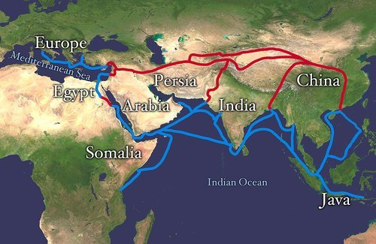
International Trade
The Silk Road connected regions of the ancient world in the East and West between 130 BCE (Before Common Era) – 1463 CE (Common Era).
European Explorer Marco Polo (1254-1324 CE) travelled these routes and good included horses, honey, fruit, rugs, grapes, camels, slaves, weapons.

Slide 4
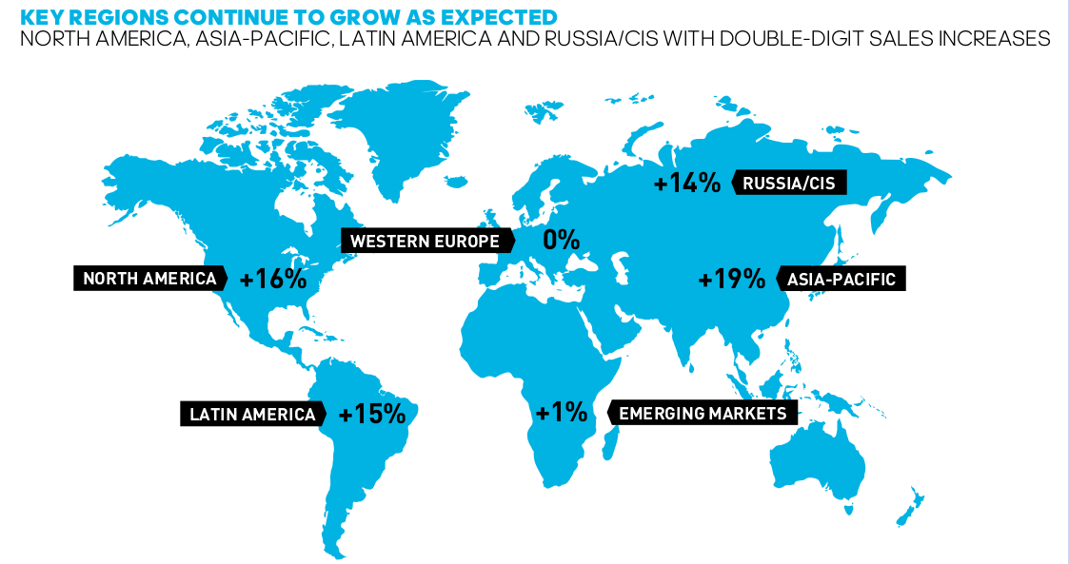
Current International Trade
How does current international trade look in comparison – Adidas Example
What does the map tell you about each market and what is the rationale for the growth?

Slide 5
Quote
Sir John Templeton, arguably the greatest stock picker of the 20th century, said: “The time of maximum pessimism is the time to buy, and the time of maximum optimism is the time to sell.”
“If you want to have a better performance than the crowd, you must do things differently from the crowd.”
The Intelligent Investor (1949) “Buy when most investors, even experts, are pessimistic. And sell when everyone is optimistic.” (Benjamin Graham). To take this approach requires courage. And the knowledge that your moves may not play out immediately. But they will bear fruit over the long term.

Slide 6
What is Finance
Finance is defined as the management of money and includes activities such as:
Investing
Borrowing
Lending
Budgeting
Saving
Forecasting.

Slide 7
What is the Economy
An economy is a system of organizations and institutions that either facilitate or play a role in the production and distribution of goods and services in a society.
Economies determine how resources are distributed among members of a society; they determine the value of goods or services; and they even determine what sorts of things can be traded or bartered for those services and goods.
How a society structures its economic system is largely a political and social issue.
The political and legal structure of a society will govern how wealth can be accumulated, how wealth and resources are distributed, and the manner of competition permitted between different participants in the economy.

Slide 8

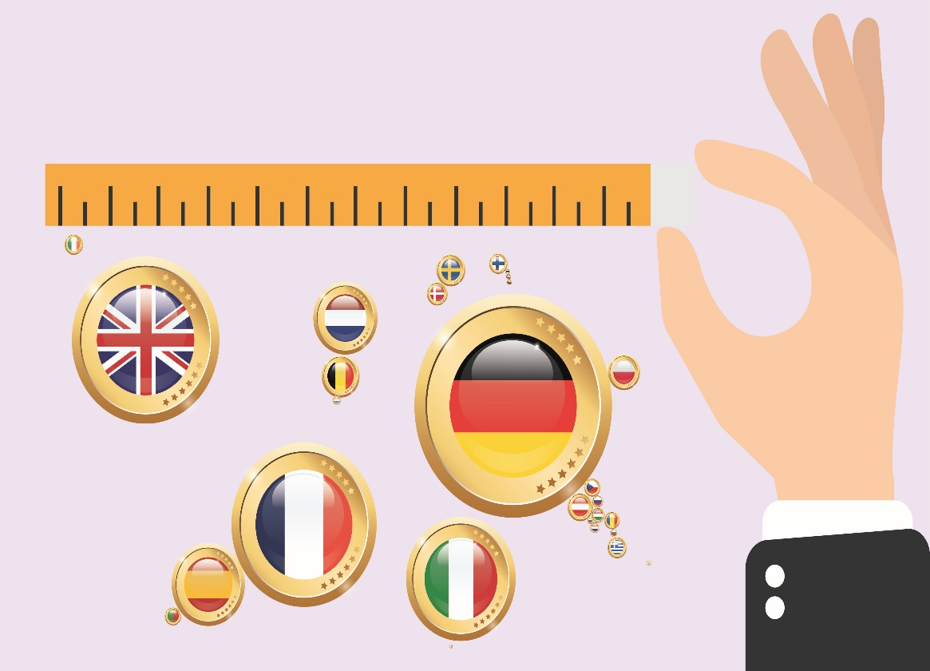
What is GDP
Gross domestic product or GDP is a measure of the size and health of a country’s economy over a period of time (usually one quarter or one year). It is also used to compare the size of different economies at a different point in time.

Slide 9
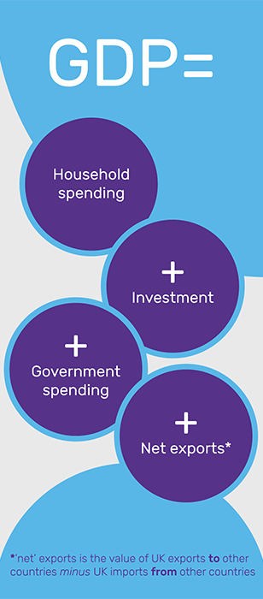
How is GDP measured
To measure GDP each quarter, the Office for National Statistics (ONS) collects data from thousands of UK companies. And to complicate matters, there are three ways to measure GDP! You can calculate it by adding up, for everyone in the country:
The total value of goods and services (‘output’) produced;
Everyone’s income;
Or what everyone in the country has spent.

Slide 10
GDP Growth
Household spending forms the biggest part, accounting for about two thirds of GDP.
Meanwhile, a business buying new equipment or a construction company building houses are examples of investment.
So when you hear talk of a country’s ‘output’, ‘expenditure’ or ‘income’, these are all ways to measure GDP.
When GDP goes up, the economy is growing – people are spending more, and businesses may be expanding. For this reason, GDP growth – also called economic growth or simply “growth” – is a key measure of the overall strength of the economy.

Slide 11
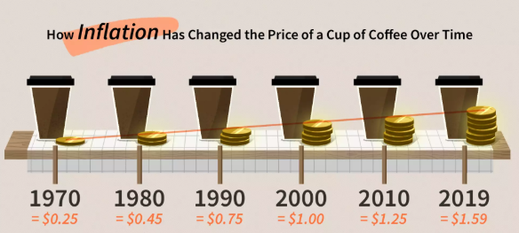
What is Inflation
Inflation is a quantitative measure of the rate at which the average price level of a basket of selected goods and services in an economy increases over a period of time.
It is the constant rise in the general level of prices where a unit of currency buys less than it did in prior periods.
Often expressed as a percentage, inflation indicates a decrease in the purchasing power of a nation’s currency.

Slide 12
What are Interest Rates
An interest rate is a percentage charged on the total amount you borrow or save.
Even a small change in interest rates can have a big impact. It’s important to keep an eye on whether they rise, fall or stay the same.
If you’re a borrower, the interest rate is the amount you are charged for borrowing money – a percentage of the total amount of the loan. You can borrow money to buy something today and pay for it later.
Interest is what you pay for the privilege. It’s a bit like hiring a car. Interest is what you pay to ‘hire’ someone else’s money.
If you’re a saver, it’s the same except the interest fee is paid to you – because banks are paying to hire your money.

Slide 13
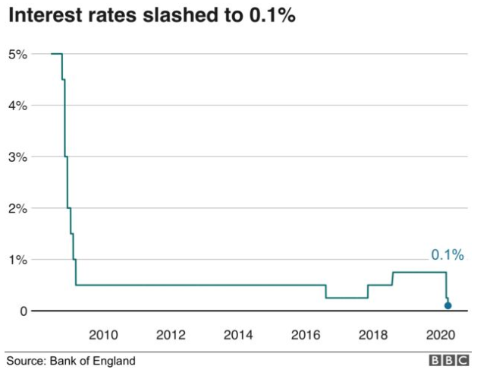
UK Interest Rates

Slide 14
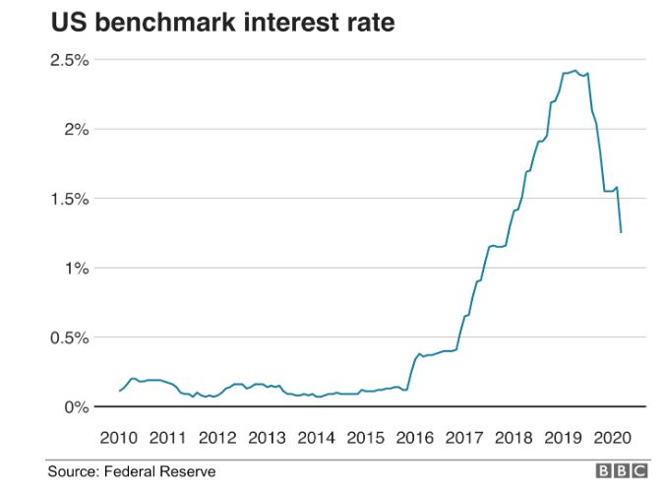
US Interest Rates

Slide 15
Labour Market
Definition: A labour market is the place where workers and employees interact with each other. In the labour market, employers compete to hire the best, and the workers compete for the best satisfying job.
Description: A labour market in an economy functions with demand and supply of labour. In this market, labour demand is the firm's demand for labour and supply is the worker's supply of labour. The supply and demand of labour in the market is influenced by changes in the bargaining power.

Slide 16
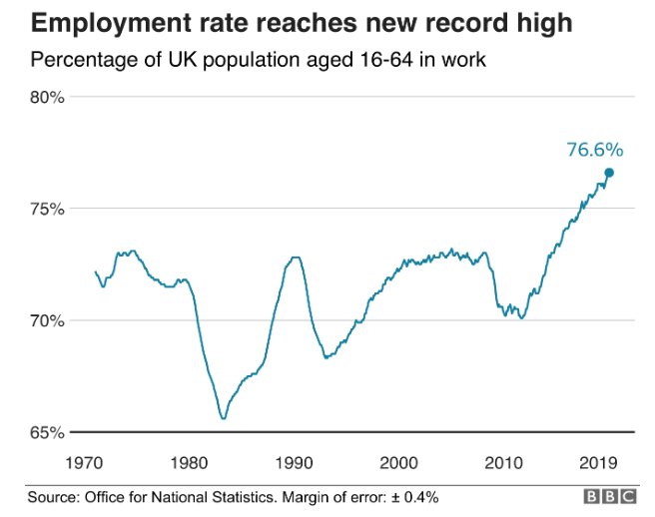
Employment
Rate
UK

Slide 17
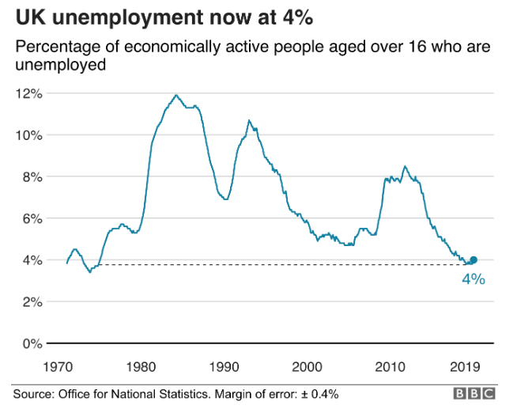
Unemployment Rate

Slide 18
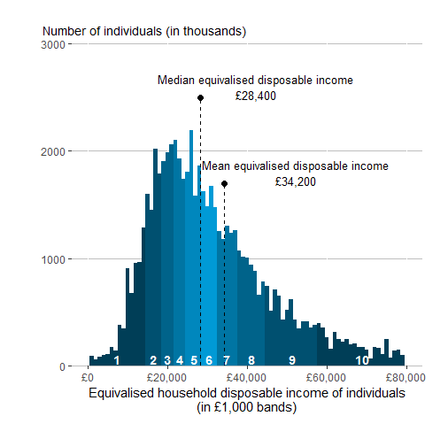
Income
Income is the revenue a business earns from selling its goods and services or the money an individual receives in compensation for his or her labor, services, or investments.

Slide 19
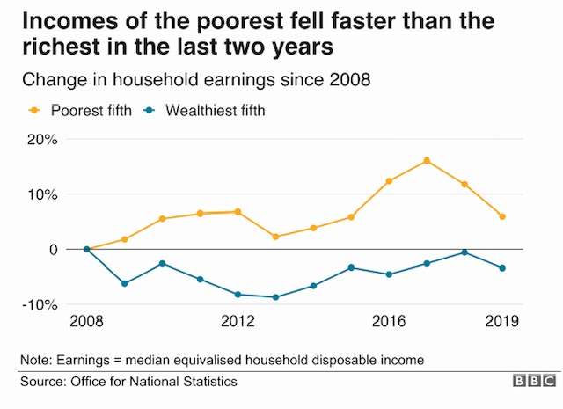
Household Income Earnings

Slide 20
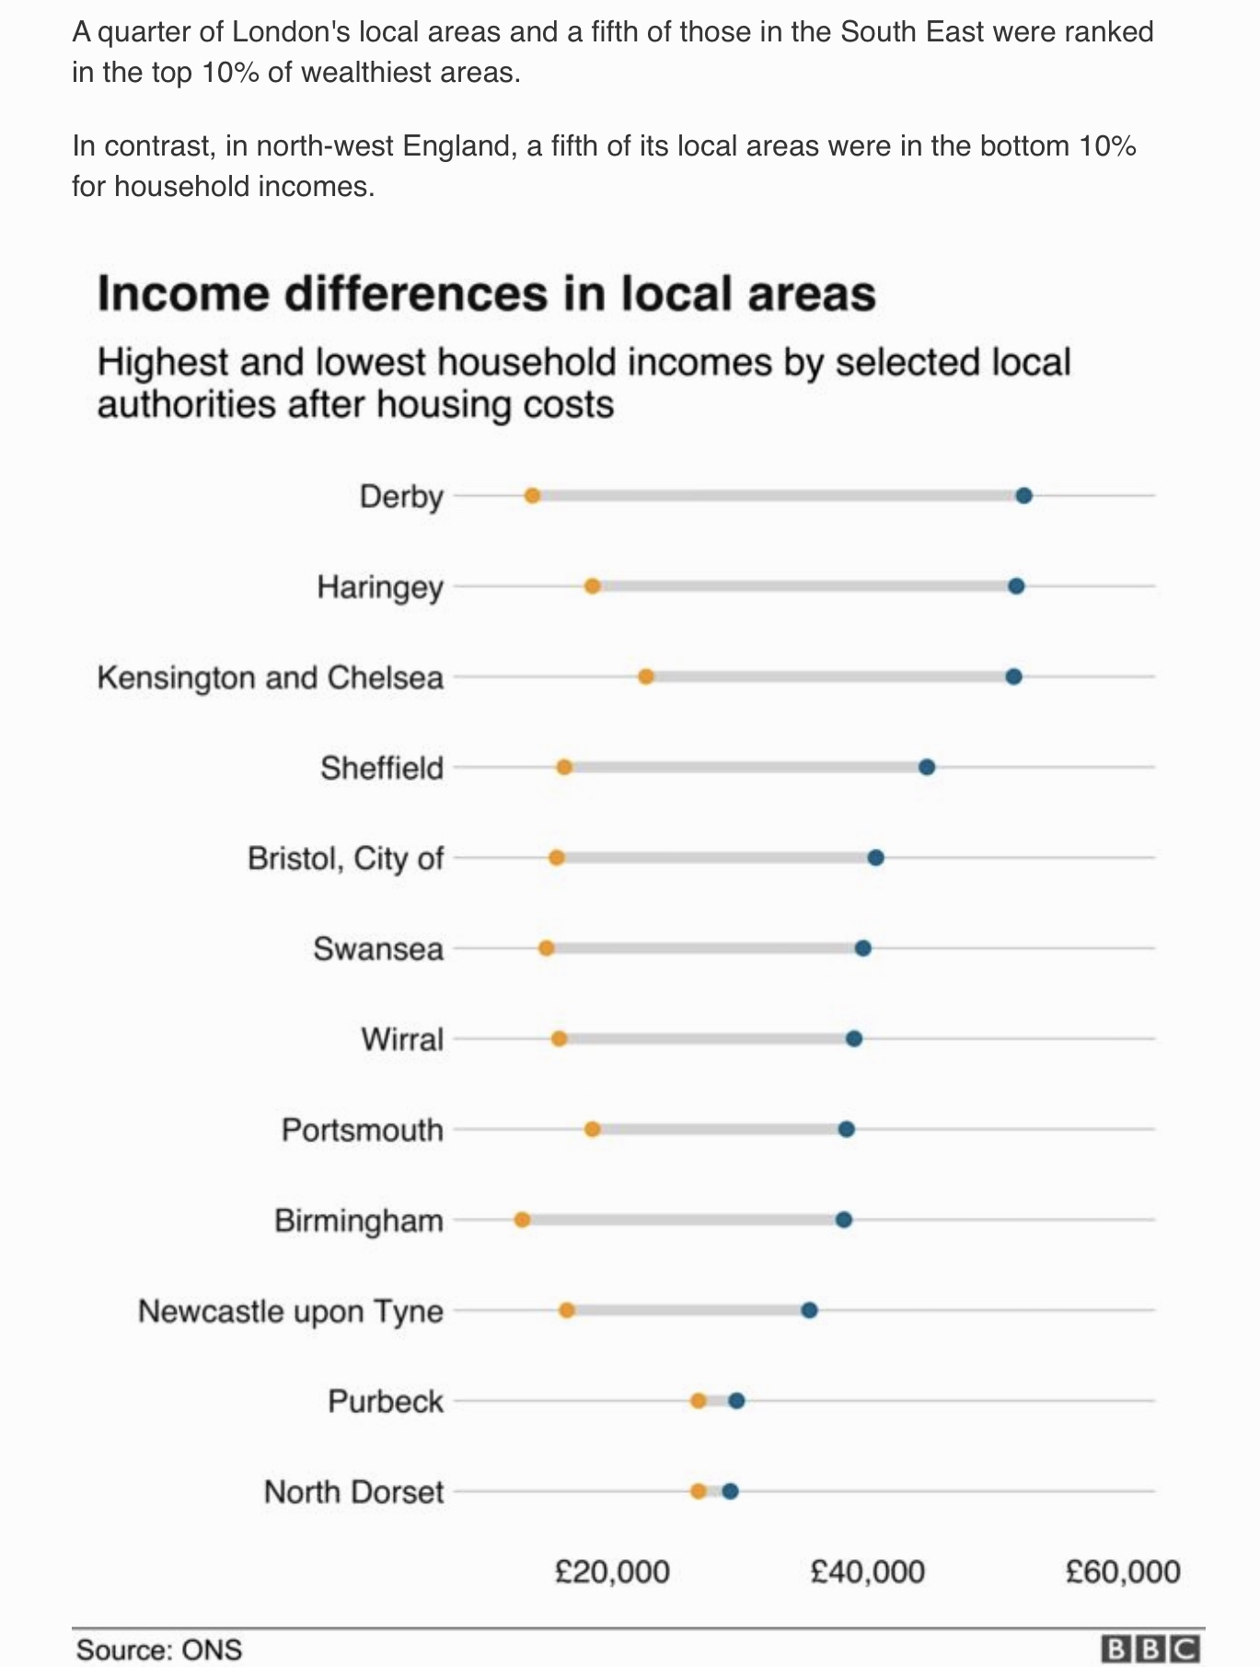
Income Variations

Slide 21
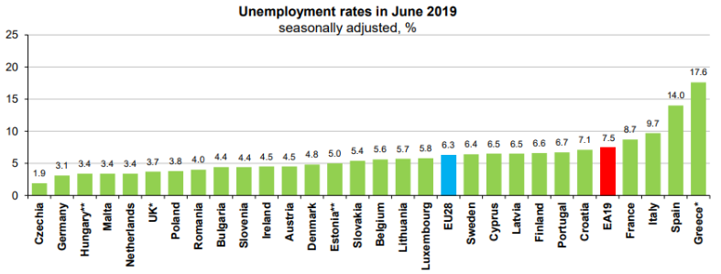
Unemployment
Unemployment is defined as people who do not have a job, have actively looked for work and are currently available for work. Students and those on training courses or apprentice schemes are not unemployed.

Slide 22
Debt / Deficit
Debt is an amount of money borrowed by one party from another. Debt is used by many corporations and individuals as a method of making large purchases that they could not afford under normal circumstances. A debt arrangement gives the borrowing party permission to borrow money under the condition that it is to be paid back at a later date, usually with interest.
Deficit is the amount by which something is less than what is required or expected, especially the amount by which the total money received is less than the total money spent.

Slide 23
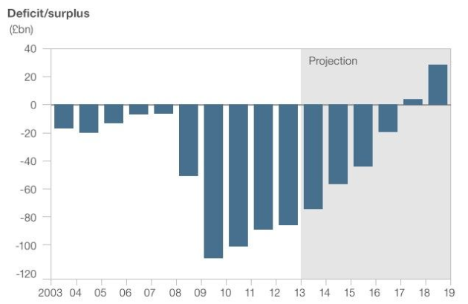
Deficit / Surplus

Slide 24
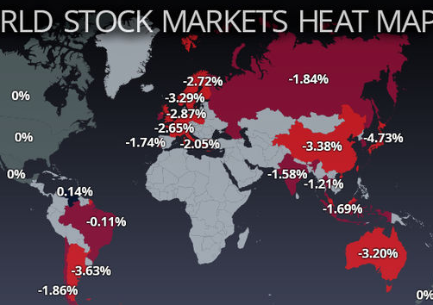
What is the Stock Market
The stock market works like an auction where investors buy and sell shares of stocks; These are a small piece of ownership of a public corporation. Stock prices usually reflect investors' opinions of what the company's earnings will be.
Traders who think the company will do well bid the price up, while those who believe it will do poorly bid the price down. Sellers try to get as much as possible for each share, hopefully making much more than what they paid for it. Buyers try to get the lowest price so that they can sell it for a profit later.

Slide 25
Unit Trust
A unit trust is an open-ended grouped investment product, which means there is no limit to how many people can invest in it or how much can be invested. You buy units with the investment you make in a unit trust.
It works by pooling your money with other investors into a single fund, which is managed by a fund manager.
The fund manager uses the unit trust fund to invest in asset classes through a variety of securities.
Not all securities have the same level of risk, so make sure you are happy with the risk involved with your chosen unit trust.

Slide 26
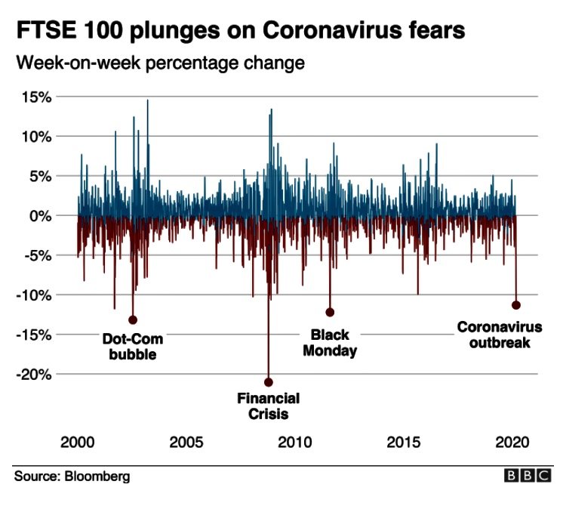
FTSE 100 Plunges

Slide 27
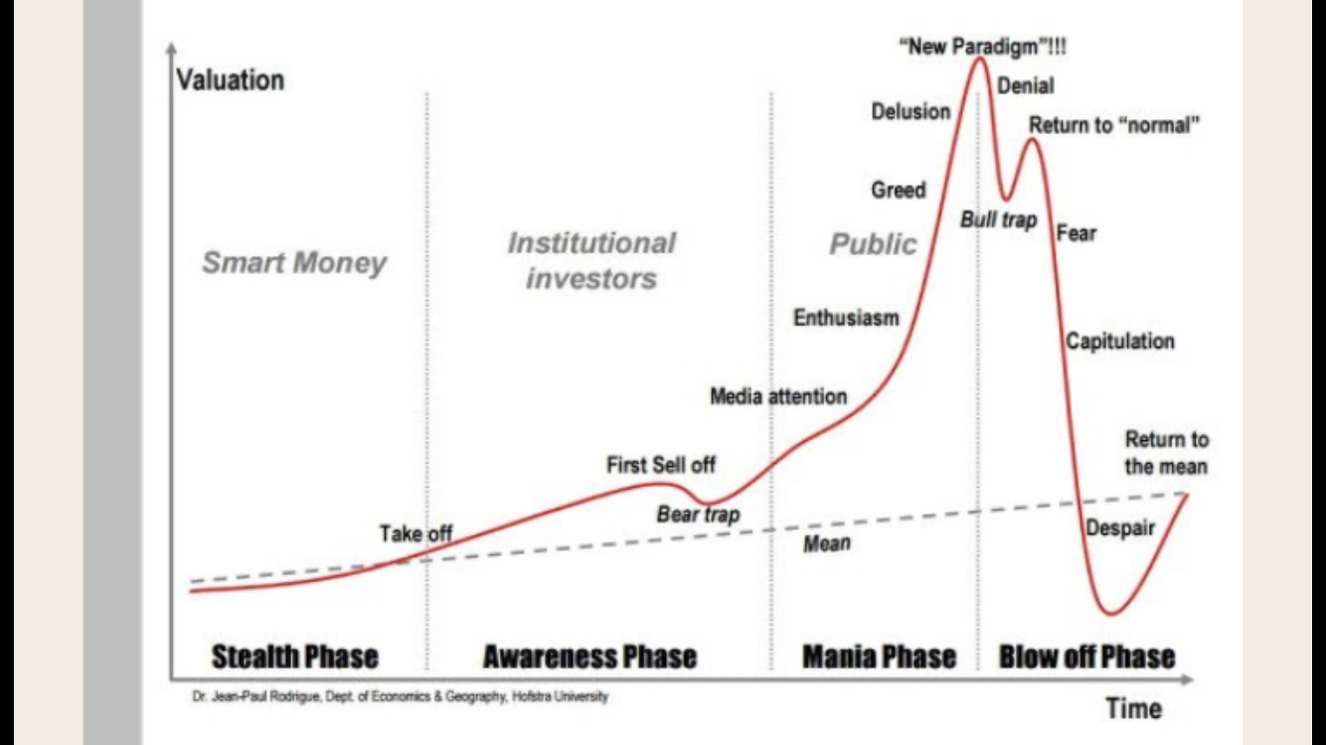
Volatile Share Trajectory

Slide 28
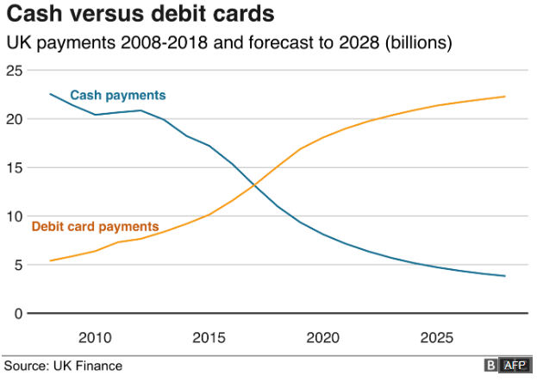
Cash vs Debit Card Payments

Slide 29
Discussion
According to the Financial Inclusion Commission, nearly 2m people don’t have a Bank Account.
The UK is fast becoming a cashless society without really knowing the consequence for the consumer or the UK Economy.
Over a quarter of cashpoints now charge for people to withdraw cash and a significant amount have closed completely.

Slide 30
Regulation
Does it matter?
Do we need notes and coins moving forward?
With an ageing population will consumers all have internet banking etc.?
Is a cashless society safer and what about taxation?
What does this all mean for Sport? E.g. Players, Clubs, Spectators, Participants, Gyms, School, Retail etc.

