Slide 1

Assignment Title; Business Plan
Student ID; 2508938
Module Name; Enterprise & Entrepreneurship
Module Number; LCLM4006 Lecturer; Rebecca Stewart

Slide 2
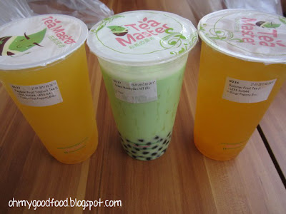

Business Plan
BOBA HEAD BUBBLE TEA

Slide 3
Overview
Boba Head Bubble Tea is a modern beverage business specializing in premium bubble tea (also known as boba tea), fruit teas, milk tea and specialty drinks. bubble tea originated in Taiwan and has become a popular global beverage, particularly among young consumers, students, and families. The industry continues to grow due to demand for customizable, visually appealing, and refreshing drinks.
Business Ideas
Pestel Key Factore
Marketing Strategies
Funding Requirements

Slide 4

Selling point
100% plastic-free, compostable/reusable packaging only
All stock sourced from West Midlands small-scale farmers/producers
Flexible subscription options+one-off orders, no minimum speed
Carbon-neutral delivery wolverhampton and surrounding areas

Slide 5
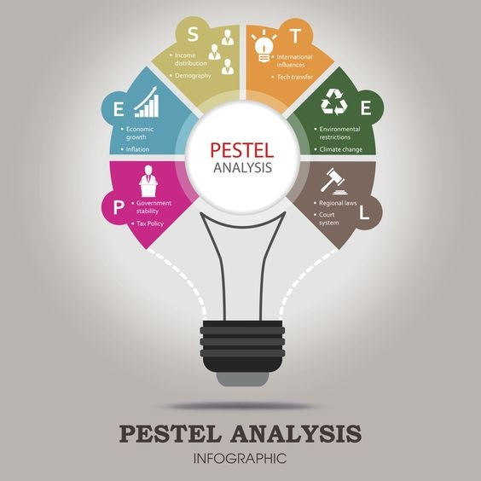
THREE IMPORTANT PESTEL
SOCIAL; UK consumer demand for sustainabe, plastic-free goods has grown 37% since 2022; West Midlands residents' rank local sourcing as a top purchase priority
Environmental; New UK extended producer responsibility laws for packaging take effect in 2027 –our zero-waste model avoids compliance costs and penalties that traditional retailers will face
ECONOMIC; High food inflation means customers are seeking value-focused, direct from source products; local supply chain cut out middlemen to keep prices competitive
ThePhoto by PhotoAuthor is licensed under CCYYSA.

Slide 6







TWO MAJOR MARKETING STRATEGIES
.
ThePhoto by PhotoAuthor is licensed under CCYYSA.
ThePhoto by PhotoAuthor is licensed under CCYYSA.

Slide 7
FUNDING REQUIREMENTS
Funding Requirements Total funding requirement is estimated at £10,000. Funding sources include owner investment (£7,000), business loan (£15,000) and family investment (£3,000).
 | MONTH
Cash in | 1
Loan- start up capital | £10,000
Sales (total sales of product and/or services) | £5,000
Other | £0
Total cash in-flows (A) | £15,000

Slide 8
 | MONTH
Cash out-expenses | 1
Rent or premises costs | £1,500
Business rates for your business premises | £300
Utilities (gas, electricity, water) | £350
Insurance | £150
Telephone and internet | £90
Marketing and advertising expenses | £900
Vehicle running costs | £250
Equipment purchases or leasing | £8,000
Postage, printing, stationery | £500
Transport and delivery | £300
Professional fees (legal, accounting etc.) | £375
Cost of sales (Cost of product) | £1,700
Wages your own | £1,500
Staff wages | £2,500
Any other | £0
Any other | £0
Total cash out-flows (B) | £10,715
Your net cash flow (A-B) | £4,585

Slide 9
Conclusion
The analysis indicates that Boba Tea Spot is a commercially viable and profitable business concept for the UK market. The growing demand for bubble tea, strong profit margins and scalable business model provide excellent growth opportunities. Effective marketing, customer retention and operational management will be critical to long-term success.
References
Companies Act 2006
Food Safety Act 1990
Health and Safety at Work Act 1974

