Slide 1


Strength in Self
Supporting body confidence, resilience and emotional wellbeing
Llinos Davies

Slide 2
Overview
Who we are and what Strength in self is.
Why this programme is needed.
Our Youth Work approach.
What wellbeing means in this programme.
How the 12-month programme works.
Young people’s participation and voice.
Trauma informed and ACE aware
practice.
Expected outcomes and impact.
How impact will be measured.
Sustainability and funding.

Slide 3

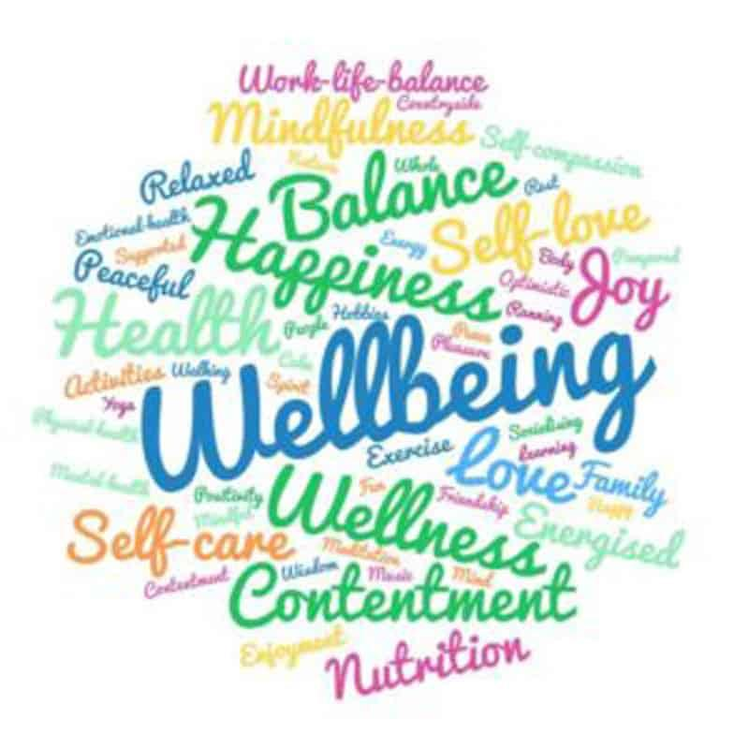
Introduction
Strength in Self: a 12-month wellbeing and body confidence programme.
Designed for young people aged 13–18.
Created by me in collaboration with Tysul Youth.
Grounded in core Youth Work values and relationship-based practice.
Focused on prevention, resilience, and long-term wellbeing.
Seeking initial funding to pilot and support the programme.

Slide 4


The need
Raising anxiety, low self-esteem and body dissatisfaction.
Social media and comparison.
Body image pressure.
ACEs and adversity.
Importance of FACEs.

Slide 5
Our approach
Voluntary participation.
Relationship-based practice.
Young person-centred & inclusive.
Consistent, trusted Youth Workers.
Community based support outside school/home.

Slide 6
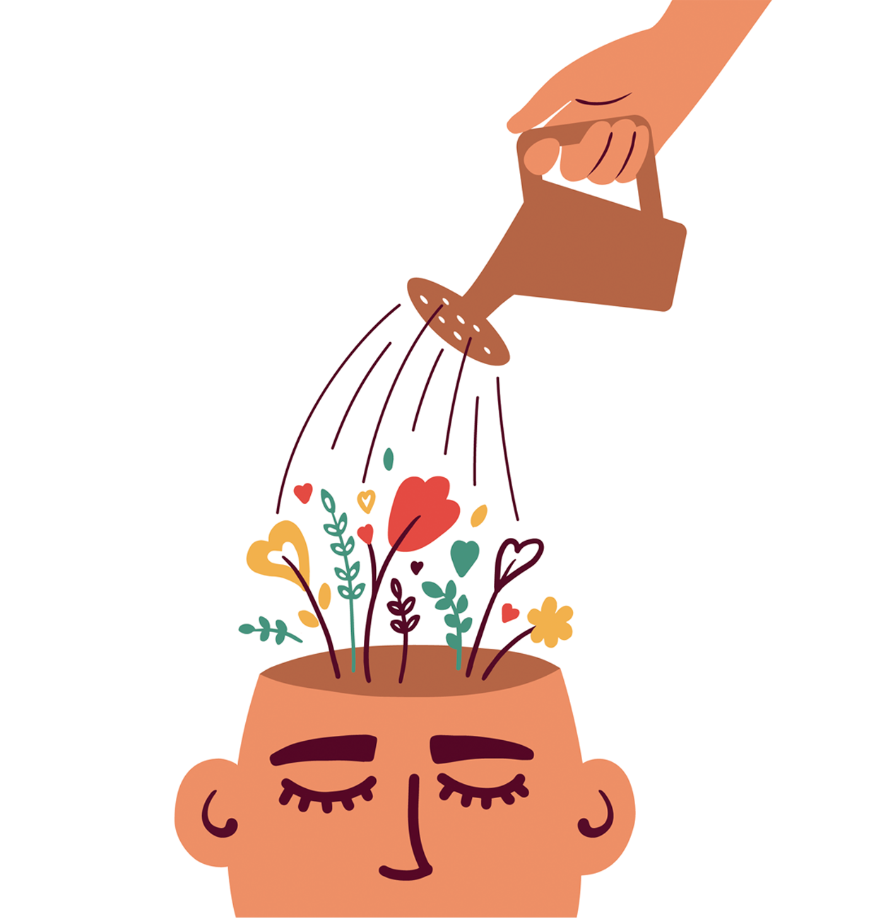
What is Wellbeing?
Wellbeing refers to a holistic state in which individuals experience physical, mental and social health alongside feelings of happiness, fulfilment and life satisfaction, as well as having the resilience and capacity to cope effectively with life’s challenges.

Slide 7

Objective wellbeing
The external conditions that shape young people’s lives:
Safe and supportive spaces.
Consistent relationships with trusted adults.
Opportunities to participate in activities.
Access to resources and positive experiences.

Slide 8
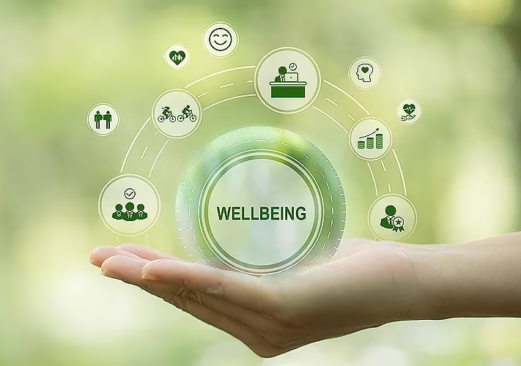
Subjective wellbeing
How young people experience themselves and the world:
Confidence and self-worth.
Emotional safety and resilience.
Positive body image and identity.
Sense of belonging and being valued.

Slide 9

Our aim
Build body confidence beyond appearance.
Strengthen emotional resilience.
Foster belonging and connection.
Embed FACEs as a protective factor.
Five ways to wellbeing.

Slide 10
Structure of the year
- Reflection
- Celebration
- Transition
Months 1-2
- Safety
- Trust
- Belonging
Months 3-4
- Emotions
- Confidence
- Social pressures
Months 5-6
- Experiential confidence building
Months 7-10
- Young person led themes and co-production
Month 11-12

Slide 11


Months 1-2
Focus on creating a safe, relaxed group space.
No pressure to talk about emotions or confidence.
Icebreakers, creative and outdoor activities.
Build relationships with consistent Youth Workers.
Set group agreements together.
Success = turning up and feeling comfortable.

Slide 12

Months 3-4
Explore stress, anxiety and confidence.
Look at social media and comparison.
Use creative and discussion activities.
Build emotional awareness and coping skills.

Slide 13
Months 5-6
Outdoor creative and team challenges.
Try new things in safe ways.
Reflect on what was learned.
Build belief in personal ability.

Slide 14
Months 7-10
Young people choose session themes.
Help plan and lead activities.
Develop voice, confidence and leadership.
Youth workers support and guide.

Slide 15

Months 11-12
Look back on progress and learning.
Reflect through creative and group activities.
Plan next steps after the programme.
Celebrate achievements.

Slide 16

Participation and young people's voice
Young people shape the programme.
Shared decision making.
UNCRC-Article 12.
Empowerment and confidence.

Slide 17
How we work with young people
Relationship-based, experiential Youth Work.
Learning through experiences.
Safe spaces to explore identity and emotions.
Positive role modelling.
Creative and outdoor activities.

Slide 18
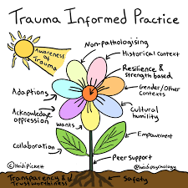
Trauma informed and ACE aware practice
Safety and consistency.
Choice and control.
Predictable session structure.
Emotional check-ins.
ACE awareness.
Warm, supportive environment.
FACEs embedded as protective factors.

Slide 19
Expected outcomes
Increased body confidence and self-esteem.
Better emotional regulation.
Stronger peer relationships.
Healthier relationship with physical activity and nature.
Greater resilience, confidence and self belief.

Slide 20
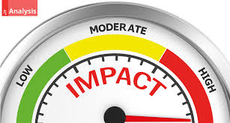
Measuring impact
Young person friendly evaluation tools.
Start, middle and end wellbeing measures.
Weekly emotional check-ins.
Group feedback discussions.
Attendance and engagement tracking.

Slide 21

Challenges, resources and sustainability
Challenges
Funding and staff capacity.
Consistency and delivery.
Safeguarding and risk.
Resources
Trained Youth Workers.
Safe spaces.
Outdoor and creative materials.
Time to build trust.
Sustainability
Embedded in the community.
Young people support new groups.
Long-term wellbeing impact.
Impact lasts beyond 12 months.

Slide 22

Why funding?
Funding will enable us to:
Deliver weekly sessions for 12 months.
Resources and staff.
Consistency and quality.
Build a sustainable, long-term impact programme.

Slide 23
Thank you (:
Time, space and supportive relationships.
Young people feel valued and understood.
Builds confidence, self-worth and resilience.
Prevention, not crisis.
Investing in young people’s futures.

Slide 24
Reference list
Bath, H. (2008) ‘The Three Pillars of Trauma-Informed Care’, Reclaiming Children and Youth, 17(3), pp. 17–21. Available at: ERIC - EJ869920 - The Three Pillars of Trauma-Informed Care, Reclaiming Children and Youth, 2008 (Accessed: 2 January 2026).
Bronfenbrenner, U. (1979) The Ecology of Human Development: experiments by nature and design. London: Harvard University Press.
By et al. (2025) Kolb’s learning Styles and Experiential Learning Cycle. Available at: https://www.simplypsychology.org/learning-kolb.html (Accessed: 7 January 2026).
Cash, T.F. and Smolak, L. (eds.) (2011) Body image: a handbook of science, practice, and prevention. London: Guilford press.
Checkoway, B. (2011) ‘What is youth participation?’, Children and youth services review, 33(2), pp. 340-345. doi: https://doi.org/10.1016/j.childyouth.2010.09.017
CLD Standards Scotland (2019) Youth Work National Occupational Standards (NOS). Available at: https://www.youthworkwales.org.uk/wp-content/uploads/2017/11/youth_work_national_occupational_standards_1_.pdf (Accessed: 5 January 2026).
ENAR Foundation (2019) Funding [image]. Available at: https://www.enar-eu.org/new-funding-fact-sheet-1685/ (Accessed: 6 January 2026).
Felitti, V. J., Anda, R. F., Nordenberg, D., Williamson, D. F., Spitz, A. M., Edwards, V., Koss, M. P., and Marks, J. S. (1998) ‘Relationship of Childhood Abuse and Household Dysfunction to Many of the Leading Causes of Death in Adults: The Adverse Childhood Experiences (ACE) Study’, American Journal of Preventive Medicine, 14(4), 245–258. doi: https://doi.org/10.1016/S0749-3797(98)00017-8
Gill, T. (2014) ‘The benefits of children's engagement with nature: A systematic literature review’, Children Youth and Environments, 24(2), pp.10-34. doi: https://doi.org/10.7721/chilyoutenvi.24.2.0010
Haidt, J. (2024) The Anxious Generation. London: Penguin Press.
Hays-Grudo, J. and Morris, A. S. (2020) Adverse and protective childhood experiences: a developmental perspective. Washington: American Psychological Association.
Health In Mind (no date) 5 ways to Wellbeing. Available at: https://health-in-mind.org.uk/resources/5-ways-to-wellbeing/# (Accessed: 2 January 2026).

Slide 25
Reference list
Honneth, A. (1996) The struggle for recognition: the moral grammar of social conflicts. Cambridge: The MIT Press.
Hughes, M. (no date) Mindtools: Gibbs’ reflective cycle. Available at: https://www.mindtools.com/ano9qiu/gibbs-reflective-cycle/ (Accessed: 2 January 2026).
Jeffs, T., Smith, M., and Walton, R. (2007) ‘Rev. of Informal education: conversation, democracy and learning (revised edition)’, Educational Review (Birmingham), 59(1), 107–108. Available at: Informal education : conversation, democracy and learning : Jeffs, Tony : Free Download, Borrow, and Streaming : Internet Archive (Accessed: 4 January 2026).

