Slide 1
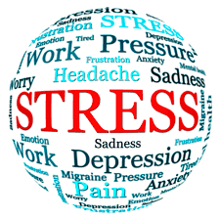
Occupational psychology
Work related stress

Slide 2
What is stress?
A natural reaction to excessive pressure
When perceived demands exceed the individual’s ability to cope
It is not a disease but if excessive/prolonged can lead to mental and physical ill health
There is no such things as positive stress (only positive pressure) – stress is always negative
Stress-related disorders a DSM classification
HSE Definition
Work-stress is the process that arises where work demands of various types and combinations exceed the person’s capacity and capability to cope.
Notes:
This can create challenges when work-related stress appears on medical/sick notes. This also has implications for employers—what does work related stress on a sick note mean to them?

Slide 3
What is stress?
Hinckle (1973) - External forces exerting pressure upon an individual, producing strain
Cannon (1929) – defined stress in terms of the internal physiological state of people expose to threatening or exciting situations
  ‘Fight’ or ‘Flight’ occurs in stressful situations
Selye (1946) provided a more elaborate model of the human response to stressors.
  The General Adaptation Syndrome

Slide 4
What is stress?
Pressure caused by an outside stimulus
Engineering model (physics)
External forces exert pressure and produce strain
  E.g., focus on daily hassle/stressful life events
  We can easily measure the stress a person is subjected to (Hinckle, 1973)
  Does not take account for individual differences!

Slide 5
What is stress?
2) Cannon (1929) – ‘Fight’ or ‘Flight’ occurs under stressful situations
Defines stress in terms of the internal physiological state of people expose to threatening or exciting situations
Selye (1946) provided a more elaborate model of the human response to stressors.
  The General Adaptation Syndrome

Slide 6
Selye’s 1946 General adaptation syndrome
Stress response involves three stages:
ALARM REACTION:
  Lowered resistance initially, followed by the activation of defence mechanisms (e,g,, adrenalin)
RESISTANCE:
  Stage of max. adaptation and hopefully the successful return to equilibrium. This will not happen if the stress agent continues. They will move on to the next stage.
EXHAUSTION:
  Failure of defence/adaptive mechanisms

Slide 7
Stress as a transaction
Psychological emphasis – Stress exists when the person FEELS they cannot cope with the demands of the environment
Interaction of person and environment
Transactional model of stress and coping (Lazarus & Folkman, 1984).
  Importance of cognitive appraisals
Notes:
Most modern theories of work stress define is as a negative emotional state that can results from the interaction between a person and their environment. It is something that is CAUSED OR MADE WORSE by work. Therefore, stress is not high work load or work related absence, rather is is the negative emotional state that can arise from pressues are work . Eg high workload is a potential cause of stress – and can contribute to a range of psychological or physical health problems causes absence – i.e., a consequence of stress.

Slide 8
The transactional model of stress and coping
(Lazarus & Folkman, 1984)
According to the transactional model, the stress and coping process involves two main elements:
This process of evaluation is known as Cognitive Appraisal
an individual's evaluation of the meaning of a particular encounter for well-being
an evaluation of a situation that produces negative emotions
coping efforts which attempt to reduce these negative emotions

Slide 9
The Transactional model of stress and coping
(Lazarus & Folkman, 1984)
Stress is a result of an interaction between an individual’s characteristics and appraisals, the external or internal event (stressor) environment, and the internal or external resources a person has available to them.
Lazarus’s initial model maintained that when individuals confront a new or changing environment they engage in a process of appraisal, which is of two types: Primary and Secondary

Slide 10
The transactional model of stress and coping
(Lazarus & Folkman, 1984)
Primary Appraisal
  What is at stake in this encounter?
  Motivational relevance
  Motivational congruence
Secondary Appraisal
  What can I do to cope and how effective will this be?
  Emotion-focused coping potential
  Problem-focused coping potential
Three kinds of stressor:
Pose harm
Threaten
Challenge
Notes:
In primary appraisal, the person considers the quality and nature of the stimulus event. Lazarus distinguished three kinds of possible stressor: those that pose harm, those that threaten, and those that set a challenge. Harm is considred as damage that has already been done, i.e., a loss or failure; threat is the expectation of future harm; and challenge results from demands that are appraised as opportunities for personal growth or opportunities that the person is confident about dealing with. Any events that are not appraised as either of these three things are considered to be benign events that require no further action.
At the same time as carrying out primary appraisals, Lazarus proposed that secondary appraisals are initiated whereby one assesses one’s resources and abilities to cope with the stress (coping potential).

Slide 11
The transactional model of stress and coping
(Lazarus & Folkman, 1984)
Stress experienced when harm or threat is HIGH and perceived coping ability is LOW
If perceived coping ability appraised to be HIGH, stress likely to be minimal
STRESS ARISES FROM A MISMATCH BETWEEN PERCEIVED DEMANDS AND RESOURCES
  (Both of which can change over time)
Notes:
Lazarus maintains that STRESS would be experienced when perceived harm or threat was high but perceived coping ability was low, whereas when perceived coping ability was appraised to be high, then stress was likely to be minimal. In other words, stress arises from a mismatch between perceived demands and resources, both of which can change over time.

Slide 12
What is coping?
A response to negative events or emotions, and involves cognitive and/or behavioural efforts to manage to adapt to the stressful situation
Psychological theories of coping attempt to identify the mechanisms through which individuals cope with events that are perceived to be stressful or threatening
Emotions and coping are often considered to be part of the same adaptational system
  E.g., Lazarus and Folkman (1984); Folkman and Lazarus (1988)

Slide 13
Dimensions of coping
Problem focused coping
  targets the causes of stress in practical ways which tackles the problem or stressful situation that is causing stress, consequently directly reducing the stress
  aim to remove or reduce the cause of the stressor
Taking control: Changing or escaping from the stress/removing the stress
Information seeking: Rational action. Trying to understand the situation and putting cognitive strategies into place to avoid it in the future.
Evaluating pros and cons of different options for dealing with the stressor.

Slide 14
Dimensions of coping
Emotion focused coping
  involves trying to reduce the negative emotional responses associated with stress.
  sometimes the only realistic option when the source of stress is outside the person’s control
  drug therapy can be seen as emotion focused coping
Keeping busy
Letting off steam
Distraction techniques
Building oneself up to expect the worst

Slide 15
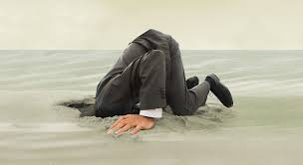

Dimensions of coping
Avoidant coping: Can putting your head in the sand ever be a good thing??

Slide 16
Dimensions of coping
Avoidant coping:
May be adaptive at an early stage in a stressful encounter, when we lack the resources to engage in problem-focused coping
However, in the longer term, and if faced with an ongoing stressor, avoidance will prevent adaptation to and mastery over the situation
Some types of avoidance (e.g., drug or alcohol misuse) are more dangerous and less adaptive than other types of avoidance (e.g., distraction)

Slide 17
Structural models of work-related stress
Karasek (1979) devised the Demand-Control Model around two particularly important features of the work environment
  1) DEMANDS
    Related to the amount of work a person does, but also factors such as time pressures and amount of mental/physical effort involved
  2) CONTROL
    Extent to which the job allows employee to use their skills/capabilities (skill discretion)
    Amount of control employee has over their work situation (decision latitude)

Slide 18
The Job Demand-control model (Karasek, 1979)
Four categories of job were described through combining levels of demand and control:
DEMAND, CONTROL
DEMAND, CONTROL
DEMAND, CONTROL
DEMAND, CONTROL
PASSIVE
HIGH-STRAIN
LOW-STRAIN
ACTIVE

Slide 19
The Job Demand-control model (Karasek, 1979)
Productive and motivated
Low strain
Active
job control (decision latitude)
low high
Passive
High strain
Risk of psychological strain and increased illness
low high
job demands
Notes:
Karasek and Theorell (1990) – employees in high strain jobs were at increased risk of various health problems, including serious psychological and physical health problems. Interestingly, control has a positive role in employee well-being. Those in active job roles (high control and high demands) were found to be the healthiest.

Slide 20
Support at work
Johnson and Hall (1988) – the Demand-Control-Support Model
  In this model, high levels of support are thought to act as a buffer against negative effects of work demands
  Jobs with higher levels of support, but equal levels of demands, tend to be healthier

Slide 21
Support at work
Two hypotheses:
The Strain Hypothesis:
  Employees working in a high-strain job (high D, low C) experience the lowest well-being/highest stress
  The strain hypothesis – emotional/practical support can help reduce the impact of high work demands.
The Learning Hypothesis:
  High C, high D plus support can lead to improved motivation and satisfaction at work

Slide 22
Evaluation?
Lots of support for the strain hypothesis
  Low control and high demands interaction
Moderating influence of social support is less consistent
Measures are broad (responsibility pressure, quality concern, role conflict, work overload and job control
Certain people are more vulnerable to strain and others benefit more from control

Slide 23

Why are we so interested in work-related stress??

Slide 24
The scale of the problem
HSE:
  Work related stress the biggest contributor to number of working days lost per year
  Estimate of 23.3m working days lost in GB in 2014/15; 9.9m of these accounted for by stress, depression or anxiety
http://www.hse.gov.uk/stress/

Slide 25
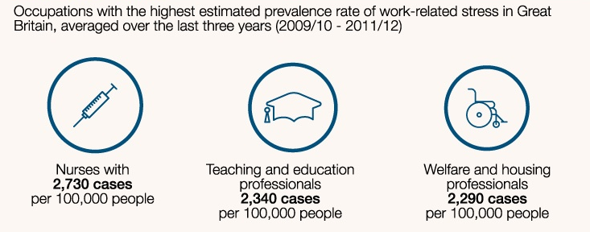
The scale of the problem
Health professionals; teaching and education professionals, and caring personal services

Slide 26
The scale of the problem
The main work activities attributed by respondents as causing their work-related stress, or making it worse, were:
    work pressure,
    lack of managerial support
    work-related violence and bullying

Slide 27
Why should organisations intervene?
Improved quality of life for workforce
A healthier, more productive workforce
  Underperformance
  Time off through illness
Business benefits from reduced sickness absence – increased productivity

Slide 28
Why should organisations intervene?
Litigation / fulfilment of statutory duties
  Health and Safety at Work Act
Power struggle
  The rights of employees to health versus the needs of the company
  Perception of rights and needs

Slide 29
Consequences and costs of work stress

Slide 30
What outcomes can be observed due to work related stress??
Physical symptoms
Behavioural symptoms
Ailments
Lack of appetite
Craving food when under pressure
Constant tiredness
Nail-biting
Nervous twitches
Nausea
Frequent crying or desire to cry
Inability to sit still
Sweating
Constipation/diarrhoea
Headaches
Cramps
Irritability with people
Unable to cope
Difficulty making decisions
Dread of the future
Difficulty concentrating
Inability to finish any tasks
Feeling of being a failure
Loss of interest in other people
Loss of sense of humour
Self-hatred
Hypertension: HBP
Heart attack
Migraine
Intense itching (pruritus)
Constipation
Colitis
Rheumatoid arthritis
Menstrual difficulties
Flatulence & indigestion
Skin disorders
depression

Slide 31
Conditions that influence employee well-being

Slide 32
Conditions that influence employee well-being
Aspects of the situation and individual differences are both important in determining the impact of work on individual employees
Situational factors:
  Not all situational factors are sources of stress for everybody in all workplaces.
  Cox et al. (2000) – HAZARD: working conditions have the potential to cause harm, but much can still depend on individual differences (personality, coping styles, ability, etc)

Slide 33
Conditions that influence employee well-being
SITAUTIONAL FACTORS??
Demands
Control
Support
Relationships at work
Roles at work
Change
Working conditions
Career-related issues

Slide 34
Situational factors
DEMANDS
  Job content and workload
    Increased stress in fast paced environments, intensive working and meeting tight deadline frequently
    Quantitative workload – too much to do
    Qualitative workload – too difficult for the individual
    Emotional dissonance (Zapf, 2002) – employee has to hide/mask emotions, e.g., airline steward

Slide 35
Situational factors
DEMANDS
  Working hours
    Long working hours take a toll on employee health
    Both the individual and the quality of their work suffers
    Recognition that working above 40hrs/week is unproductive and can create ill-health (Sparks et al., 1997)
    However, what if the person has to work long hours in order to complete the tasks of the job? (Burke & Cooper, 2008). Interaction between working hours and job workload

Slide 36
Situational factors
DEMANDS
  Shift work
    Demir et al. (2003) – working night shifts leads to exhaustion, loss of energy and detachment from patients in nurses
    Shift work can have a profound effect on physical functioning, changes in blood temp and pressure, sugar levels and impact on sleep patterns, mental efficiency and work motivation

Slide 37
Situational factors
DEMANDS
  Work-life interface
    Growing research about how work and non-work demands interact – consequences for the employees’ well-being
    Can be one of two variations (Lewis & Cooper, 2005):
      1) work interference with family – demands of work create difficulties for home life
      2) family interference with work – demands of home life create difficulties for work
    Simply put – the time spent on one is effectively taken away from the other. Also relates to cognitive, emotional and physical demands.

Slide 38
Situational factors
CONTROL
Control over quality of work
Control over work pace
Influence over policies and procedures
Control of holidays or leave
Control of methods used in work
Control over decision-making
Etc, etc, etc
Notes:
A lack of influence in the way in which work is organised and performed can be damaging to psychological and physical well-being. While low levels of control are a source of work stress, high levels of control tend to be beneficial.

Slide 39
Situational factors
CONTROL
Bond et al. (2006): high levels of control associated with higher levels of job performance and lower levels of absense
High levels of control tend to be beneficial (Weinburg & Cooper, 2007)
Notes:
Control is a powerful predictor of employee health. Bond et al also found that high levels of control are also associated with higher levels of job performance and lower levels of absence.

Slide 40
Situational factors
RELATIONSHIPS AT WORK
Workplace bullying
  Recognised as a major occupational stressor, with massive financial and legal implications for organisations
  Giga et al. (2008) – annual cost of bullying = £13.75 billion
    In relation to absenteeism, turnover and productivity
  Bullying can be experienced at individual, team and organisational levels

Slide 41
Situational factors
ROLES AT WORK
Role ambiguity
  When individuals do not have a clear picture about their work objectives, expectations of them, responsibilities,e tc
  Can be present at the start of a new job, getting a new boss, unrealistic job description, or change in the organisation itself (Beehr, 1995).
  Tubre and Collins (2000) – role ambiguity significantly linked to low job performance

Slide 42
Situational factors
ROLES AT WORK
Role conflict
  When individual is torn by conflicting job demands, or doing things they do not want to do
Responsibility
  Responsibility for people or responsibility for things
    For people is particularly stressful – amount of time spent interacting with others, attending meetings, meeting deadlines, etc

Slide 43
Situational factors
CAREER-REALTED ISSUES
A host of issues can act as potential stress factors
  Lack of job security
  Fear of redundancy
  Numerous performance appraisals
For most, progression is important
  In early years, progression more likely – earn more money and enjoy increased status
  At middle age, career progress slows or stops. Job opportunities become fewer and energy levels can flag. Also, younger applicants become a threat

Slide 44

What about individual differences in people?

Slide 45
Individual differences and occupational stress
Why are some people more vulnerable to stress than others??
Individual differences in personality, cognitions and emotions can have direct and indirect effects on stress outcomes

Slide 46
Individual differences and occupational stress
Individual differences that are often investigates in work-related stress research:
  Neuroticism/emotional instability
  Type A personality
  Locus of control; self-efficacy and self-esteem
  Coping styles

Slide 47
Type a behaviour pattern
‘Stress-prone behaviour pattern’
Type A Behaviour is a multidimensional concept combining action and emotion and manifests in individuals showing the following:
  Competitiveness
  Time-urgent behaviours (trying to do too much in too little time)
  Easily annoyed/aroused hostility and anger
  Impatience
  Achievement-oriented behaviour
  Exhibit a vigorous speech pattern
Notes:
People who exhibit type a personality are more prone than others to the effects of stress.

Slide 48
Type a behaviour pattern
Furnham (1990)
  Type A’s respond more quickly to stress and in a more emotional way
  Exhibit a greater need for control than Type B’s (more relaxed, reflective)
  Show greater physiological responses to stress

Slide 49
Locus of control
Locus of control: an expectancy concerning the degree of personal control we have in our lives
  Internal
      Life outcomes are under our personal control
  External
      Outcomes have less to do with one’s own efforts than with the influence of external factors

Slide 50
Locus of control
A generalised expectancy (Rotter, 1966)
People with an internal locus of control:
  Behave in a more self-determined fashion
  Achieve better grades
  Are more resistant to social influence
  Engage in more health-promoting behaviours; experience less depression and anxiety

Slide 51
Intervention strategies for psychological well-being at work

Slide 52
Stress management interventions
HSE’s Stress Management Standards
  The six management standards cover the primary sources of stress at work
  Define the characteristics, or culture, of an organisation where the risks from work related stress are being effectively managed and controlled
  Cover six key areas of work design that, if not properly managed, are associated with poor health and well-being, lower productivity and increased sickness absence.

Slide 53

Health & Safety Executive
Management of stress at work
http://www.hse.gov.uk/stress/

Slide 54
Hse’s stress management standards
Demands:
  Workload, work patterns and the work environment
Control:
  How much say the person has in the way they do their work
Support:
  Encouragement, sponsorship and resources provided by the organisation, line management and colleagues
Relationships:
  Promoting positive working to avoid conflict and dealing with unacceptable behaviour
Role:
  Whether people understand their role within the organisation and whether the organisation ensures that they do not have conflicting roles
Change:
  How organisational change (large or small) is managed and communicated in the organisation

Slide 55
Hse’s stress management standards
These Management Standards represent a set of conditions that, if present, reflect a high level of well-being and organisational performance
Demonstrate good practice and allow assessments of the current situation
Help simplify risk assessment for work related stress by:
  Identifying the main risk factors for work related stress
  Helping employers focus on the underlying causes and their prevention
  Providing a way in which organisations can gauge their performance in tackling the key causes of stress

Slide 56
Challenges?
Harm is not easy to define
Hazards are determined by the way in which people perceive them
Difficult to establish cause and effect in individual cases
Difficult to distinguish between minor and serious harm
Everyone is potentially exposed
Work/life issues

Slide 57
Stress management interventions
Ivancevich et al. (1990)
“any activity, program, or opportunity initiated by an organisation, which focuses on reducing the presence of work-related stressors or on assisting individuals to minimise the negative outcomes of exposure to these stressors”.

Slide 58
Stress management interventions
Primary stress management interventions
Attempt to eliminate the sources of stress in organisations by focusing on changing the physical or socio-political environment to match individual needs and granting them with more control over their work situation (Cooper et al., 2001).
Improving communication processes, redesigning jobs or involving employees in the decision-making process are all examples of primary level interventions.

Slide 59
Stress management interventions
Primary stress management interventions
  Redesign the task
  Redesign the work environment
  Establish flexible work schedules
  Include the employee in career development
  Analyse work roles and establish goals
  Build cohesive teams
  Establish fair methods for the distribution of rewards
Arnold et al,. 2010 – pages 474 and 475

Slide 60
Stress management interventions
Secondary stress management interventions
Tend to help individuals manage stress without trying to eliminate or modify workplace stressors.
Stress management programmes assist individuals to identify stress symptoms in themselves and others, and to acquire or improve their coping skills.

Slide 61
Stress management interventions
Tertiary stress management prevention
Strategies seek to assist individuals who are experiencing on-going problems stemming either from the work environment or their work lives.
The purpose of such programmes is to adapt individual behaviour and lifestyle without much reference to changing organisational practices.

Slide 62
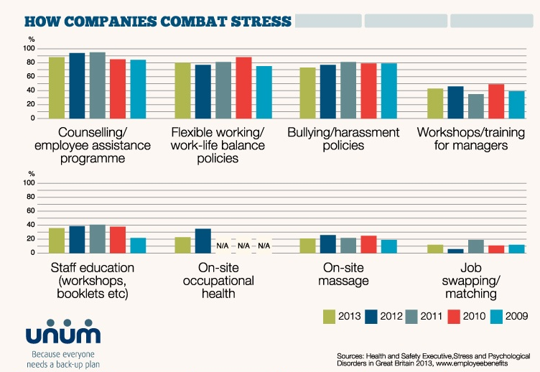

Slide 63

Questions?

