Slide 1
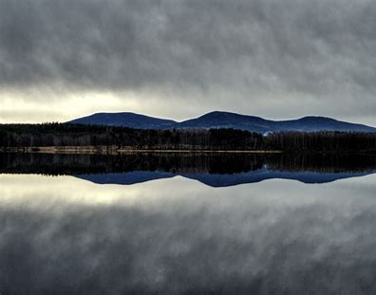
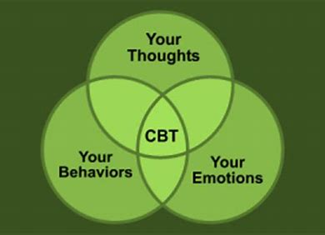
Week 10 Counselling Specialisms and Populations
Guidance and Structure
Assessment 1: Report

Slide 2
Structure and Guidance Review
REPORT Format
Critically evaluate a presenting issue and a client population with reference to current theory, research and practice.
Word Count 5,000 to 6,000.

Slide 3
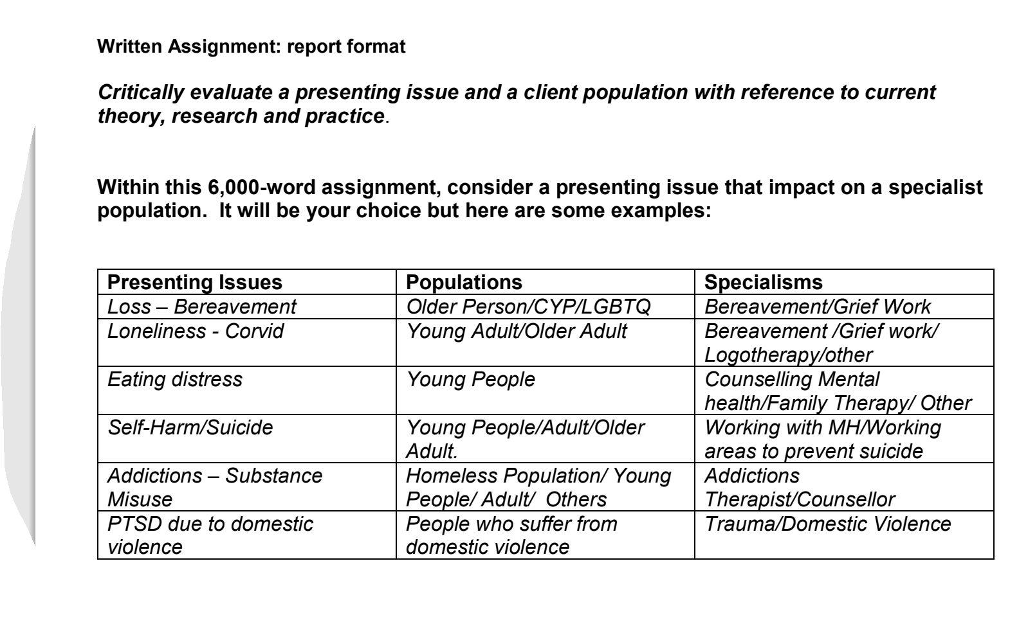

Slide 4

REPORT FORMAT STRUCTURE
BASIC OUTLINE OF A REPORT
Cover Page (you may want an image) You may also use images through out your report.
  Title of your Report – Create your own tiltle.
  Name, programme, date
Table of Contents (separate page from the rest of the report)
Summary/Outline of your presenting issue/and population
Introduction
Body (divided up into various headings/subheadings)
Future recommendations or implications
Conclusion
References
Appendices
Helpful Website Report Writing: https://visme.co/blog/report-writing-format/

Slide 5
Additional Guidance
Summary/Outline of your presenting issue/and population (200-300 words) This helps to summarise what you will be exploring
Introduction
Body
Background and currency of the issue (there may be additional headers within the section)
Theoretical approaches or interventions This is to reflect your knowledge of working with the issues/population. Current research and practice/evidence-base. (there may be additional headers within the section)
Ethical considerations or dilemmas(there may be additional headers within the section)
Future recommendations or implications
Conclusion
References (not added in the word count)
Appendices (not necessary and is not added in the word count)

Slide 6
Examples of Reports
These are just some examples of differernt type of reports.
Joseph Rowntree Foundation: https://www.jrf.org.uk/reports
MIND UK Research Report: https://www.mind.org.uk/media-a/4608/blue-light-programme_impact-on-the-public-report.pdf - Very Good example
Examples of Cover Pages: https://www.bing.com/search?q=cover+page&form=WNSGPH&qs=LS&cvid=89bf965c95de44faa4ae1b78d62a3d9c&pq=Cover+pa&cc=GB&setlang=en-GB&nclid=976CD71D61B6EF62010C1919CC33B2BF&ts=1607499098716&wsso=Moderate

