Slide 1

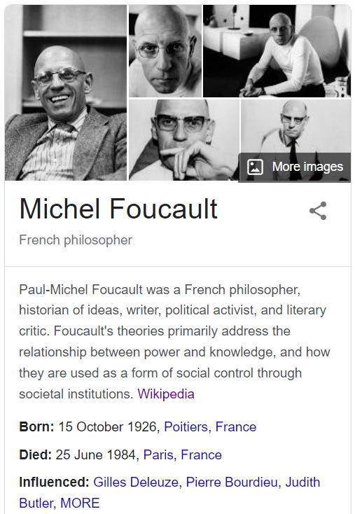
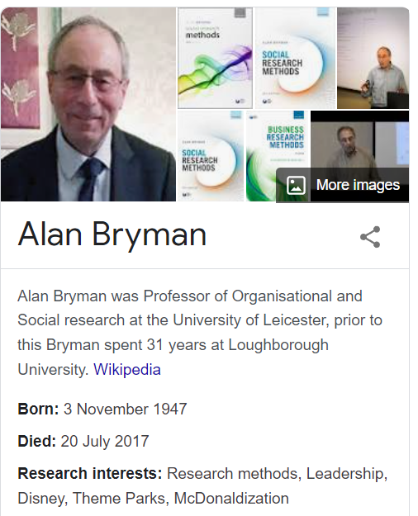


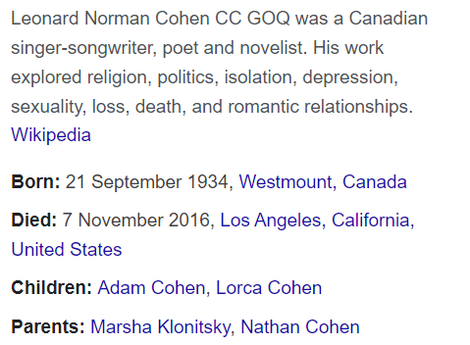
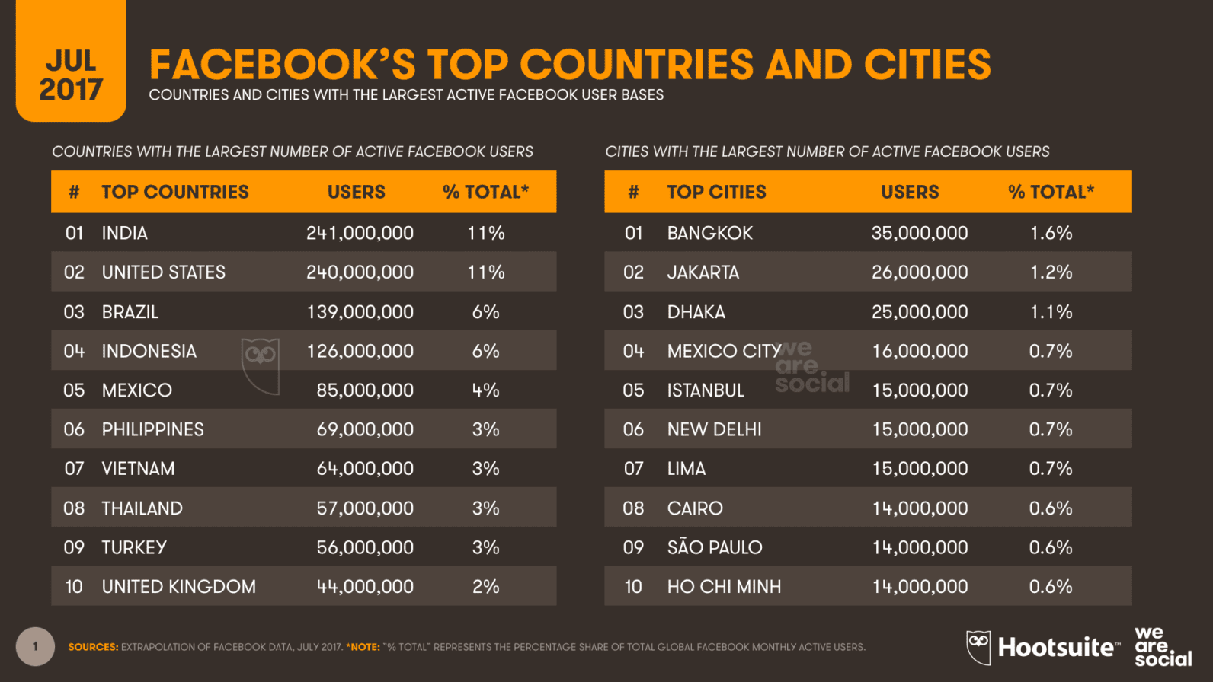
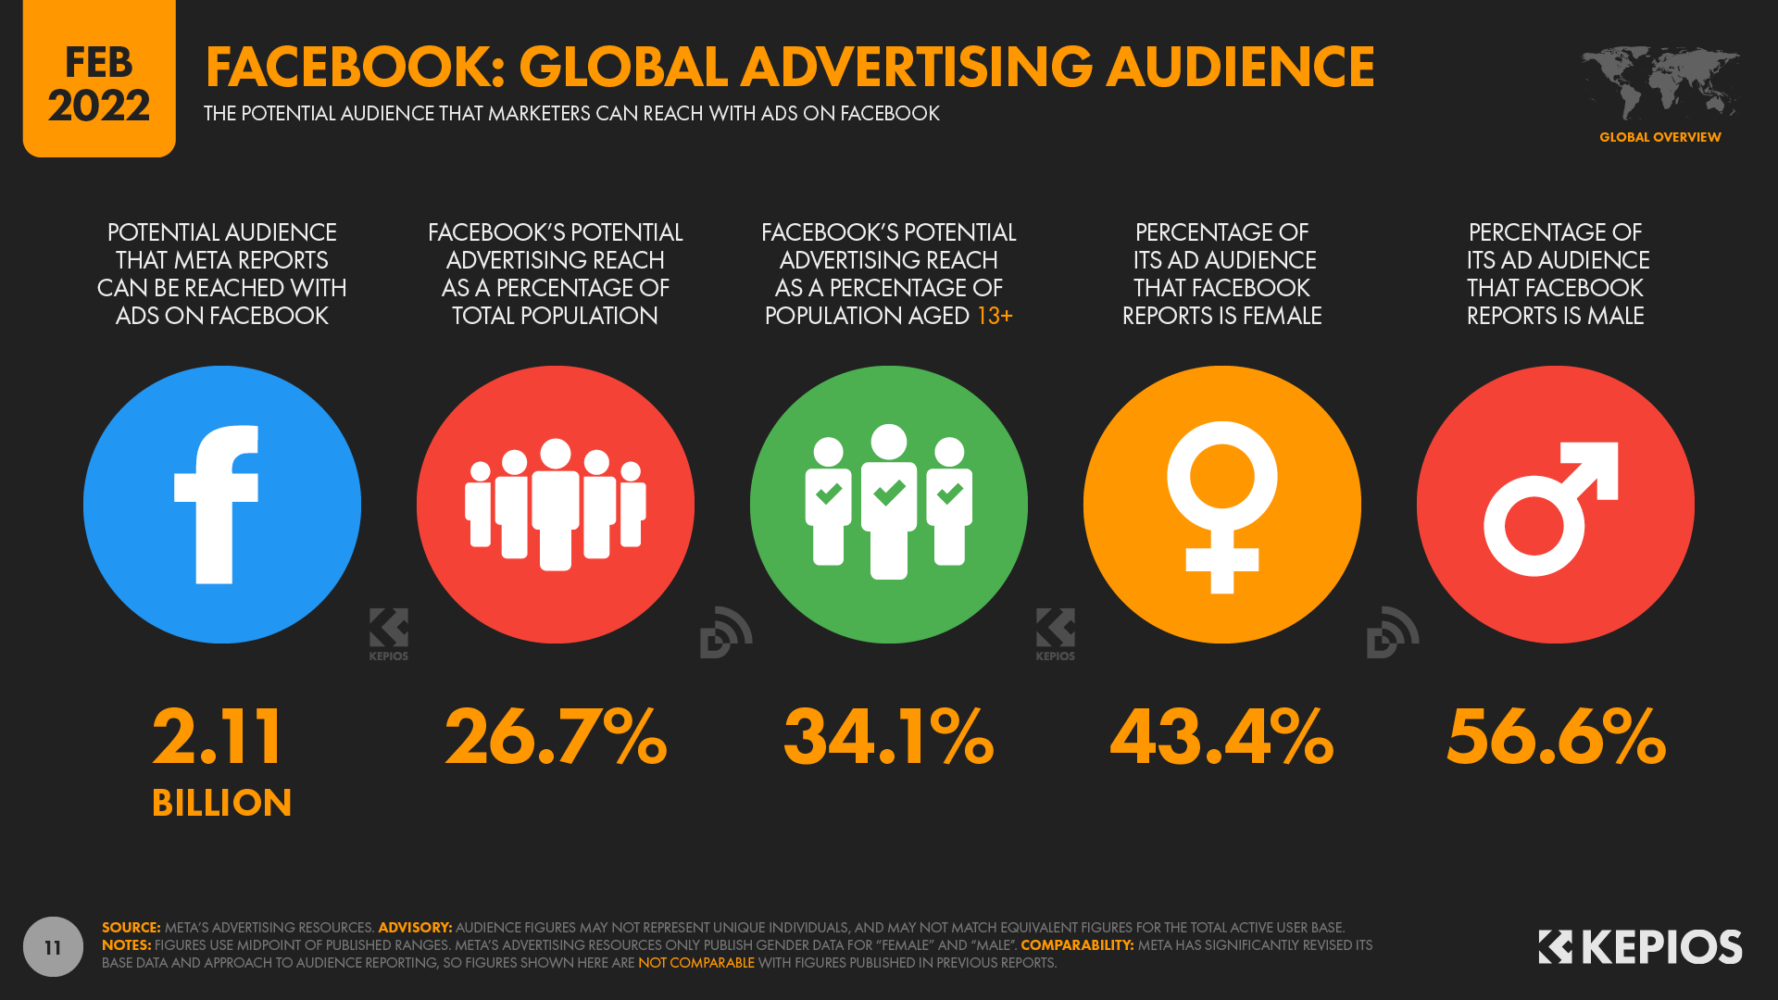
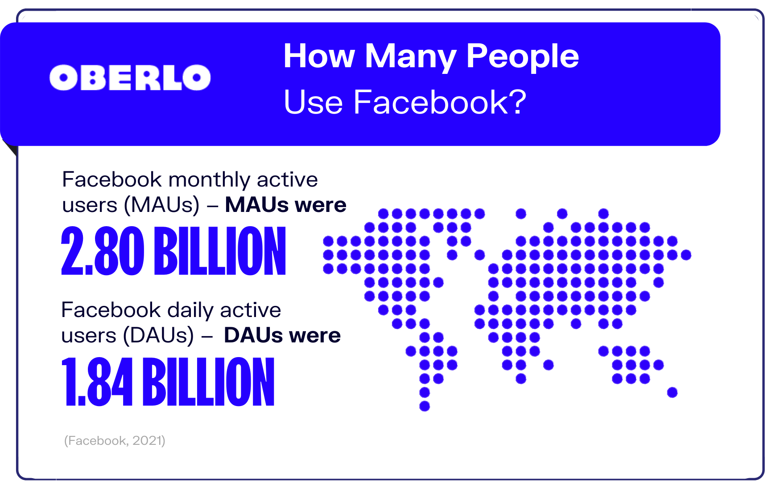
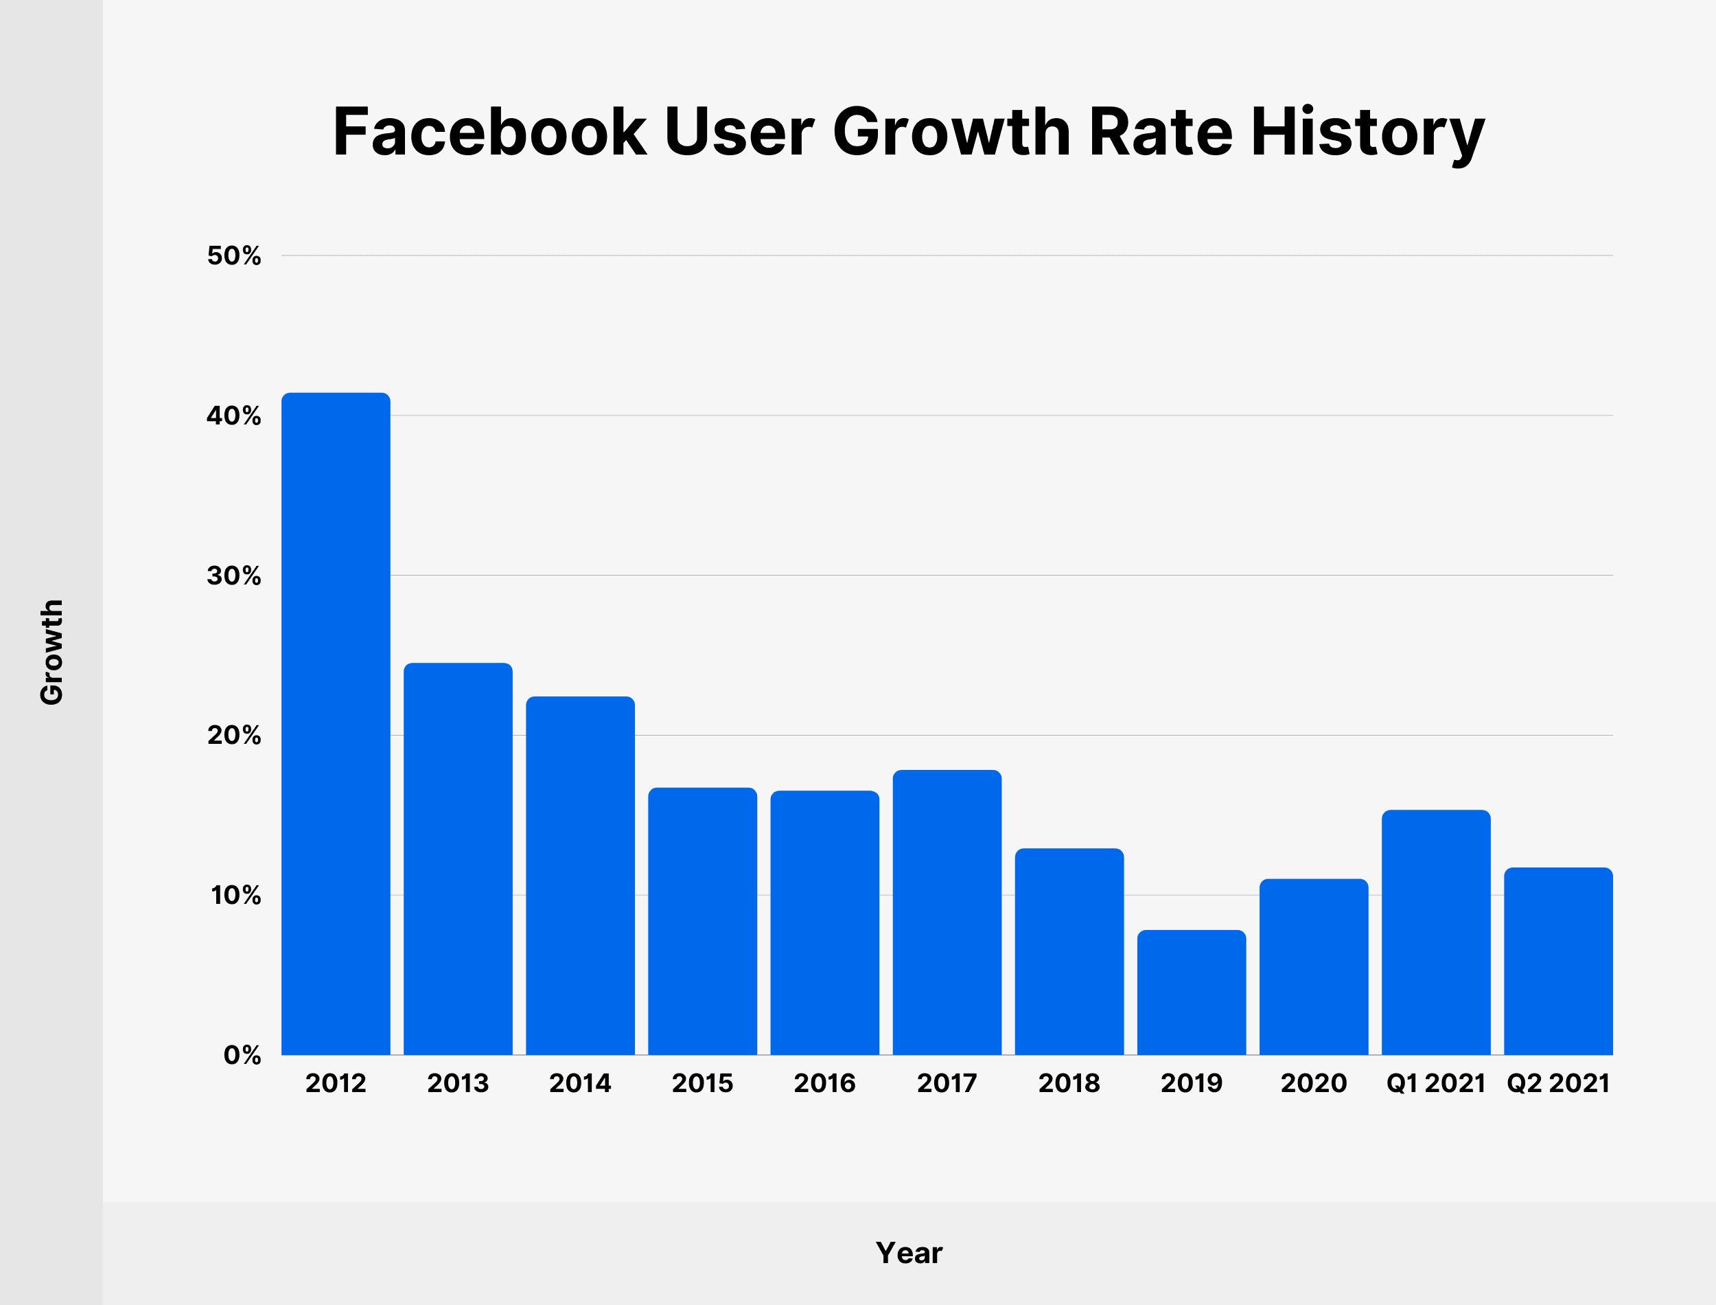
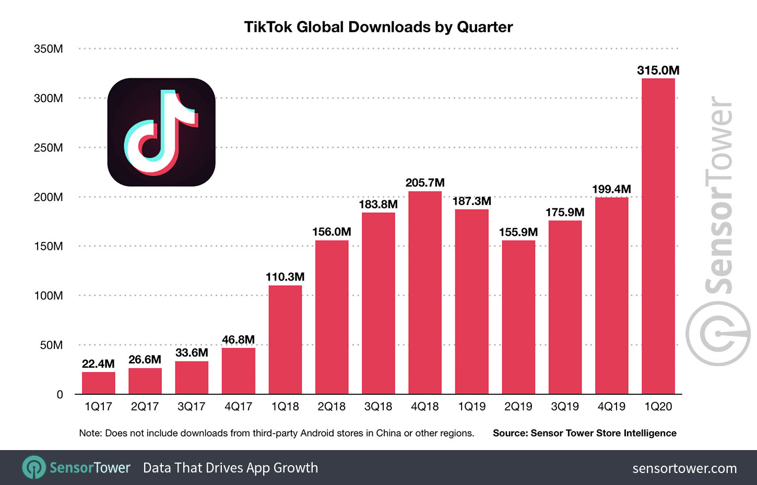




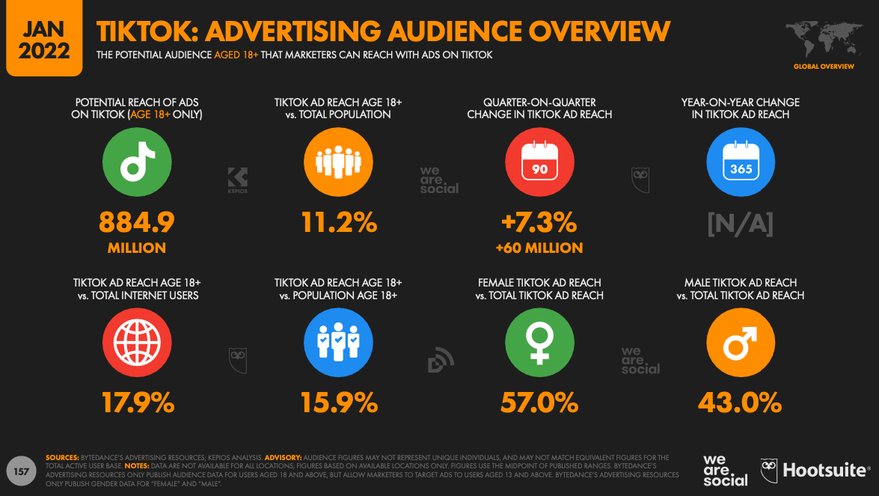
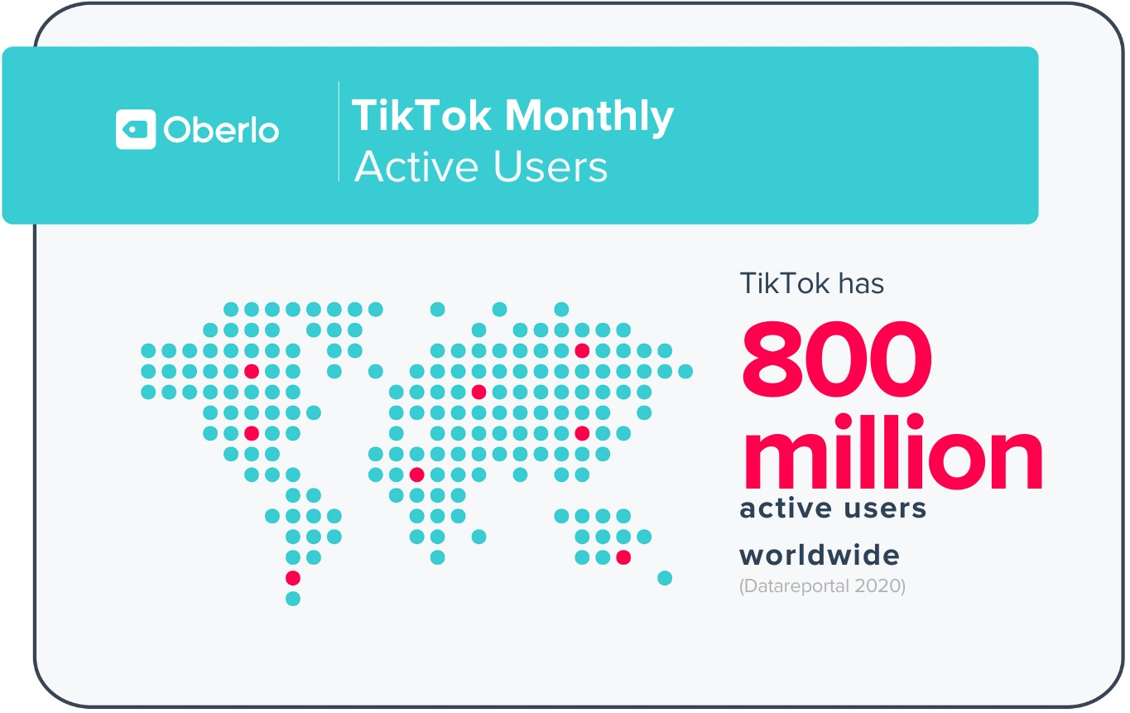
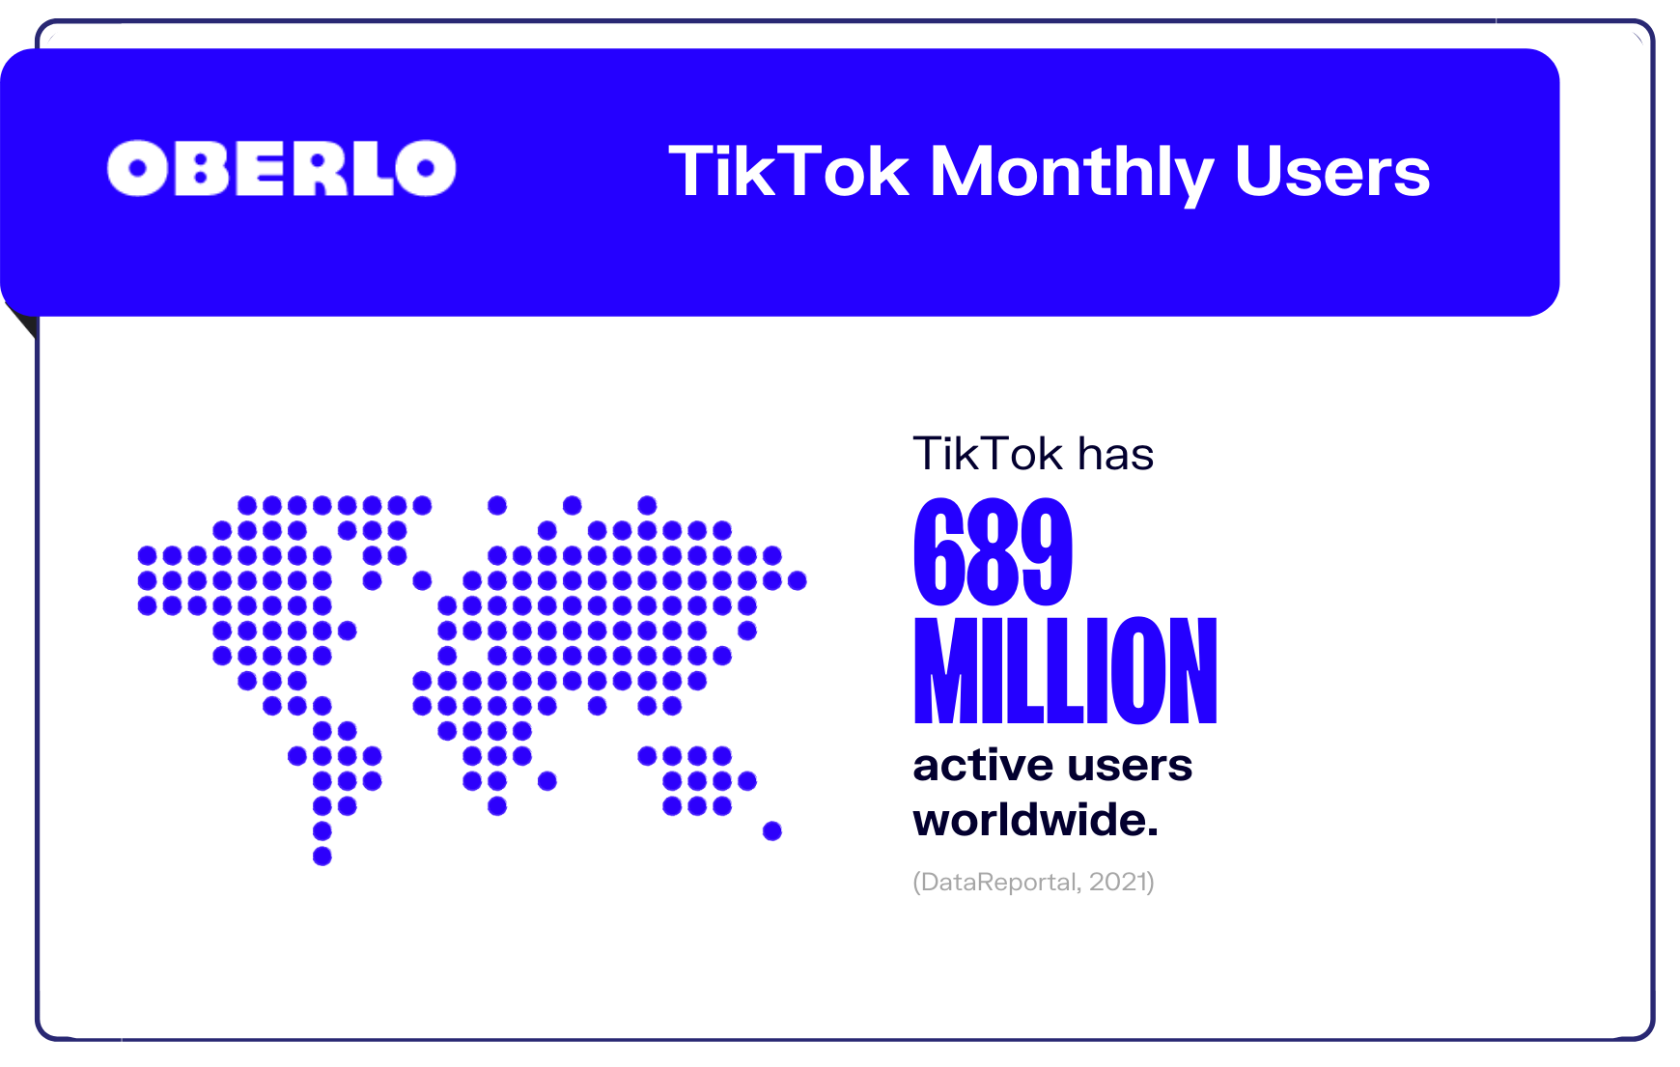
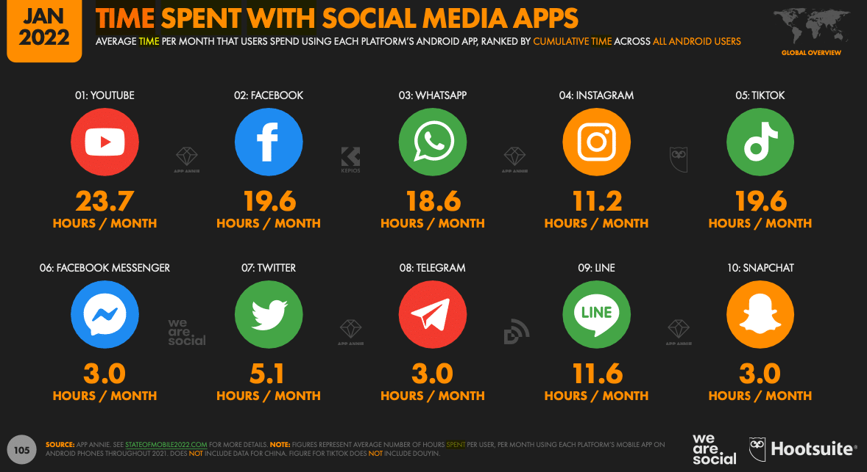
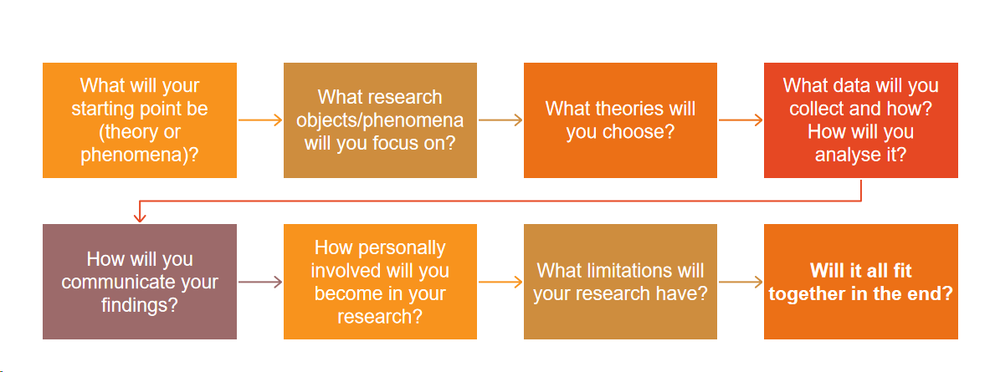


Academic Research Posters：
Strategies and Principles For Social Marketing , Andy（Xuefeng Qin）University of Wales Trinity Saint David
Introduction
Consumers are the key in the e-commerce short video era. E-commerce short video is being reflected to customers in a new way. Consumer decisions are influenced by the format of product display, the quality of video, the influence of bloggers, and other factors. Using big data analysis to promote product transactions can be more effective than traditional display methods, and enterprises can achieve their sales goals.
Research Question
Research Question 1 (RQ1)-What is e-commerce and short video, and how does it affect business?
Research Question 1 (RQ1)-What factors contribute to people's buying behavior? Will short videos have a positive impact on e-commerce?
Research Question 1 (RQ1)-What are people's buying factors, the development and future of short video in China and other countries?
Research Question 1 (RQ1)-What factors drive people's buying decisions? What is the future development of e-commerce and short video?
Research Question 1 (RQ1)-What gaps are left in previous studies, and what theories and practices are needed to fill them?
Research Gap
Through reviewing the literature research, electronic commerce after years of development, people have become accustomed to online shopping, for convenience, and many other advantages, but with the development of new technology, and people's cognitive restructuring, China, the United States, Britain, Japan and other major countries in the world for this new purchase behavior depends on, from the literature study, 1, People for e-commerce and short video is still separated, and not as a collation to study; 2. Despite the rapid development of short video, does it have a positive or negative impact, or both? 3. How much people are affected by the new shopping habits, leading to the withdrawal of major brands from their short videos (advertising is also a kind of short video) and rapid spread on the Internet;

